Slide 1

Introducing YOGA: Your OSINT Graphical Analyzer
Micah Hoffman
https://webbreacher.com
©2018 Spotlight Infosec LLC

Slide 2



Who am I?
OSINTer / Pentester
Mentor / Advisor
Author and Instructor SANS SEC487 OSINT Course
Open Source Fan

Slide 3
Let's talk about cooking

Slide 4
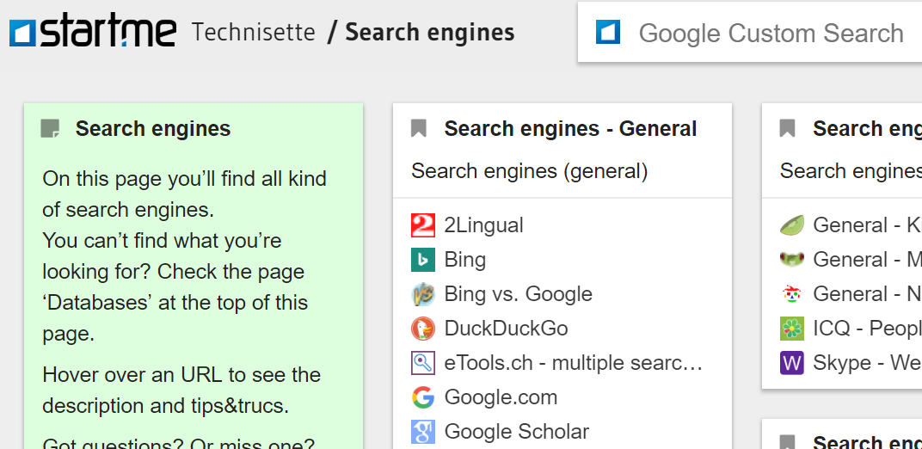
https://technisette.com

Slide 5
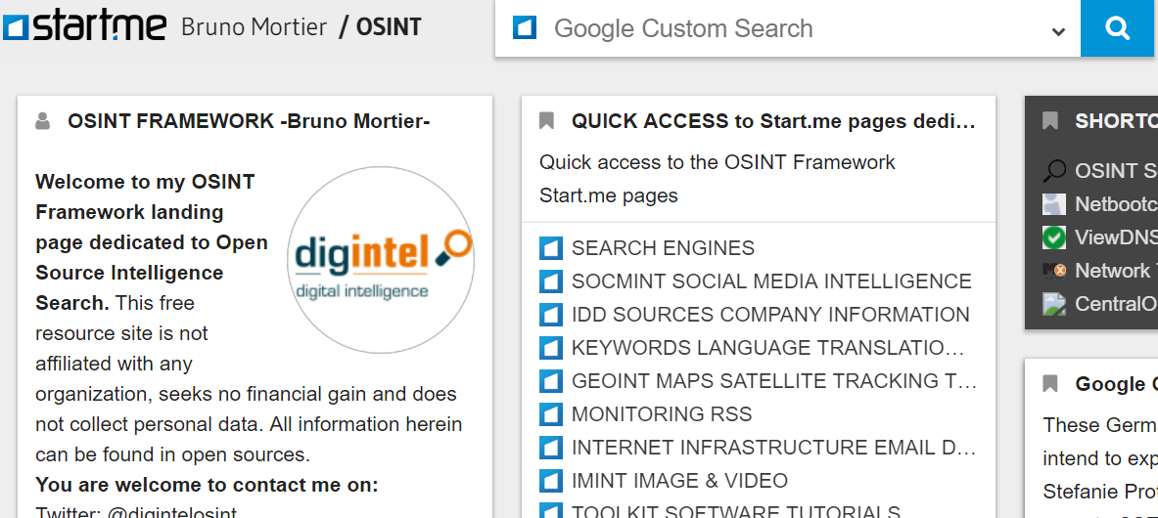
https://start.me/p/ZME8nR/osint

Slide 6
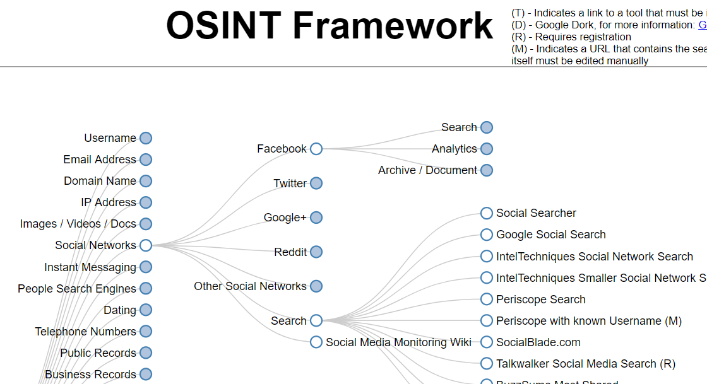
http://osintframework.com

Slide 7
OSINTers,
we have a problem

Slide 8
Unique URLs per Resource

Slide 9
6,187
OSINT Links

Slide 10
We need to understand how things fit together

Slide 11
If I have this data,
then I can do that

Slide 12
At a "recipe" level

Slide 13
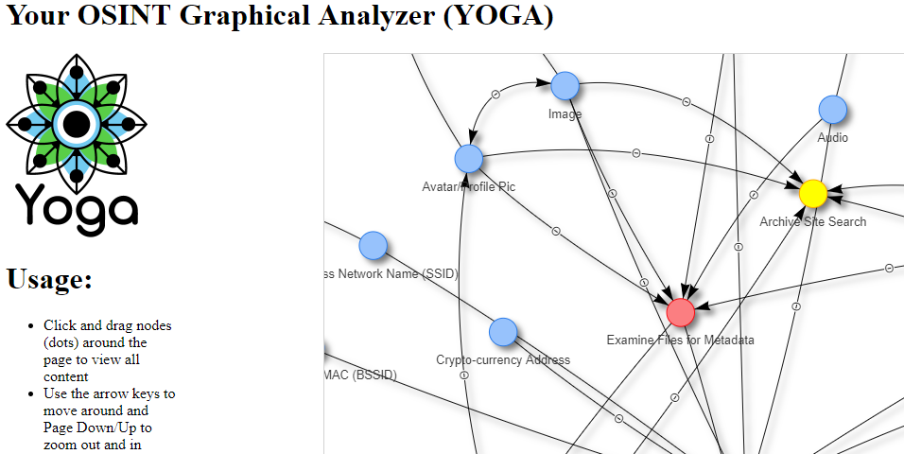
https://yoga.osint.ninja

Slide 14
Yoga Details
https://github.com/WebBreacher/yoga
Javascript (vis.js) and HTML
Self-contained (download and run)

Slide 15
Demo

Slide 16
Unique URLs per Resource

Slide 17
How many are duplicate resources?

Slide 18
We need an
OSINT-wide taxonomy

Slide 19

https://orcs.osint.ninja
Being created now by the community
https://osint.team
Tagging of resources

Slide 20

https://www.sans.org/sec487
Micah Hoffman
@WebBreacher
https://webbreacher.com
https://the.osint.ninja/presos

