Slide 1
PROJECT PRESENTATION
Portfolio + ATS Resume Builder
One data entry, ten portfolio designs, and a scored, coached, ATS-safe resume — running entirely in the browser.
August 2026 · React + Vite · Runs locally via VS Code

Slide 2
Agenda
1
Problem & Objectives
2
Proposed Solution
What gap this project closes, and what it set out to do
One shared data model, two independent generators
3
System Architecture
4
Core Modules
How the browser-only app is structured
Data entry, 10 portfolio designs, ATS resume builder
5
Testing & Results
6
Advantages & Future Scope
What was verified, and a real before/after example
What works well today, and what's next
Portfolio + ATS Resume Builder
2

Slide 3
The Problem
A portfolio website
2
Needs design sense, front-end skill, and hosting — usually outside a candidate's day-to-day skill set.
A resume that survives an ATS
Needs to avoid tables, columns, and graphics that parsers misread — knowledge most candidates never get taught.
very different deliverables expected of every job seeker
Existing tools solve at most one
Website builders need hosting and accounts; resume builders often upload personal data to a server and gate ATS formatting behind a paywall.
Portfolio + ATS Resume Builder
3

Slide 4
Objectives
1
2
3
One form
10 designs
ATS-safe output
Collect every detail once: personal info, links, skills, experience, education, projects, certifications
Generate at least ten genuinely distinct, ready-to-publish portfolio designs — no recolored duplicates
Single-column resume format, exportable as .docx, .pdf, and .txt
4
5
6
Score & coach
Job-description tailoring
Fully local
Measure resume content quality and suggest specific, actionable fixes
Reorder skills and surface matched keywords against a pasted posting
No account, no backend server, no data leaving the device
Portfolio + ATS Resume Builder
4

Slide 5
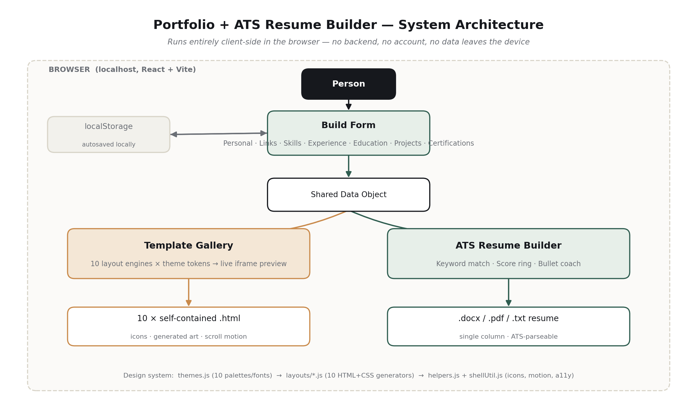
System Architecture
A single-page React app — no backend. One shared data object feeds two independent generators, each producing files the browser downloads directly.
Portfolio + ATS Resume Builder
5

Slide 6
Technology Stack
1
2
3
React 18
Vite 5
docx (npm)
Component-driven UI for the three-tab builder
Fast local dev server and production bundling
Generates the .docx resume — paragraphs and headings only, no tables
4
5
6
jsPDF
IntersectionObserver
localStorage
Generates a paginated, fully text-selectable .pdf resume
Drives scroll-reveal motion across all 10 portfolio designs
Persists entered data across reloads, entirely in-browser
Portfolio + ATS Resume Builder
6

Slide 7
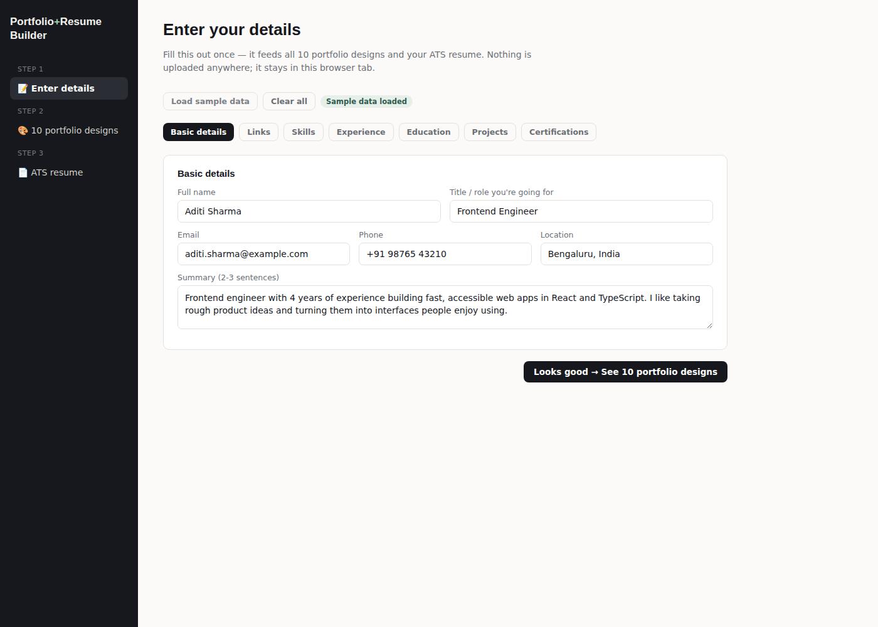
Module 1
Data Entry
Seven switchable sections: Basic details, Links, Skills, Experience, Education, Projects, Certifications
One skill-tag input; repeatable blocks for experience, education, projects, and certifications
One-click sample-data loader for instant demoing
Autosaves to the browser between sessions — nothing is uploaded anywhere
Portfolio + ATS Resume Builder
7

Slide 8
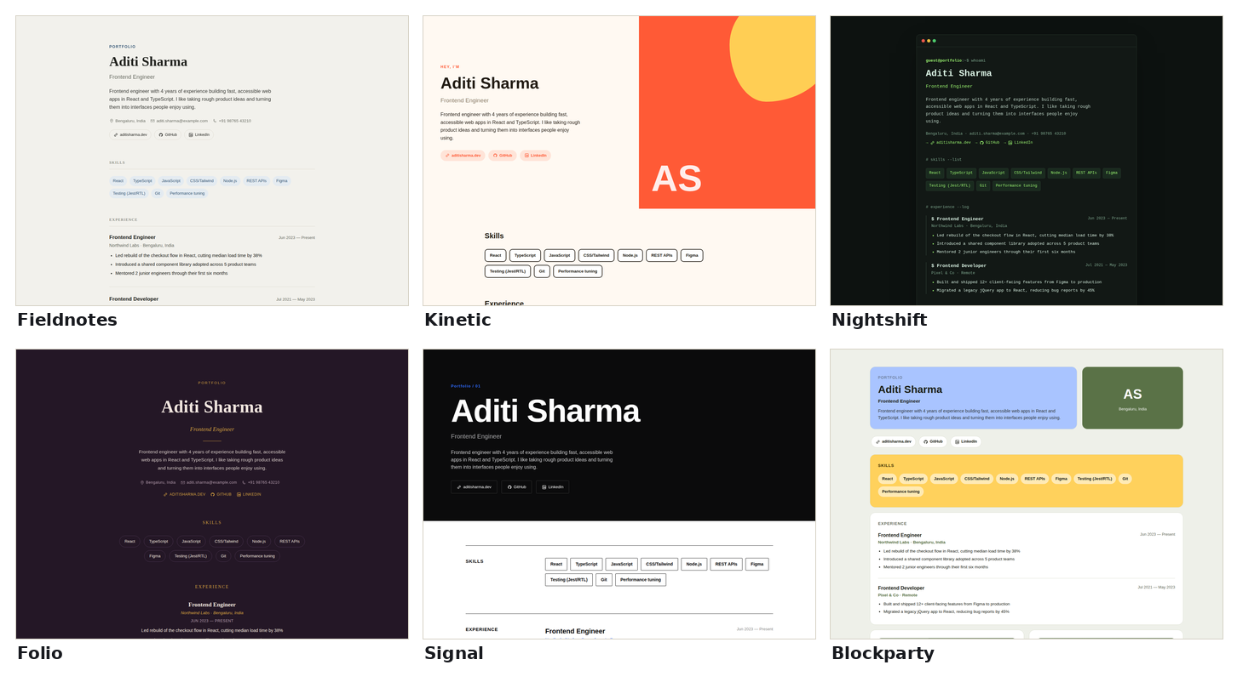
Module 2
10 Portfolio Designs
Fieldnotes · Nightshift · Kinetic · Ledger · Atlas · Blockparty · Chronicle · Ascent · Folio · Signal — each a distinct layout, palette, and font pairing, with generated project art, icons, and scroll motion.
Portfolio + ATS Resume Builder
8

Slide 9
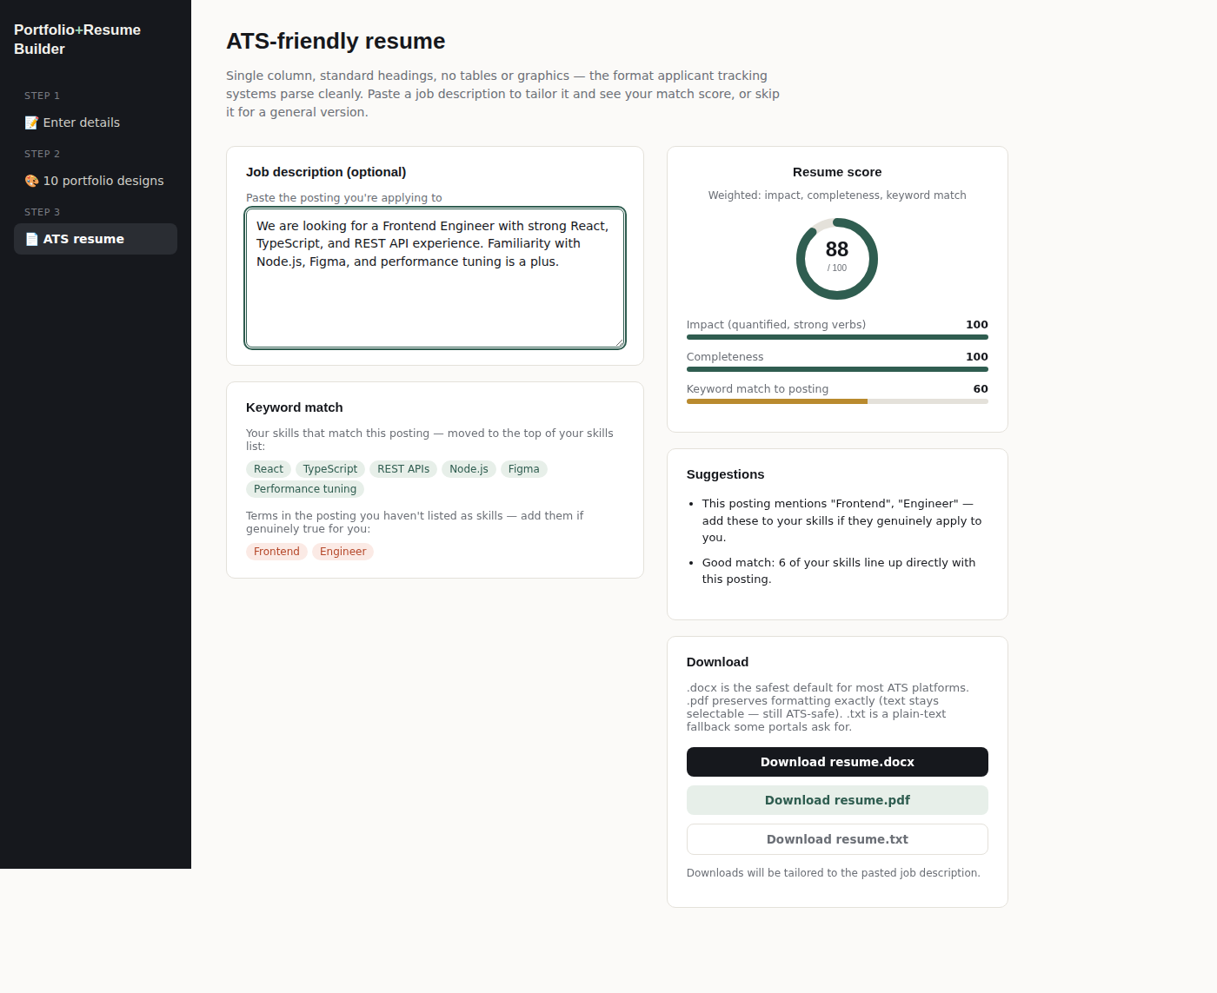
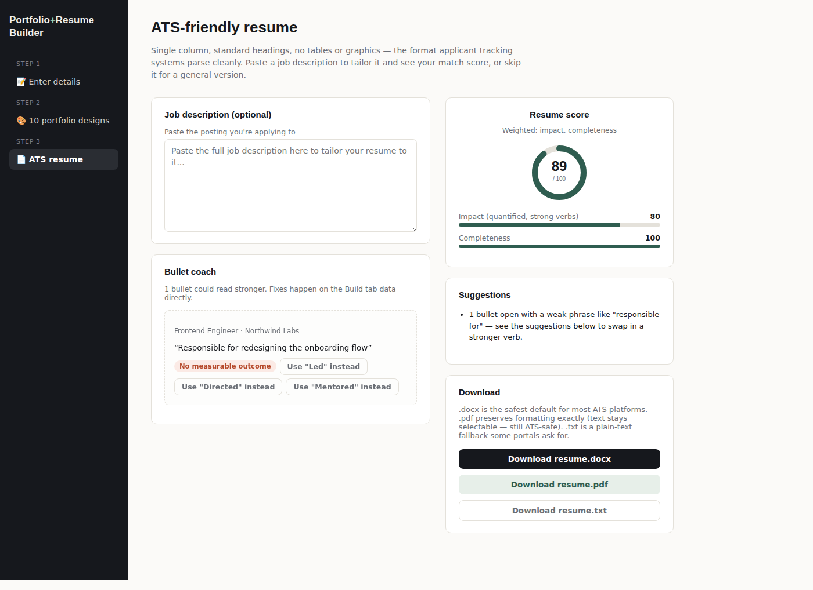
Module 3
ATS Resume Builder
A live 0–100 score, keyword match against a pasted job description, and a bullet coach that rewrites weak lines on click.
Portfolio + ATS Resume Builder
9

Slide 10
A score that responds to real improvements
One bullet-coach click — replacing “Responsible for” with “Led” — and the impact sub-score and overall score both moved immediately:
BEFORE
AFTER
89
93
APPLY
“Responsible for redesigning
the onboarding flow”
“Led redesigning the
onboarding flow”
Portfolio + ATS Resume Builder
10

Slide 11
Testing & Validation
Test | Method | Result
All 10 templates render | Node script, sample data | Pass
Production build | vite build | Pass — clean bundle
Portfolio visual QA | Playwright screenshots, full scroll | Pass
No-JS / print fallback | DOM inspection pre-scroll | Defect found → fixed
.docx / .pdf generation | Render + pdftotext extraction | Pass — text fully extractable
Bullet coach flow | End-to-end Playwright click-through | Pass — score 89 → 93
Portfolio + ATS Resume Builder
11

Slide 12
Advantages
✓
✓
✓
✓
No duplicate data entry
Fully offline
Genuinely distinct designs
ATS-aware by construction
One form drives both the portfolio sites and the resume
No account, server, or recurring cost after setup
Ten different layouts and type systems, not one template recolored
No tables, columns, or graphics to trip up a parser
Portfolio + ATS Resume Builder
12

Slide 13
Future Scope
1
Resume upload & parsing
Auto-fill the form from an existing PDF/DOCX resume
2
Optional LLM-powered rewriting
True natural-language bullet rewrites, kept opt-in
3
Real project screenshots
Upload support alongside the generated abstract art
4
Static-site export
A ready-to-deploy folder target, alongside single-file HTML
5
Cover-letter generator
Sharing the same underlying data model
Portfolio + ATS Resume Builder
13

Slide 14
Conclusion
A single, well-modeled set of personal data can drive two very different job-search deliverables — a designed portfolio and an ATS-safe resume — from one local, dependency-light application, with real testing behind every claim.
Thank You
npm install → npm run dev → http://localhost:5173
Portfolio + ATS Resume Builder
14

