Slide 1
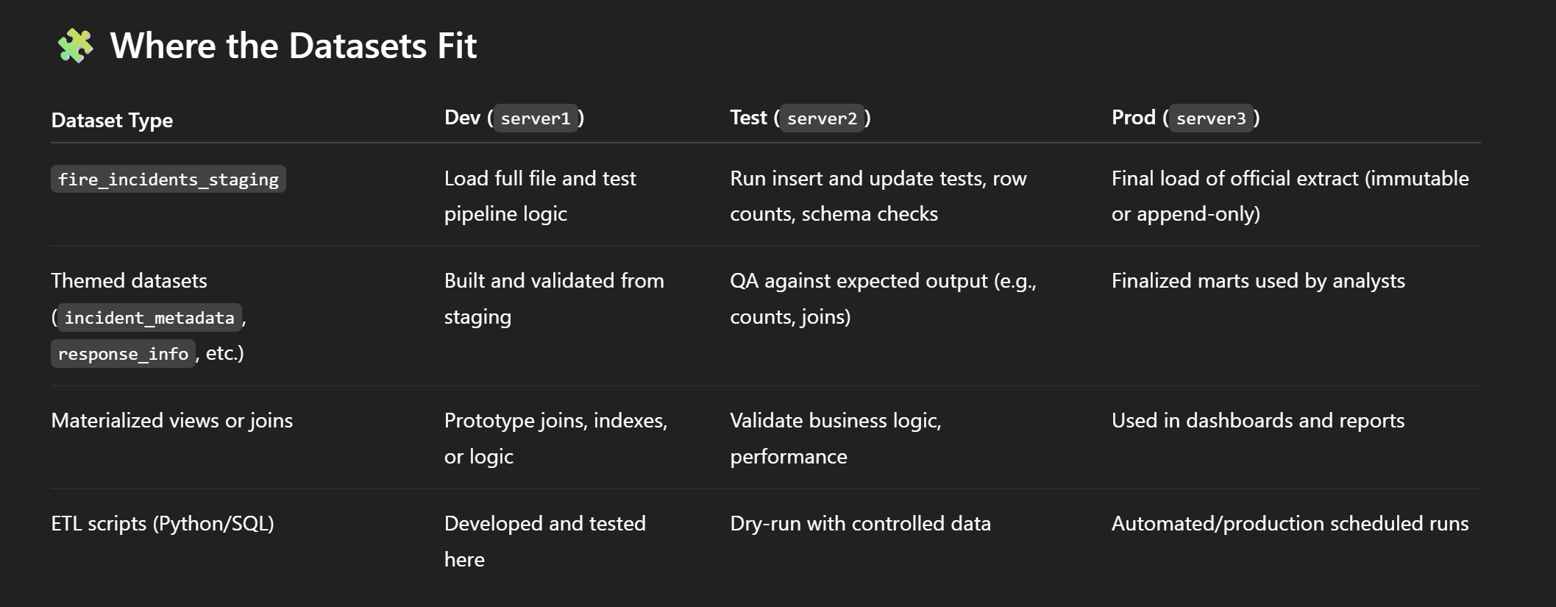
PG Server environment functions with examples

Slide 2
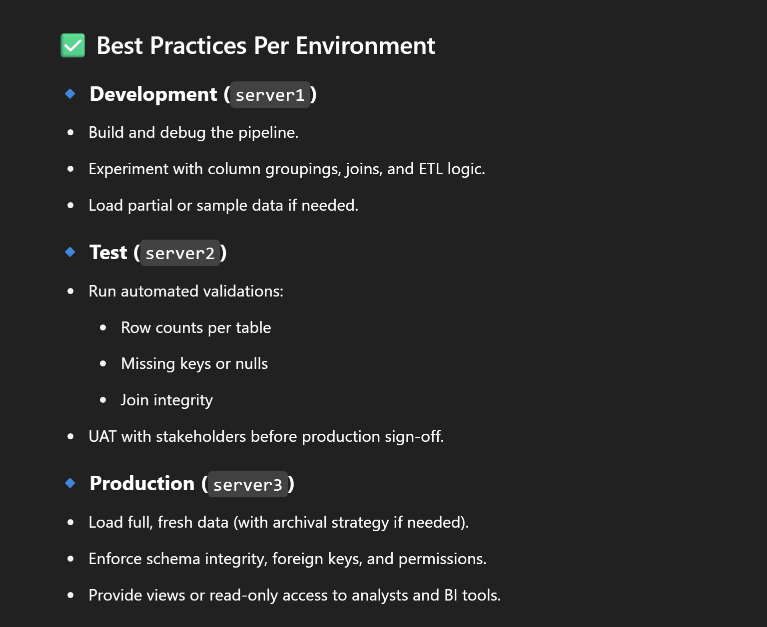
Best Practices for Environment

