Slide 1
GNU Radio – Introduction to DSP
2016-03-08 Zürich, CH

Slide 2
Legal disclamer
I am not a lawyer
Laws vary country to country
They are usually not very clear
It's safe to listen to things you transmit yourself
Transmitting usually requires a license
Get an amateur license to get Tx access to many bands
Check www.uska.ch and www.bakom.admin.ch

Slide 3
GNU Radio – Introduction to DSP
Introduction and motivation
DSP theory
SDR in practice

Slide 4
Who am I?
Leszek “Makdaam” Jakubowski
Interested in radio, electronics and communication
Working on dispersed systems and networks by day
Likes automation

Slide 5
What signals are there?
Audio and visual signals
Electrical signals
Radio signals
  voice comms (boring)
  digital voice comms (some interesting stuff)
  telemetry data (including airplanes, lightbulbs, satellites, water meters, toasters, railroad signals etc.)
  radar

Slide 6
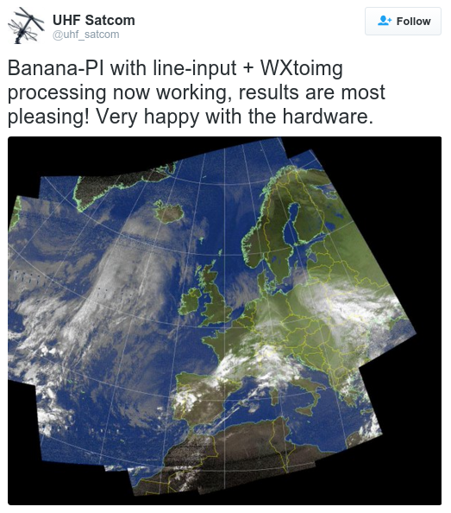
Weather satellite images

Slide 7
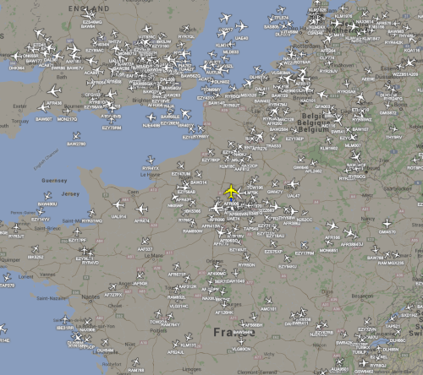
Airplane data
Airspy, ADSBSpy software example screenshot
http://airspy.com/adsb/

Slide 8
Theory
Sinusoids and presentation
Sampling frequency and bit depth
Interpolation
Folding
Modulation

Slide 9
Sinusoids
ω = 2π f = 360° f
(1) f(t) = A sin(ω t + φ)
(2) s(t) = A (cos(ω t + φ) + j sin(ω t + φ) )
c = a + j b
j² = -1

Slide 10
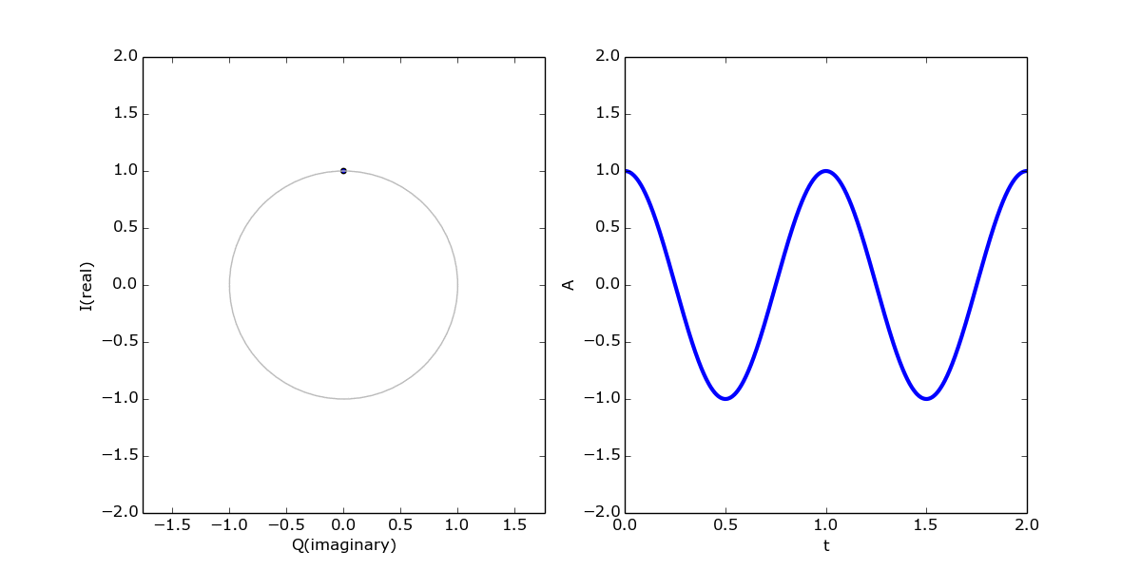
Sinusoids

Slide 11
Sinusoids

Slide 12
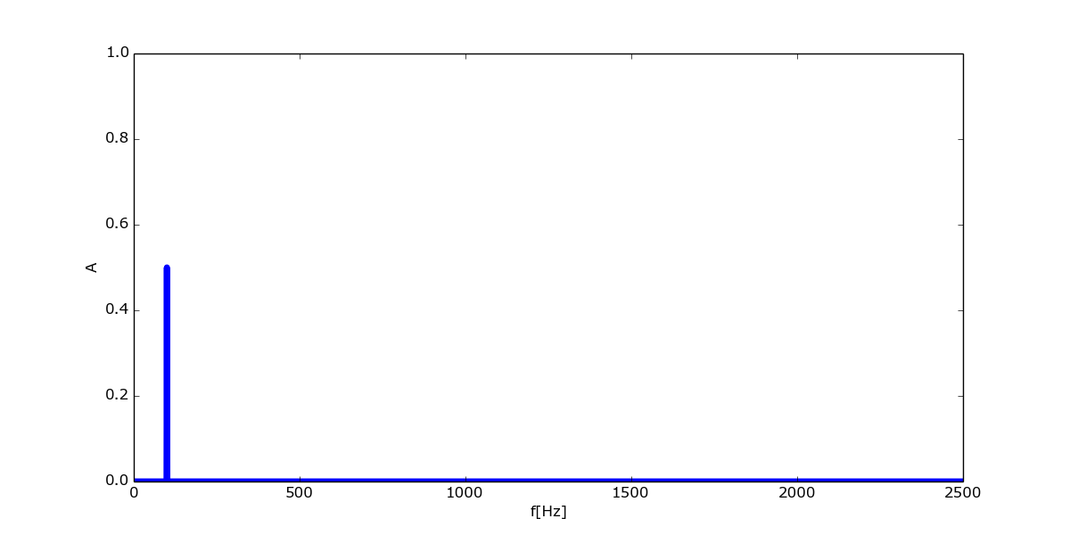

Slide 13
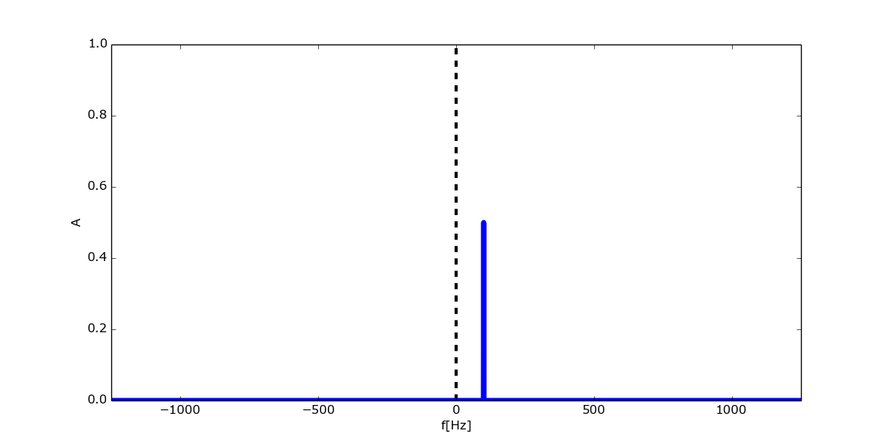
Sinusoids

Slide 14
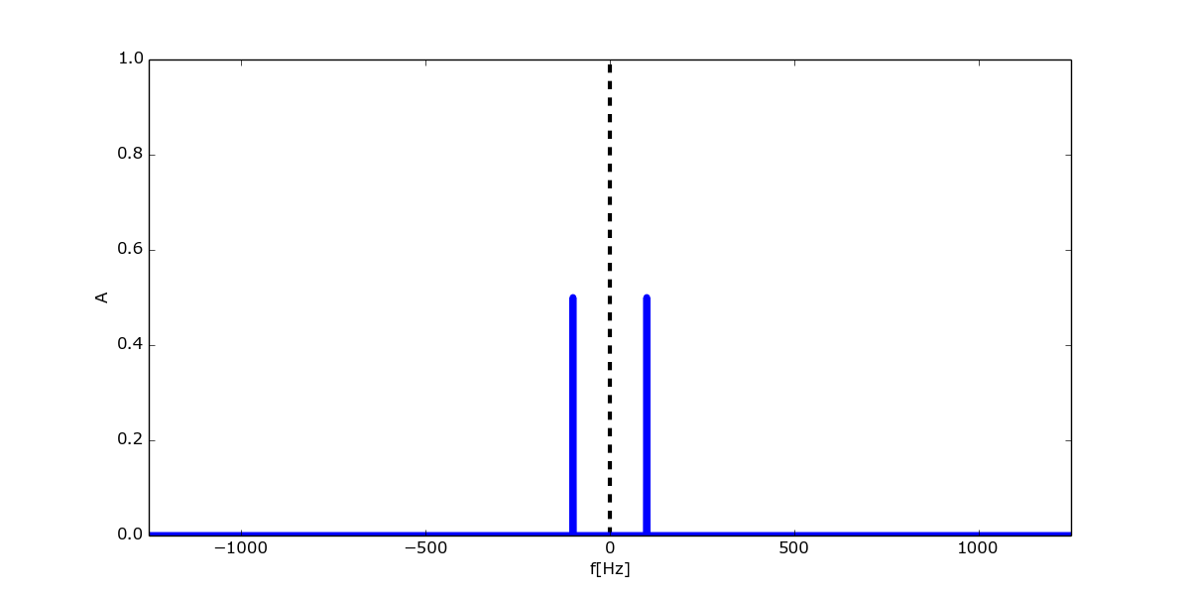
Sinusoids

Slide 15
Sampling

Slide 16
Sampling

Slide 17
Sampling

Slide 18
Interpolation

Slide 19
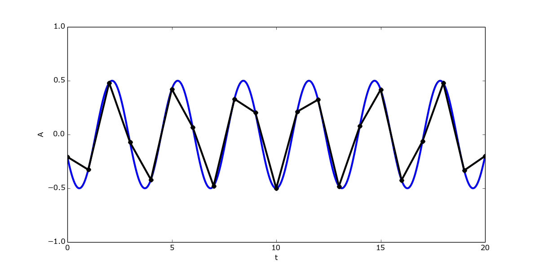
Interpolation

Slide 20
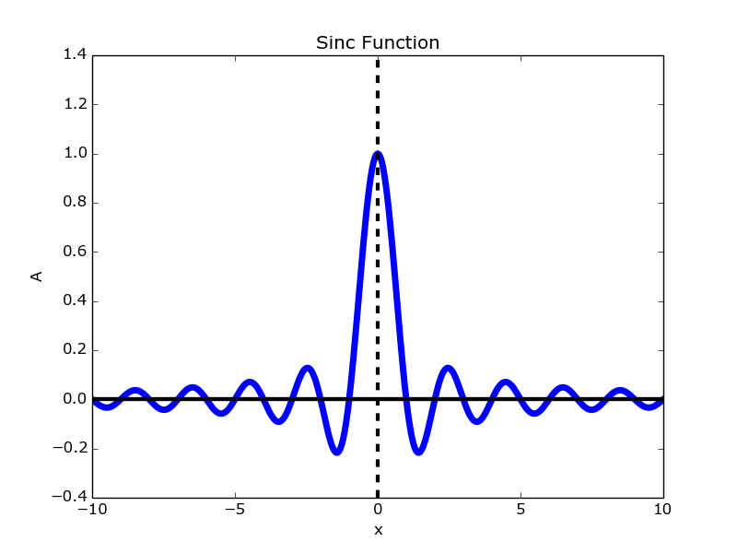
sinc(x) = sin(πx) / πx

Slide 21
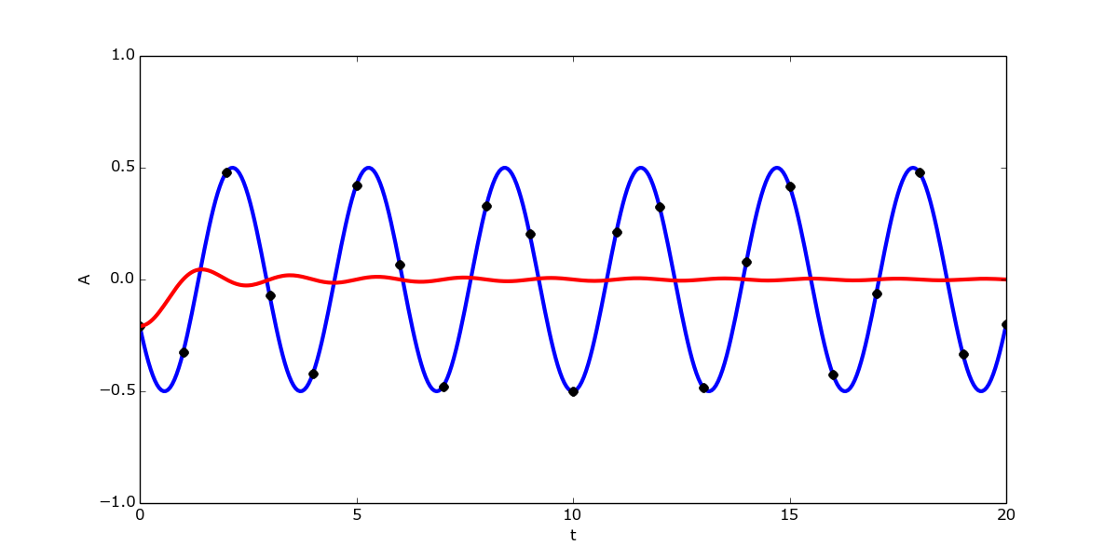
Interpolation the right way

Slide 22
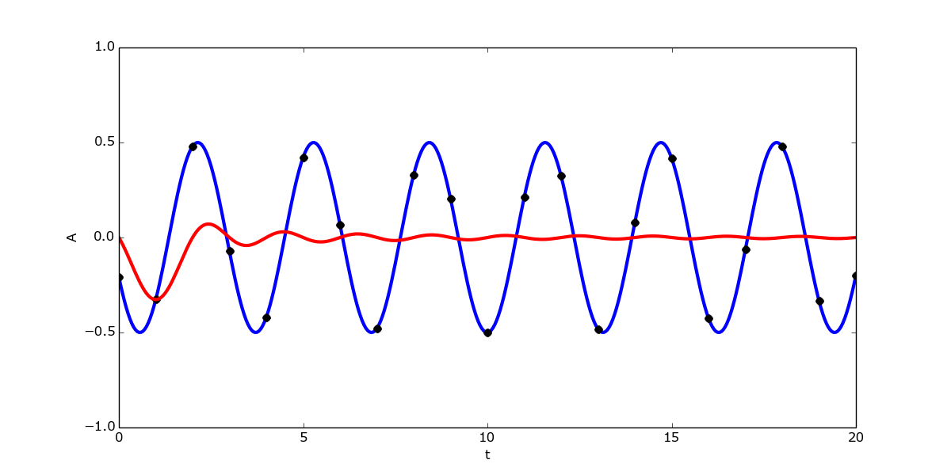
Interpolation the right way

Slide 23
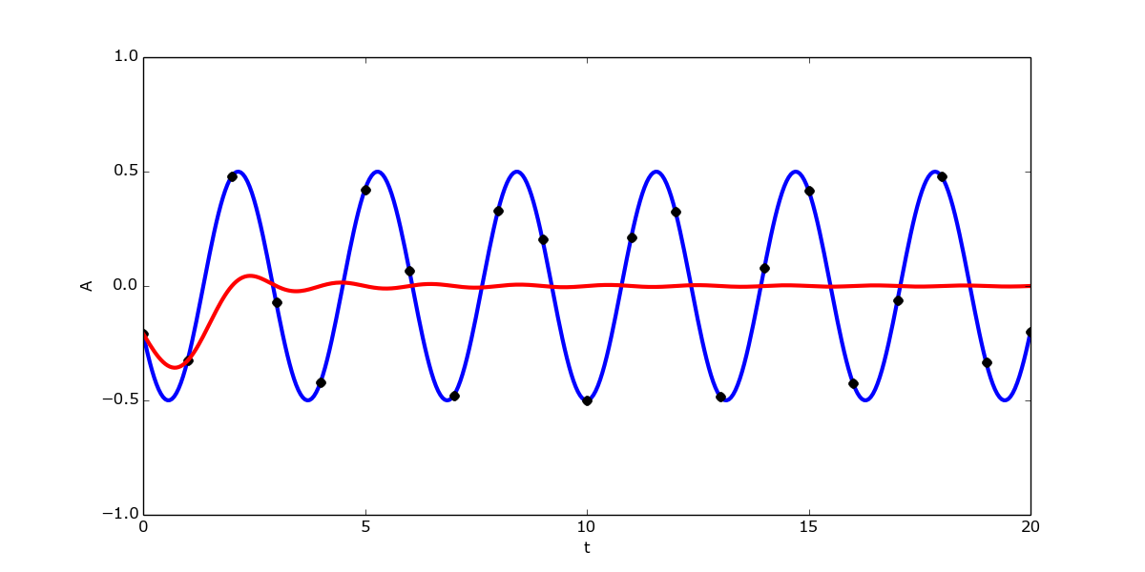
Interpolation the right way

Slide 24
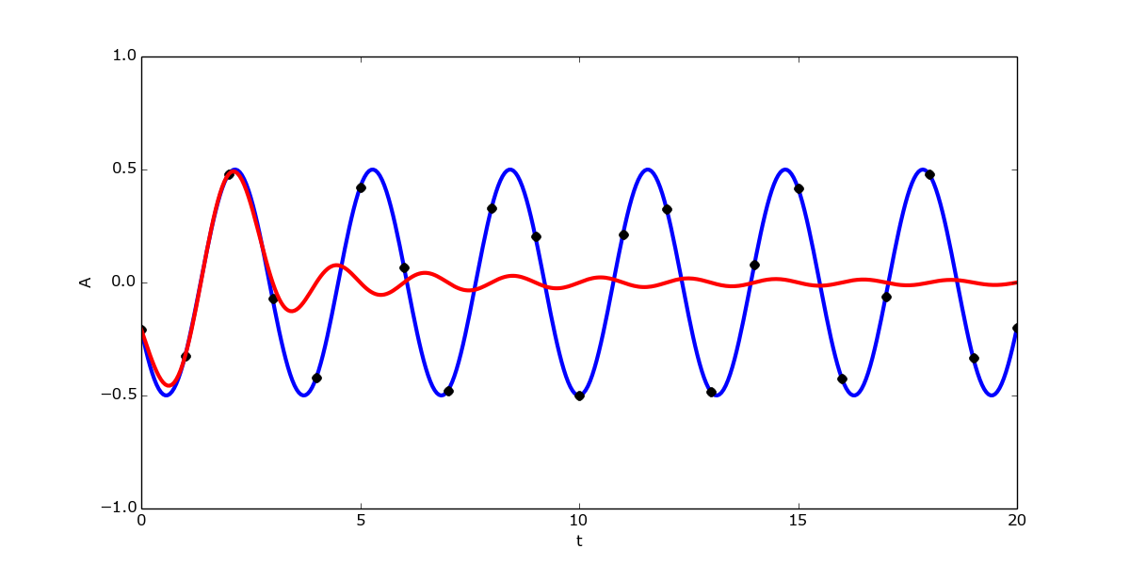
Interpolation the right way

Slide 25
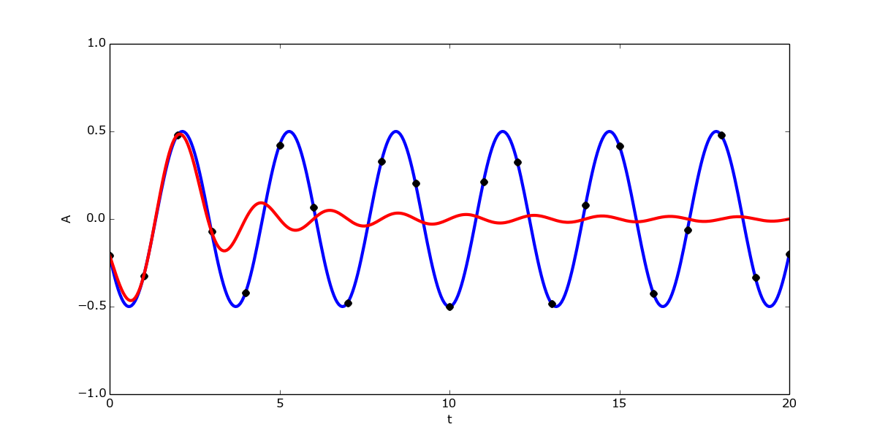
Interpolation the right way

Slide 26
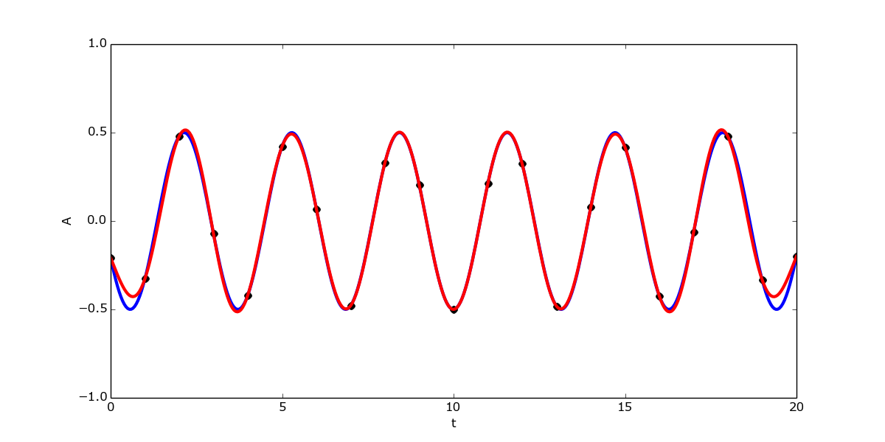
Interpolation the right way

Slide 27
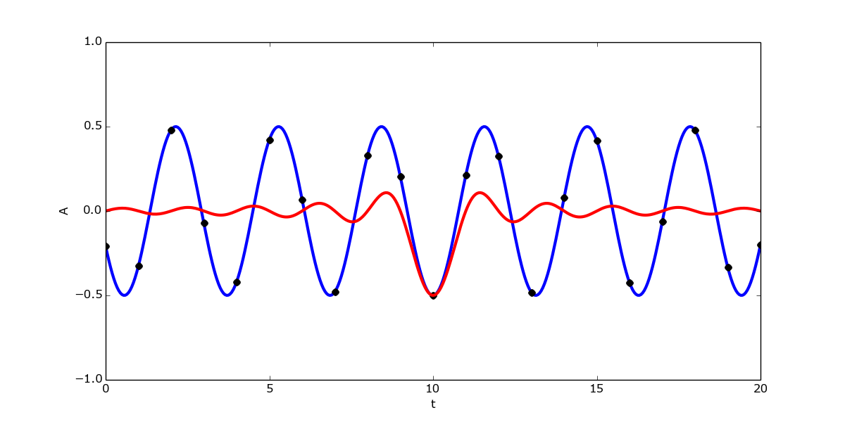
Interpolation the right way

Slide 28
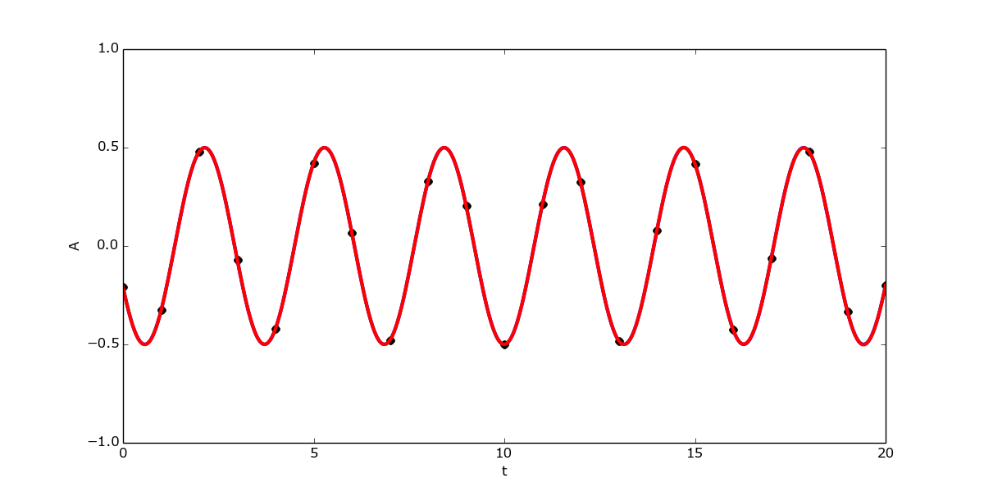
Interpolation the right way

Slide 29
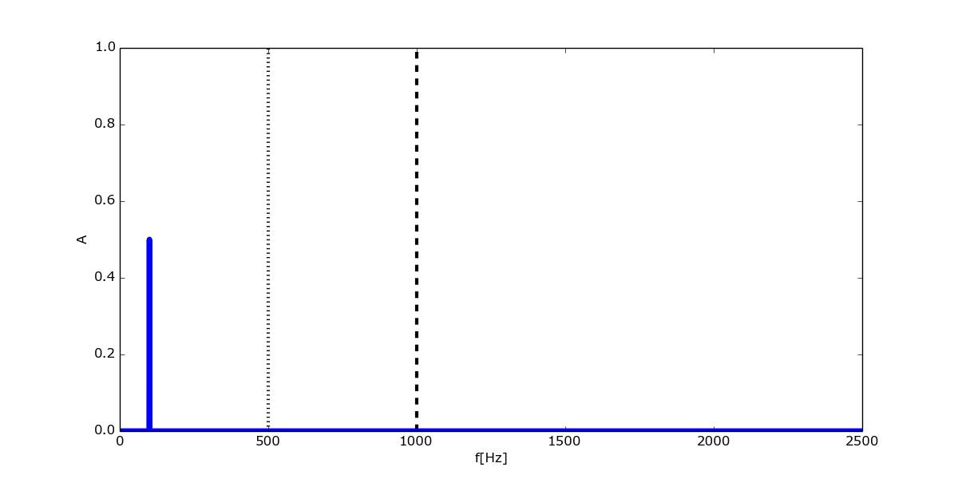
Folding

Slide 30
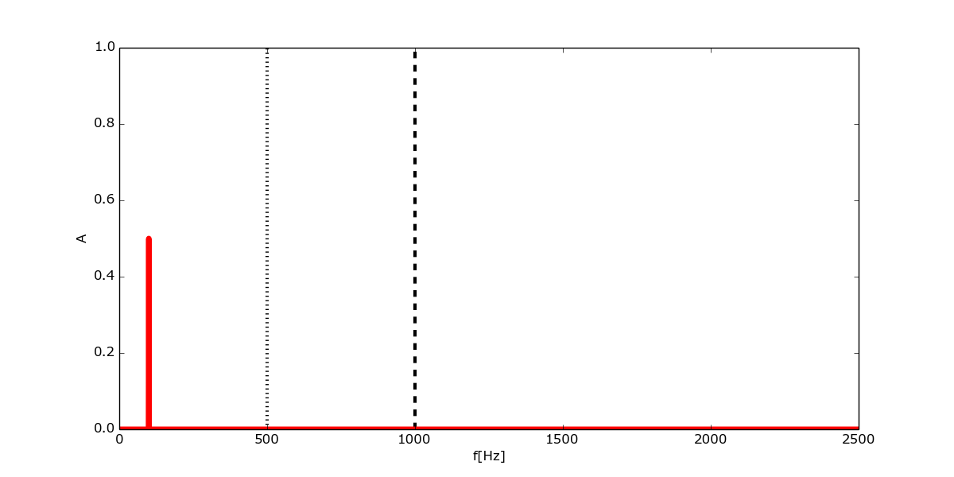

Slide 31
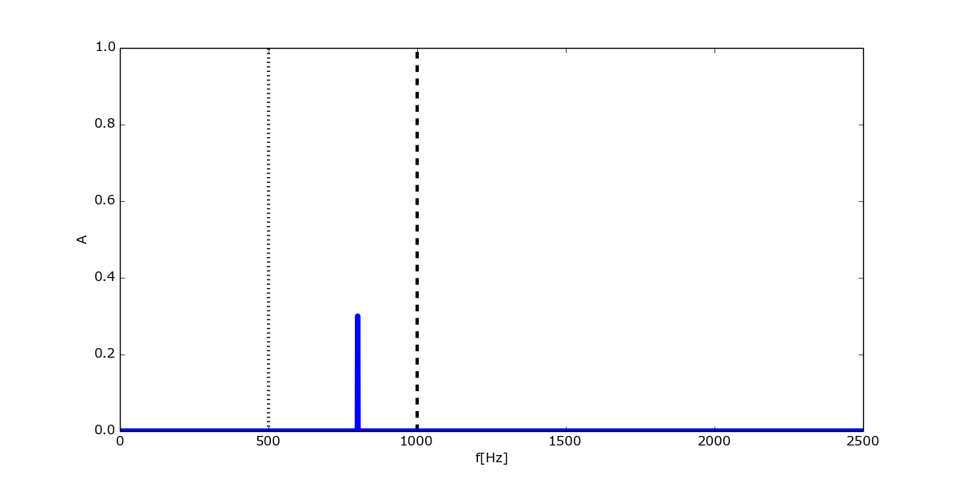

Slide 32
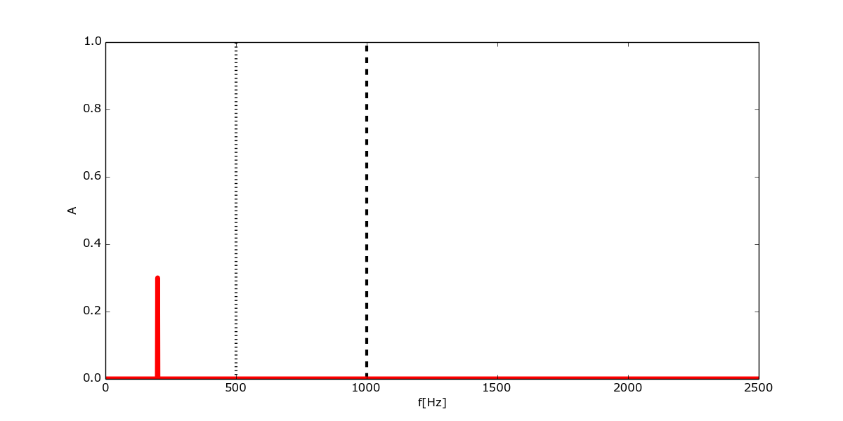

Slide 33
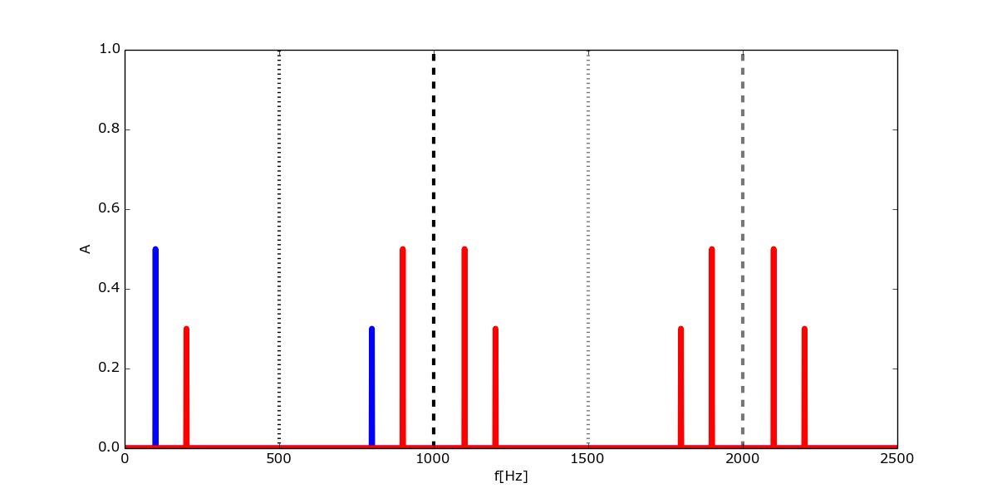

Slide 34
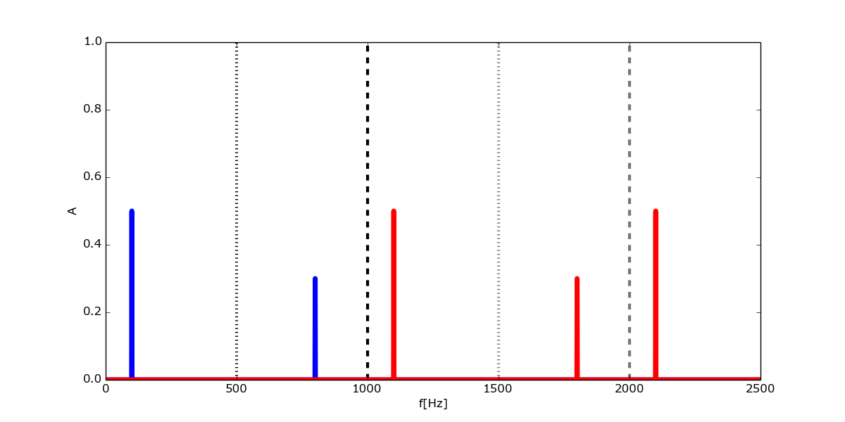

Slide 35
Modulation and Keying
ω = 2π f = 360° f
(1) f(t) = A sin(ω t + φ)
(2) s(t) = A cos(ω t + φ) + j sin(ω t + φ)

Slide 36
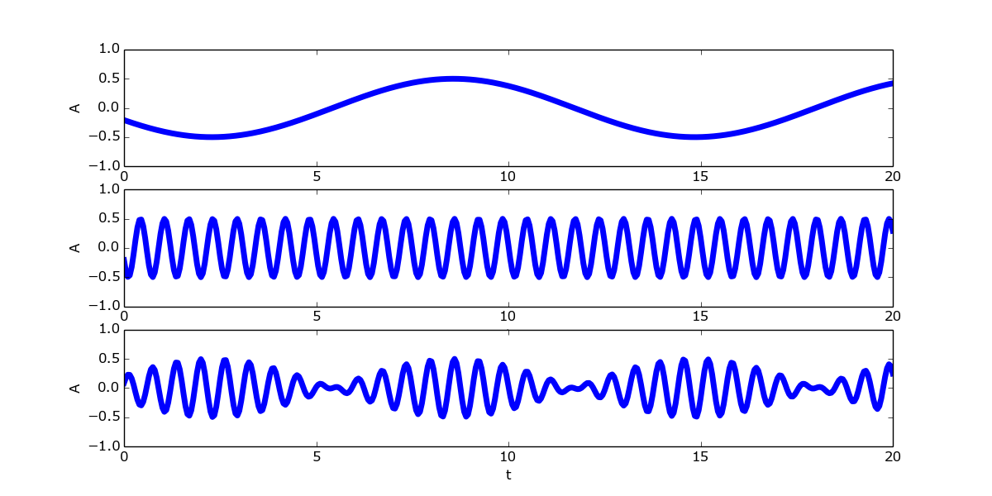
Amplitude Modulation

Slide 37
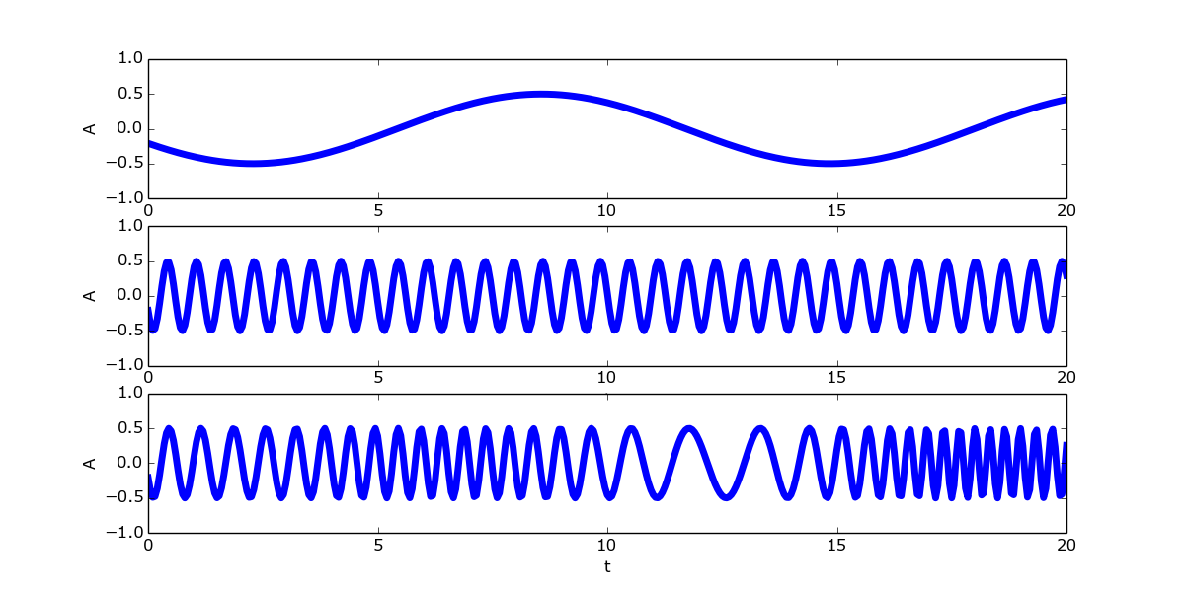
Frequency Modulation

Slide 38
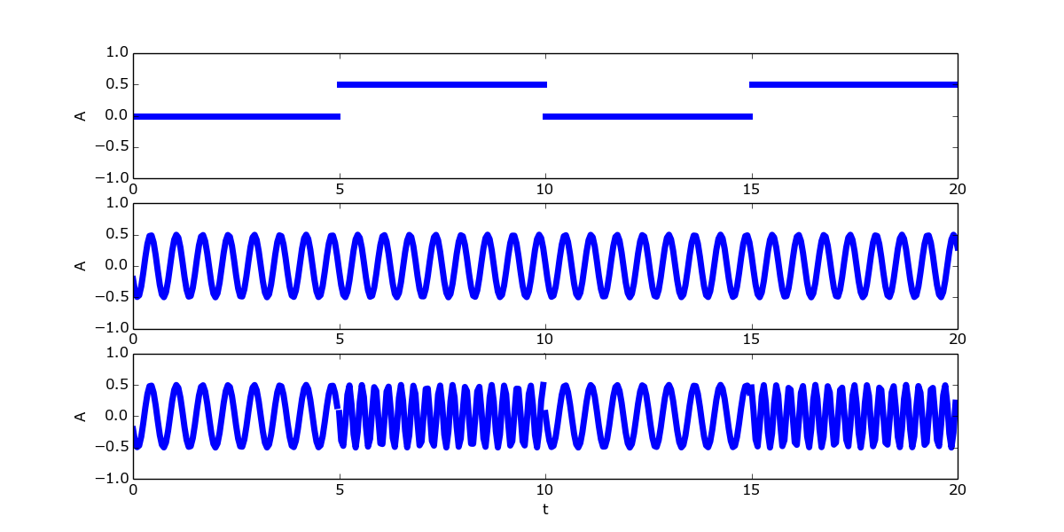
Frequency Shift Keying

Slide 39

Phase Modulation

Slide 40
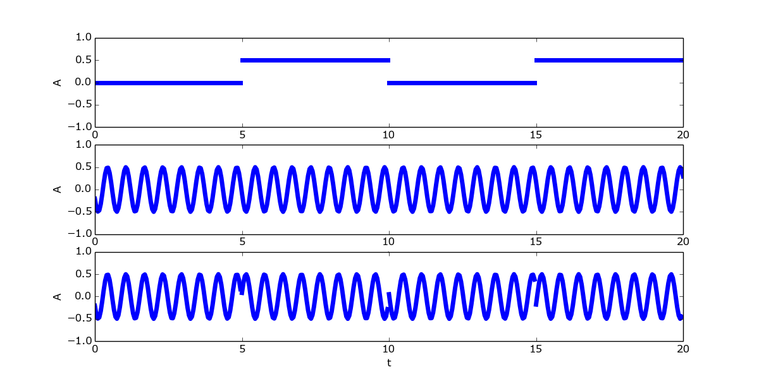
Binary Phase Shift Keying

Slide 41
SDR in practice
Hardware
Software
Pipeline

Slide 42
Hardware
Radio + soundcard
RTL-SDR (~20 USD)
HackRF One (~300 USD) / rad1o
BladeRF (~500USD)
USRP (~5000 USD)
antennas!

Slide 43
Software
GNU Radio
GQRX
baudline
inspectrum
rtlfm
rfcat/rflib (also Python!)

Slide 44
GNU Radio
Free & open source software
DSP lab on your PC
C/C++ processing blocks with inputs and outputs (ports)
Connected together in C++ or Python
Extensive documentation on the official website
Includes wxWidgets or Qt based GUI blocks

Slide 45
GNU Radio
code example

Slide 46
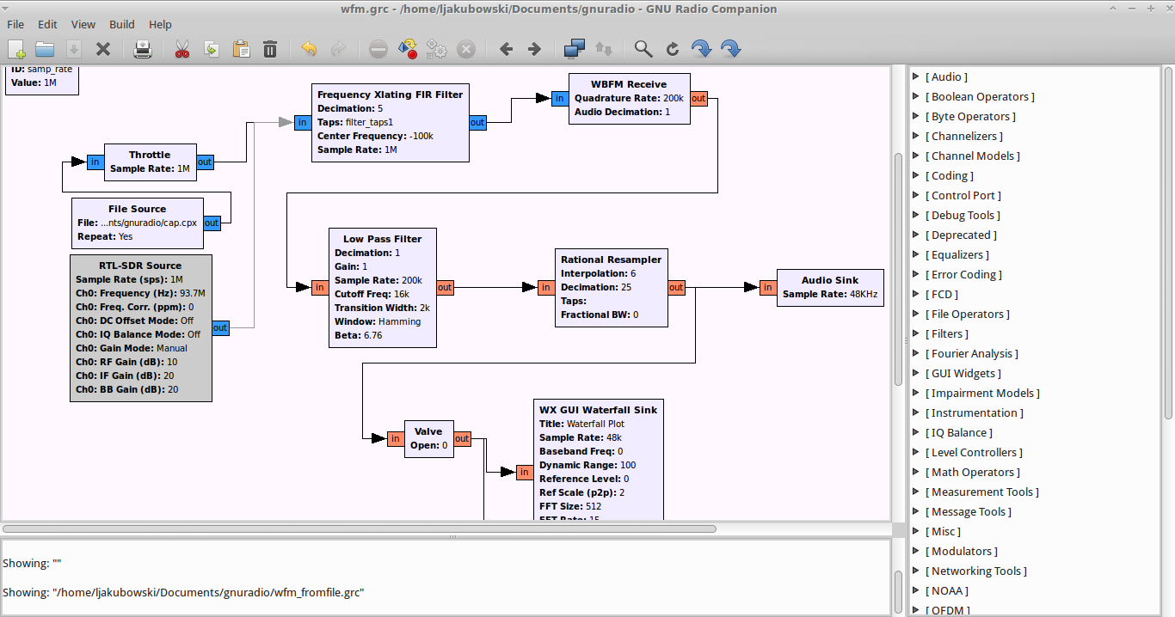
GNU Radio Companion
GUI for GNU Radio, so that we don't have to write that much glue code

Slide 47
Instrumentation and tools
Oscilloscope
IQ plot (constellation plot)
FFT
Waterfall
GUI widgets
Variables
Remember that you can Enable/Disable blocks

Slide 48
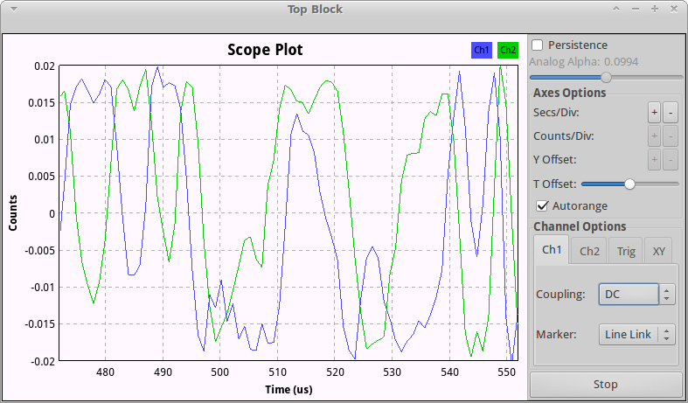
Scope sink

Slide 49
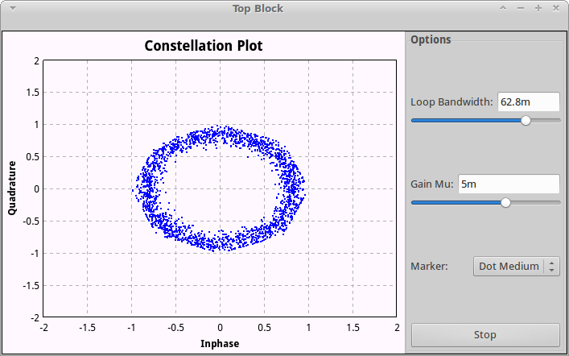
Constellation sink

Slide 50
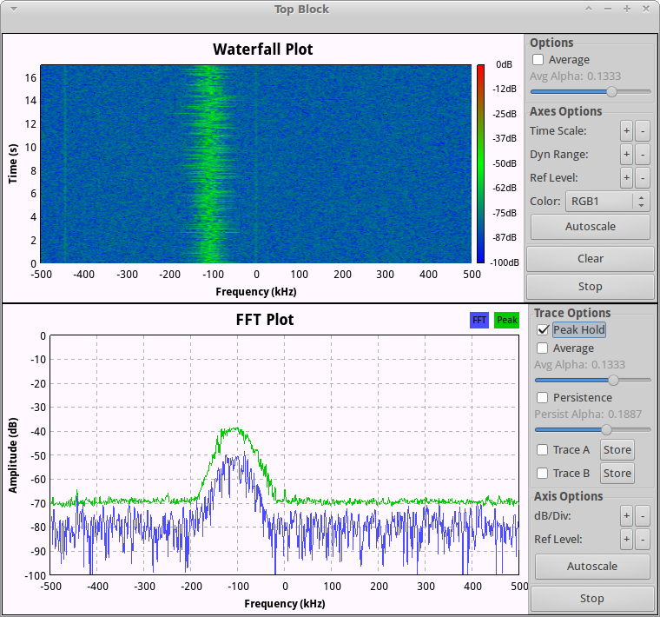
FFT and waterfall

Slide 51
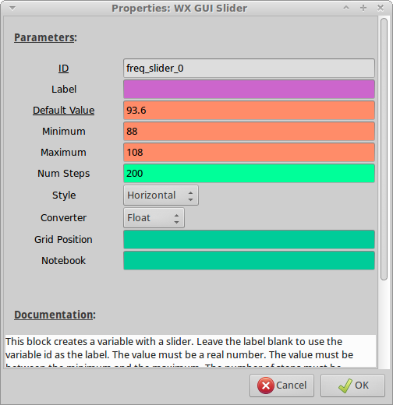
GUI→WX→slider

Slide 52
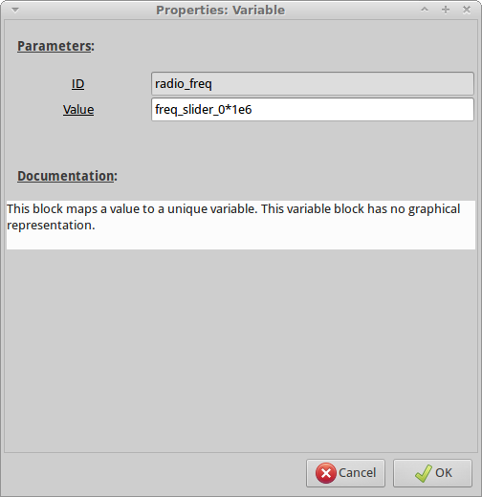
Variables

Slide 53
Pipeline
Get the signal (sources)
Center the signal you want
Filter out the rest
Remove useless data (save some cpu power)
Demodulate (FM, AM, FSK, ASK etc.)
Clean up signal
Output (sinks)

Slide 54
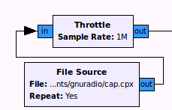
File source

Slide 55
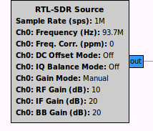
SDR source

Slide 56
Data from SDR

Slide 57
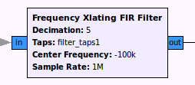
Correcting the offset

Slide 58
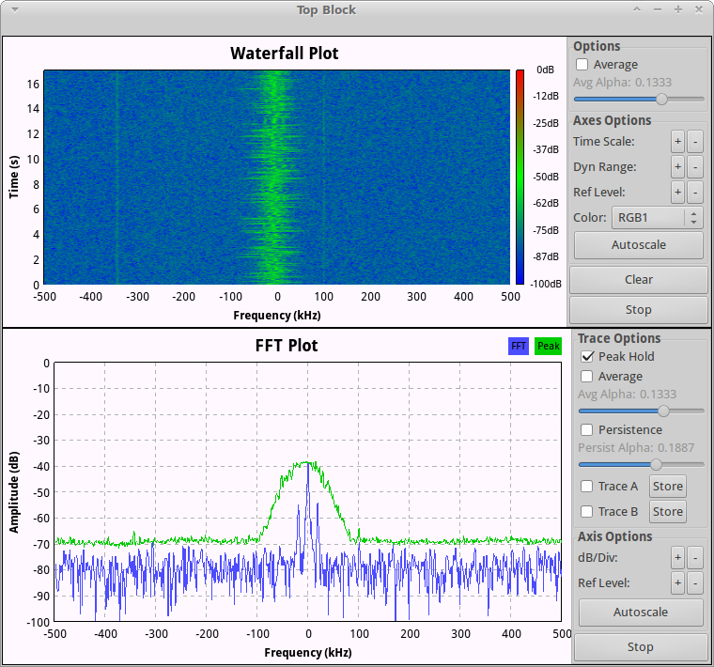
Signal is at 0Hz

Slide 59
Correcting the offset

Slide 60
Example filter taps
No filter (let everything through)
[1]
Low pass
firdes.low_pass(1.0, samp_rate, freq_hz,
transition_hz, firdes.WIN_HAMMING)

Slide 61
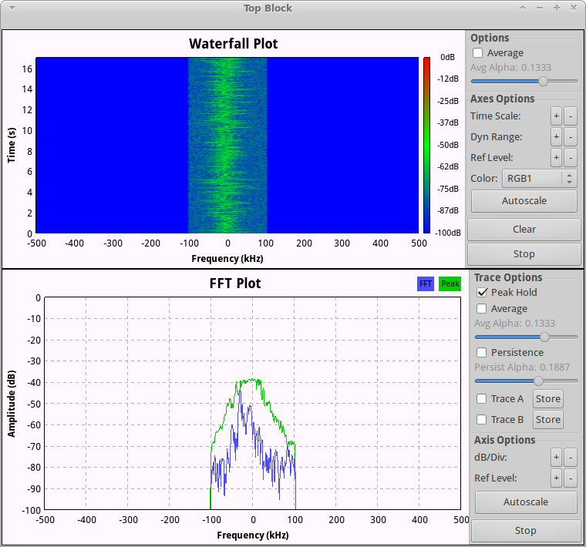
Filtered according to taps

Slide 62
Correcting the offset

Slide 63
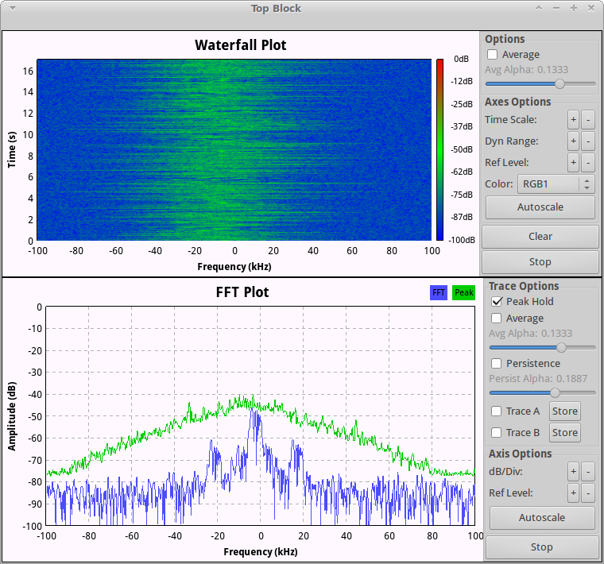
Less data, less cpu used

Slide 64
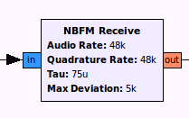

Slide 65

Demodulate

Slide 66
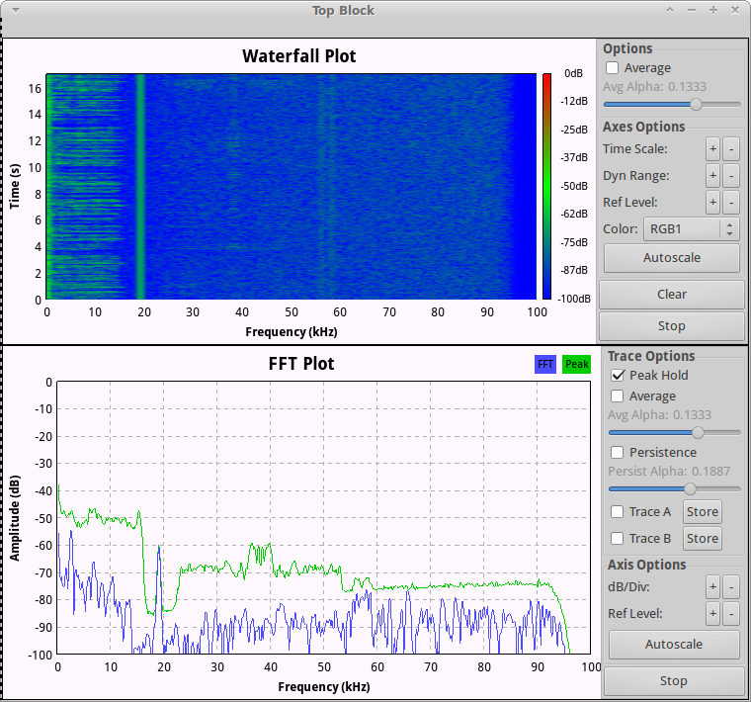
Demodulated Wideband FM

Slide 67
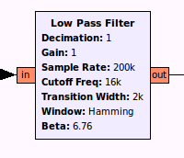
Cleaning up the audio

Slide 68
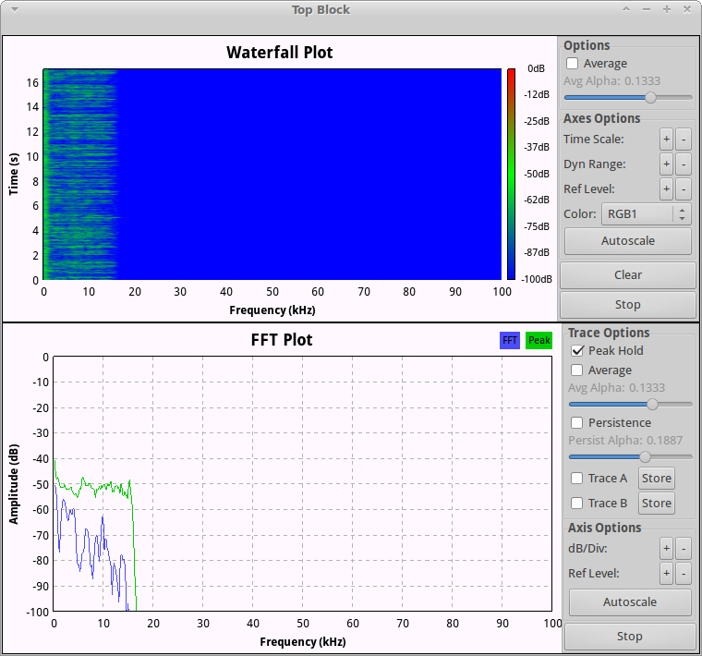

Slide 69
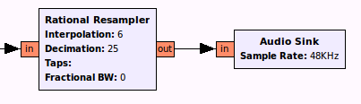
Output
200000 * 6 / 25 = 48000

Slide 70
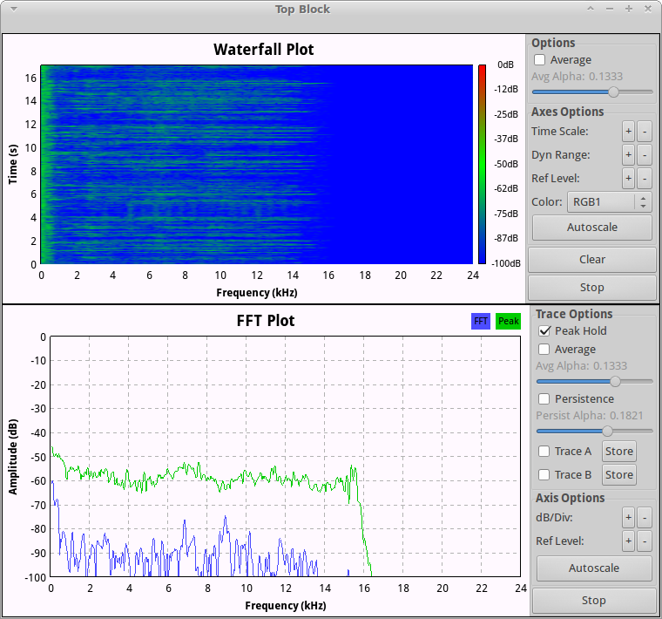
Audio sent to soundcard

Slide 71
Interesting people
Interesting projects
Alexandru Csete - @csete
Oona Räisänen - @windyoona
Michael Ossman - @michaelossman
Travis Goodspeed - @travisgoodspeed
UHF Satcom - @uhf_satcom
DSP Guide - http://www.dspguide.com/
Mathematics of the DFT
https://ccrma.stanford.edu/~jos/mdft/mdft.html

Slide 72
Questions
?

Slide 73
Thank you

