Slide 1
MGL Club
Javafx Application Project
Machael Ellakkis

Slide 2

Content
Project Objective
Time & Research
Issues Encountered
Software Requirements
Context Diagram
Final Product
Future Enhancements
What We Learn?
References

Slide 3
Project Objective
To develop an Java Application which will provide the ability to manage member’s accounts of a fictitious club called MGL.

Slide 4
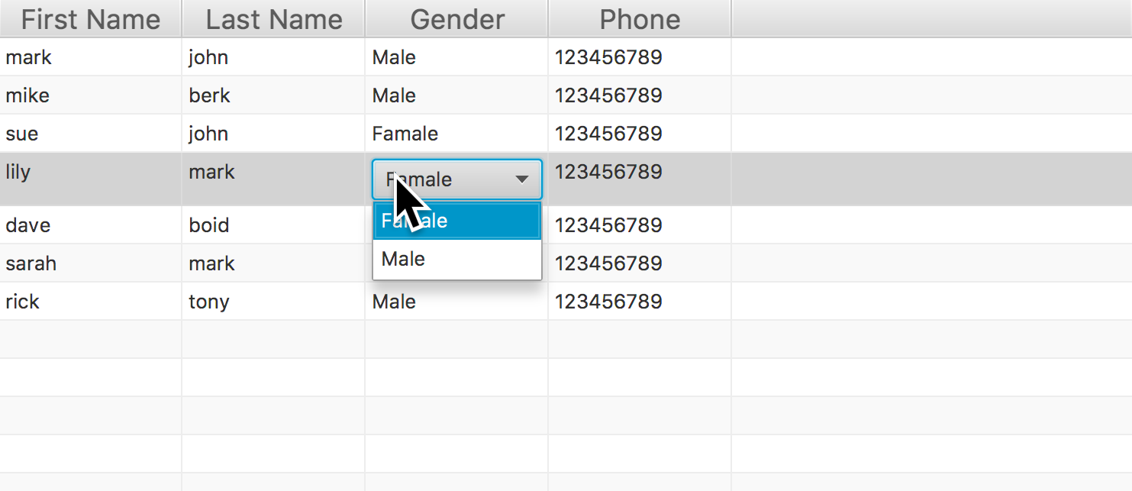
Issues Encountered
Item alignments
How to enable inline editing in the tableView.

Slide 5

Software Requirements
Java/Javafx Libraries
Eclipse
CSS
Git + Github

Slide 6
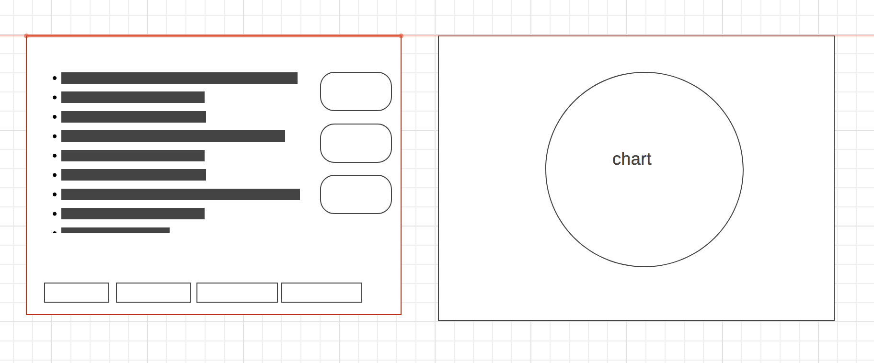
Context Diagram

Slide 7
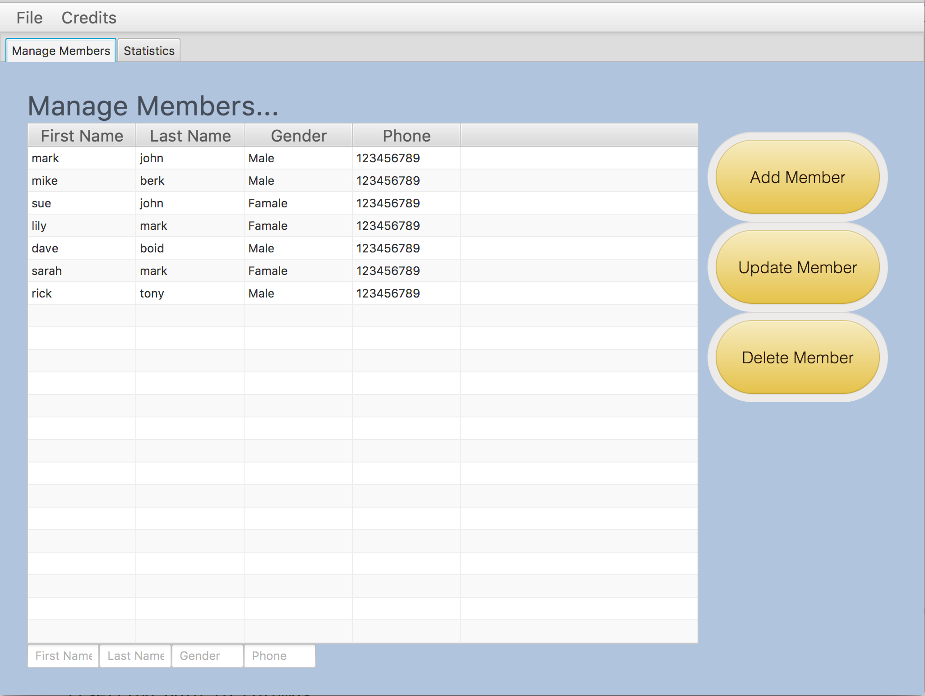
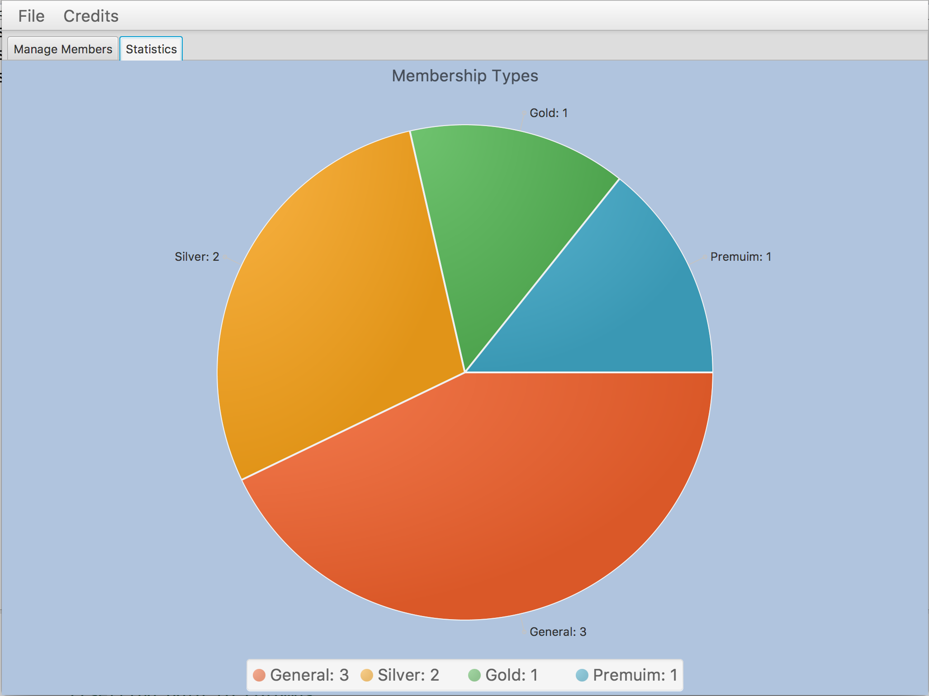
Final Product

Slide 8
Future Enhancements
Add member’s picture to the members management screen
Add more reports and charts to statistics screen

Slide 9
What We Learn?
More on Javafx Programming
Database integration with java applications
Better OOP
TableView
CSS styling
CRUD

Slide 10
References
stackoverflow.com
Oracle.com

