Slide 1





Client
Server
Javascript
Jquery
SASS
GET/POST
Apache
Python Flask SQLLite
WSGI
JSON

Slide 2
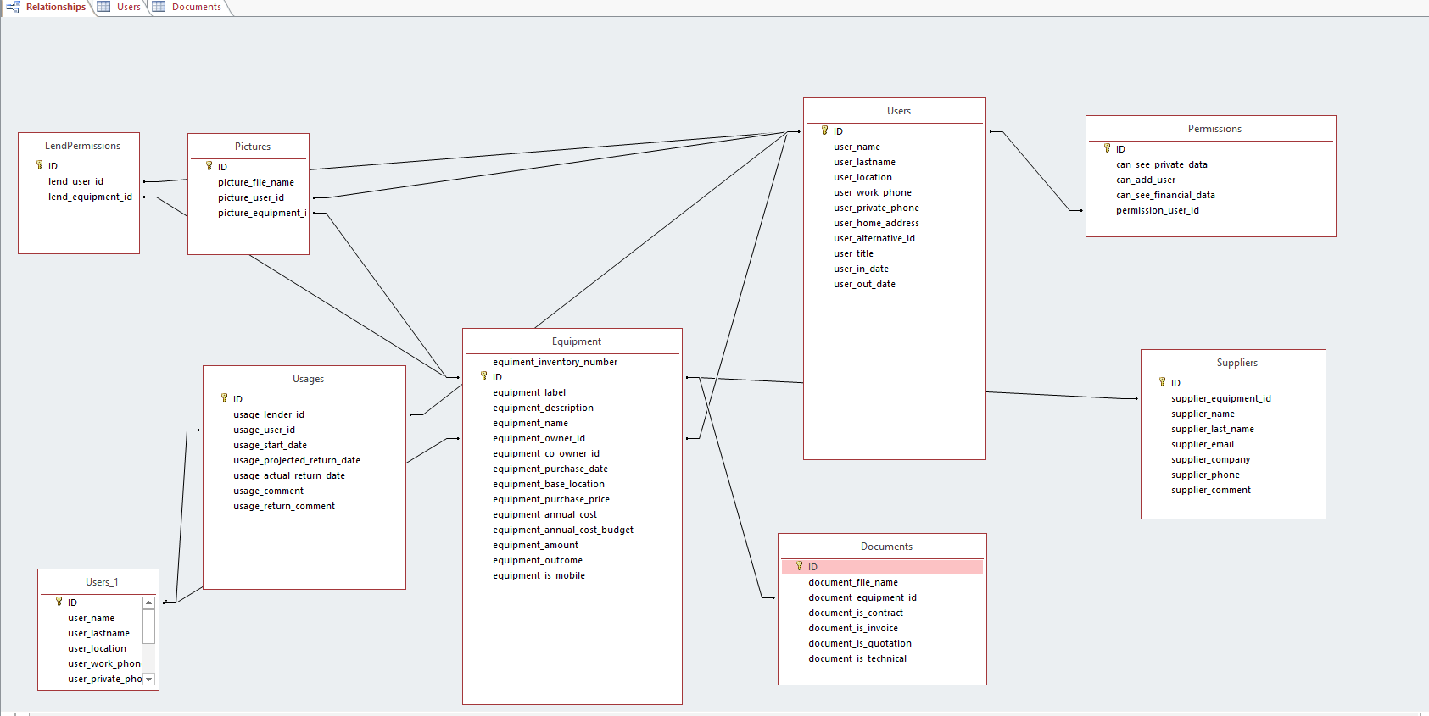

Slide 3
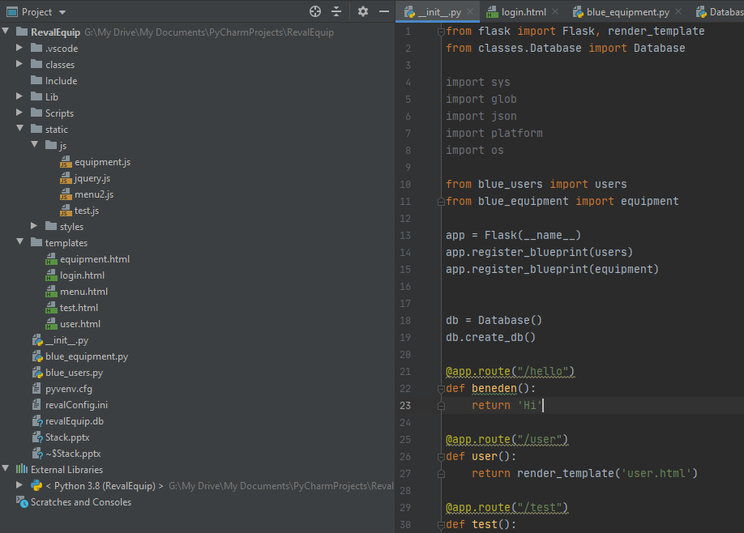

Slide 4
