Slide 1
Subscription Based Game Database
Mitch Gerber and Jason Carpenter

Slide 2
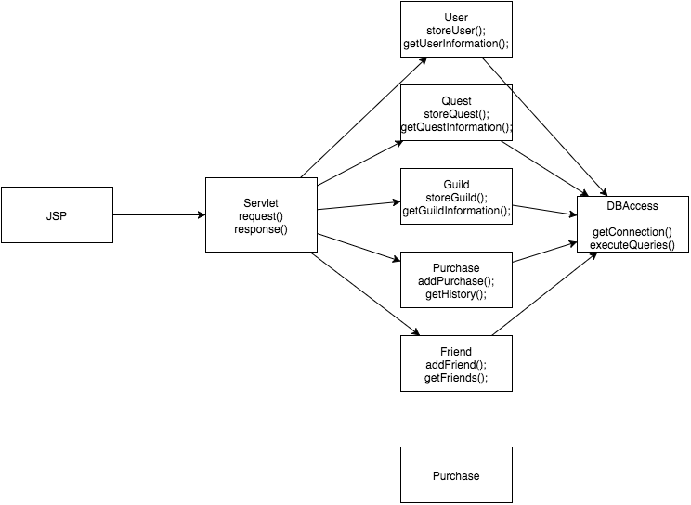
Layout at a glance

