Slide 1
LADY GAGA V2 Basic flow scheme
arrow indicates air flows between components in indicated direction.
Letters indicate details follow on subsequent pages.
MFC – air
Compressed air, 20 psi, charcoal filtered
MFC – odor 1
Bubbler, odor 1
A
B
Valve Arrays (5)
T-Manifolds (5)
MFC – odor 2
Bubbler, odor 2
Flow chamber
exhaust
C
D
Note: all clippard fittings require that the buna-n gasket (default) be replaced by epdm

Slide 2
A
Clippard 11923 1/8” OD
compression fitting
Upchurch p-301 fittings
1/16” teflon tubing;
small ID (0.175 mm)
1/8” teflon tubing
Valve Array
Bubbler, odor 1
1/8” teflon tubing
Manifold P-153
MFC, Odor 1
Upchurch p-844 fittings
Valve Array
MFC, Odor 2
Upchurch p-301 fittings
Bubbler, odor 2
1/8” teflon tubing
Manifold P-153
Valve Array
1/8” teflon tubing
Valve Array
NOTE: 1/16” small ID tubing sets flow resistance for odor streams. All tubing segments must be cut same length. For best results, cut all tubing segments from same larger piece of tubing.
Valve Array

Slide 3
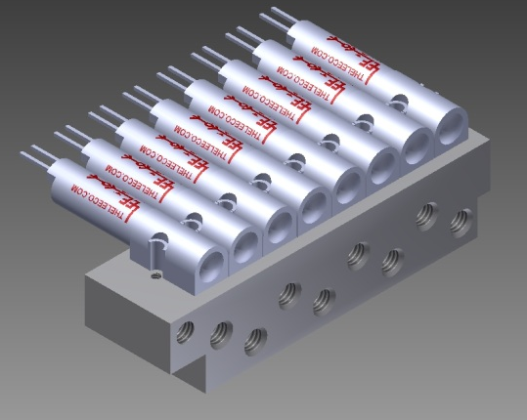
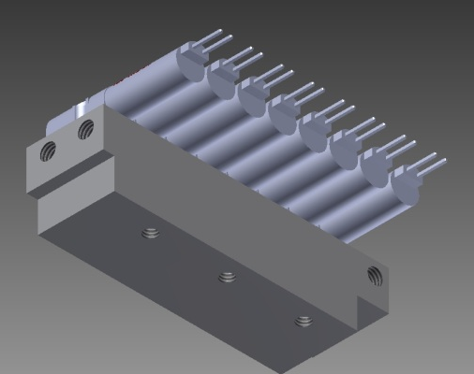
A
Manifold with valves
Odor 1 (NO) inlet, Odor 2 (NC) inlet: connect with clippard 10-32 to 1/8” compression fitting and 1/8” OD teflon tubing or seal with clippard 10-32 plug
Valve common (outlet), 8X: connect with upchurch 10-32 flat bottom vacutight fitting to 1/16” OD, 175 um ID
To distribute odor to 5 valve manifolds, use upchurch p-153, 6-port manifold for 1/8" OD tubing

Slide 4
B
MFC, Air
Clippard MAN-12 (share 4 between 5 t-manifolds)
5X
1/8” teflon tubing
1/16” teflon tubing;
small ID (0.175 mm)
Clippard 11923 1/8” OD
compression fitting
Valve Array
T-Manifold
1/16” teflon tubing; large ID (0.03”)
Upchurch p-844 fittings
NOTE: 1/16” large ID tubing sets flow resistance for air streams. All tubing segments must be cut same length. For best results, cut all tubing segments from same larger piece of tubing.

Slide 5
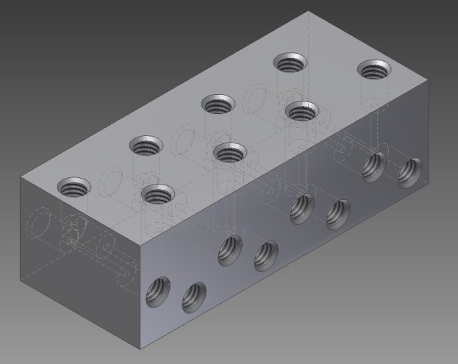
B
Air inlet 8x. Connect with 10-32 clippard compression fittings to 1/8” OD teflon tubing.
T-manifold
Odor flows from valve manifold to t-manifold through 1/16” OD 175 um ID teflon tubing (connect at both ends with 10-32 vacutight fittings) (8x)
Combined air and odor outlet, 8x. Connect with 10-32 vacutight fittings and 1/16” OD, 0.03” ID teflon tubing.
Notes: to combine multiple valve arrays, use t-manifolds in series, connected with 1/16” OD 0.03” ID tubing. Air inlet should be last connection.
To distribute air to each inlet, use clippard MAN-12 and NPT tees.

Slide 6
Upchurch p-844 fittings
Clippard 11752-5 1/16” ID hose barbs
T-Manifold
Flow chamber
Clippard MAN-12
MAN-ASF1-08
T-Manifold
Clippard MAN-12
T-Manifold
exhaust
Clippard MAN-12
T-Manifold
Clippard MAN-12
T-Manifold
1/16” teflon tubing; large ID (0.03”)
C,D

Slide 7
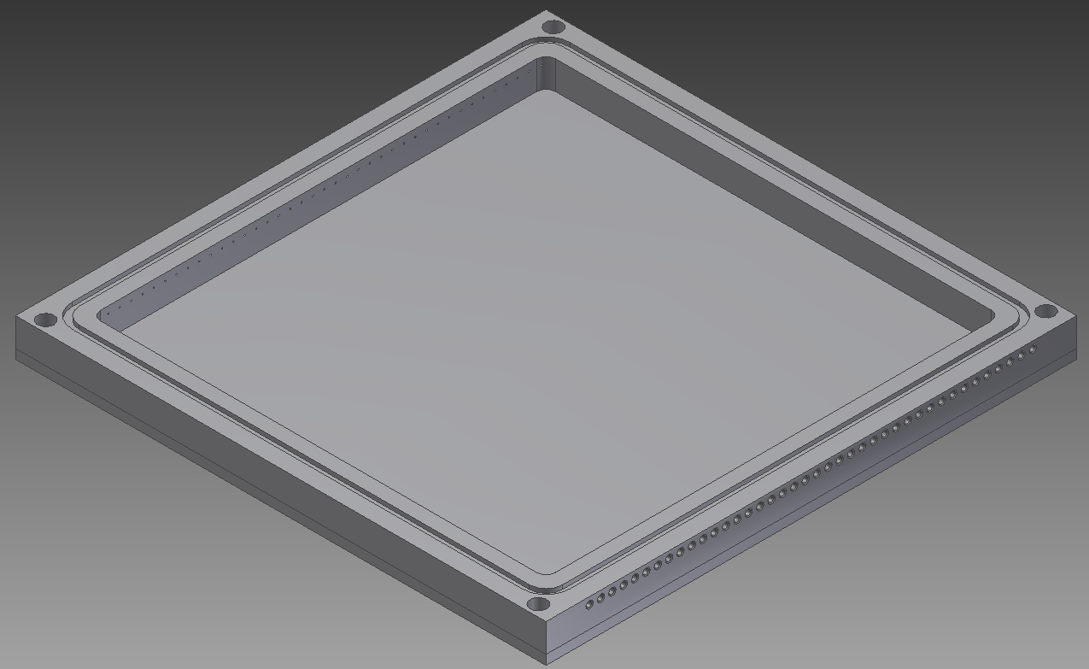
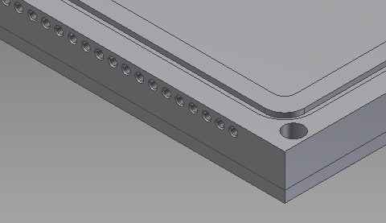
Odorized air flows from t-manifold to flow chamber through 1/16” OD 0.03” ID teflon tubing (connect with 10-32 vacutight fittings, both ends)
C
Connect with 10-32 vacutight fittings (40 places)

Slide 8
D
Flow chamber outlet: connect with clippard 10-32 to 1/16” ID hose barbs to 1/8” OD, 1/16” ID fep lined tygon tubing (40 x). Connect other end to clippard MAN-12 using clippard barbs. Connect all MAN-12s to MAN-ASF1-08 (use NPT plugs to fill empty connections). connect MAN-ASF1-08 to tubing (this is the outlet, which should run through a flow meter and then into whatever venting system you decide to use)

Slide 9
Alternate connection scheme for multiple independent valve arrays
MFC – air
Compressed air, 20 psi, charcoal filtered
MFC – odor 1
Bubbler, odor 1
Valve Arrays (5)
MFC – odor 2
Bubbler, odor 2
MFC – odor 3
Bubbler, odor 3
Valve Arrays (5)
T-Manifolds (5)
T-Manifolds (5)
MFC – odor 4
Bubbler, odor 4
Flow chamber
exhaust

