Slide 1
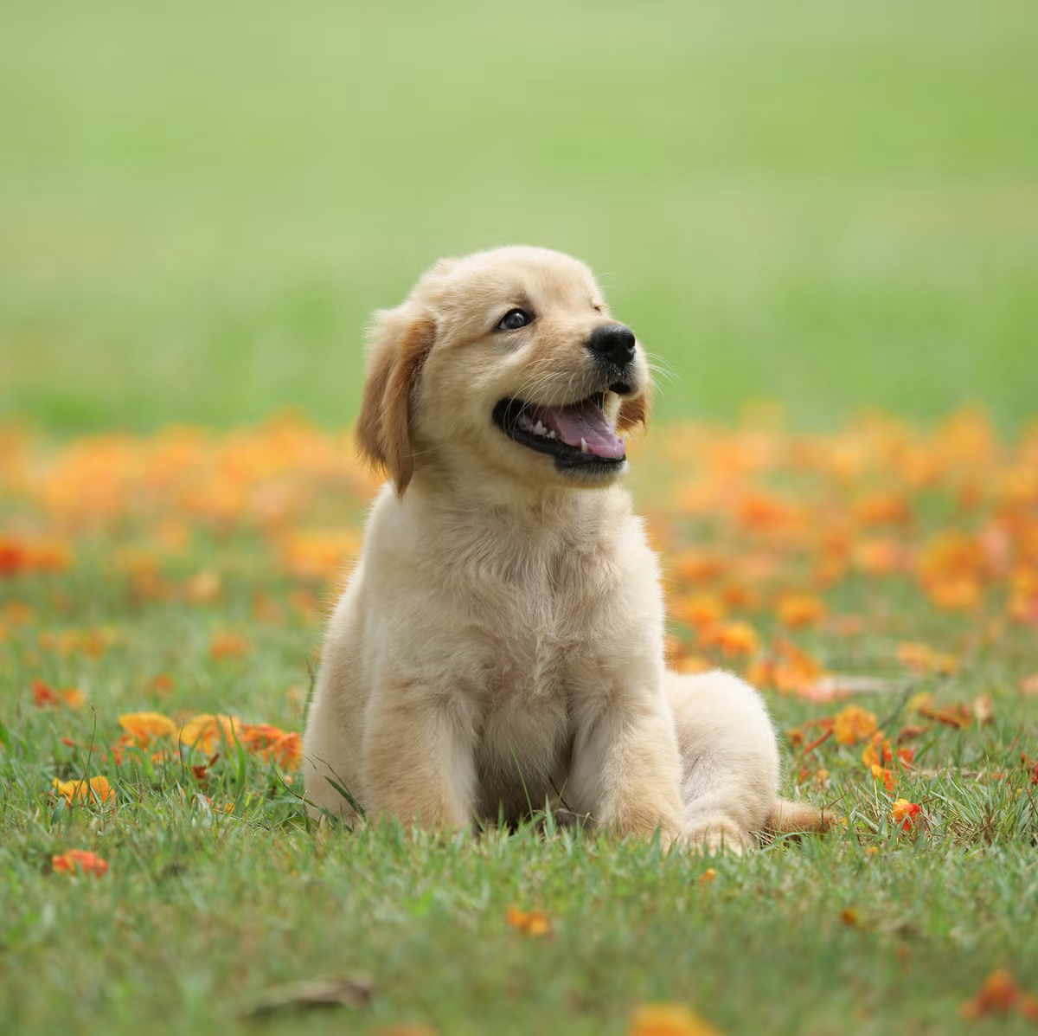

Dog Breed Classification Via Machine Learning
Mel Gerst
Reading Summary

Slide 2
Primary Paper Overview
Dog Breed Identification using ResNet Model Reddy, Y. A. ., Kumar, Y. S. ., M, S. ., & Mana, S. C. . (2023). International Journal on Recent and Innovation Trends in Computing and Communication, 11(7s), 64–71. https://doi.org/10.17762/ijritcc.v11i7s.6977
This paper used ResNet50, which is a residual neural network that excels at image classification, to classify dogs. Resnet was used to identify the images and uses transfer learning with convolutional neural network to classify a large database of images. Used in conjunction with TensorFlow, a dataset was created, tested, and trained for the detection of dog breeds. 120 dog breeds are covered in the dataset which includes 20,580 images of dogs. In this reference project, all these images are used and converted into a NumPy array and normalized. Then,100 epochs were used with a batch size of 128 to achieve the best accuracy. Using these tools and process the team was able to achieve an accuracy of 91%.
For my implementation, and depending on computing power requirements and time requirements, I may choose to focus on a fewer number of breeds. I am targeting at least 80% accuracy for my model. As pointed out in later slides, other reference projects using similar approaches were able to achieve 70% and 85% accuracy results, so I hope to be able to achieve at least 80%.

Slide 3
Summary of the Method
Primary Reference: Dog Breed Identification using ResNet Model
Reddy, Y. A. ., Kumar, Y. S. ., M, S. ., & Mana, S. C. . (2023)
Top Level Summary
Project used an existing database (Kaggle / Stanford) of dog pictures to train a neural network using transfer learning techniques.
Trained the model using these pictures and a defined set of labels.
The overall model is testedfor accuracy, target 80%+.
Finally, present some personal dog photos and see if the model can successfully identify the breed.
Main Technologies
Python
Tensorflow: 2.3.1
Opencv
Sklearn
Numpy
Pandas
Matplotlib
ResNet50V2 - Pretrained Residual Neural Network
Major Project Steps
Import necessary libraries and prepare coding environment
Download and prep dog photos
Preprocess dataset
Encode, scale and augment dog pictures
Split pictures into training and test sets
Build the model
Train the model
Test the model
Predict breed using personal photos
Summarize results

Slide 4
Summary of Related Works and Links
1) TechVidVan - https://techvidvan.com/tutorials/dog-breed-classification/
TechVidVan is a group and website with software and machine learning tools and topics. They have conducted a similar project to the primary paper with good explanation of the process, steps and techniques to be successful.
Through their website they have an excellent project example for dog breed classification, with source code and a link to the original dataset I had planned to use. Therefore, this is a strong reference as a related work.
Similar tools were used as the primary paper and appears to have used a similar process. One difference from the primary, which I will likely follow, is to test the model with personal files via a simple local file upload, instead of hosting the system on website.
For this project, the team reached an accuracy of 80.5% which is above my 80%. It will be interesting to see if I can achieve similar or possibly better results.
2) Dog Breed Classification Using Deep Learning
https://www.researchgate.net/publication/353693466_Dog_Breed_Classification_Using_Deep_Learning
Varshney, Akash & Katiyar, Abhay & Singh, Aman & Chauhan, Surendra. (2021). Dog Breed Classification Using Deep Learning. 1-5. 10.1109/CONIT51480.2021.9498338.
This related work also performed dog breed classification using the same Stanford dog database, so is a good candidate for support on this project.
In addition, the team used two different CNN tools to perform the modeling. Name, they used Inception V3 neural network and the VGG16 neural network. With these models they were able to achieve top accuracy performance of 85% and 70% respectively.
This team also showed the increase in accuracy of both models as the number of epochs was increased. Again, it will be interesting to see what performance I can achieve with my implementation.

Slide 5
THANK YOU

