Slide 1
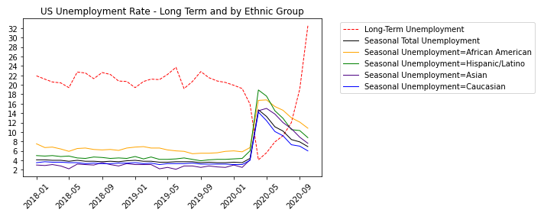
Unemployment: Long Term vs Seasonal - 1 -
Seasonal Unemployment trends depict the dramatic increase covered since the start of the pandemic.
Of all the Ethnic groups, the African American and Hispanics groups have been the most affected.
Alarmingly though, Long-Term Unemployment, which covers those unemployed for at least 27 weeks, has accelerated, going up by 8-fold.
Rising long-term unemployment impacts the broader economy.

Slide 2

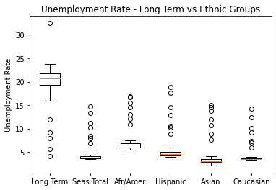
Unemployment: Long Term vs Seasonal - 2 -
From the boxplot, the outliers represent the Y2020 unemployment numbers.
It may be inferred that exogeneous shocks to the economy result in considerable erratic variations in fundamental economic measures.
The question is how long do we see these as outliers, or if they become the norm.

Slide 3
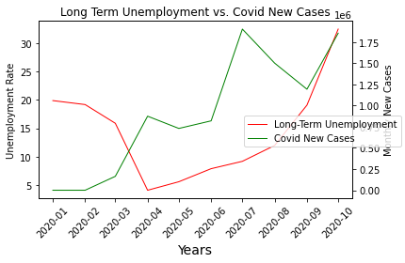
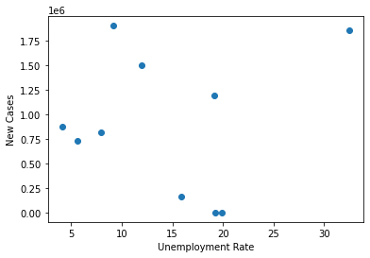
Long Term Unemployment vs Covid Increase
We attempted to establish the correlation between long-term unemployment vs Covid New Cases using monthly data.
Simply plotted, both are on an upward trend.
However, the scatter plot exhibits very wide dispersion, possibly because:
1. data is monthly (long-term unemployment is available only on a monthly basis)
2. There is no depth to the data as only 10 sets of monthly data is tracked.

Slide 4
Conclusions and Imact

Slide 5
Difficulties and Further Considerations

