Slide 1
ChumFlash
CS50’s Introduction to Programming with Python
Final Project
Mojtaba Ghaderi
GitHub: mghadery
edX: mojghaderi
Erba, Italy
6/15/2025

Slide 2
Objectives
A flash card application for learning new languages.
User can define new flash cards each containing two terms on its front and back sides with possibly two different languages.
The application can present randomly selected cards to the user as a quiz.

Slide 3
Features
Each card stores front and back languages along with the terms.
A number indicating the complexity of the front side term is stored for each card, which is used to award points for correct answers.
The back side is suggested by the application by translating the front side, so the user may choose not to enter it manually during creation.
The entered terms for front and back terms are trimmed to remove excess spaces, and necessary spaces are added where required.
Each card is assigned a category for organizational purposes.
Each card is assigned a list of tags.

Slide 4
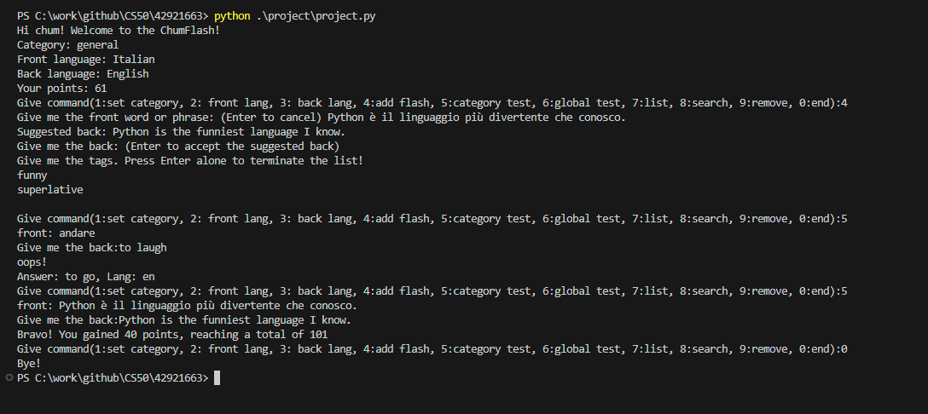
Execution

Slide 5
Implementation notes
The class FlashCardRepo is defined to act as the repository for storing and retrieving cards.
Currently, a csv file is used to store cards in the class FlashCardRepo. In future developments, its implementation can be changed to use a relational database for that purpose.

Slide 6
Implementation notes
The class UserData is defined to store current user settings including front language, back language and category.
UserData, is used also for storing the points earned by the user in answering quizzes

Slide 7
Future Developments
Search by tag
Using SQLAlchemy to store data in a relational database
Adding creation time to the flash card info
Adding last attempt time to the flash card info
Random selection of cards based on their last attempt time and whether the user answered them correctly
Auto correction of entered texts based on the selected languages
Adding a graphical user interface

Slide 8
The End

