Slide 1
Making Robots Sing
On music, computers and hacks that entertain
Stefanie Schirmer
Mahtab Ghamsari-Esfahani
November 26 2013
Notes:
Welcome everyone, today we're going to go over the subject of music technology, hacking and tools. The research surrounding music and technology is very vast and in many cases very theoretical so it's almost impossible to cover everything in an hour but we'll try our best.

Slide 2
Overview
About Sound
A brief history of computer music
Where we are today
Analysis, Synthesis, and Composition
Tools and Software
Demo 1: LiveCoding with Overtone
Demo 2: Modular synthesis using PureData
Music Listening and the Internet
Notes:
Before we get started it's important to discuss what music technology entails (scientifically). I think using sound technology is also appropriate since we're no longer dealing just with notes and melodies, but we're trying to modify sound itself and its properties. In addition we're re-creating sound through digital synthesis by computers and theoretically, this is a world of its own. Continuous sound is being recreated with discrete 0s and 1s.

Slide 3
About sound
Sound is a wave
Notes:
Sound → Vibrating string or air in a tube
Properties → Amplitude, Frequency, Phase,
Simplest sound wave → A sine/cosine wave (pure tone) at a constant frequency

Slide 4
History of music & technology
Evolution of Instruments → Hundreds of years
Using electricity in music → 1920s
Digital Music → 1950s
Continuous evolution to this day …
Notes:
Music Listening and Performance has evolved with the evolution in technology, on purpose or not.

Slide 5
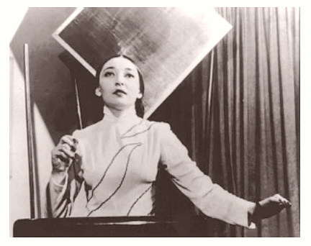
Theremin
1918 - Invented by Léon Theremin
Uses Magnetic Fields
No contact with hands
Hands control Volume and Pitch
Clara Rockmore – First
Virtuoso on the Theremin
www.youtube.com/watch?v=pSzTPGlNa5U

Slide 6
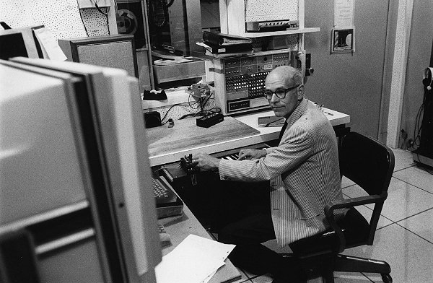
Max Mathews – MUSIC
1957: Max Matthews creates the first programming language to do digital synthesis called MUSIC
Matthews was also on the team who made the first computer sing: 1961
Singer: IBM 7094
http://www.youtube.com/watch?v=41U78QP8nBk

Slide 7
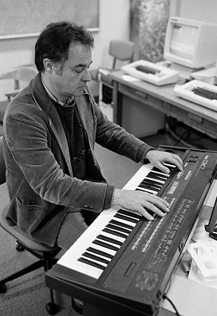
John Chowning – FM Synthesis
Yamaha DX7
1969: John Chowning develops FM Synthesis
Originally Analog
Example: Every song from the 80s

Slide 8
For the most part however ...
Up until the 21st century, synthesizers were mainly used in the context of traditional instruments turned digital
Computers themselves weren't making music
What has changed?
Computers are more powerful!

Slide 9
Algorithmic tools and software for music
Real-time sound synthesis with own language: Supercollider
Sound and visuals: Processing
Cmusic – Music Compiler written in C
Recording and mixing: Audacity (free) and many non-free software
Live coding: Chuck https://www.coursera.org/course/chuck101
Live coding, functional programming: Overtone http://overtone.github.io/

Slide 10

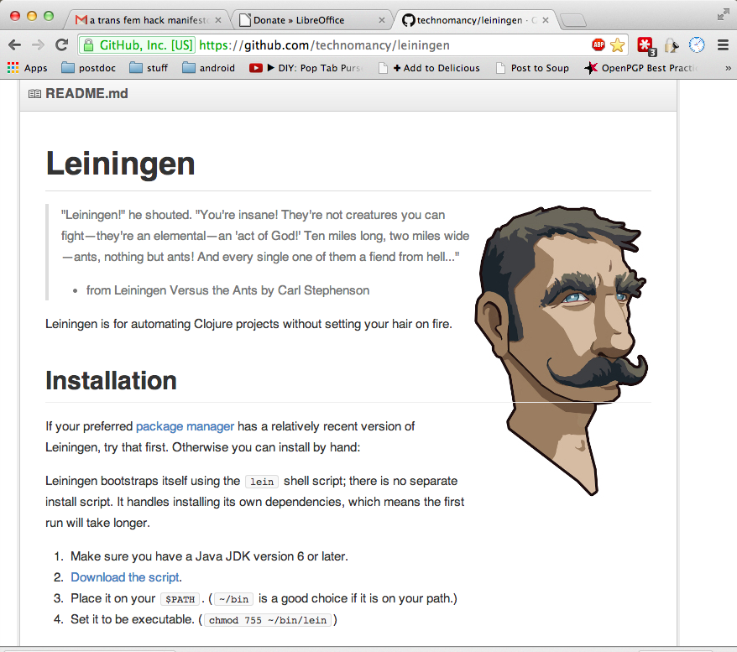

Overtone
Based on the functional programming language Clojure
(a LISP-dialect on the Java VM)
Client for the supercollider server
Easy to explore via the automatic project generator Leiningen and the REPL

Slide 11
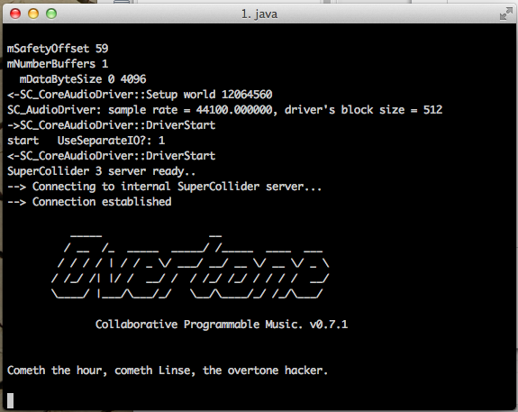
Getting started with Overtone
Install leiningen via package manager (apt-get, pacman) or https://github.com/technomancy/leiningen
lein new insane-noises
vi insane-noises/project.clj
# add the following dependencies to insane-noises/project.clj
# [org.clojure/clojure "1.5.1"]
# [overtone "0.8.1"]
cd insane-noises
lein deps
lein repl

Slide 12
First sounds with Overtone
lein repl
;; boot the server
user=> (use 'overtone.live)
If this produces errors, go to troubleshooting.
;; listen to the joys of a simple sine wave
user=> (demo (sin-osc))
;; or something more interesting...
user=>(demo 7 (lpf (mix (saw [50 (line 100 1600 5) 101 100.5]))
(lin-lin (lf-tri (line 2 20 5)) -1 1 400 4000)))
quit
I already built a project for you :-D
git clone https://github.com/linse/keymusix.git
git branch algomap
cd keymusix
lein run

Slide 13
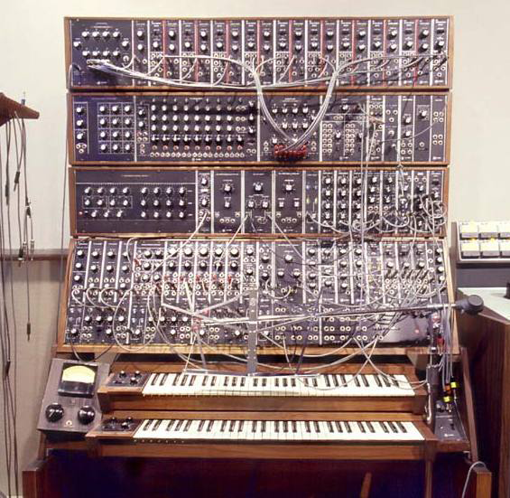
Modular Synthesizers
1969 – Moog Modular Synthesizer
The graphical programming languages Max/MSP and PureData are inspired by these synthesizers
http://www.youtube.com/watch?v=a-aQwrXH4Ow
Notes:
The idea for using modular synthesizers comes from the theory of modifying units of sound or sound effects.
Single modules of sound are connected by cables creating a synthesizer

Slide 14

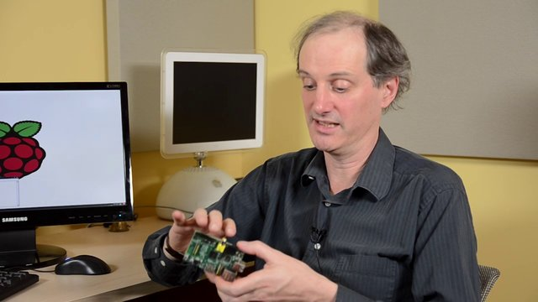
Max/MSP and PureData
Patches
Objects
Connectors
  Control
  Audio Signal
Founders: Max Mathews (MAX)
Miller Smith Puckette (MSP)
Notes:
Data flows between objects connected through cords or wires
• Thin cords carry message data; fat cords carry audio signals
• Objects take in data at inlets, and may send output to outlets; inlets and outlets appear as tabs at the edge of objects
• Types of object names: – Object names with ~: Process signals – Object names without ~: Process messages

Slide 15
PureData – Logic and DataFlow

Slide 16
PureData - Exercise

Slide 17
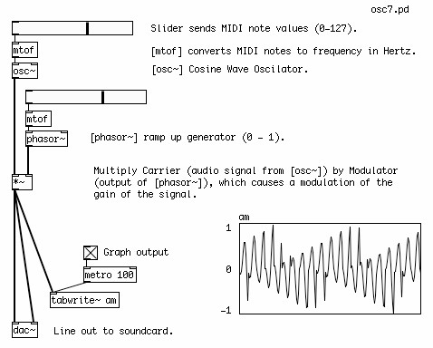
More PD Examples
AM (Amplitude Modulation) synthesis with PureData
To see a more sophisticated example: www.youtube.com/watch?v=ryNN2_yHRXw‎

Slide 18
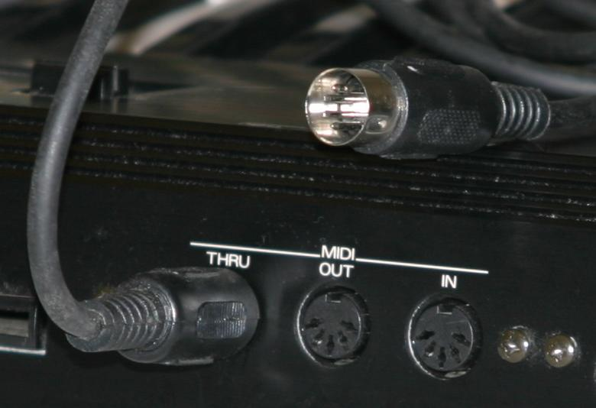
Digital music protocols
MIDI (musical instrument digital interface),
      8 bit integer
      16 channels max
OSC (open sound control)
      integer/long/float
      Does not need special hardware

Slide 19
Music listening and the Internet
Music listening had also greatly changed
      MP3s, Napster, Torrents, Bigger Hard Drives, etc …
Challenge of the 21st century: Finding music
      There's too much music everywhere
Solution: Classification, Recognizer Apps, Recommendation Engines, Internet Radio:
    Dealing with LOTS and LOTS of musical data
    New Algorithms, Machine Learning, Data Science

Slide 20
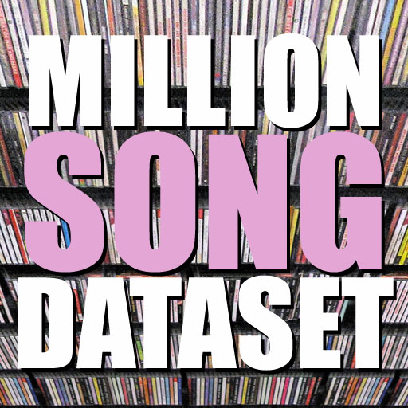
Music Hackathons
Started in 2009 by two guys from SoundCloud
IDEA: Help artists get recognized, save the music business
      Musichackday.org
Some Apps built at MHDs:
Participating Companies:
      Echonest
      SoundCloud
      Spotify
      MusicBrainz
      Last.fm

