Slide 1


Answering scientific questions with NLP
Meisam Ghasemi Bostanabad
Abdosamad Keramatfar
2022-12-15
RCDAT

Slide 2
What is Natural Language?
Natural language refers to the way we communicate with each other. Which mainly includes speech and text.

Slide 3
What is Natural Language Processing
Natural language processing (NLP) is a subfield of linguistics, computer science, and artificial intelligence concerned with how to program computers to process and analyze natural language data.
The engineering side of computational linguistics, often called natural language processing (NLP), which is largely concerned with building computational tools that do useful things with language, e.g., machine translation, summarization, question-answering, etc.

Slide 4
Why is it important?
More than half a million Persian scientific papers at SID.
798,132 Persian and 6,301,375 English Wikipedia articles.
1.72 billion websites.
500 million tweets per day.
3.5 billion google searches per day.

Slide 5
NLP Applications
Any kind of computer manipulation of natural language. At one extreme, it could be as simple as counting word frequencies to compare different writing styles. At the other extreme, NLP involves “understanding” complete human utterances, at least to the extent of being able to give useful responses to them. Recently, there is more advanced application including natural language generation.

Slide 6
Word2Vec: Motivation
Mikolov T, Sutskever I, Chen K, Corrado GS, Dean J. Distributed representations of words and phrases and their compositionality. Advances in neural information processing systems. 2013s.

Slide 7
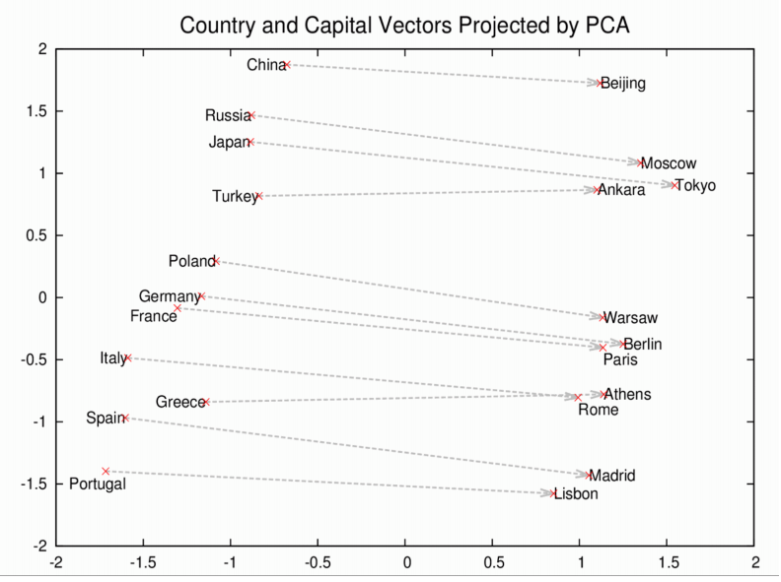
Word2Vec: Motivation

Slide 8
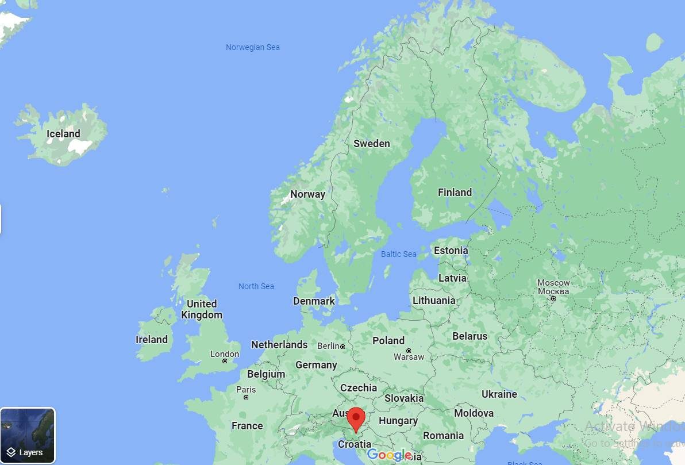
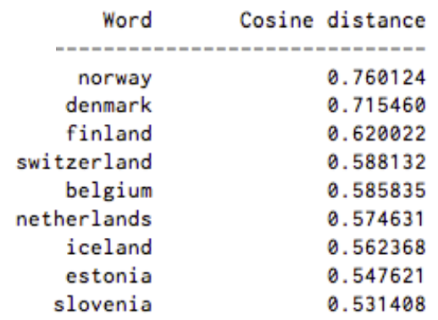
Word2Vec: Motivation
A list of words associated with “Sweden” using Word2vec, in order of proximity:

Slide 9
Word2Vec
Word embeddings are a modern approach for representing text in natural language processing.
A word embedding is an approach to provide a dense vector representation of words that capture something about their meaning.
Each word is represented by a point in the embedding space and these points are learned and moved around based on the words that surround the target word.
The vector space representation of the words provides a projection where words with similar meanings are locally clustered within the space.
The use of word embeddings over other text representations is one of the key methods that has led to breakthrough performance with deep neural networks on problems like machine translation.
Word2vec is one algorithm for learning a word embedding from a text corpus.

Slide 10
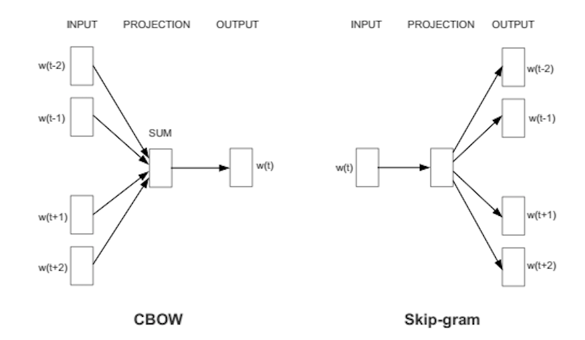
Word2Vec Diagram

Slide 11
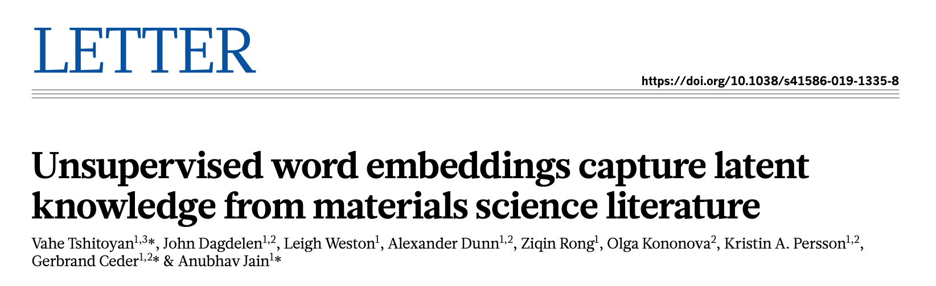
Paper in a glance
Beyond property values, publications contain valuable knowledge regarding the connections and relationships between data items as interpreted by the authors.
It shows that materials science knowledge present in the published literature can be efficiently encoded as information-dense word embeddings.
The key idea is that, because words with similar meanings often appear in similar contexts, the corresponding embeddings will also be similar.

Slide 12
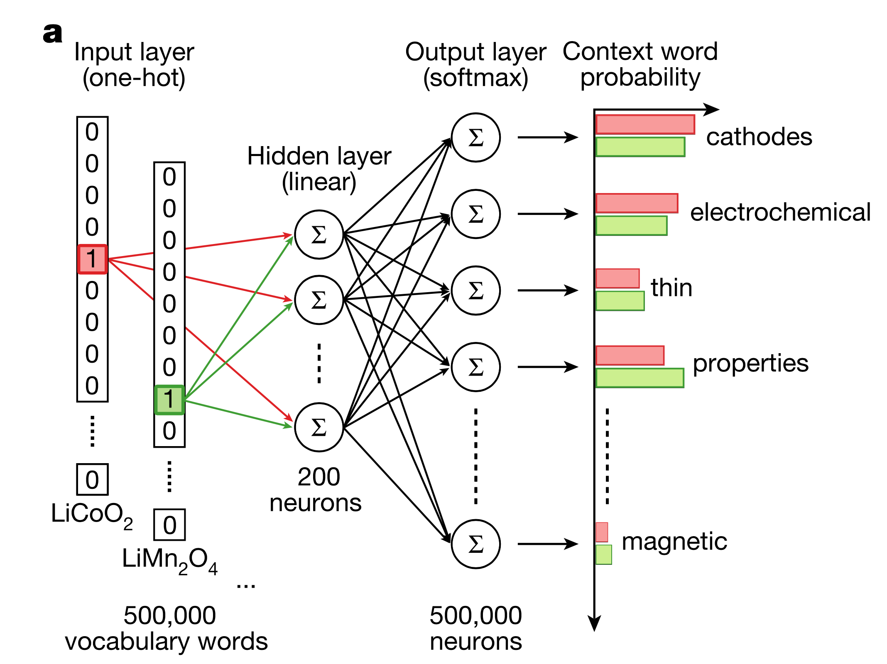
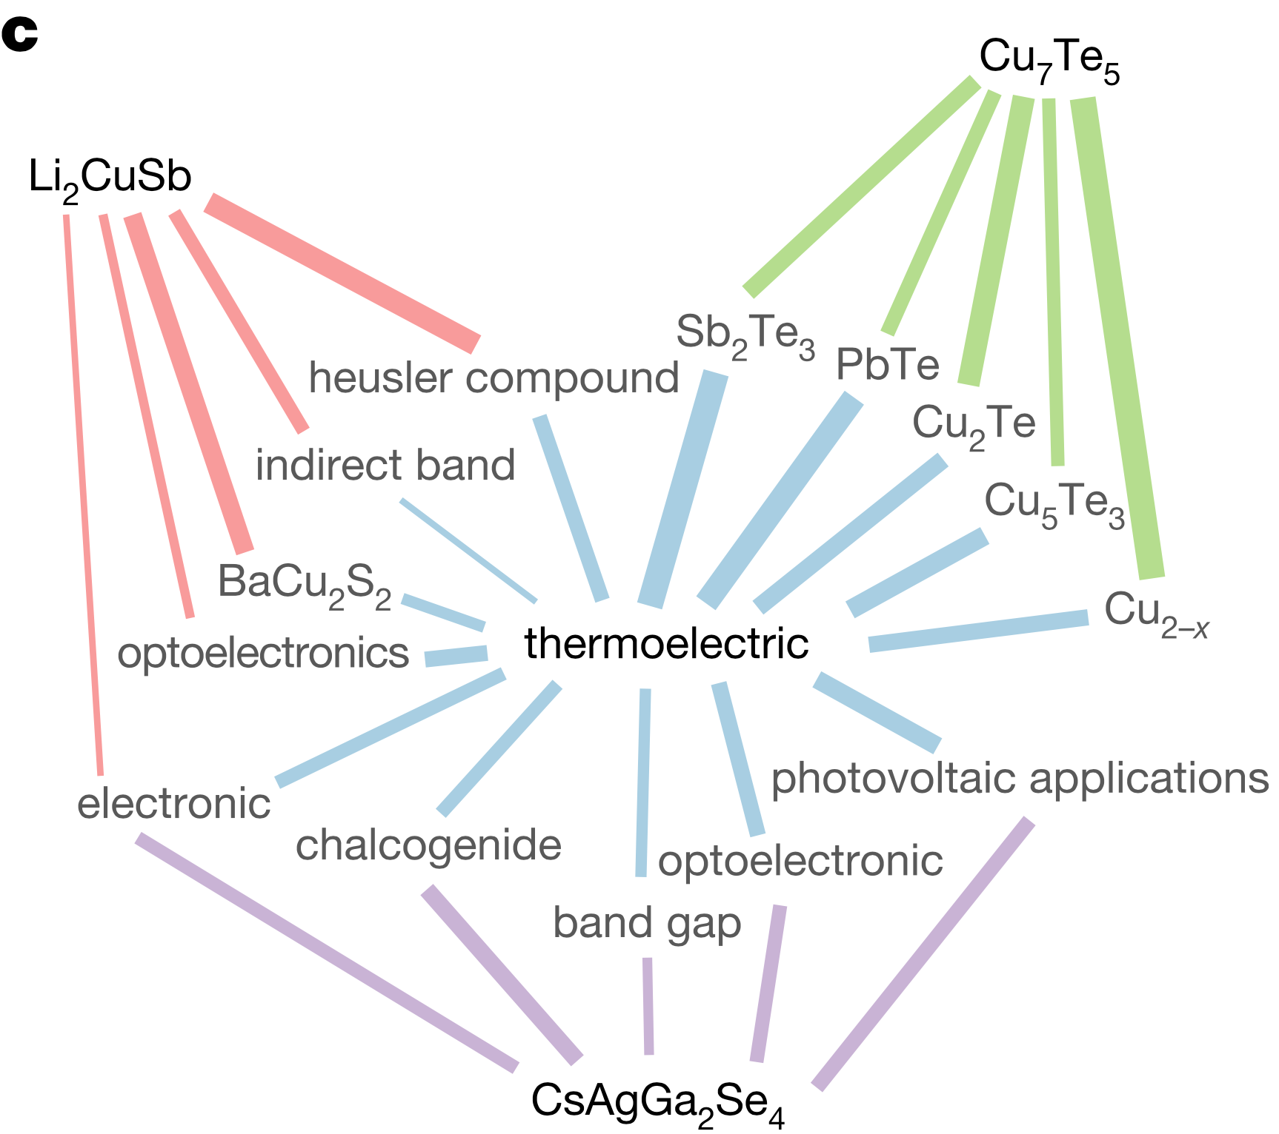
Model structure
The thermoelectric effect is the direct conversion of temperatures differences to electric voltage and vice versa.
Cosine similarity of a material embedding and the embedding of thermoelectric is high, text corpus necessarily includes abstracts reporting on the thermoelectric behaviour of this material.

Slide 13
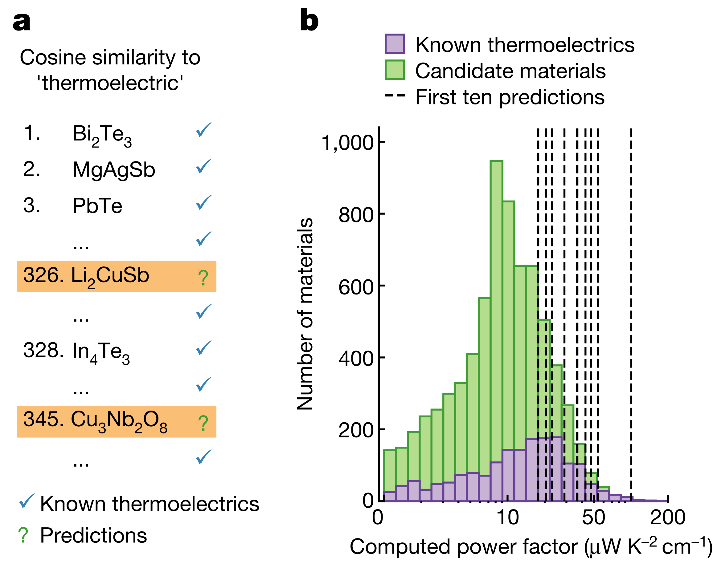
Model prediction
A ranking of thermoelectric materials can be produced using cosine similarities of material embeddings with the embedding of the word ‘thermoelectric’.

Slide 14
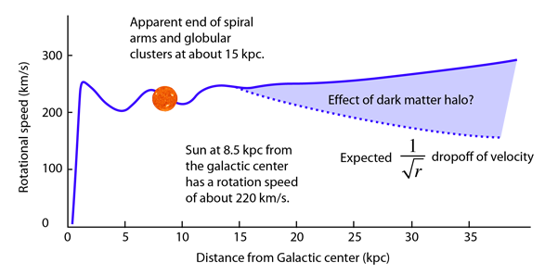
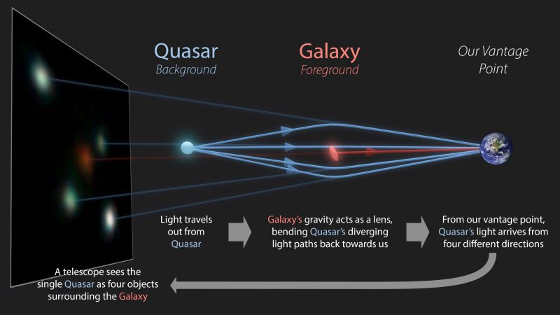
Dark matter existence
Over 90% of all matter in the universe is made up of material/energy scientists have never seen.
These particles/energies don’t interact with light (or any electromagnetic fields) so they are dark.
The orbital velocity observation of galaxies (left plot) and gravitational lensing (right plot) are the clues for dark matter existence.
more in backup

Slide 15
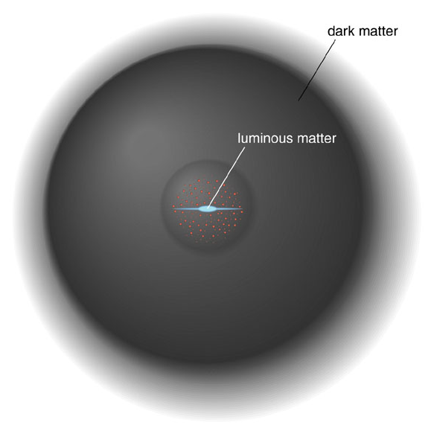
Dark matter is or is not
Dark matter is not:
cloud of normal matter, because it would emit particles we could detect
anti-matter produces gamma rays with matter interactions
black hole to be singular in space-time
Dark matter could be:
massive so it interacts via gravity
weakly interacting particle (WIMP)
nothing but just a modification in gravity

Slide 16
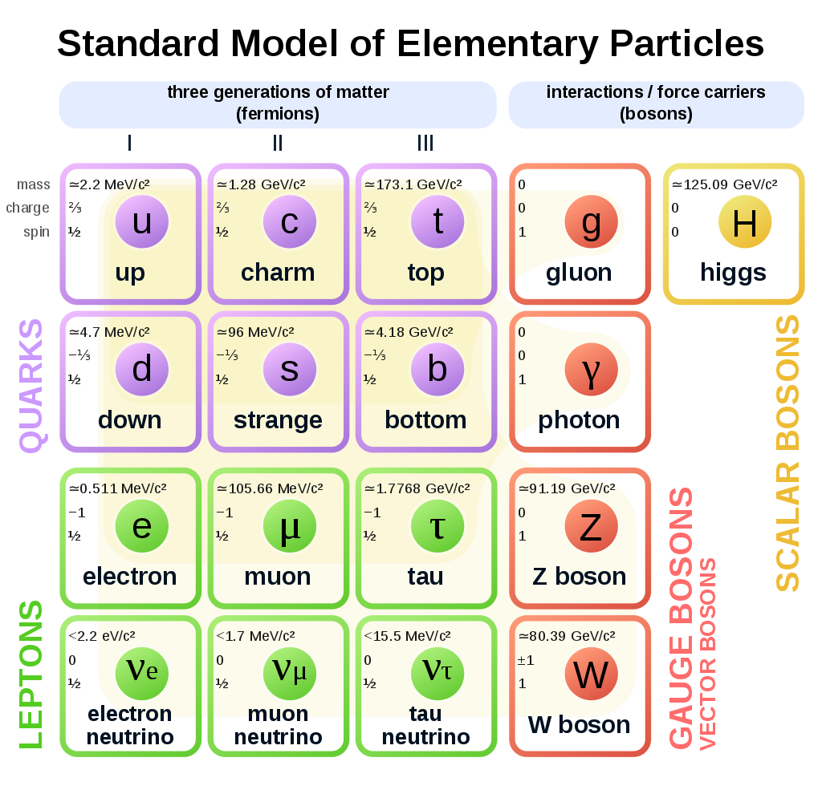
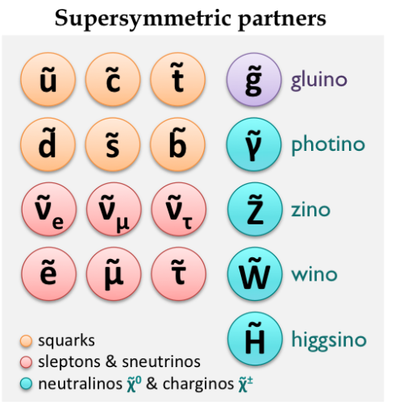
All elementary particles
All observed particles are shown below right (many Nobel prizes for detection).
Lightest Supersymmetric particles (like neutralinos) could be dark matter candidates.

Slide 17
Few points to note
There are so many high energy physics papers looking for dark matter tracks using different new physics theories like supersymmetry or string theory:
most papers from CERN, NASA, SLAC, DESY, and Fermilab are available in inspirehep site.
more papers in particle physics compared to cosmology due to number of experiments and countries budget
After dealing with api to download papers, should consider
spacing – sometimes particles are written in different formats like space, dash between words
choose word embedding algorithms
Your feedback is welcome and appreciated

Slide 18
Backup

Slide 19
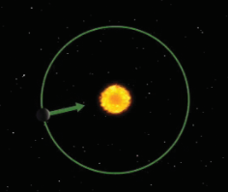
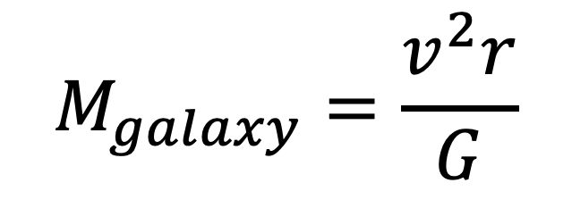
Uniform circular motion (classical)
Orbital Speed Depends on the Mass of the Central Object
$$M_{galaxy}=\frac{v^{2}r}{G}$$

Slide 20
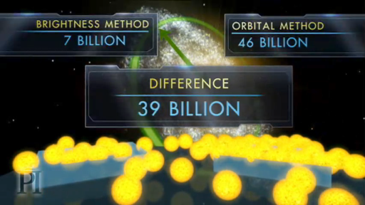
Definition of Key Variables
Galaxies are More Massive Than it Looks
Values based on Solar mass

Slide 21
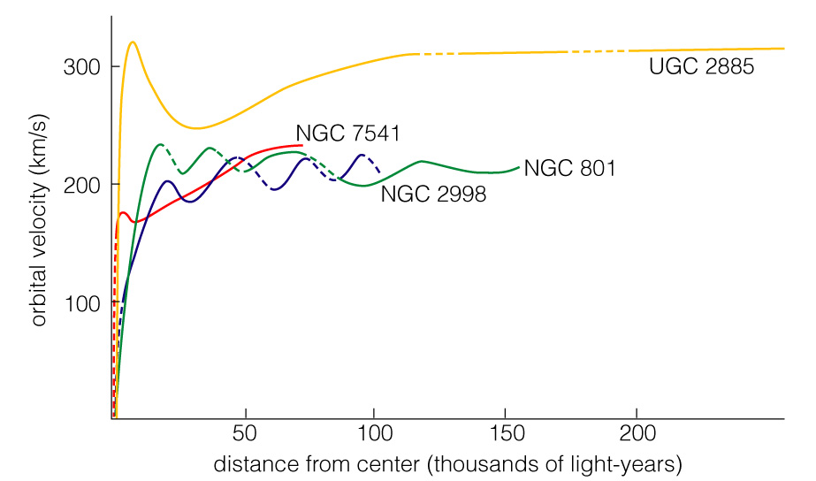
Definition of Key Variables
Spiral galaxies all tend to have flat rotation curves indicating large amounts of dark matter

Slide 22
Definition of Key Variables
The visible portion of a galaxy lies deep in the heart of a large halo of dark matter

Slide 23
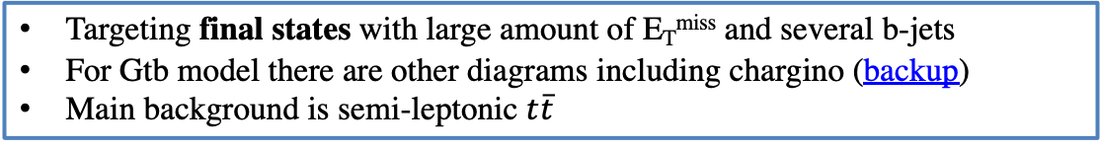
Simplified Supersymmetry Models
Target gluino pair production (strong SUSY) with off-shell top and bottom squarks in their decay products
Gtt (1L/0L)
Gbb (0L)
Gtb
Targeting final states with large amount of E_{T}^{miss} and several b-jets
For Gtb model there are other diagrams including chargino (backup)
Main background is semi-leptonic $t\overline{t}$

Slide 24
CCA Background-only Fit Results
VRs
Full set of detector systematics and theory systematics are included in the fit. More studies are ongoing for QCD and RW systematic effects
For each SR, ttbar norm-factor is derived in CRs and validated in VRs. Observe no significant pulls in the VRs
CRs
SRs

Slide 25
NN Background-only Fit Results
Background-only fit results for Gtt (top) and Gbb (bottom) regions. Like CCA analysis, ttbar norm-factor is derived and validated in the CRs and VRs. Statistical and all systematic uncertainties are included
Gtt
Gbb

