Slide 1

Jet tagging with ML Analysis
Meisam Ghasemi Bostanabad
Analysis meeting
2024-01-27

Slide 2
Related works
Several ATLAS/CMS groups have been working on jet tagging by ML (classification task) and report state-of-the-art models:
Particle Transformer for Jet Tagging
How Much Information is in a Jet?
N-Jettiness: An Inclusive Event Shape to Veto Jets
Identifying Boosted Objects with N-subjettiness
Maximizing Boosted Top Identification by Minimizing N-subjettiness
In addition to kinematics (energy and momentum), other variables such as charges, trajectory displacement and N-Jettiness are good options to be fed as the inputs for ML training.
All papers used more than 10M signal+bkg events with CUDA cores to speed up the training and surpass the previous state-of-the-art.

Slide 3
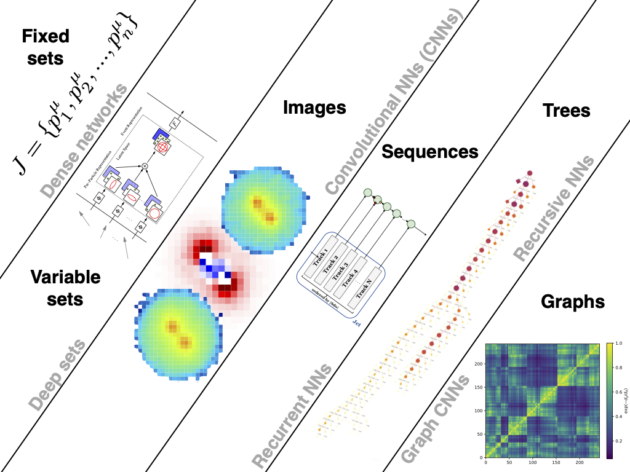
Jet representations and ML models
In any machine learning problem, how we represent the data often has a large impact on the performance of the models we train. For jet tagging, the most common approaches one finds in the literature include:
Jets as images: A jet image is a pixelated grayscale image, where the pixel intensity represents the energy (or transverse momentum) of all particles that deposited in a particular location in the detector plane (CNN).
Jets as sequences. Here the idea is to order the particles in a jet (usually by p_{T}) and use sequence-based architectures like recurrent neural networks (RNNs).
Jets as graphs. This approach treats each jet as a generic graph of nodes and edges. Graph neural networks (which we’ll also encounter later in the course) excel on this type of data.

