Slide 1
Machine Learning Lecture 3: Regularization, Decision trees, Random Forests
Mohamad GHASSANY
EFREI Paris

Slide 2
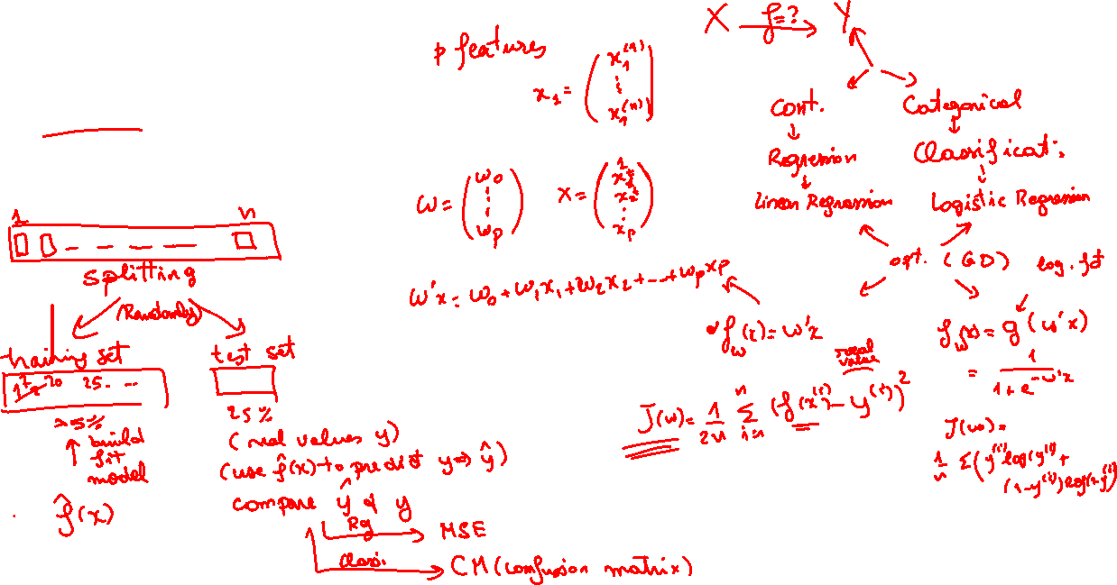
Regression and Classification
Supervised learning
Target variable type
Hypothesis
Cost function
Optimization
Sampling

Slide 3

The problem of overfitting

Slide 4
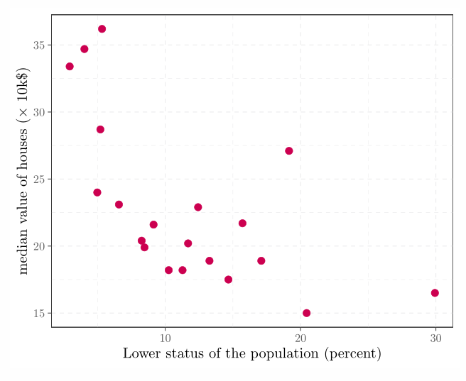
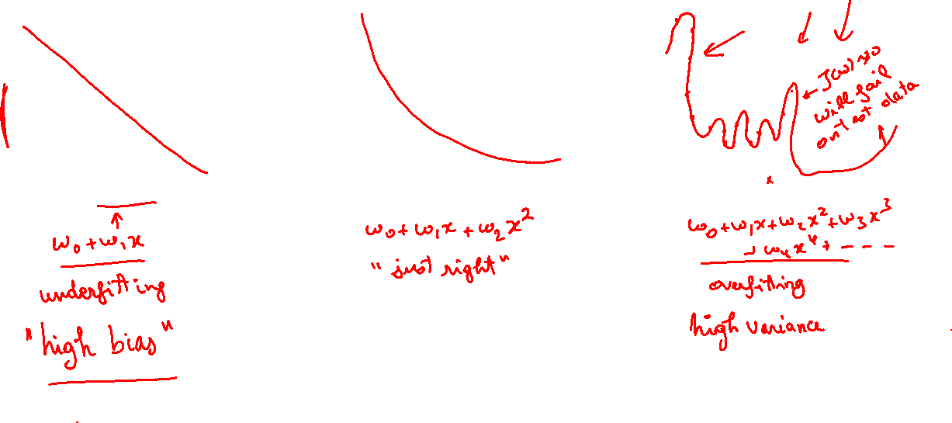
Overfitting: Regression example

Slide 5
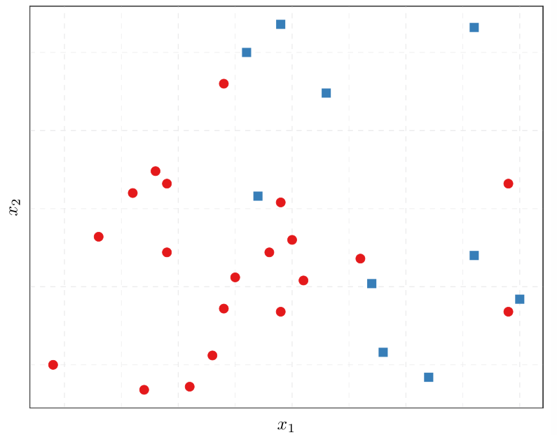
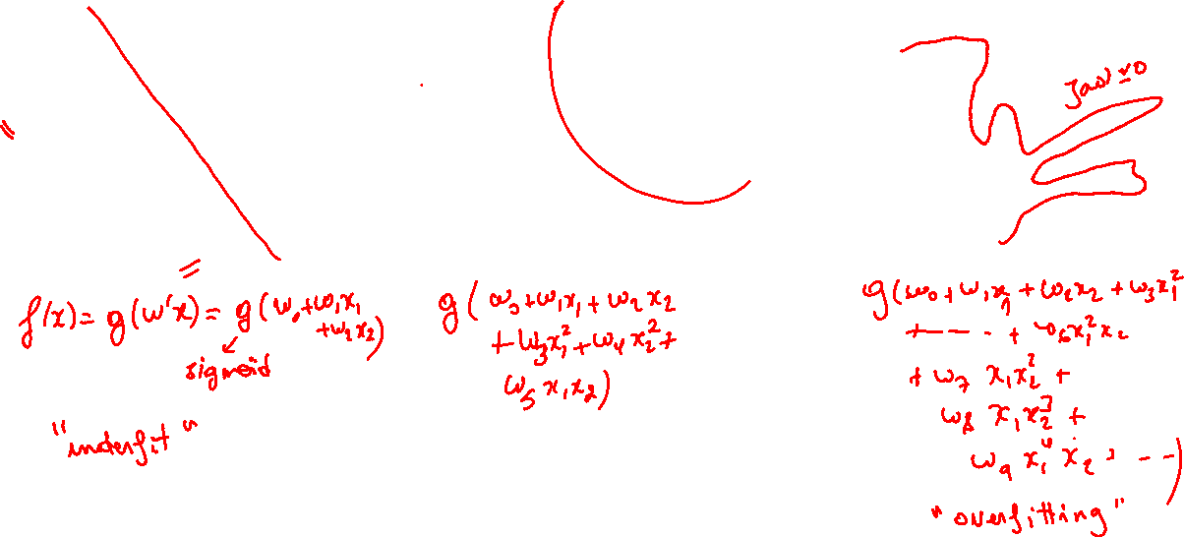
Overfitting: Logistic Regression example

Slide 6
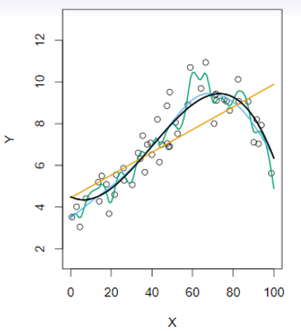
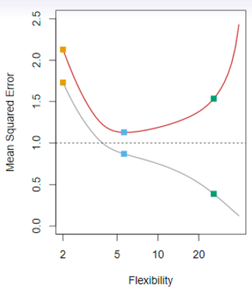
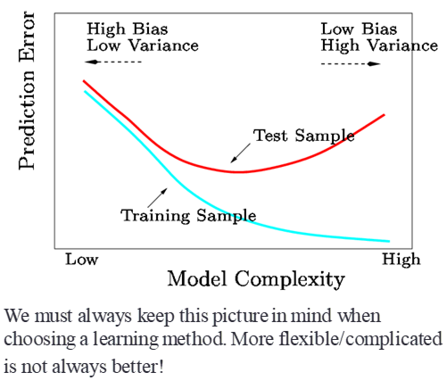
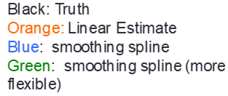
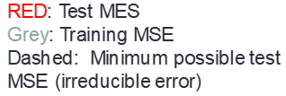
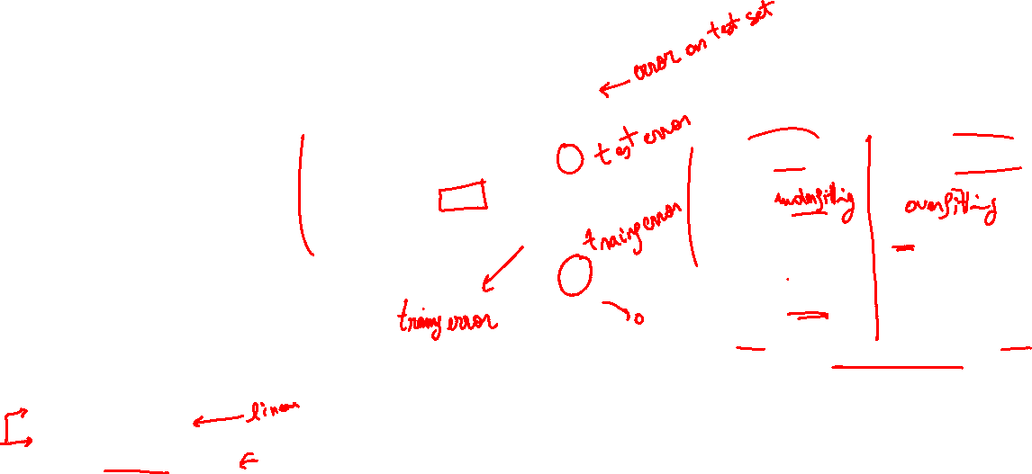
Underfitting/Overfitting Trade off

Slide 7
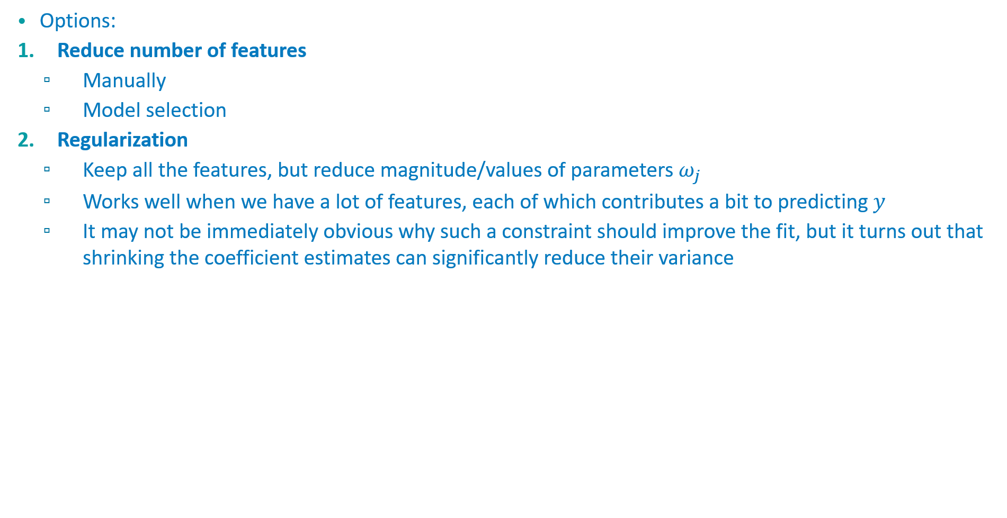
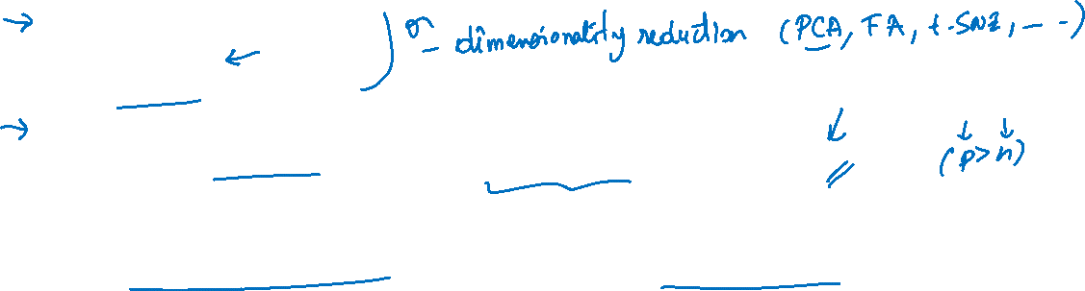
Adressing overfitting
Options:
Reduce number of features
Manually
Model selection
Regularization
Keep all the features, but reduce magnitude/values of parameters $ω_{j}$
Works well when we have a lot of features, each of which contributes a bit to predicting $y$
It may not be immediately obvious why such a constraint should improve the fit, but it turns out that shrinking the coefficient estimates can significantly reduce their variance

Slide 8
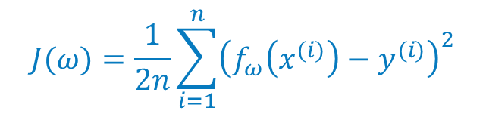
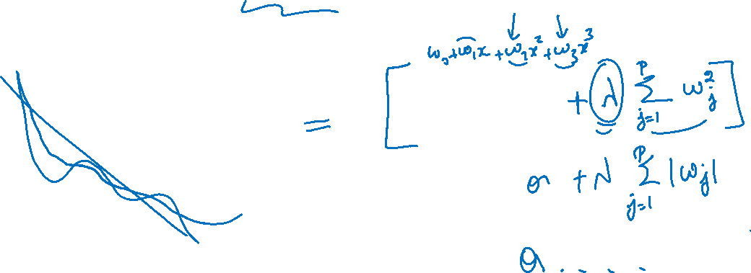
Regularization: Cost function
$$J(ω)=\frac{1}{2n}\sum_{i=1}^{n}{{\left(f_{ω}\left(x^{(i)}\right)−y^{(i)}\right)}^{2}}$$

Slide 9

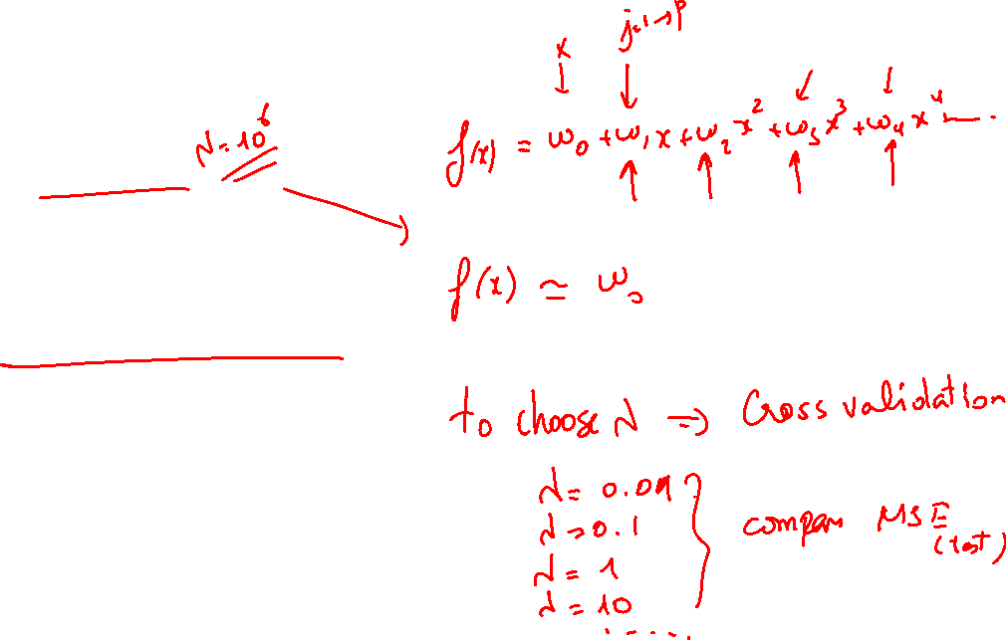
Choice of $λ$
$J(ω)=\frac{1}{2n}[\sum_{i=1}^{n}{{\left(f_{ω}\left(x^{(i)}\right)−y^{(i)}\right)}^{2}+λ\sum_{j=1}^{p}{w_{j}^{2}}] }$
Choice of $λ$
What happens if $λ$ is large ?

Slide 10
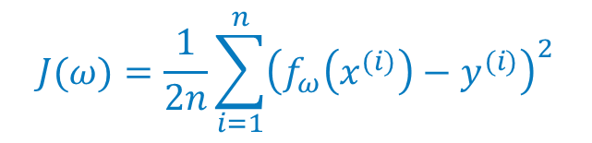
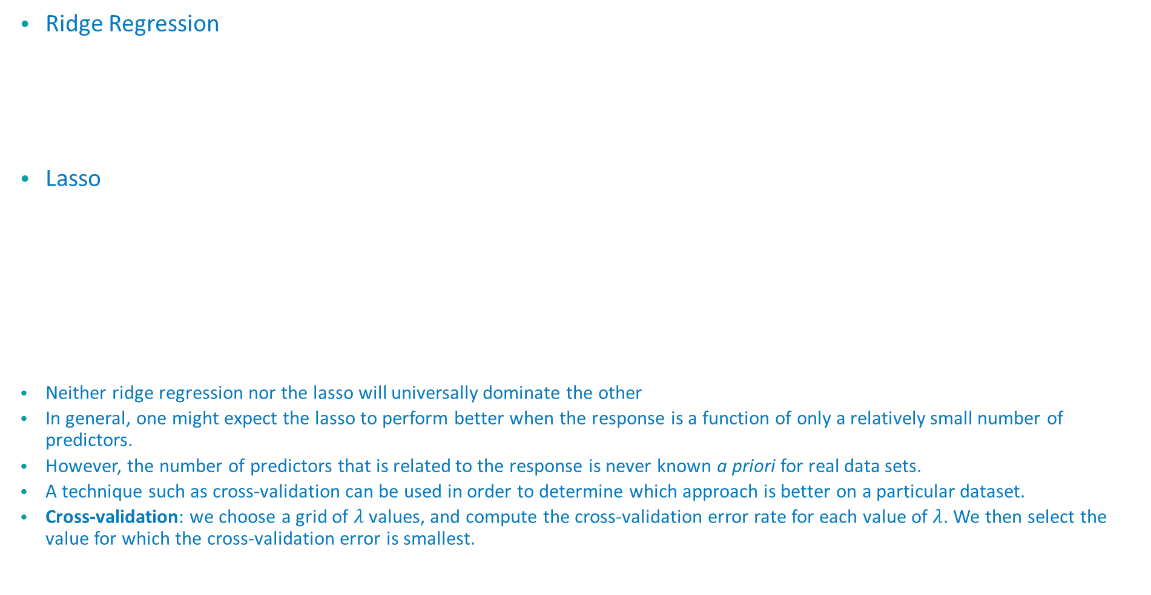
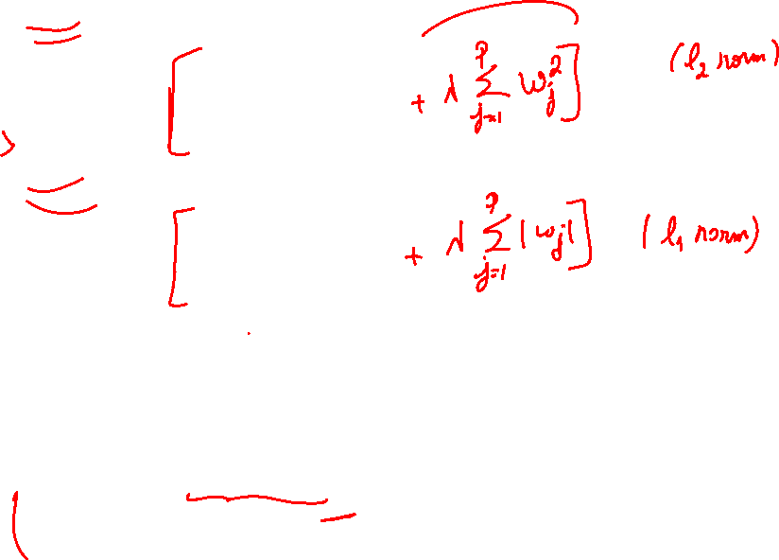

Ridge Regression and Lasso
Ridge Regression
Lasso
Neither ridge regression nor the lasso will universally dominate the other
In general, one might expect the lasso to perform better when the response is a function of only a relatively small number of predictors.
However, the number of predictors that is related to the response is never known a priori for real data sets.
A technique such as cross-validation can be used in order to determine which approach is better on a particular dataset.
Cross-validation: we choose a grid of $λ$ values, and compute the cross-validation error rate for each value of $λ$. We then select the value for which the cross-validation error is smallest.
$$J(ω)=\frac{1}{2n}\sum_{i=1}^{n}{{\left(f_{ω}\left(x^{(i)}\right)−y^{(i)}\right)}^{2}}$$
$$J(ω)=\frac{1}{2n}\sum_{i=1}^{n}{{\left(f_{ω}\left(x^{(i)}\right)−y^{(i)}\right)}^{2}}$$

Slide 11
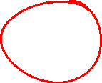
Regularization for Linear Regression

Slide 12

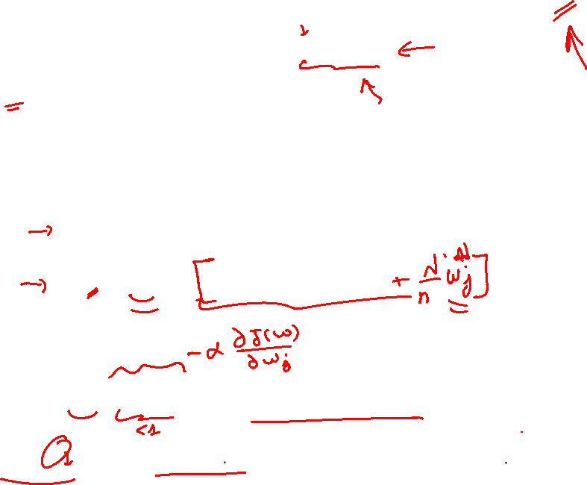
Regularized Linear Regression: GD
$J(ω)=\frac{1}{2n}[\sum_{i=1}^{n}{{\left(f_{ω}\left(x^{(i)}\right)−y^{(i)}\right)}^{2}+λ\sum_{j=1}^{p}{w_{j}^{2}}] }$
$\min_{ω}{J(ω)}$
Using GD:
initialize$ω_{j}$ randomly
repeat until convergence{
$ω_{0}^{new}=ω_{0}^{old}−α\frac{1}{n}\sum_{i=1}^{n}{\left(f_{ω}\left(x^{(i)}\right)−y^{(i)}\right)}$
$ω_{j}^{new}=ω_{j}^{old}−α \frac{1}{n}\sum_{i=1}^{n}{\left(f_{ω}\left(x^{(i)}\right)−y^{(i)}\right)}.x_{j}^{(i)}$ $\text{simultaneously} \text{for} \text{every} j=1,…,p$
}
$ω_{j}^{new}=ω_{j}^{old}(1−α\frac{λ}{n})−α\frac{1}{n}\sum_{i=1}^{n}{\left(f_{ω}\left(x^{(i)}\right)−y^{(i)}\right)}.x^{(i)}$
$(1−α\frac{λ}{n})$ will always be less than 1

Slide 13

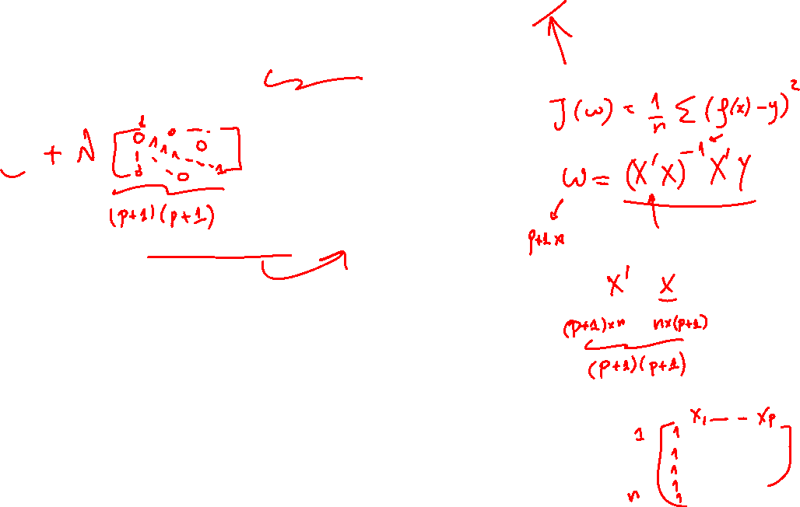
Regularized Linear Regression: OLS
$J(ω)=\frac{1}{2n}[\sum_{i=1}^{n}{{\left(f_{ω}\left(x^{(i)}\right)−y^{(i)}\right)}^{2}+λ\sum_{j=1}^{p}{w_{j}^{2}}] }$
$\min_{ω}{J(ω)}$
$ω=(X^{′}X{ )}^{−1}X^{′}y$
Using regularization takes care also of non-invertibility problem

Slide 14
Regularization for Logistic Regression

Slide 15

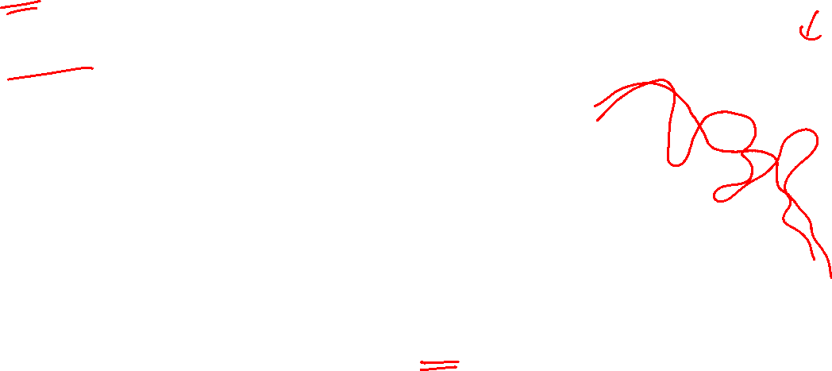
Regularized Logistic Regression
$J(ω)=−\frac{1}{n}\sum_{i=1}^{n}{y^{(i)}}\text{log}f_{ω}\left(x^{(i)}\right)+\left(1−y^{(i)}\right)\text{log}\left(1−f_{ω}\left(x^{(i)}\right)\right)$ $+\frac{λ}{2n}\sum_{j=1}^{p}{ω_{j}^{2}}$
$\min_{ω}{J(ω)}$
Using GD:
initialize$ω_{j}$ randomly
repeat until convergence{
$ω_{0}^{new}=ω_{0}^{old}−α\frac{1}{n}\sum_{i=1}^{n}{\left(f_{ω}\left(x^{(i)}\right)−y^{(i)}\right)}$
$ω_{j}^{new}=ω_{j}^{old}−α[\frac{1}{n}\sum_{i=1}^{n}{\left(f_{ω}\left(x^{(i)}\right)−y^{(i)}\right)}.x^{(i)}+\frac{λ}{n}ω_{j}] \text{simultaneously} \text{for} \text{every} j=1,…,p$
}

Slide 16
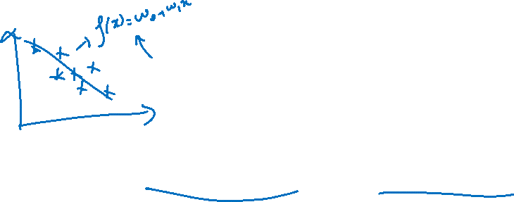
Data modelling vs Algorithmic modelling

Slide 17
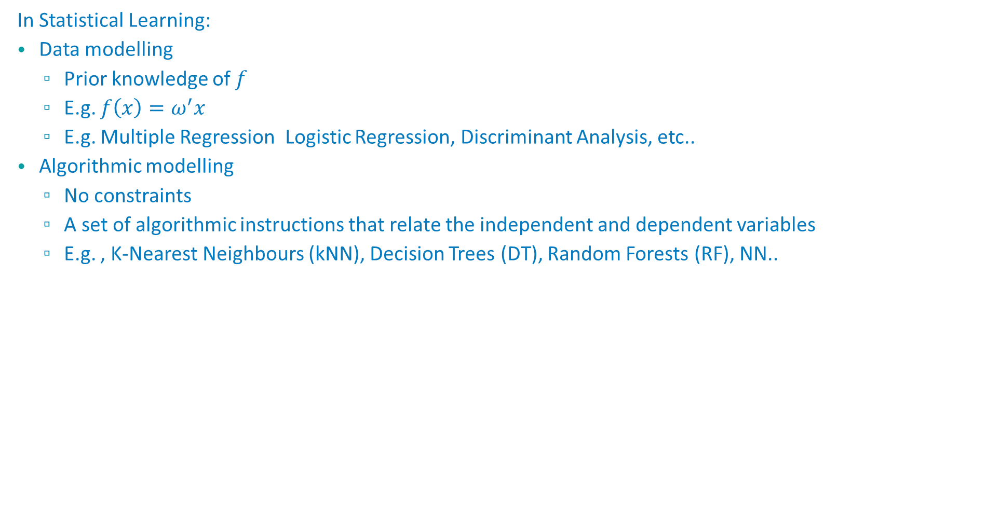
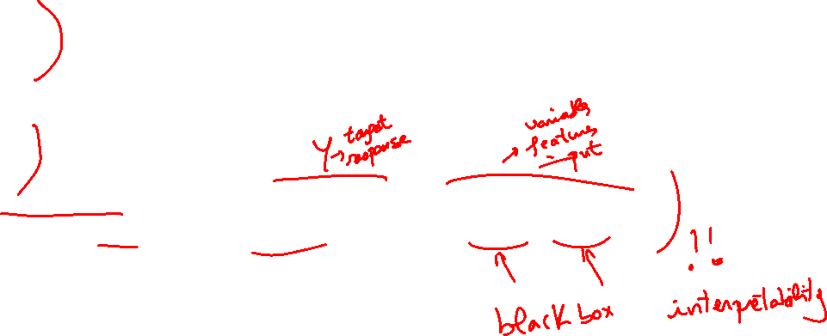
Data modelling vs Algorithmic modelling
In Statistical Learning:
Data modelling
Prior knowledge of $f$
E.g. $f\left(x\right)=ω^{′}x$
E.g. Multiple Regression Logistic Regression, Discriminant Analysis, etc..
Algorithmic modelling
No constraints
A set of algorithmic instructions that relate the independent and dependent variables
E.g. , K-Nearest Neighbours (kNN), Decision Trees (DT), Random Forests (RF), NN..

Slide 18
K-Nearest Neighbors (kNN)

Slide 19
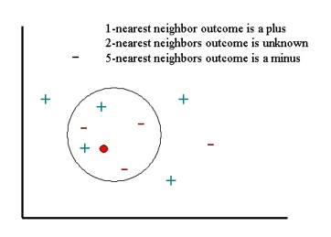
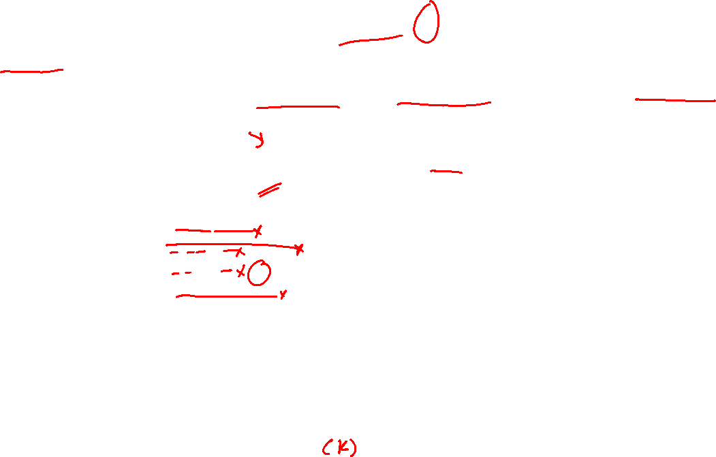
K-Nearest Neighbors (kNN)
A non parametric method used for regression and classification.
The kNN algorithm assumes that similar things exist in close proximity. In other words, similar things are near to each other.
Need to choose only the number of nearest neighbors and a distance

Slide 20
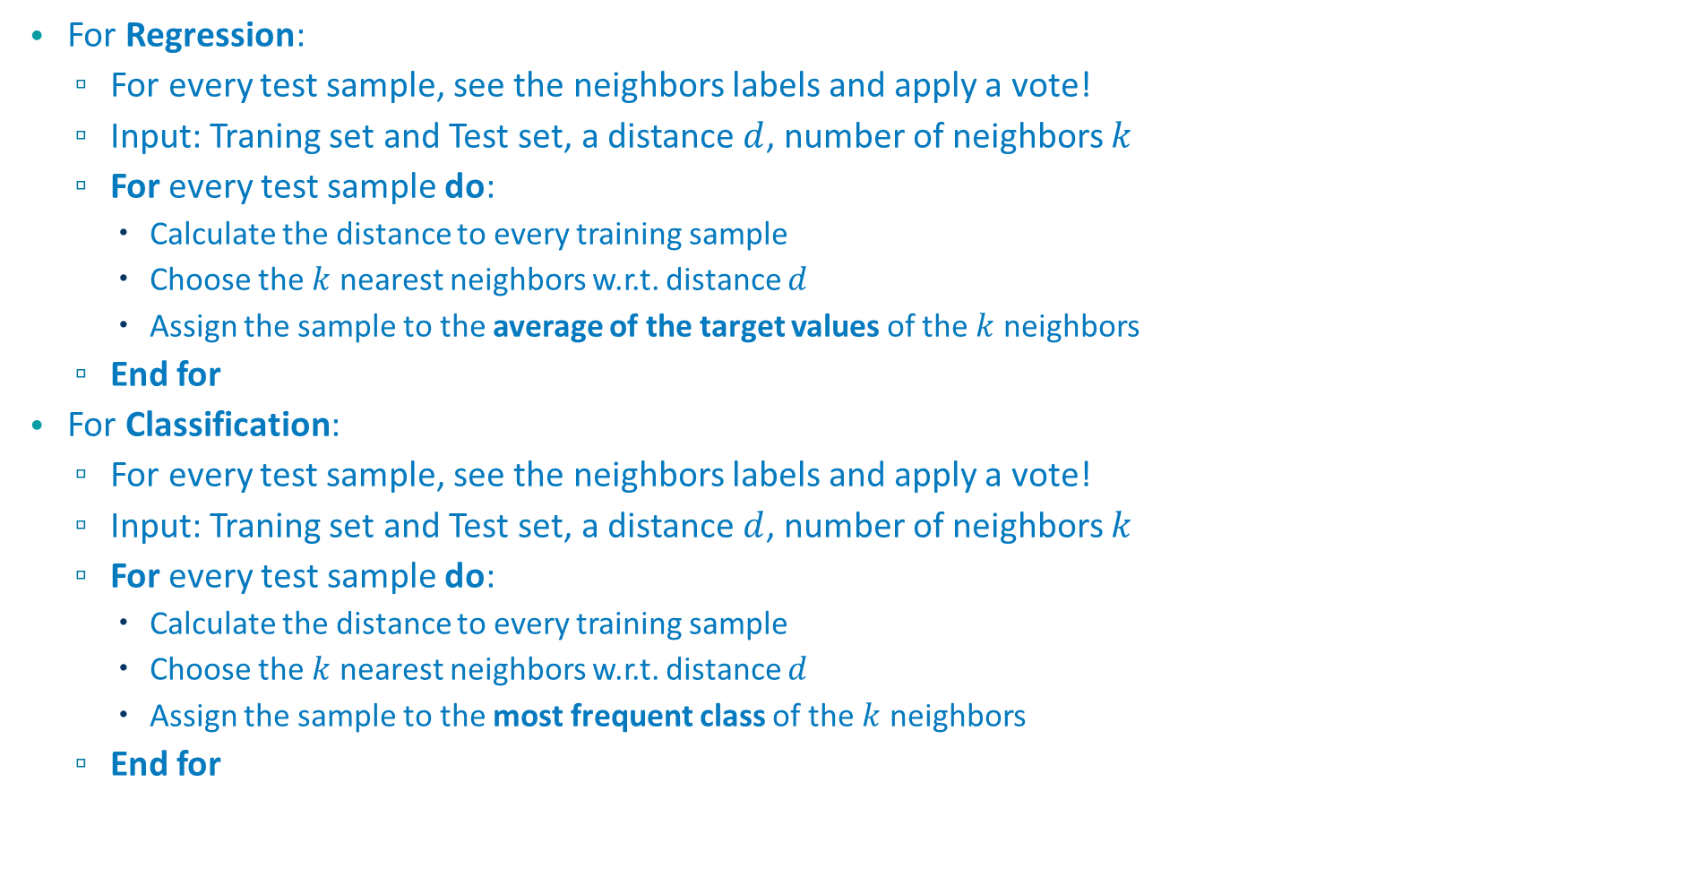

kNN Algorithm
For Regression:
For every test sample, see the neighbors labels and apply a vote!
Input: Traning set and Test set, a distance $d$, number of neighbors $k$
For every test sample do:
Calculate the distance to every training sample
Choose the $k$ nearest neighbors w.r.t. distance $d$
Assign the sample to the average of the target values of the $k$ neighbors
End for
For Classification:
For every test sample, see the neighbors labels and apply a vote!
Input: Traning set and Test set, a distance $d$, number of neighbors $k$
For every test sample do:
Calculate the distance to every training sample
Choose the $k$ nearest neighbors w.r.t. distance $d$
Assign the sample to the most frequent class of the $k$ neighbors
End for

Slide 21

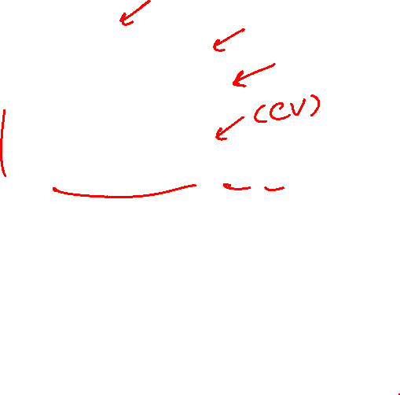
kNN pros and cons
Pros:
Simple
Do like neighbors
Sometimes effective
Cons:
Need to choose $k$
Heavy calculations if $n$ or $p$ are large

Slide 22
Cross Validation

Slide 23
Cross Validation
Cross-validation is a resampling procedure used to evaluate machine learning models on a limited data sample. ... That is, to use a limited sample in order to estimate how the model is expected to perform in general when used to make predictions on data not used during the training of the model.
The general procedure is as follows:
Shuffle the dataset randomly.
Split the dataset into k groups
For each unique group:
Take the group as a hold out or test data set
Take the remaining groups as a training data set
Fit a model on the training set and evaluate it on the test set
Retain the evaluation score and discard the model
Summarize the skill of the model using the sample of model evaluation scores

Slide 24
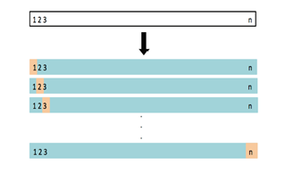
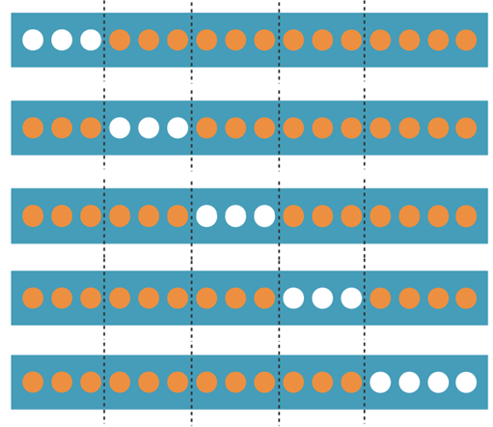
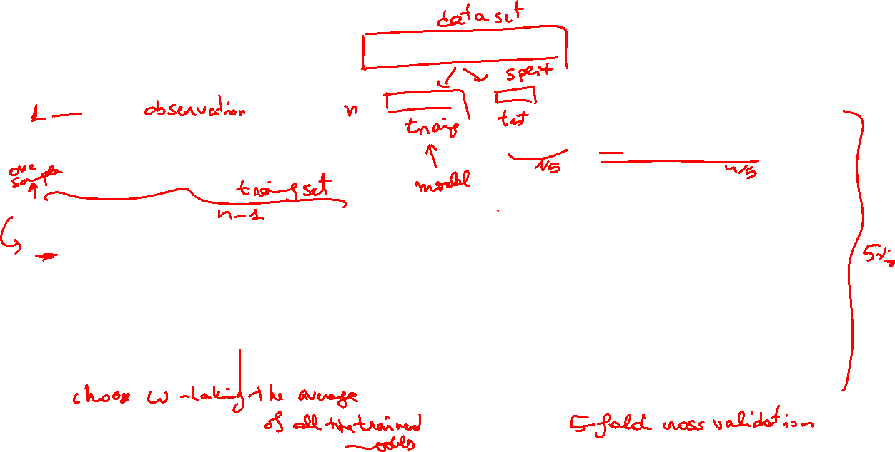
Cross Validation

Slide 25
Decision Trees

Slide 26
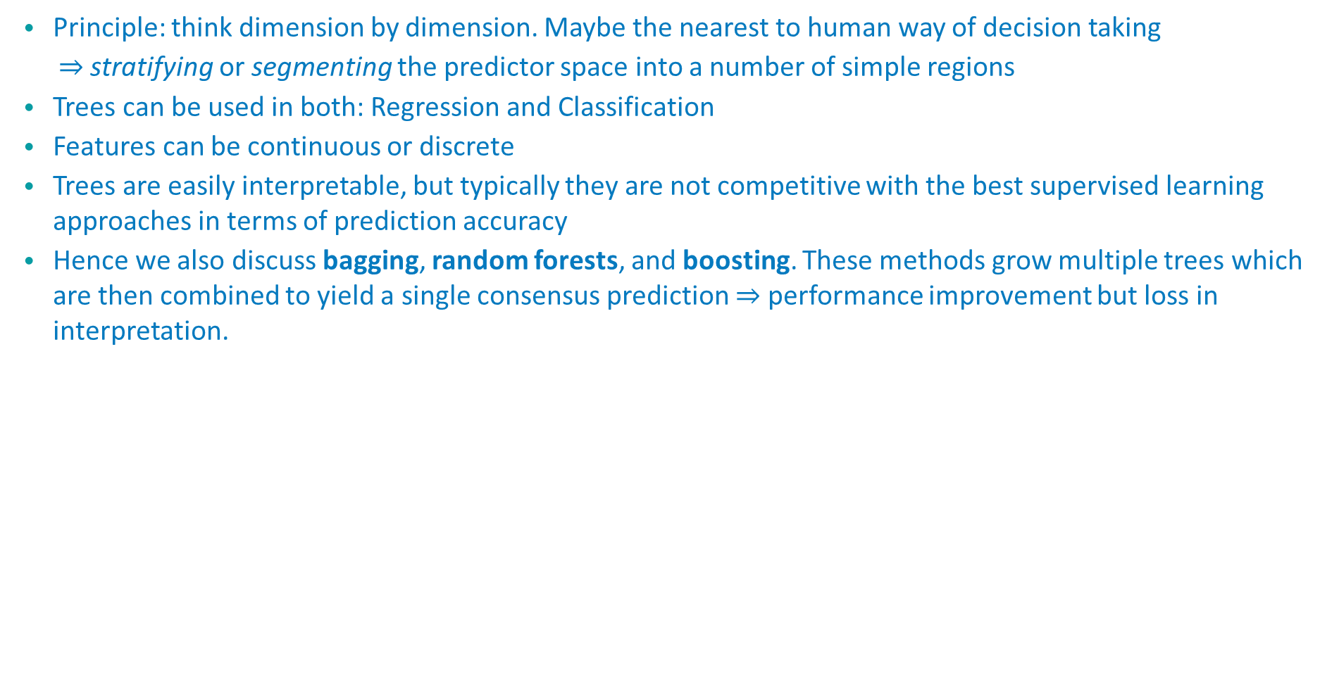
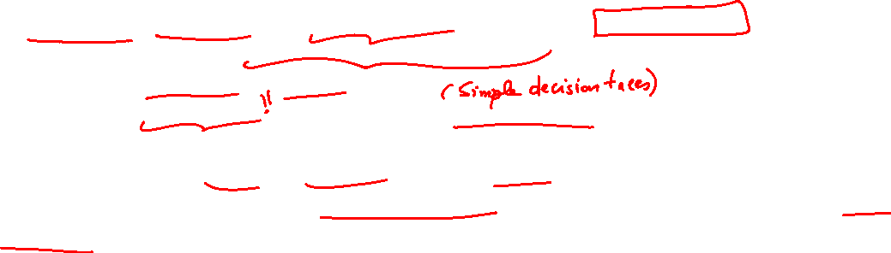
Decision Trees
Principle: think dimension by dimension. Maybe the nearest to human way of decision taking
$⇒$ stratifying or segmenting the predictor space into a number of simple regions
Trees can be used in both: Regression and Classification
Features can be continuous or discrete
Trees are easily interpretable, but typically they are not competitive with the best supervised learning approaches in terms of prediction accuracy
Hence we also discuss bagging, random forests, and boosting. These methods grow multiple trees which are then combined to yield a single consensus prediction $⇒$ performance improvement but loss in interpretation.

Slide 27
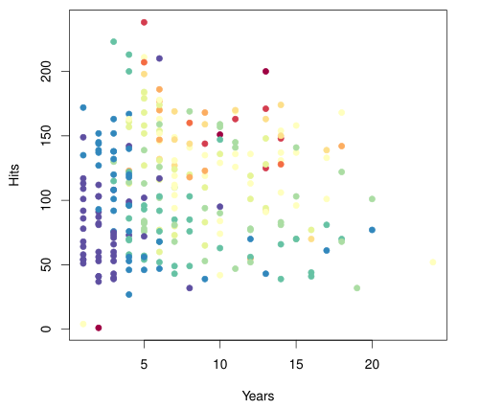
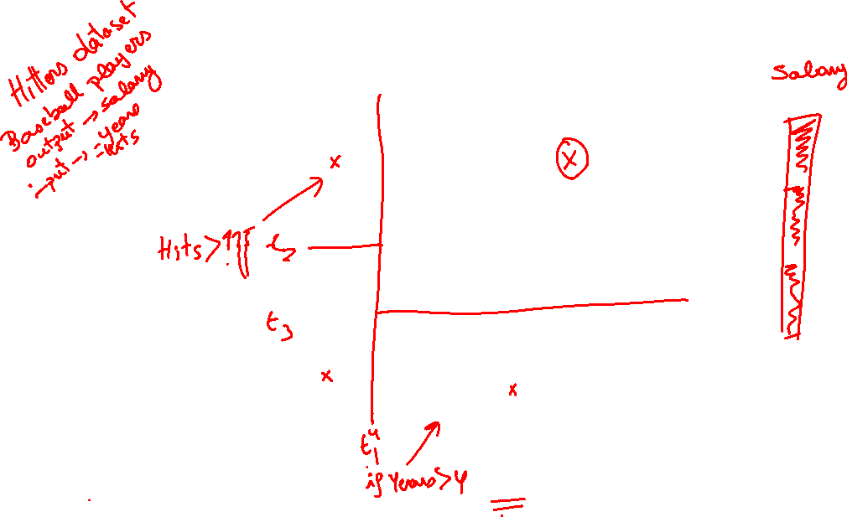
Decision Trees: Intuition

Slide 28
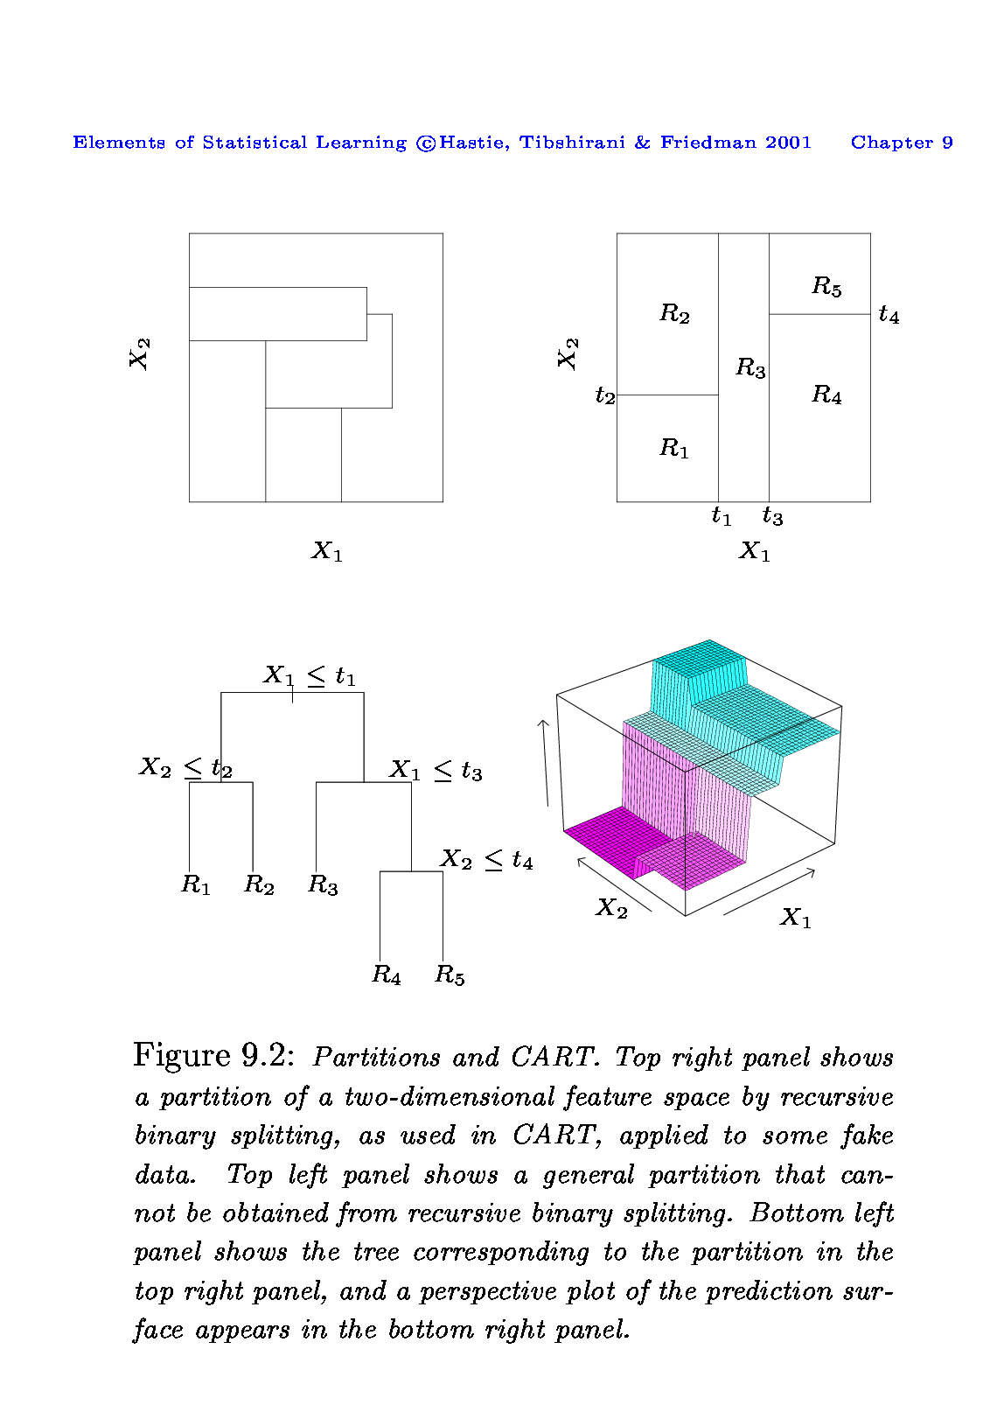
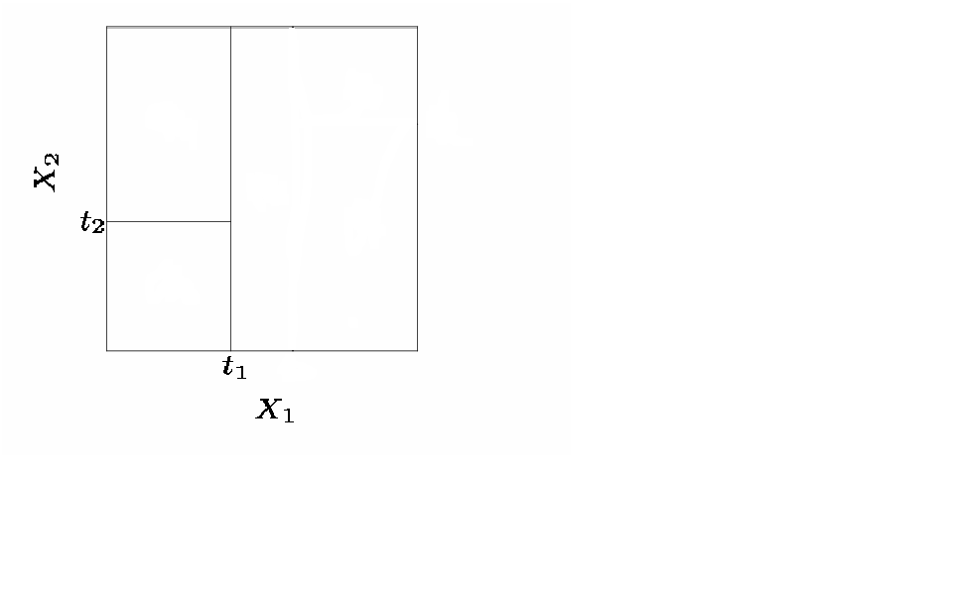
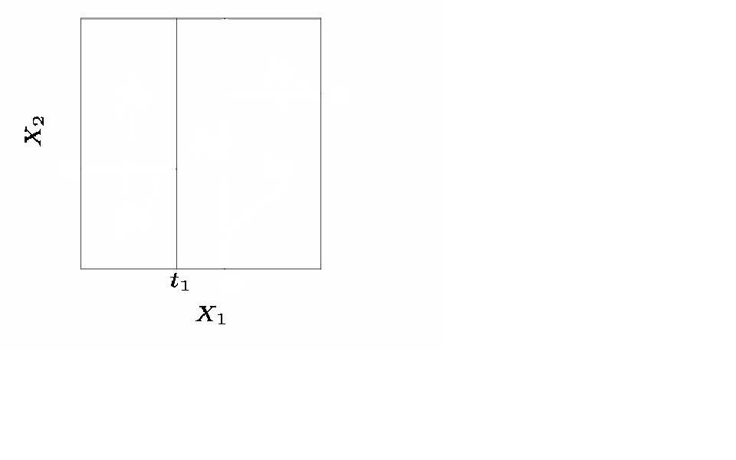
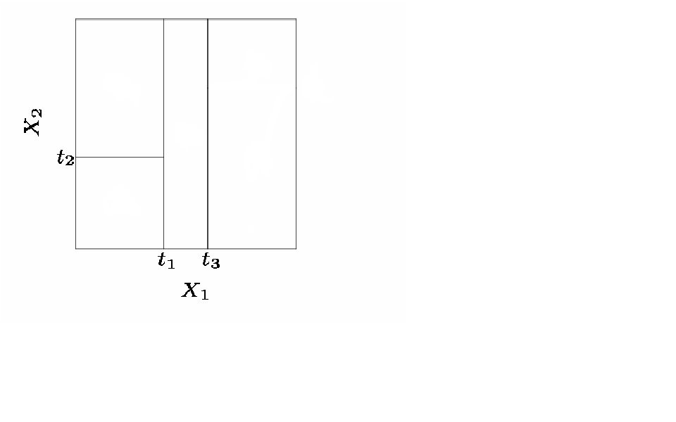
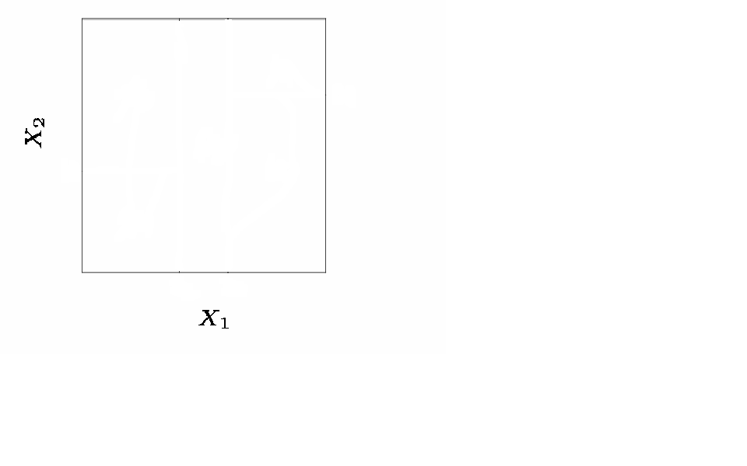
Decision Trees: principle
Generally we create the partitions by iteratively splitting one of the X variables into two regions
First split on X1=t1
If X₁<t₁, split on X₂=t₂
If X₁>t₁, split on X₁=t₃
If X₁>t₃, split on X₂=t₄

Slide 29
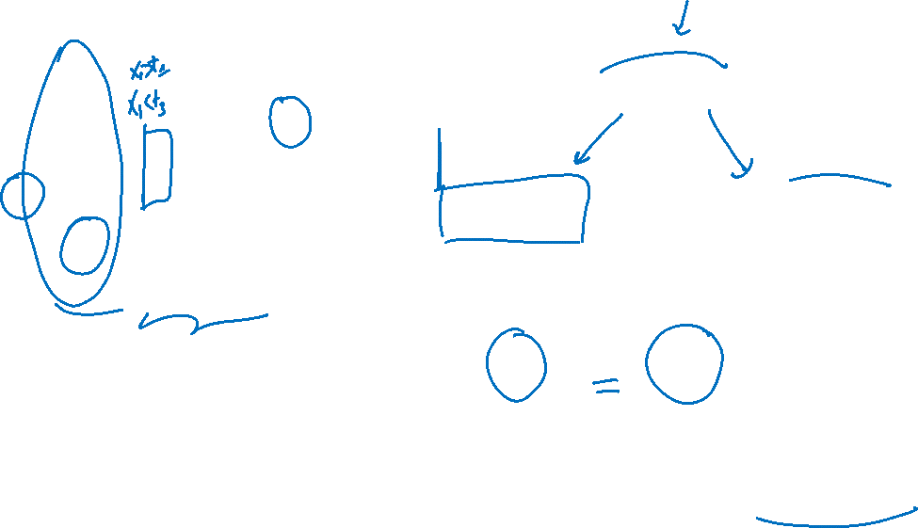
Decision Trees: principle
When we create partitions this way we can always represent them using a tree structure.
This provides a very simple way to explain the model to a non-expert i.e. your boss!

Slide 30
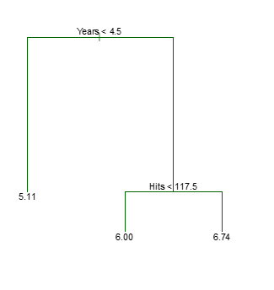
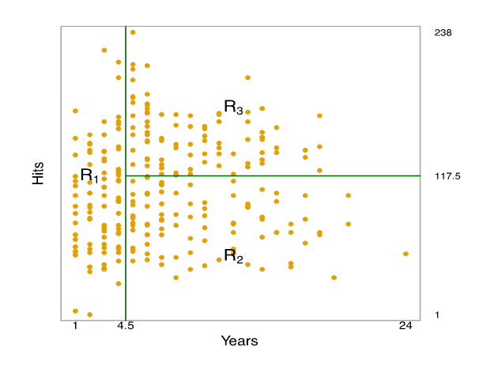

Decision Tree for Regression

Slide 31

Decision Trees: Terminology
In keeping with the tree analogy, the regions R1, R2, and R3 are known as terminal nodes
Decision trees are typically drawn upside down, in the sense that the leaves are at the bottom of the tree.
The points along the tree where the predictor space is split are referred to as internal nodes

Slide 32


Important questions
What are the predicted values ?
How do we cut ?
In theory, the regions could have any shape. However, we choose to divide the predictor space into high-dimensional rectangles, or boxes, for simplicity and for ease of interpretation of the resulting predictive model.
The goal is to find boxes R1, . . . , RJ that minimize $\sum_{\left\{j=1\right\}}^{J}{\sum_{\left\{i∈R_{j}\right\}}{{\left(y_{i}−{\hat{y}}_{R_{j}}\right)}^{2}}}$ where${ \hat{y}}_{R_{j}}$ is the mean response for the training observations within the $j$th box.
It is computationally infeasible to consider every possible partition of the feature space into $J$boxes.
For this reason, we take a top-down, greedy approach that is known as recursive binary splitting.
Predictions: We predict the response for a given test observation using the mean of the training observations in the region to which that test observation belongs.

Slide 33


Pruning
The process described before may produce good predictions on the training set, but is likely to overfit the data
$⇒$A smaller tree with fewer splits (that is, fewer regions R1, . . . , RJ)
Strategy: grow a very large tree $T_{0}$ , and then prune it back in order to obtain a subtree
Cost complexity pruning is used to do this
A tuning parameter $α$ controls a trade-off between the subtree’s complexity and its fit to the training data
We select an optimal value of $α$ using cross-validation.
We then return to the full data set and obtain the subtree corresponding to the optimal value of $α$

Slide 34


Pruning
Consider the ozone data set¹. The data set consists of 111 observations on the following variables:
ozone : the concentration of ozone in ppb
radiation: the solar radiation (langleys)
temperature : the daily maximum temperature in degrees F
wind : wind speed in mph
## ozone radi temp wind ## 1 41 190 67 7.4 ## 2 36 118 72 8.0 ## 3 12 149 74 12.6 ## 4 18 313 62 11.5 ## 5 23 299 65 8.6
We see that temperature is the “most important” predictor for predicting the ozone concentration. Observe that we can split on the same variable several times.
1. https://web.stanford.edu/~hastie/ElemStatLearn/datasets/ozone.info.txt

Slide 35


Deeper Tree: overfitting?

Slide 36

Building a regression tree: Algorithm
Use recursive binary splitting to grow a large tree on the training data, stopping only when each terminal node has fewer than some minimum number of observations.
Apply cost complexity pruning to the large tree in order to obtain a sequence of best subtrees, as a function of $α$.
Use $K$-fold cross-validation to choose $α$. That is, divide the training observations into $k$ folds. For each $k=1,…,K$:
Repeat Steps 1 and 2 on all but the $k$th fold of the training data.
Evaluate the mean squared prediction error on the data in the left-out $k$th fold, as a function of $α$.
Average the results for each value of $α$, and pick $α$ to minimize the average error.
Return the subtree from Step 2 that corresponds to the chosen value of $α$.

Slide 37



Pruning the ozone tree

Slide 38
Decision Trees for Classification

Slide 39

Decision Trees for Classification
Now allow for 𝐾≥2 number of classes for the response.
Building a decision tree in this setting is similar to building a regression tree for a quantitative response, but there are two main differences: the prediction and the splitting criterion.

Slide 40


Decision Trees for Classification
1) The prediction:
In the regression case we use the mean value of the responses in $R_{j}$ as a prediction for an observation that falls into region $R_{j}$.
For the classification case, however, we have two possibilities:
Majority vote: Predict that the observation belongs to the most commonly occurring class of the training observations in $R_{j}$
Estimate the probability that an observation $x_{i}$ belongs to a class $k$, ${\hat{p}}_{jk}(x_{i})$, given as the proportion of class $k$ training observations in region $R_{j}.$
Region $j$ has $N_{j}$ observations and with $n_{jk}$ observations lying in class k:
$${\hat{p}}_{jk}=\frac{1}{N_{j}}\sum_{i:x_{i}∈R_{j}}^{​}{I}(y_{i}=k)=\frac{n_{jk}}{N_{j}}.$$

Slide 41





Decision Trees for Classification
2) The splitting criterion: We can use some measure of impurity of the node. For leaf node $j$ and class $k=1,…,K$:
Gini index:
$G=\sum_{k=1}^{K}{{\hat{p}}_{jk}}(1−{\hat{p}}_{jk}) ,$
which is small if all of the ${\hat{p}}_{jk}$’s are close to 0 or 1.
Cross entropy:
$D=−\sum_{k=1}^{K}{{\hat{p}}_{jk}}\text{log}{\hat{p}}_{jk} .$
Since $0≤{\hat{p}}_{jk}≤1$, it follows that $0≤−{\hat{p}}_{jk}\text{log}{\hat{p}}_{jk}$, with values near zero of ${\hat{p}}_{jk}$ is close to 0 or 1.
When making a split in our classification tree, we want to minimize the Gini index or the cross-entropy.
Gini = 0,94
Gini : 4/55 × 2/26 × 2/29 + 51/55 × 24/26 × 27/29 = 0,79
Gini = 0,24

Slide 42


From trees to forests
Advantages (+)
Trees automatically select variables.
Tree-growing algorithms scale well to large $n$, growing a tree greedily.
Trees can handle mixed features (continuous, categorical) seamlessly, and can deal with missing data.
Small trees are easy to interpret and explain to people.
Some believe that decision trees mirror human decision making.
Trees can be displayed graphically.
Disadvantages (-)
Large trees are not easy to interpret.
Trees do not generally have good prediction performance (high variance).
Trees are not very robust, a small change in the data may cause a large change in the final estimated tree.

Slide 43

What is next?
Several of the listed disadvantages can be addressed by
Bagging: grow many trees (from bootstrapped data) and average - to get rid of the non-robustness and high variance by averaging.
Random forests: inject more randomness (and even less variance) by just allowing a random selection of predictors to be used for the splits at each node.
Boosting: make one tree, then another based on the residuals from the previous, repeat. The final predictor is a weighted sum of these trees.
In addition:
Variable importance - to see which variables make a difference (now that we have many trees).

Slide 44

Bagging (bootstrap aggregation)

Slide 45


Bagging
Decision trees often suffer from high variance. By this we mean that the trees are sensitive to small changes in the predictors: If we change the observation set, we may get a very different tree.
Another way to understand “high variance” is that, if we split our training data into two parts and fit a tree on each, we might get rather different decision trees.
To reduce the variance of decision trees we can apply bootstrap aggregating (bagging), invented by Leo Breiman in 1996.
Assume we have $B$ i.i.d. observations of a random variable $X$ each with the same mean and with variance $σ^{2}$. We calculate the mean $\overset{‾}{X}=\frac{1}{B}\sum_{b=1}^{B}{X_{b}}$. The variance of the mean is
$$\text{Var}(\overset{‾}{X})=\text{Var}(\frac{1}{B}\sum_{b=1}^{B}{X_{b}})=\frac{1}{B^{2}}\sum_{b=1}^{B}{\text{Var}}(X_{b})=\frac{σ^{2}}{B}.$$
By averaging we get reduced variance. This is the basic idea!
For decision trees, if we have $B$ training sets, we could estimate ${\hat{f}}_{1}(x),{\hat{f}}_{2}(x),…,{\hat{f}}_{B}(x)$ and average them as
$${\hat{f}}_{avg}(x)=\frac{1}{B}\sum_{b=1}^{B}{{\hat{f}}_{b}}(x) .$$
However, we do not have many independent data set - so we use bootstrapping to construct $B$ data sets.

Slide 46



Bagging
Bootsrapping: Draw with replacement $n$ observations from our sample - and that is our first bootstrap sample.
We repeat this $B$ times and get $B$ bootstrap samples - that we use as our $B$ data sets.
For each bootstrap sample $b=1,…,B$ we construct a decision tree, ${\hat{f}}^{∗b}(x)$.
For a regression tree, we take the average of all of the predictions and use this as the final result:
$${\hat{f}}_{bag}(x)=\frac{1}{B}\sum_{b=1}^{B}{{\hat{f}}^{∗b}}(x).$$
For a classification tree we record the predicted class (for a given observation $x$) for each of the $B$ trees and use the most occurring classification (majority vote) as the final prediction.
Source: link

Slide 47


Variable importance plots
Drawback of bagging: It becomes difficult to interpret the results. Instead of having one tree, the resulting model consists of many trees (it is an ensemble method).
Variable importance plots show the relative importance of the predictors: the predictors are sorted according to their importance, such that the top variables have a higher importance than the bottom variables.
There are in general two types of variable importance plots:
variable importance based on decrease in node impurity.
variable importance based on randomization.

Slide 48
Random Forests

Slide 49


Random Forests motivation
If there is a strong predictor in the dataset, the decision trees produced by each of the bootstrap samples in the bagging algorithm becomes very similar: Most of the trees will use the same strong predictor in the top split.
Not optimal, as we get 𝐵 trees that are highly correlated. → No large reduction in variance by averaging ${\hat{f}}^{∗b}(x)$ when the correlation between the trees is high.
Random forests provide an improvement over bagged trees by a small tweak that decorrelates the trees. This reduces the variance when we average the trees.
As in bagging, we build a number of decision trees on bootstrapped training samples.
But each time a split in a tree is considered, a random selection of 𝑚 predictors is chosen as split candidates from the full set of 𝑝 predictors. The split is allowed to use only one of those m predictors.
A fresh selection of 𝑚 predictors is taken at each split, typically
$m≈\sqrt{p}$ (classification),
$m=p/3$ (regression).
The general idea is that for very correlated predictors 𝑚 is chosen to be small.

Slide 50


Comparison

Slide 51
Boosting

Slide 52

Boosting

Slide 53

Boosting

Slide 54

Boosting

