Slide 1
Machine Learning II: Unsupervised Learning

Slide 2
Unsupervised Learning
Categorization
Clothes
Unsupervised Learning algorithms
Grouping by Similarity
Finding Frequent Patterns
Summarizing Key
Information
Finding Outliers
Dimensionality Reduction
Anomaly Detection
Make the best outfits from the given clothes
Identify clothing items that significantly differ from the rest of the collection.
Clustering
Association Rule Learning
PCA
Isolation Forest
Split up similar clothing into clusters
Find what clothes I often wear together
K-means
Out of scope of this module

Slide 3
Clustering

Slide 4
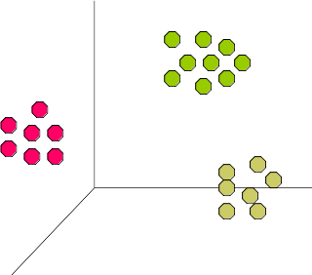
Clustering
Definitions
A Cluster is a collection of data objects:
  Similar to one another within the same cluster
  Dissimilar to the objects in other clusters
The quality of a clustering method depends on:
  the similarity measure used by the method.
  its ability to discover some or all of the hidden patterns.
Intra-cluster distances
Inter-cluster distances
A good clustering method will produce high quality clusters with:
  high intra-class similarity
  low inter-class similarity
Outliers are objects that do not belong to any cluster or form clusters of very small cardinality.
outliers

Slide 5
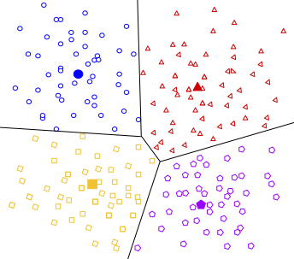
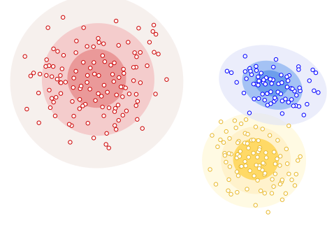
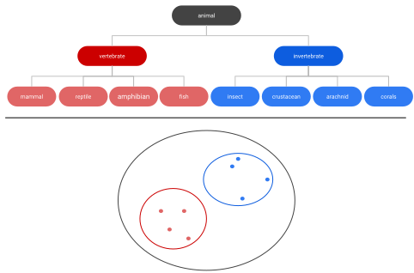
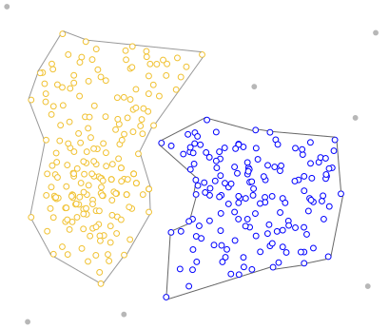
Clustering
Categories
Centroid-based Clustering
E.g. K-means, K-means++
Density-based Clustering
DBSCAN, OPTICS
Distribution-based Clustering
Gaussian Mixture Models (GMM)
Hierarchical Clustering
Agglomerative vs Divisive

Slide 6
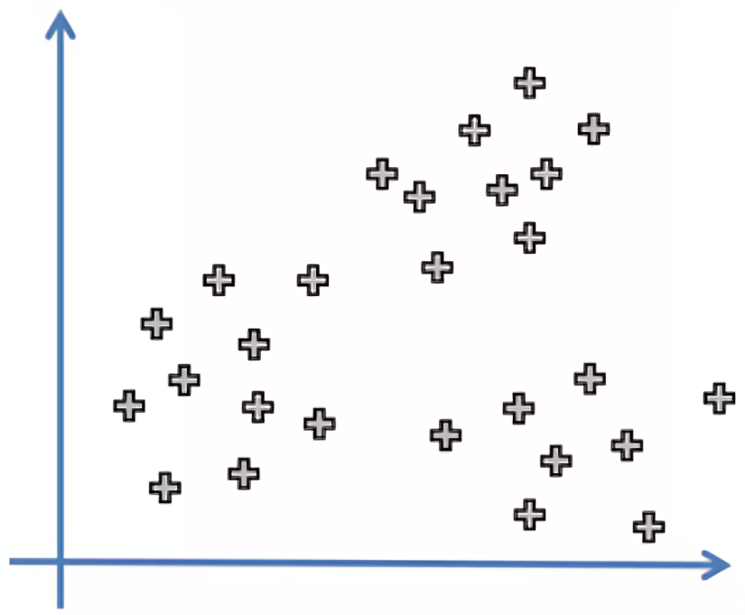
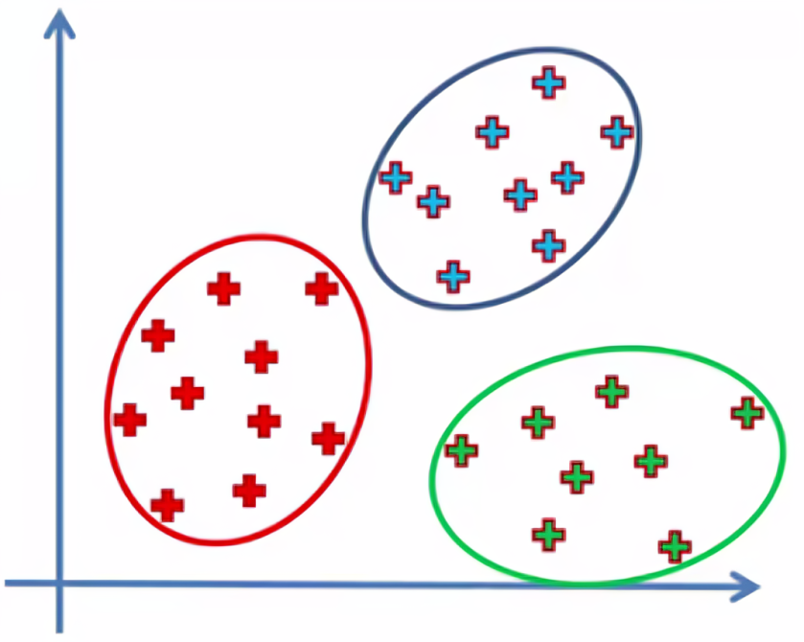
Centroid-based Clustering
K-means
K-means is the most widely-used centroid-based clustering algorithm.
The number of clusters is represented by the variable “K”.
The algorithm works iteratively to assign each data point to one of K-groups based on the provided features.
K-means

Slide 7
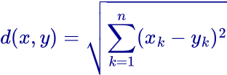

Centroid-based Clustering
K-means
How does it works?
Example: K = 2
Initialization:
  Choose how many clusters you want → k
  Randomly assign a centroid to each of the k clusters.
Assignment
  Calculate the distance of all observation to each of the k centroids.
  Assign observations to the closest centroid
Update centroids: Recalculate the centroids of the clusters by taking the mean of all data points assigned to each cluster.
When the centroids no longer change significantly
Repeat: Repeat steps 2 and 3 until convergence.
When a specified number of iterations is reached

Slide 8
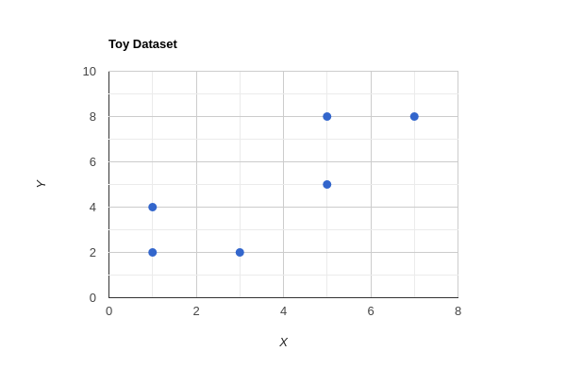
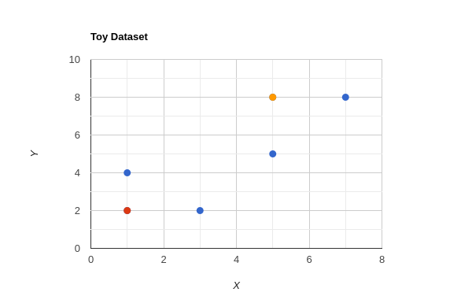
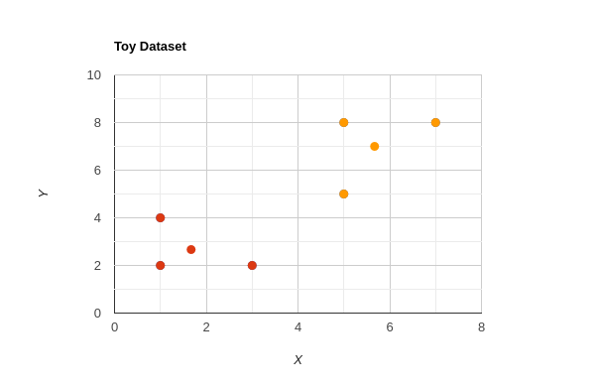
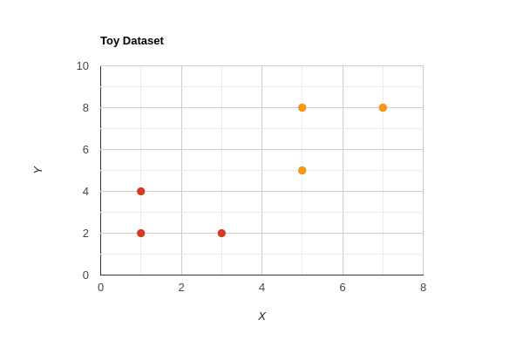
Centroid-based Clustering
K-means Example
Input Data
Step 2: Calculate Distance and Assign Clusters
Point | X | Y
A | 1 | 2
B | 1 | 4
C | 3 | 2
D | 5 | 8
E | 7 | 8
F | 5 | 5
Point | Distance to C1 | Distance to C2 | Cluster
A | 0 | 7.21 | 1
B | 2 | 5.66 | 1
C | 2 | 6.32 | 1
D | 7.21 | 0 | 2
E | 8.49 | 2 | 2
F | 5 | 3 | 2
Step 1: Initialize Centroids
Centroid 1: C1 (1, 2)
Centroid 2: C2 (5, 8)
Step 4: Reassign Clusters
Point | Distance to C1 | Distance to C2 | Cluster
A | 0.94 | 6.15 | 1
B | 1.55 | 5.33 | 1
C | 1.55 | 5.87 | 1
D | 6.15 | 1.22 | 2
E | 7.48 | 1.68 | 2
F | 4.08 | 2.08 | 2
Step 3: Update Centroids
Cluster 1 (Points: A(1,2), B(1,4), C(3,2)):
C1: (1+1+3)/3, (2+4+2)/3 ≈ (1.67, 2.67)
Cluster 2 (Points: D(5,8), E(7,8), F(5,5)):
C2: (5+7+5)/3, (8+8+5)/3 ≈ (5.67, 7.00)

Slide 9
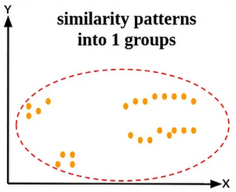
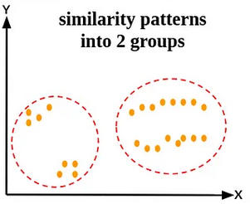
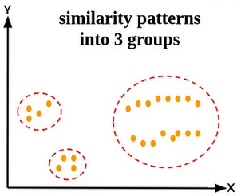
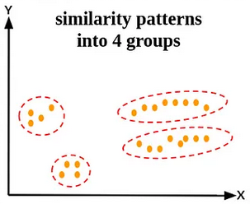
Centroid-based Clustering
K-means ++
K-means algorithm is efficient but sensitive to initial conditions.
If the initialization of clusters is not appropriate, K-means can result in arbitrarily bad clusters.
How to choose the best K ?
Solution: K-means++

Slide 10
Centroid-based Clustering
K-means ++
K-means++
Specifying a procedure to initialize the cluster centers
then
standard k-means algorithm
Example: K = 2
pick one centroid at random (like K-means)
calculate the distance of each data point with this centroid.
The next centroid will be the one whose squared distance is the farthest from the current centroid.
Apply the standard K-means algorithm

Slide 11
Centroid-based Clustering
Pros vs. Cons
Pros | Cons
Various Applications like Customer segmentation, image segmentation, etc. | Sensitive to initial choice of centroids
Scalable (Suitable for large datasets) | Prior knowledge of number of clusters
Fast | Limited to linearly separable data
Simple and easy to understand | Prone to converge into local optima

Slide 12
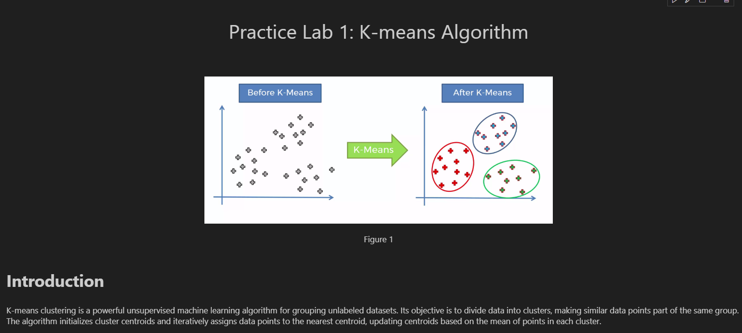
Centroid-based Clustering
Practice Lab 1: K-means

Slide 13
Clustering
Categories
Centroid-based Clustering
E.g. K-means, K-means++
Density-based Clustering
DBSCAN, OPTICS

Slide 14
Density-based Clustering
Notions Definitions
Density-based clustering connects areas of high example density into clusters.
It allows for arbitrary-shaped distributions as long as dense areas can be connected comparing to centroid-based clustering.
Two main parameters
  ε : Maximum radius of the neighbourhood
  MinPts: Minimum number of points in an ε-neighbourhood of that point
Neither a core point nor a border point
Neighborhood of point p contains all points within distance ε from p:
  N_{Eps}(p) = {q | dist(p,q) <= ε }
Outlier or Noise
A core point p:
  If the number of points in the ε-neighborhood of p is at least MinPts.
Core point
A border point q:
  If the number of points in the ε-neighborhood of q is at least MinPts., but are inside the ε-neighborhood of a core point.
MinPts = 5
ε = 1 cm
Border point

Slide 15
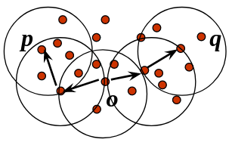
Density-based Clustering
Notions Definitions
Directly density-reachable: A point p is directly density-reachable from a point q wrt. ε, MinPts if:
1) p belongs to N_{Eps}(q)
2) core point condition: |N_{Eps} (q)| >= MinPts
p
MinPts = 5
ε = 1 cm
Density-reachable: A point p is density-reachable from a point q wrt. ε, MinPts if:
there is a chain of points p₁, …, p_{n}, p₁ = q, p_{n} = p such that p_{i+1} is directly density-reachable from p_{i} .
q
Density-connected: A point p is density-connected to a point q wrt. ε, MinPts if:
  there is a point o such that both, p and q are density-reachable from o wrt. ε and MinPts.
p
p₁
A cluster is defined as a maximal set of density-connected points.
q

Slide 16
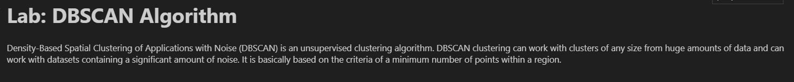
Density-based Clustering
Density-Based Spatial Clustering of Applications with Noise (DBSCAN)
Arbitrarily select a point p
Retrieve all points density-reachable from p wrt. ε and MinPts.
If p is a core point, a cluster is formed.
If p is a border point, no points are density-reachable from p and DBSCAN visits the next point of the database.
Continue the process until all of the points have been processed.

Slide 17
Density-based Clustering
DBSCAN vs K-Means
DBSCAN | K-Means
No need to specify the number of clusters. | Very sensitive to the number of clusters
Clusters can be of any arbitrary shape. | Clusters are spherical or convex in shape
It works well with datasets having noise and outliers | It does not work well with outliers data.
Two parameters are required for training the Model | Only one parameter is required is for training the model
Some interesting algorithms:
Ordering Points To Identify the Clustering Structure (OPTICS)
DENsity-based CLUstEring (DENCLUE)
Clustering In QUEst (CLIQUE)

Slide 18
Clustering
Categories
Centroid-based Clustering
E.g. K-means, K-means++
Distribution-based Clustering
Gaussian Mixture Models (GMM)

Slide 19
Distribution-based Clustering
Gaussian Mixture Models (GMMs)
The Gaussian Mixture Model represents data as a combination of multiple Gaussian distributions.
All of the data points are considered parts of a cluster based on the probability that they belong to a given cluster.
GMM determines probabilities and allocates them to data points in the K number of clusters. Each of which has three parameters:
  Mean
  Covariance
  Mixing probability.
To compute these parameters GMM uses the Expectation Maximization technique.

Slide 20
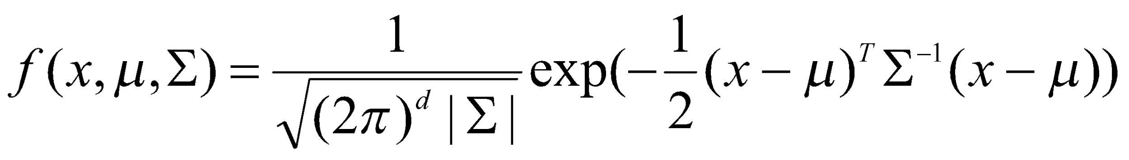
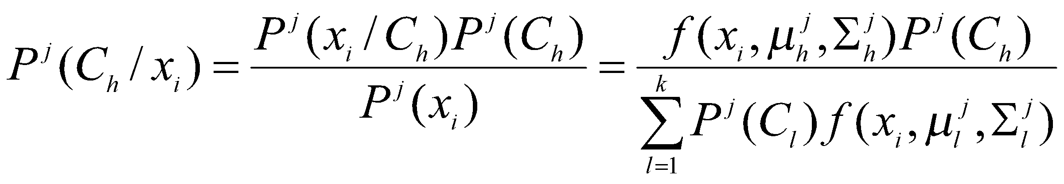
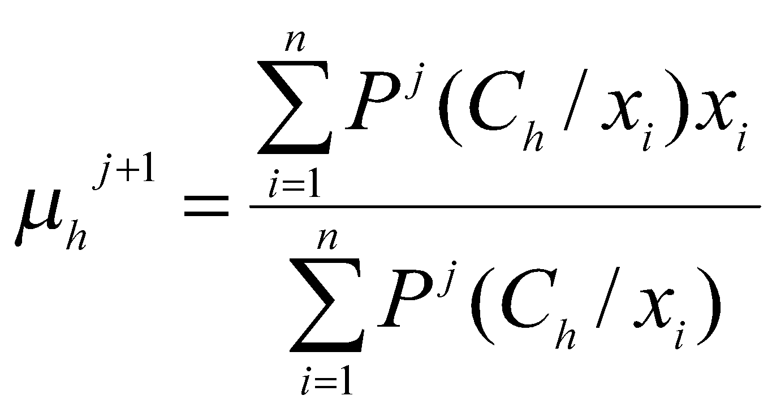
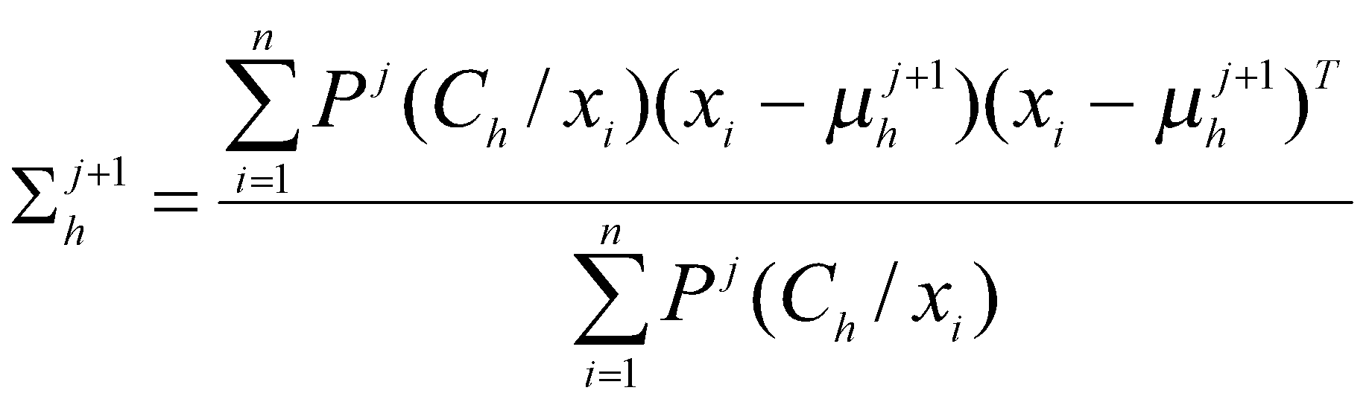
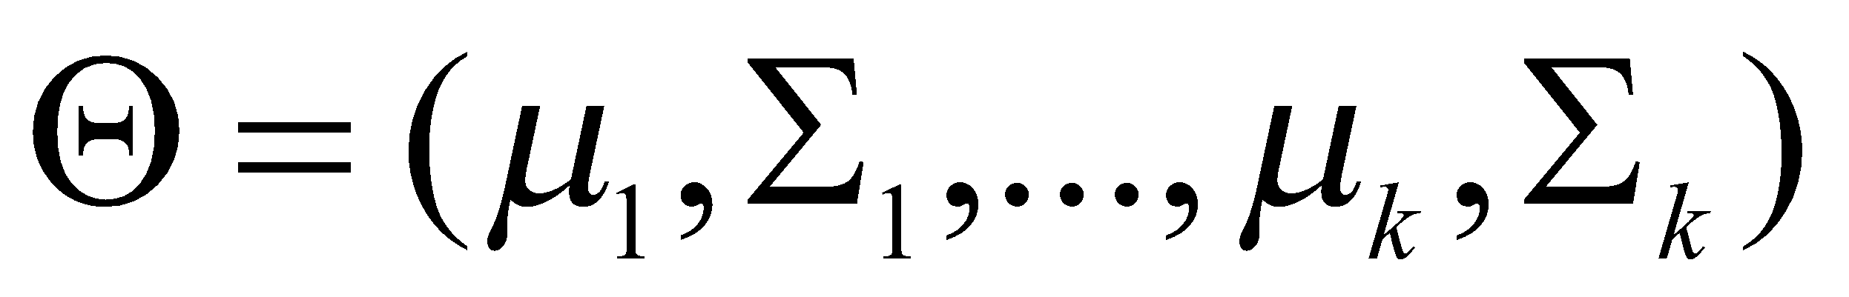
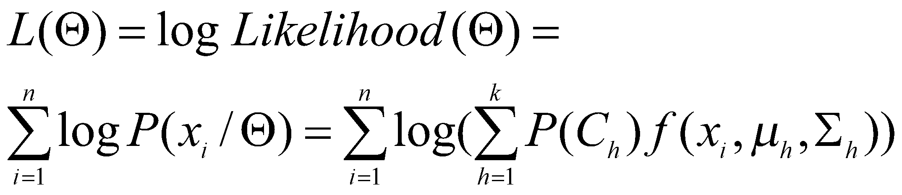
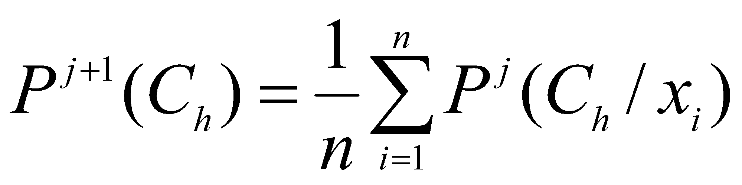
Distribution-based Clustering
Expectation Maximization (EM)
The Expectation-Maximization algorithm is an iterative optimization approach used for clustering.
EM iteratively updates the parameters of these distributions, aiming to find the best-fit clusters within the data.
Algorithm Steps:
Initialize K cluster centers
Iterate between two steps:
  Expectation step: assign points to clusters
  Maximization step: estimate model parameters
Estimate the probability of a given point i to belong to cluster h at iteration j as follows:
Cluster h
Stop when the log-likelihood of two consecutive iterations k and k+1 is less than ε

Slide 21
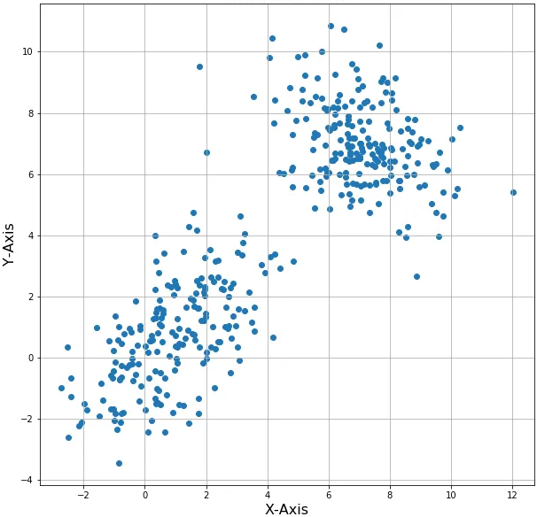
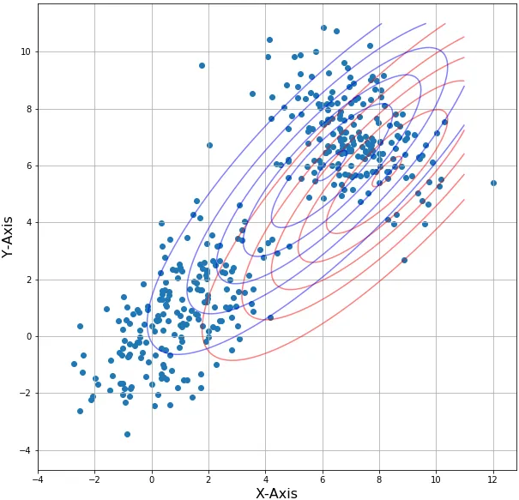
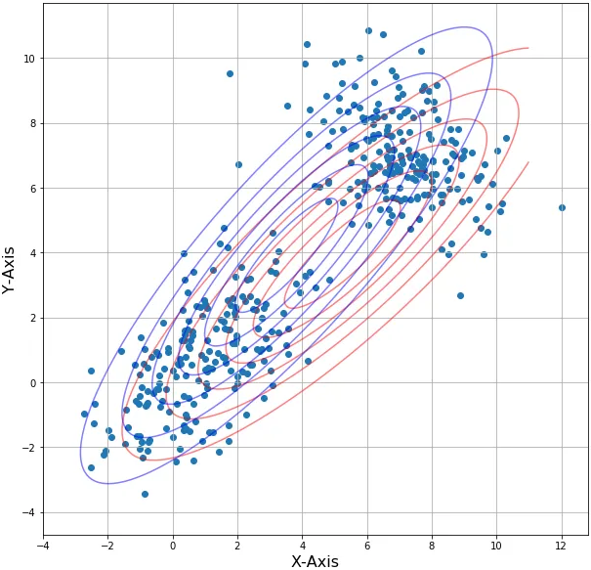
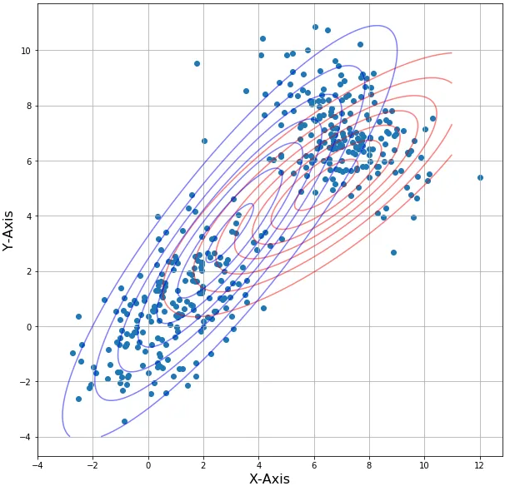
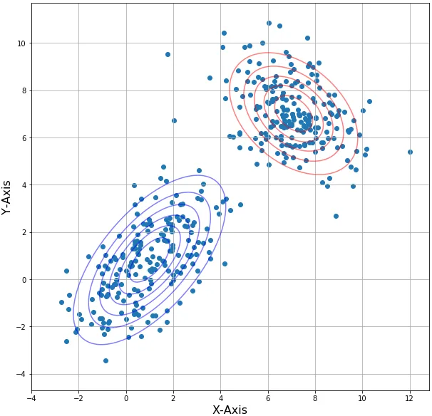
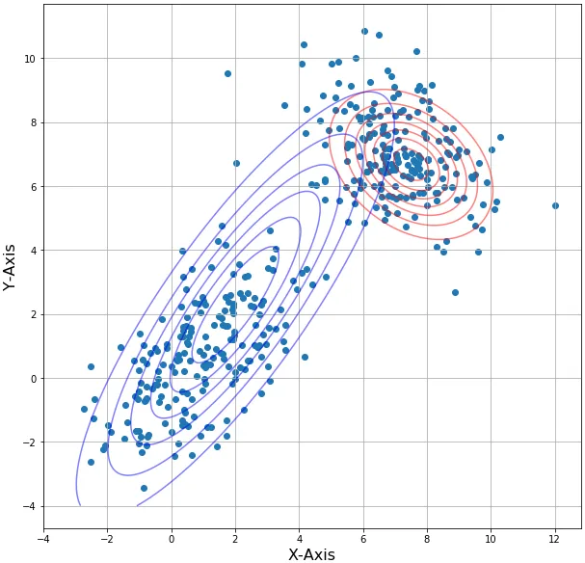
Distribution-based Clustering
GMMs - EM
Iteration 3
Iteration 4
Final State
Iteration 2
Iteration 1
Initial State

Slide 22
Distribution-based Clustering
Pros | Cons
Robust to noisy data | Slow convergence for high-dimensional data / Convergence is not guaranteed for all cases.
Adaptable to various probabilistic models. | Limited scalability for very large datasets.
Can be applied to large datasets. | Assumes data is generated from a specific model
Not very sensitive to initial parameter values | Can be computationally intensive for some problems

Slide 23
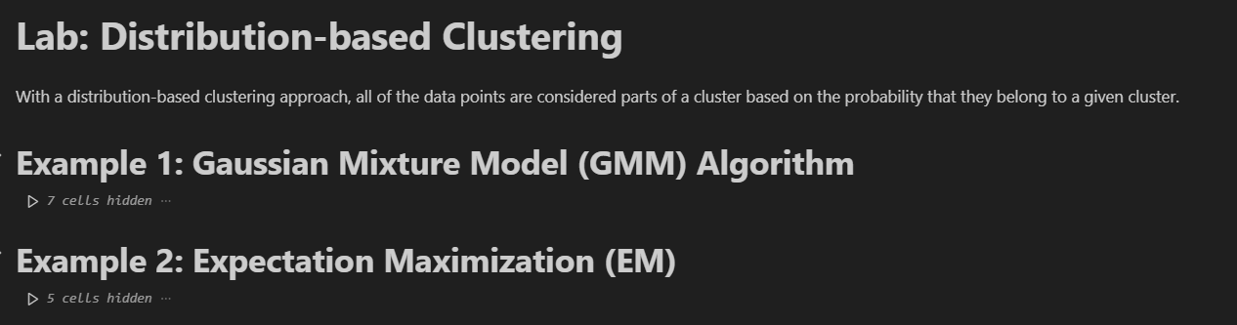
Distribution-based Clustering
GMMs - EM

Slide 24
Clustering
Categories
Centroid-based Clustering
E.g. K-means, K-means++
Density-based Clustering
DBSCAN, OPTICS
Distribution-based Clustering
Gaussian Mixture Models (GMM)
Bayesian Gaussian Mixture Models
Hierarchical Clustering
Agglomerative vs Divisive

Slide 25
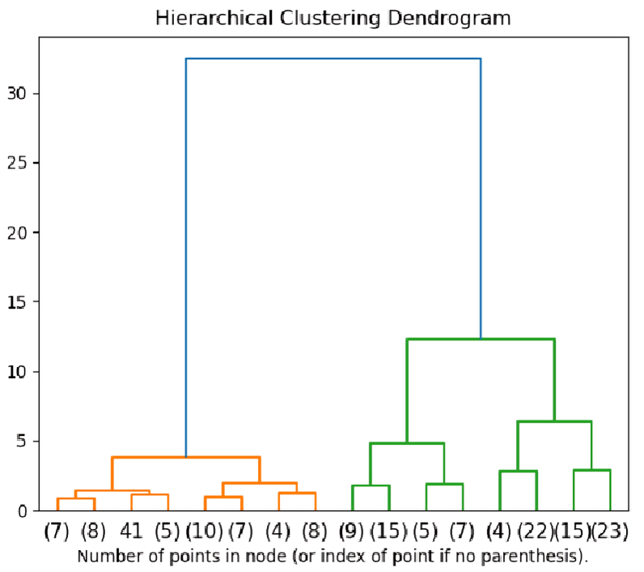
Hierarchical Clustering
Hierarchical clustering creates a tree of clusters.
Any number of clusters can be chosen by cutting the tree at the right level.
Hierarchy of clusters in Dendrogram shaped
More popular
Agglomerative Approach: (Bottom-up):
  It builds the dendrogram from the bottom level
  It merges the most similar (or nearest) pair of clusters
  It stops when all the data points are merged into a single cluster (i.e., the root cluster).
    i.e. each data set is a cluster
Divisive Approach: Top-down approach
  It starts with all data points in one cluster, the root.
  It splits the root into a set of child clusters. Each child cluster is recursively divided further
  It stops when each cluster is only with a single point
    i.e. whole data set is a single cluster.

Slide 26
Hierarchical Clustering
Agglomerative Clustering
Agglomerative Clustering procedure:
Compute the proximity matrix
Let each data point be a cluster
Repeat
  Merge the two closest clusters
  Update the proximity matrix
Until only a single cluster remains
distance
Cluster 1
Cluster 2
Main operation: is the computation of the proximity of two clusters. The distance between the clusters can be calculated by taking either of the following ways:
– Finding the distance between the closest data points (MIN)
– Finding the distance between the furthest data points (MAX)
– Finding the average distance (AVERAGE)
– Finding the distance between the Centroids of the clusters

Slide 27
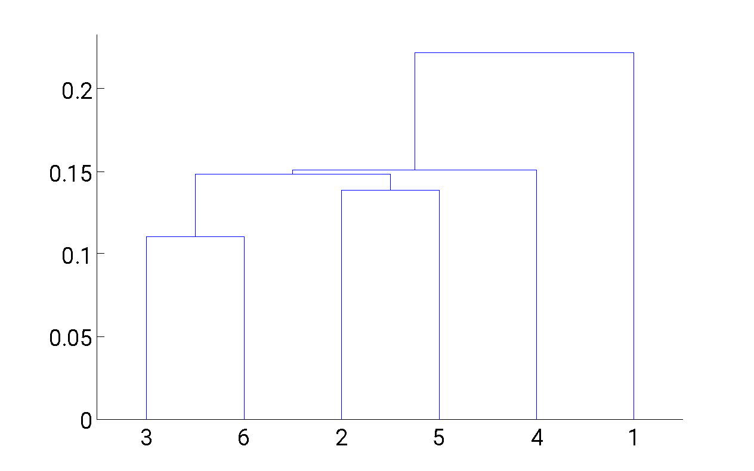
Hierarchical Clustering
Agglomerative Clustering: MIN Example
5
1
3
5
2
1
2
3
6
4
4
  Strength: Can handle non-elliptical shapes
  Limitation: Sensitive to noise and outliers
Dendrogram

Slide 28
Hierarchical Clustering
Pros | Cons
Easy to understand (with Dendrograms) | Computationally expensive in Time (~ O(n^3)) and Space (~ O(n^2))
Suitable for small datasets | Different methods gives different results
Detection of overlapping clusters | Greedy Algorithm
Handles different types of distance measure and linkage | Not suitable for large dataset and when clusters are not well separated
Some other relevant algorithms:
  Clustering Using REpresentatives (CURE)
  RObust Clustering using linKs (ROCK)
  Hierarchical Clustering Using Dynamic Modeling (CHAMELEON)
  Balanced Iterative Reducing and Clustering using Hierarchies (BIRCH)

Slide 29
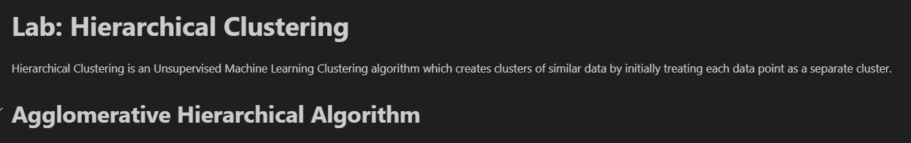
Hierarchical Clustering

Slide 30
Cluster Validity
and
Analysis

Slide 31
Cluster Validity / Analysis
Evaluation
For supervised classification, they are a variety of measures to evaluate how good our model is
  Accuracy, precision, recall, F1-score, AUC …
How to evaluate the goodness of the resulting clusters in unsupervised learning?
Silhouette score
Calinski and Harabasz score
Davies–Bouldin index
Dunn Index

Slide 32
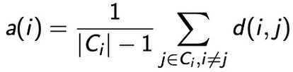
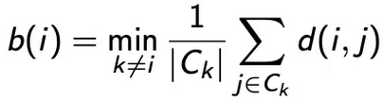

Cluster Validity / Analysis
Silhouette Coefficient
The silhouette analysis measures how well a point is clustered and it estimates the average distance between clusters.
For each point i, the silhouette width s(i) is calculated as follows:
Calculate the average dissimilarity a(i) between i and all other points of the cluster Ci to which i belongs.
Calculate the average dissimilarity b(i) between i and all other points of its “neighbor” cluster Ck, i.e., the nearest one to which it does not belong.
Calculate the Silhouette Index of the point i:
best score
-1 < < +1
worst score

Slide 33



Cluster Validity / Analysis
Calinski and Harabasz Score
It is also known as the Variance Ratio Criterion.
The score is defined as ratio of the sum of between-cluster dispersion and of within-cluster dispersion.
For a set of data E of size nE which has been clustered into k clusters, the Calinski-Harabasz score s is defined by:
Center of cluster q
Center of E
between-cluster dispersion matrix
within-cluster dispersion matrix
The higher the score, the better the performances

Slide 34
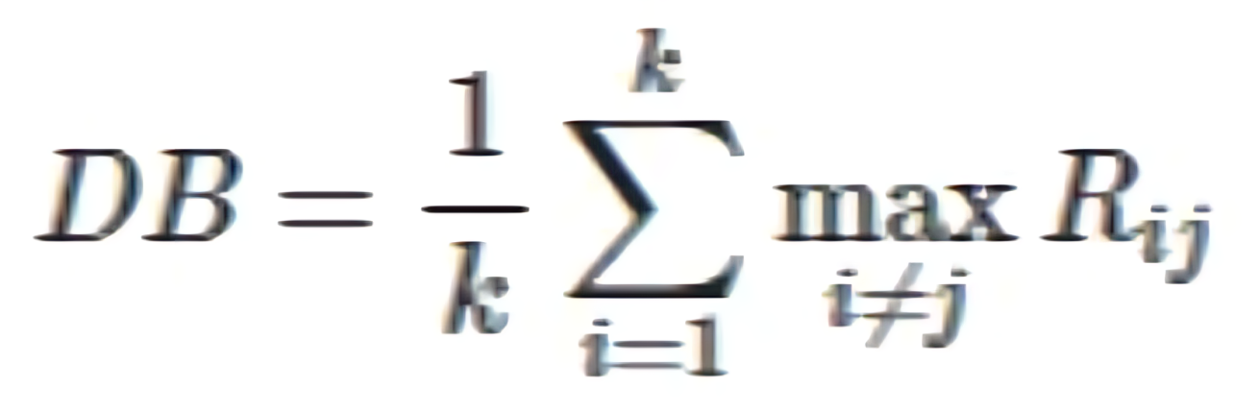

Cluster Validity / Analysis
Davies–Bouldin index
This index is the average similarity between each cluster i and its most similar one j.
The Davies-Bouldin index is defined as:
Cluster diameter: the average distance between each point of cluster i/j and its centroid.
The distance between cluster centroids i and j
The lower the index, the better the separation between clusters

Slide 35



Cluster Validity / Analysis
Dunn index
A cluster is considered compact if there is small variance between members of the cluster.
The Dunn index aims at quantifying the compactness and variance of the clustering.
the Dunn index for a set of clusters C is then defined by:
Euclidean Distance
A higher Dunn Index will indicate compact, well-separated clusters

Slide 36
Cluster Validity / Analysis
Metrics Comparison
Calinski-Harabasz Index
Pros
Cons
Silhouette Score
Davies–Bouldin index
Dunn index
bounded (-1 for incorrect clustering and +1 for highly dense clustering)
Works with Various Distance Measures
Fast to compute
higher when clusters are dense and well separated
Simpler to compute
higher when clusters are dense and well separated
higher when clusters are dense and well separated
higher for convex clusters than others
The usage of centroid distance limits the distance metric to Euclidean space
Sensitivity to Data Scaling
higher for convex clusters than others
Computationally expensive and time-consuming with large datasets
High computational complexity: O(n²)
higher for convex clusters than others

Slide 37
Dimensionality Reduction

Slide 38
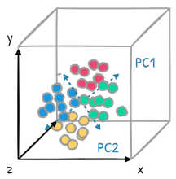
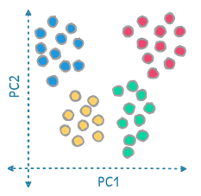
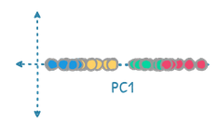
Dimensionality Reduction
Definition
The curse of dimensionality is a common problem in machine learning:
  The performance of the model decreases as the number of features increases.
  High dimensional data → more difficult to find a good solution.
The main idea is to project first the d-dimensional points in a k-dimensional space (k << d) and then solve the problem in low dimensions.

Slide 39
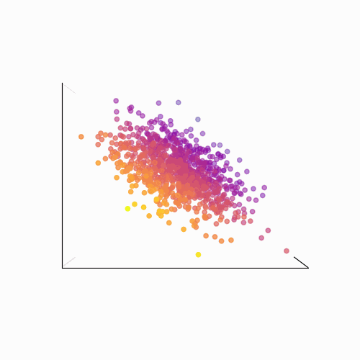
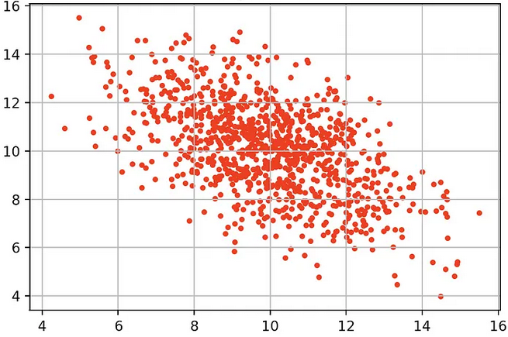
Dimensionality Reduction
Definition
Dimensionality reduction can help to:
  Reduce the complexity of the model
  Improve the model generalization performance.

Slide 40




Dimensionality Reduction
Principal Component Analysis (PCA)
How does PCA work?
Standardization for each feature
Compute the covariance matrix to identify correlations
f2
Compute the eigenvectors and eigenvalues
  Eigenvectors represent the principal components
  Eigenvalues represent the magnitude of variance.
e1
e2
Sort the eigenvalues in descending order
  The eigenvectors of the highest eigenvalues capture the most variance in the data
f1
Choose the top k eigenvectors (principal components)
Transform the Data using the chosen eigenvectors

Slide 41
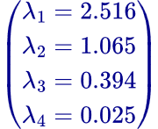
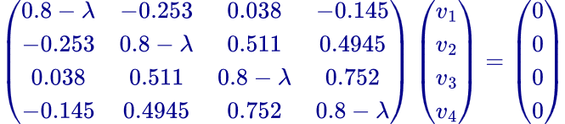
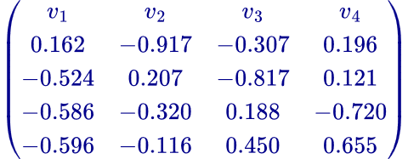
Dimensionality Reduction
Principal Component Analysis (PCA)
Compute Covariance Matrix
Compute Eigenvalues
Features / Samples | F1 | F2 | F3 | F4
1 | 1 | 2 | 3 | 4
2 | 5 | 5 | 6 | 7
3 | 1 | 4 | 2 | 3
4 | 5 | 3 | 2 | 1
5 | 8 | 1 | 2 | 2
 | F1 | F2 | F3 | F4
F1 | 0.8 | -0.253 | 0.038 | -0.145
F2 | -0.253 | 0.8 | 0.511 | 0.4945
F3 | 0.038 | 0.511 | 0.8 | 0.752
F4 | -0.145 | 0.4945 | 0.752 | 0.8
Standardization
Compute Eigenvectors
 | F1 | F2 | F3 | F4
mean | 4 | 3 | 3 | 3.4
std_dev | 3 | 1.58114 | 1.73205 | 2.30217
Features / Samples | F1 | F2 | F3 | F4
1 | -1 | -0.63 | 0 | 0.26
2 | 0.33 | 1.265 | 1.732 | 1.564
3 | -1 | 0.63 | -0.577 | -0.174
4 | 0.33 | 0 | -0.577 | -1.042
5 | 1.33 | -1.265 | -0.577 | -0.608
Choose the highest k eigenvalues (e.g. k=2)
Q
X =
Transform Data
Features / Samples | New F1 | New F2
1 | 0.014 | 0.756
2 | -2.556 | -0.780
3 | -0.051 | 1.253
4 | 1.014 | 0.0002
5 | 1.580 | -1.230

Slide 42
Dimensionality Reduction
Singular Value Decomposition (SVD)
How does SVD work?
n
r
r
n
k
X
U
⅀
Vᵗ
r
Matrix Decomposition of data points X
m
Diagonal Matrix
r x r
Orthogonal Matrix
r x n
Select the top k largest singular values in Σ and its corresponding vectors in Vᵗ or U
Orthogonal Matrix
m x n
Getting the new data points X’ in reduced dimensions
k
k
k
Columns are the right singular vectors of X
X’
U
⅀
k
Contains the singular values of X in descending order
m
Columns are the left singular vectors of X

Slide 43
Dimensionality Reduction
Singular Value Decomposition (SVD)
SVD
Pros
Cons
PCA
simple to visualize
Used in Data Compression
Capturing independent information
Numerically stable
Applicable for noise reduction
Applicable for noise Reduction
Loss of Interpretability
Computationally expensive in terms of time and memory
Assumption of Linearity between variables
Sensitive to Missing Values
Sensitive to Scaling
Sensitive to outliers
Sensitive to outliers

Slide 44
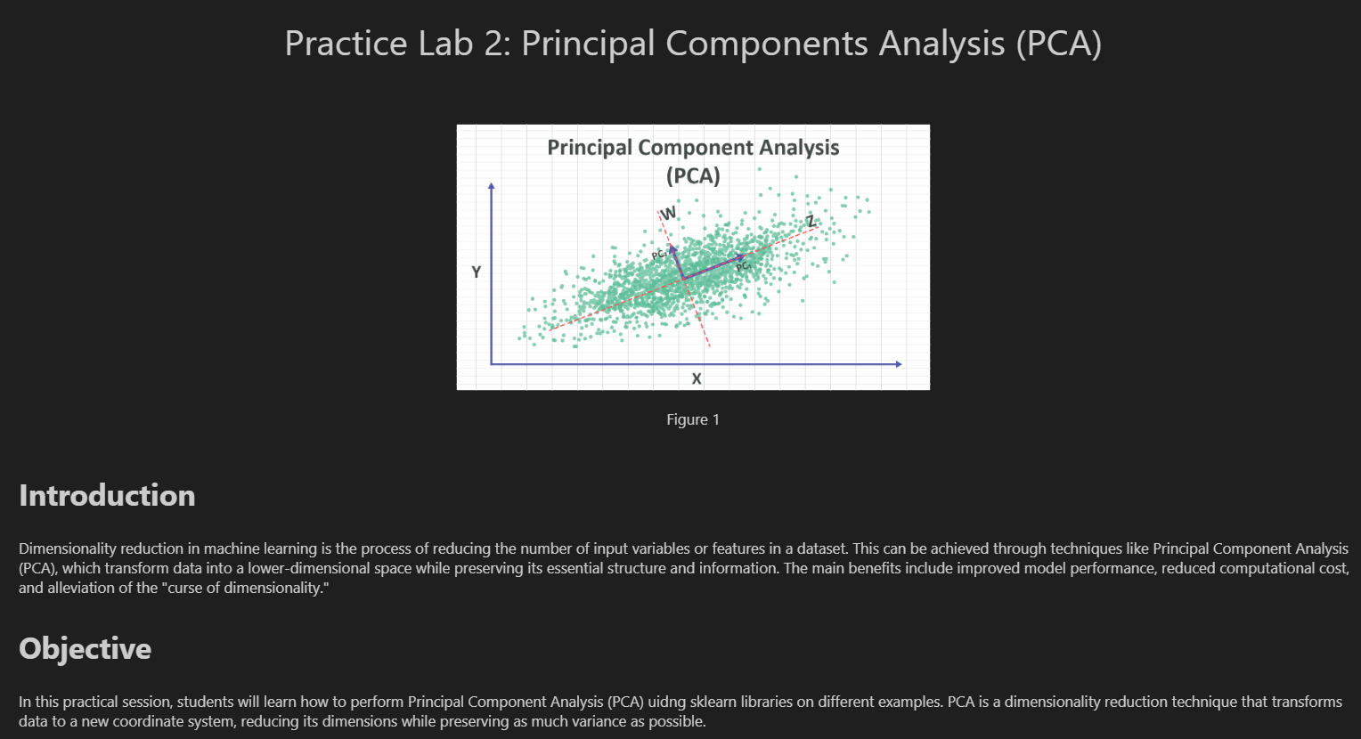
Dimensionality Reduction
PCA

Slide 45
Anomaly Detection

Slide 46
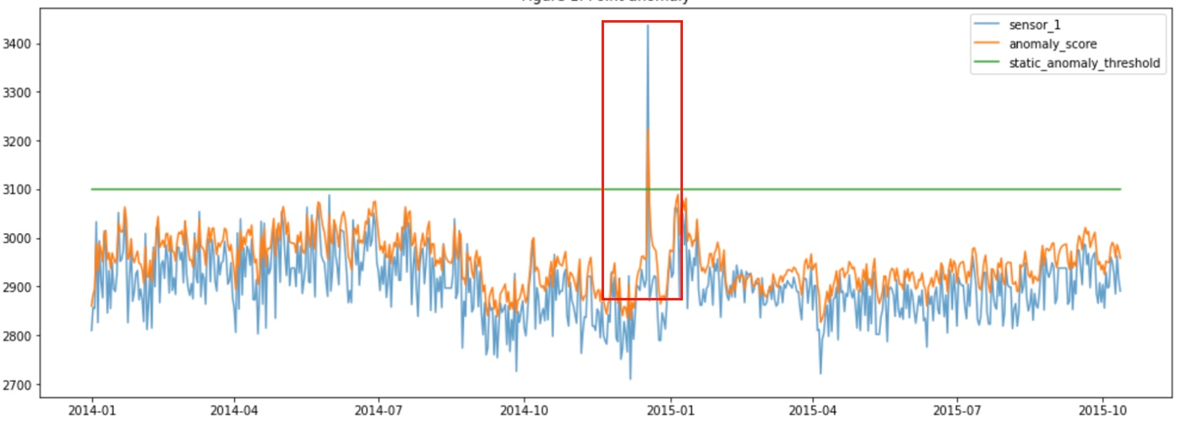
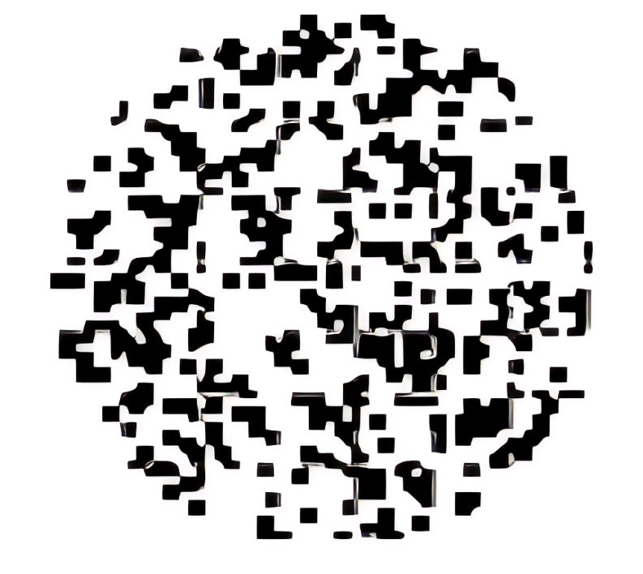
Anomaly Detection
An anomaly is a data point that is considerably different from the remainder of the data.
Change in events
Outliers

Slide 47
Anomaly Detection
An anomaly is a data point that is considerably different from the remainder of the data.
Assumption:
There are considerably more “normal” observations than “abnormal” observations (outliers/anomalies) in the data
Challenges:
– How many outliers are there in the data?
– Method is unsupervised → Validation can be quite challenging (just like for clustering)
General Steps:
Build a profile of the normal behavior: patterns or summary statistics for the overall population
Use the normal profile to detect anomalies
Anomalies are observations whose characteristics differ significantly from the normal profile

Slide 48
Dimensionality Reduction
(100, 200)
Isolation Forest Algorithm
How does it work?
Subsampling: Randomly select a subsample of the data.
subsample size = 4
Model Building
(4, 5)
Repeat the tree-building process to create a forest of Isolation Trees.
  The number of trees is a parameter of the model.
(3, 4)
(2, 3)
nb_trees = 3
(1, 2)
Tree Building
Tree 1
(1,2), (2,3), (3,4), (100, 200)
For each subsample, build an Isolation Tree (iTree):
  Randomly select a feature: Pick a feature randomly from the set of all features.
  Randomly select a split value: Choose a random split value within the range of the selected feature.
  Partition the data: Split the data into two partitions according on the split value.
  Recursively repeat: Continue the process recursively for each partition until:
    All points in a partition have the same values, or
    The tree reaches a maximum depth (a predefined limit), or
    The partition contains only one point.
Feature 1: X
Split value: 2.5
(1,2), (2,3)
(3,4), (100, 200)
Feature 2: Y
Feature 2: Y
Split value: 2.5
Split value: 4.5
(1,2)
(2,3)
(3,4)
(100,200)

Slide 49
Dimensionality Reduction
(100, 200)
Isolation Forest Algorithm
How does it work?
Subsampling: Randomly select a subsample of the data.
subsample size = 4
Model Building
(4, 5)
Repeat the tree-building process to create a forest of Isolation Trees.
  The number of trees is a parameter of the model.
(3, 4)
(2, 3)
nb_trees = 3
(1, 2)
Tree Building
Tree 2
(1,2), (2,3), (4,5), (100, 200)
For each subsample, build an Isolation Tree (iTree):
  Randomly select a feature: Pick a feature randomly from the set of all features.
  Randomly select a split value: Choose a random split value within the range of the selected feature.
  Partition the data: Split the data into two partitions according on the split value.
  Recursively repeat: Continue the process recursively for each partition until:
    All points in a partition have the same values, or
    The tree reaches a maximum depth (a predefined limit), or
    The partition contains only one point.
Feature 2: Y
Split value: 10
(1,2), (2,3), (4,5)
(100, 200)
Feature 1: X
Split value: 3
(1,2), (2,3)
(2,3)

Slide 50
Dimensionality Reduction
(100, 200)
Isolation Forest Algorithm
How does it work?
Subsampling: Randomly select a subsample of the data.
subsample size = 4
Model Building
(4, 5)
Repeat the tree-building process to create a forest of Isolation Trees.
  The number of trees is a parameter of the model.
(3, 4)
(2, 3)
nb_trees = 3
(1, 2)
Tree Building
Tree 3
(1,2), (2,3), (3,4), (4, 5)
For each subsample, build an Isolation Tree (iTree):
  Randomly select a feature: Pick a feature randomly from the set of all features.
  Randomly select a split value: Choose a random split value within the range of the selected feature.
  Partition the data: Split the data into two partitions according on the split value.
  Recursively repeat: Continue the process recursively for each partition until:
    All points in a partition have the same values, or
    The tree reaches a maximum depth (a predefined limit), or
    The partition contains only one point.
Feature 1: X
Split value: 3.5
(1,2), (2,3), (3,4)
(4, 5)
Feature 2: Y
Split value: 2.5
(1,2)
(2,3), (3,4)

Slide 51
Dimensionality Reduction
Tree 1
Isolation Forest Algorithm
X<=2.5
X>2.5
How does it work?
(1,2), (2,3)
(3,4), (100,200)
Scoring
Y<=2.5
Y>2.5
Y<=4.5
Y>4.5
Path Length Calculation: For each data point, compute the average path length across all trees. The path length is the number of edges traversed from the root node to the terminating node (leaf).
Normalization: Normalize the path length to account for the tree size. The normalized path length helps compare path lengths from trees of different sizes.
(1,2)
(2,3)
(3,4)
(100,200)
Tree 2
Y<=10
Y>10
Calculate the path length for each point:
(1,2), (2,3), (4,5)
(100,200)
Point (1, 2): same for Point (2, 3)
  Tree 1: Path length = 2
  Tree 2: Path length = 2
  Tree 3: Path length = 2
  Average path length = (2 + 2 + 2) / 3 = 2
Point (3, 4):
  Tree 1: Path length = 2
  Tree 2: Path length: Not in Subsample
  Tree 3: Path length = 2
  Average path length = (2 + 2) / 2 = 2
X<=3
X>3
(1,2), (2,3)
(4,5)
Tree 3
Point (100, 200):
  Tree 1: Path length = 2
  Tree 2: Path length = 1
  Tree 3: Path length: Not in Subsample
  Average path length = (2 + 1 ) / 2 = 1.5
Point (4, 5):
  Tree 1: Path length: Not in Subsample
  Tree 2: Path length = 2
  Tree 3: Path length = 1
  Average path length = (2 + 1 ) / 2 = 1.5
X<=3.5
X>3.5
(1,2), (2,3), (3,4)
(4,5)
Y<=2.5
Y>2.5
(1,2)
(2,3), (3,4)

Slide 52


Dimensionality Reduction
Tree 1
Isolation Forest Algorithm
X<=2.5
X>2.5
How does it work?
Anomaly Score Calculation:
  Compute an anomaly score for each data point based on its average normalized path length. The anomaly score is typically calculated using the following formula:
(1,2), (2,3)
(3,4), (100,200)
Y<=2.5
Y>2.5
Y<=4.5
Y>4.5
(1,2)
(2,3)
(3,4)
(100,200)
s(x,n) is the anomaly score for point x.
E(h(x)) is the average path length of point x across all trees.
Tree 2
Y<=10
Y>10
(1,2), (2,3), (4,5)
(100,200)
For n = 3: c(n) = 1.852
X<=3
X>3
Anomaly score for (1, 2)/(2,3)/(3,4)
  E(h(1,2))= 2
  s((1,2),5)= 0.473
Decision Threshold:
  Set a threshold for the anomaly score to classify points as anomalies.
(1,2), (2,3)
(4,5)
Anomaly score for (100, 200):
  E(h(1,2))= 1.5
  s((1,2),5)= 0.570
Tree 3
Take threshold = 0.5
X<=3.5
X>3.5
Anomaly score for (4, 5):
  E(h(1,2))= 1.5
  s((1,2),5)= 0.570
(4, 5) and (100, 200) are anomaly points
(1,2), (2,3), (3,4)
(4,5)
Y<=2.5
Y>2.5
(1,2)
(2,3), (3,4)

Slide 53

Practice Lab 3: Isolation Forest Algorithm

