Slide 1
9.073/HST460 J
Introduction to the Generalized Linear Model
Emery N. Brown
March 15, 27, 2017

Slide 2
I. OBJECTIVES
Understand the Theory of the Generalized Linear Model
Understand how stimulus-response neurophysiology
experiments can be formulated and analyzed using
the General Linear Model

Slide 3
OUTLINE
I. Motivation: The Stimulus-Response Structure of
Neuroscience Experiments
II. Current Analysis Methods: Linear Model Formulations
III. Wiener-Volterra Kernel Expansions and the
Generalized Linear Model Theory
Applications
A. Retinal Neuron Spike Train
B. Hippocampal Experiment [Lecture 3]
C. Inferior Colliculus Experiment [Lecture 3]
V. Conclusion

Slide 4
II. Motivation: The Stimulus-Response Structure of
Neuroscience Experiments

Slide 5
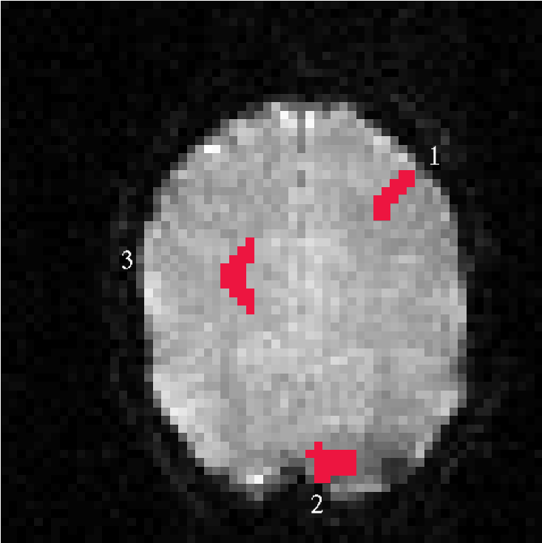
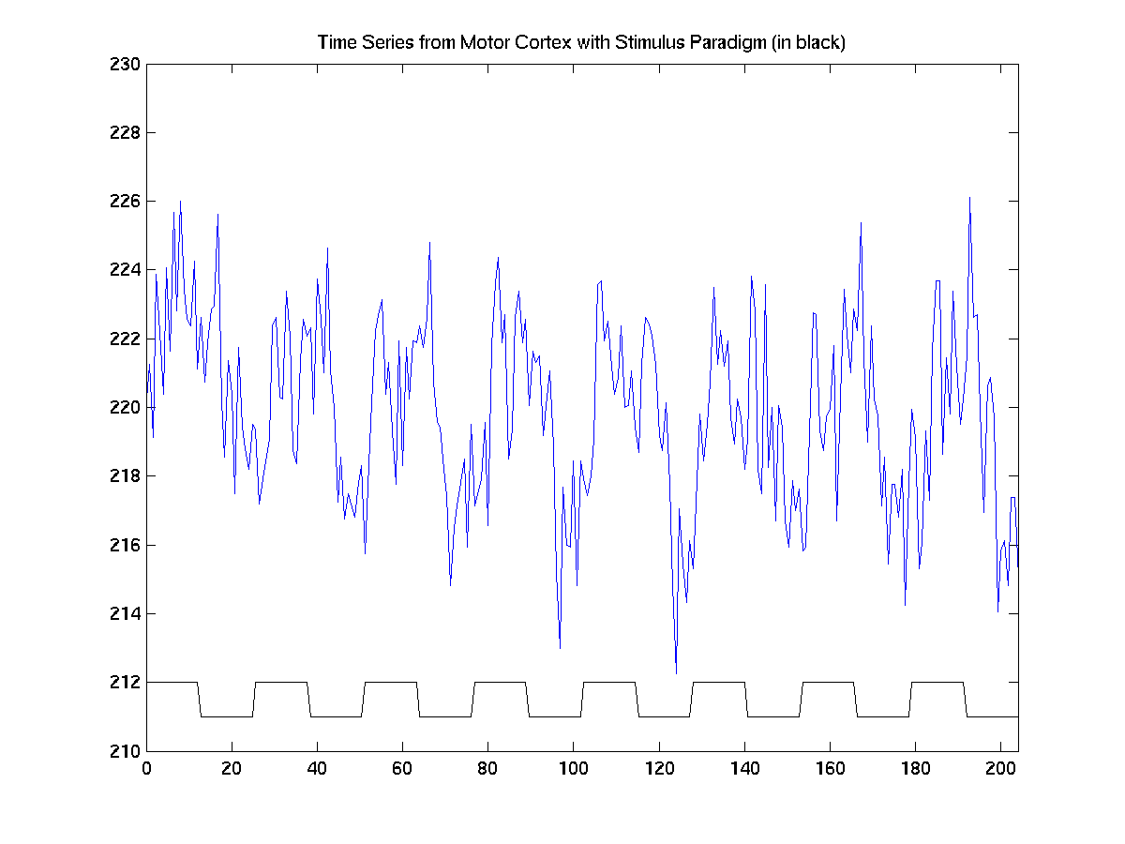
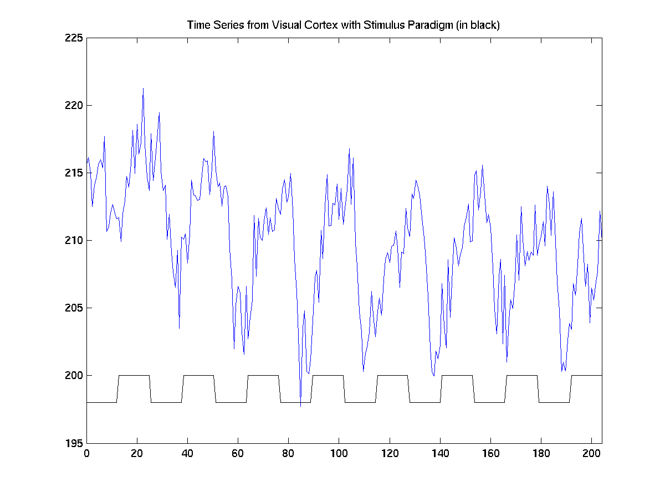
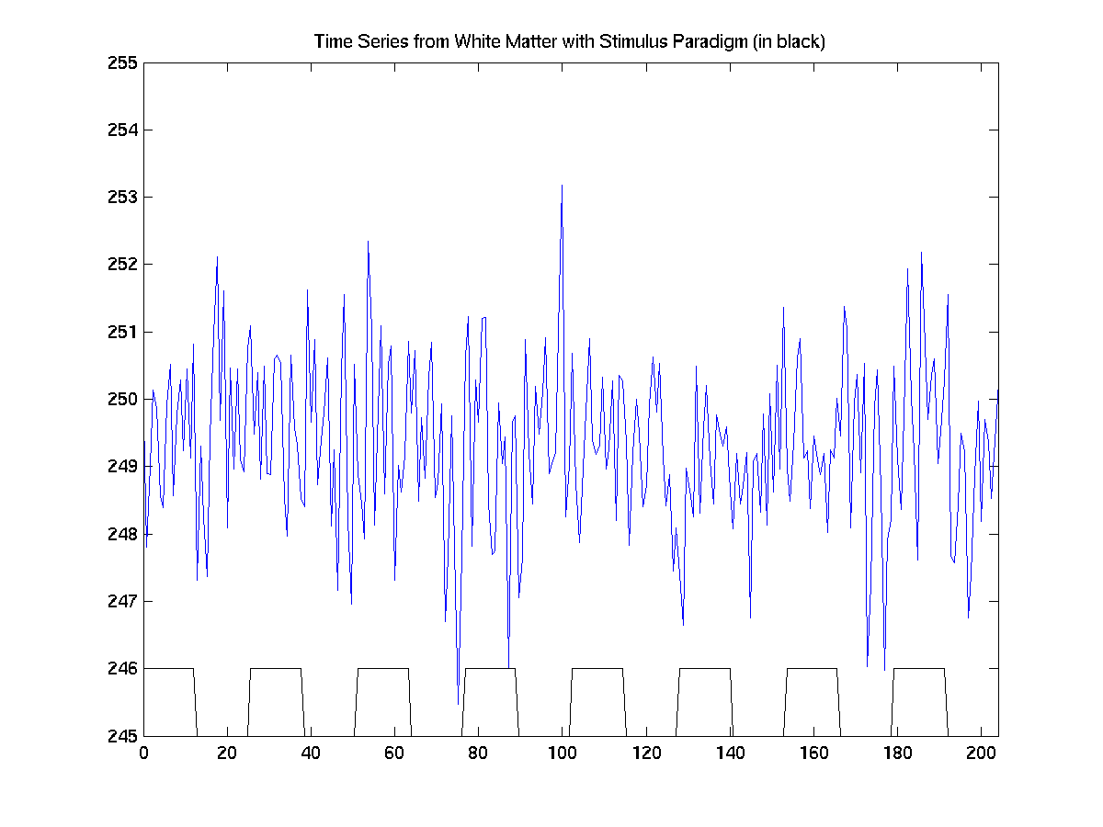
Visual and Motor Stimulation

Slide 6
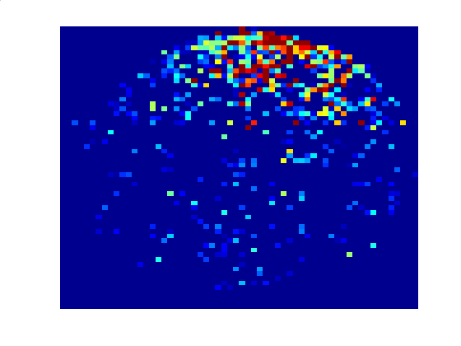
Spatial Receptive Fields of Hippocampal Pyramidal Neurons
Circular Environment
Spike Histogram
70
70
x₂ (cm)
x₂ (cm)
35
35
0
35
70
0
35
70
x₁ (cm)
x₁ (cm)

Slide 7
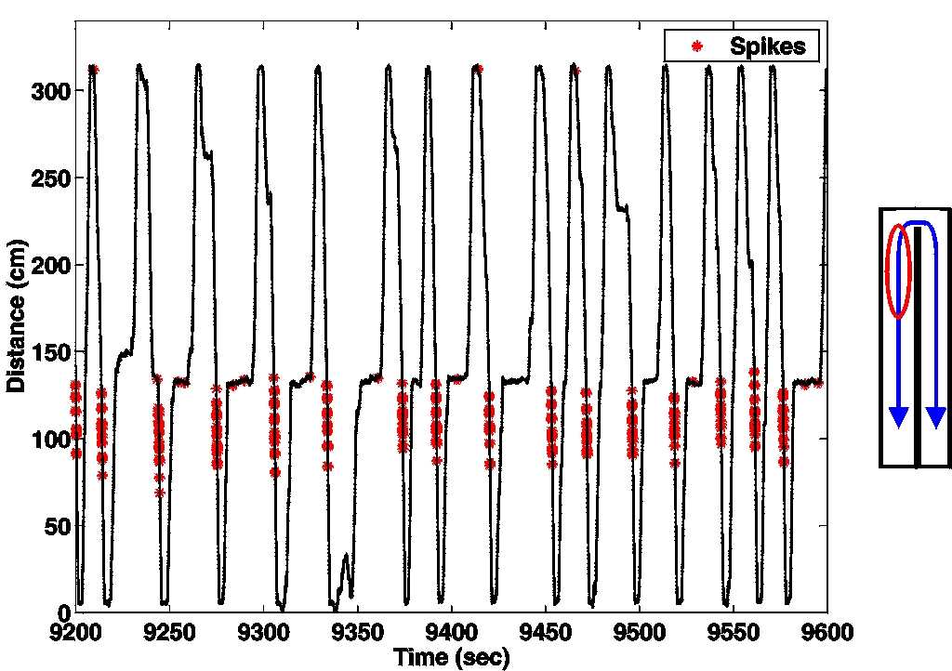
The Place Cell Phenomenon of the Rat Hippocampus
O’Keefe and Dostrovsky (1971)
Frank et al., Neuron, 2000

Slide 8
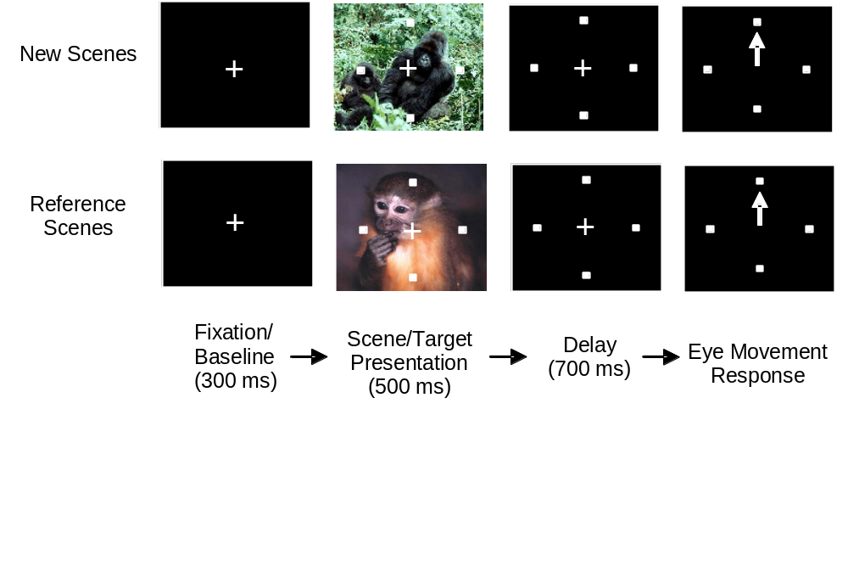
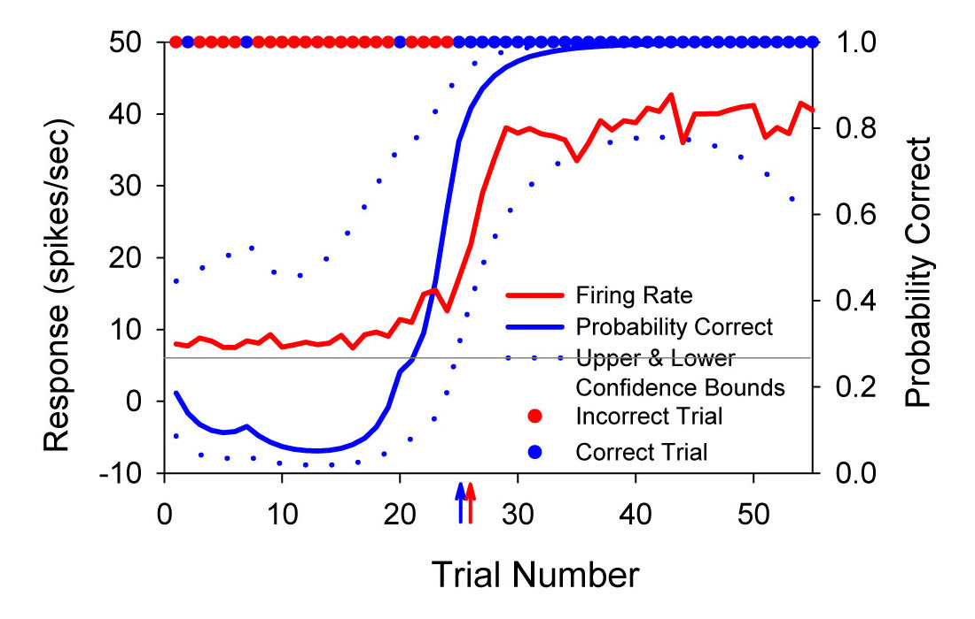
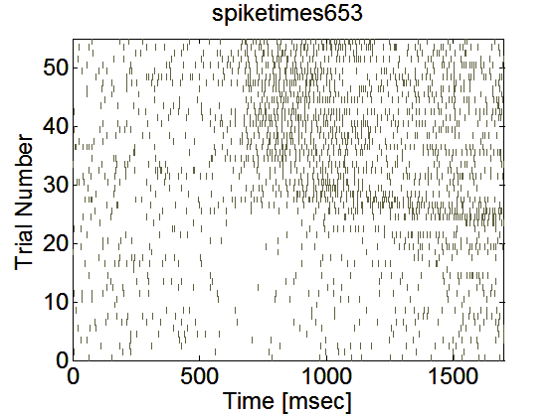
Stimulus-Response Behavioral Learning Experiment
Stimulus: Location-Scene Association
Task
Wirth et al., Science (2003)
Response 1: Hippocampal Neural Activity
Response 2: Correct/Incorrect Response
Fixation
Scene
Delay
Response

Slide 9
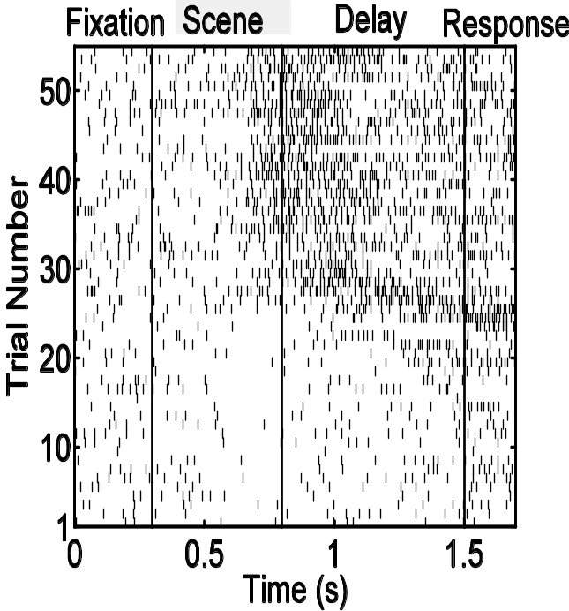
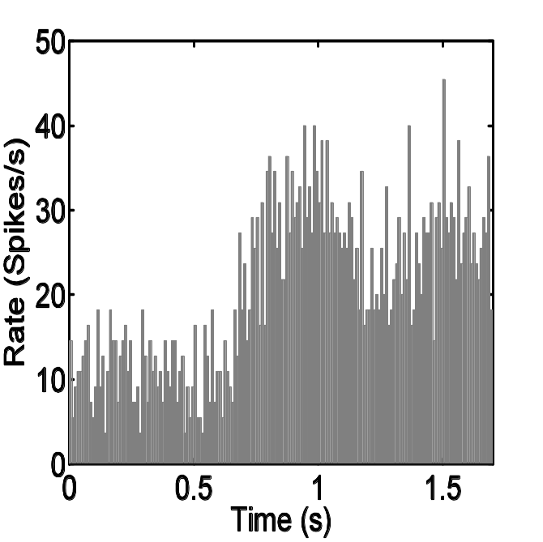
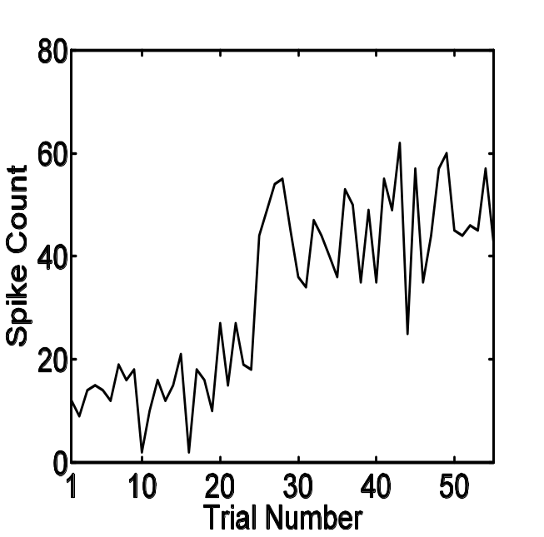
Different Data Summaries
A
B
C
Spike Counts
PSTH
Raster Plot
Wirth et al., Science (2003), Czanner et al., J. Neurophys (2008)

Slide 10
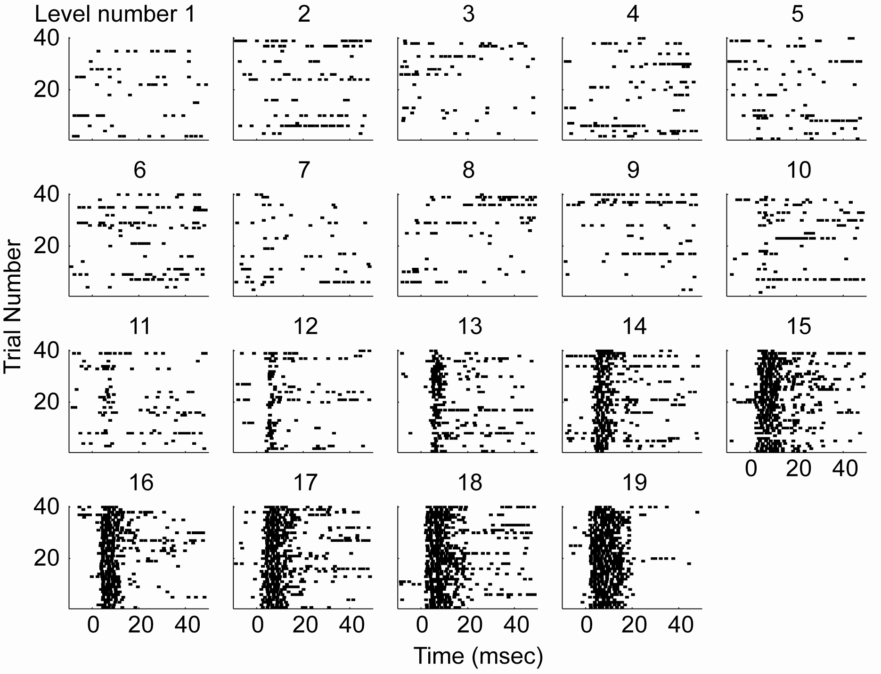
Responses of a Rat Primary Auditory Cortex to Ipsilateral Inferior Colliculus Stimulation across Current Levels
Lim and Anderson, (2007)

Slide 11
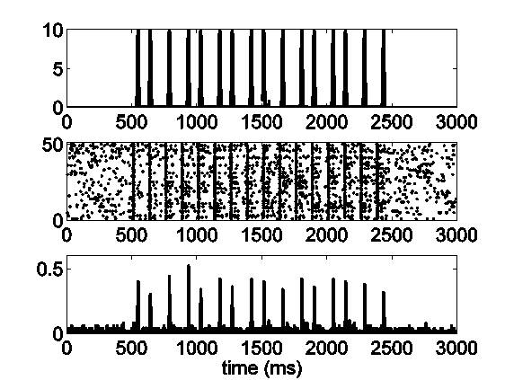
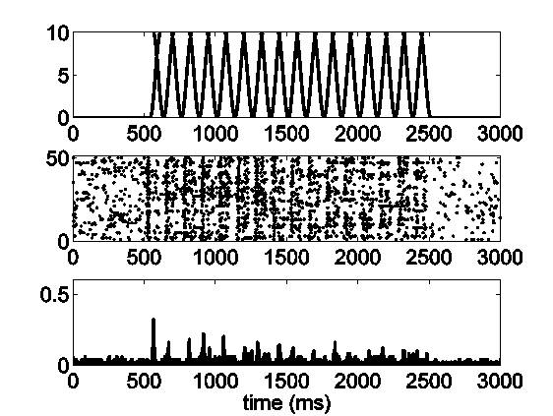
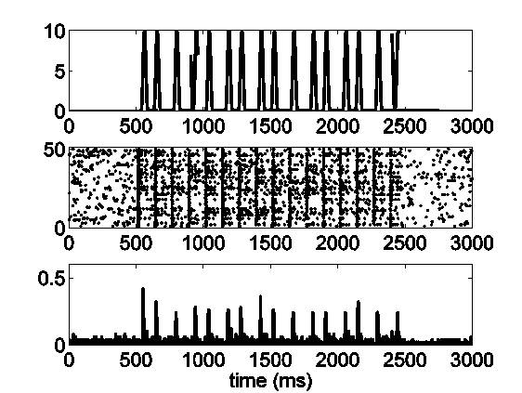
High Velocity (80 mm/s)
Responses of Thalamic Neurons to 8Hz Whisker Stimulation
Low Velocity (16 mm/s)
Medium Velocity (50 mm/s)
Temeranca et al. (2008), Ba et al. (2008)

Slide 12
Most Neuroscience Experiments are Stimulus-Response.
Experiment Stimulus/Covariate Response
fMRI Visual/Motor BOLD
Hippocampus Position/Spike History Spikes
Theta Rhythm
Behavior Association Task Incorrect/Correct
Responses
I. Colliculus Electrical Current Spikes
Retina Spiking History Spikes
Thalamus Whisker Stimulation/Spike History Spikes
Therefore, we need a general framework that allows us to relate the stimuli in neuroscience experiments to their responses.

Slide 13
III. Current Analysis Methods: Linear Model Formulations

Slide 14
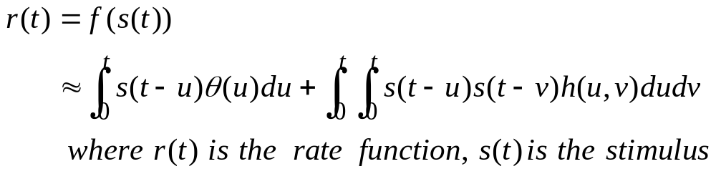
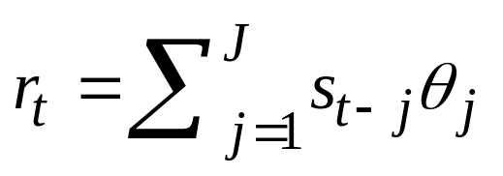

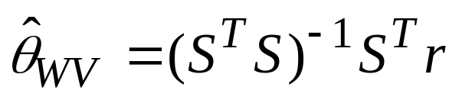
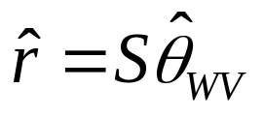
III. Current Analysis Methods: Linear Model Formulations
Wiener-Volterra Kernel Expansion (Marmarelis and
Marmarelis, 2005)
Discrete Approximation and Linear Model Formulation
Least-Squares Estimates

Slide 15
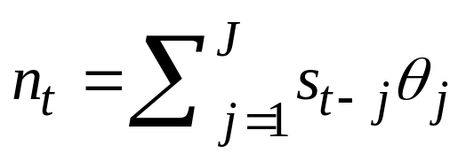

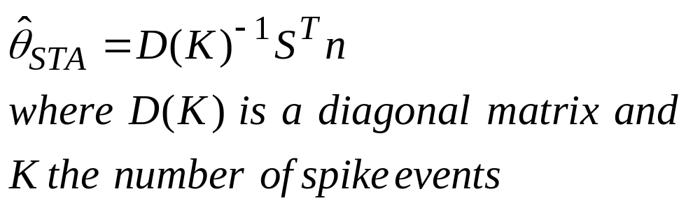
Current Analysis Approaches: Linear Model Formulations
B. Spike Triggered Average (Simoncelli et al. 2004)
Procedure: For every spike event average the stimulus J
milliseconds preceding the event
Estimate of the Stimulus Effect

Slide 16
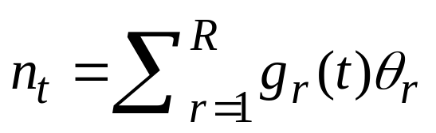

Current Analysis Approaches: Linear Model Formulations
C. Peristimulus Time Histogram (Gerstein, 1963)
Procedure: Average all of the spikes across trials
in a bin or equivalently perform a linear
regression on a matrix of unit impulse
functions

Slide 17
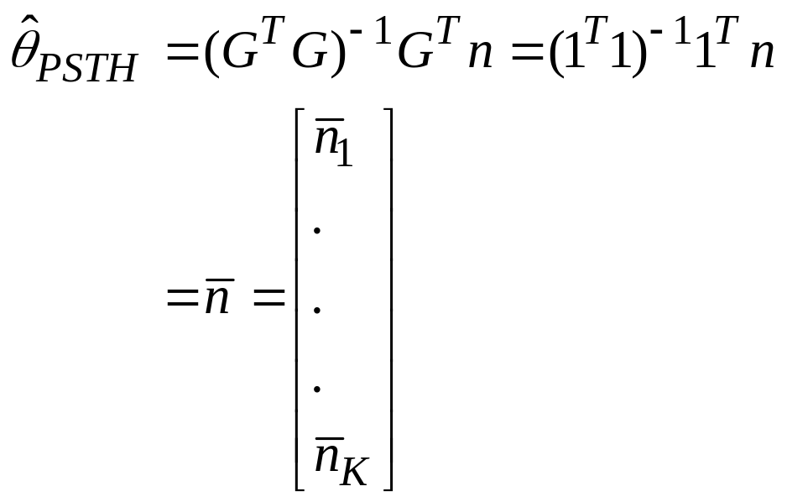
PSTH and Stimulus Basis Functions: Unit Step Functions
g₁(t)
1
g₂(t)
g_{R}(t)
0 100 200 T-100 T
t (ms)
Estimate of the
Stimulus Effect

Slide 18
Summary
Current methods use either explicitly or implicitly linear
models to analyze neural spike train data.
Very often neuroscientists are not aware of the implicit
models that underlie these methods.
There is an incorrect analogy drawn between this problem
and analysis of continuous data that linear models are
“reasonable” first-order or elementary approximations
to the underlying stimulus response relation.
Remember: Neural spike trains are point processes.
The elementary model for a neural spike train
is a conditional Bernoulli probability model.
.

Slide 19
IV. Wiener-Volterra Kernel Expansions and the
Generalized Linear Model Theory

Slide 20
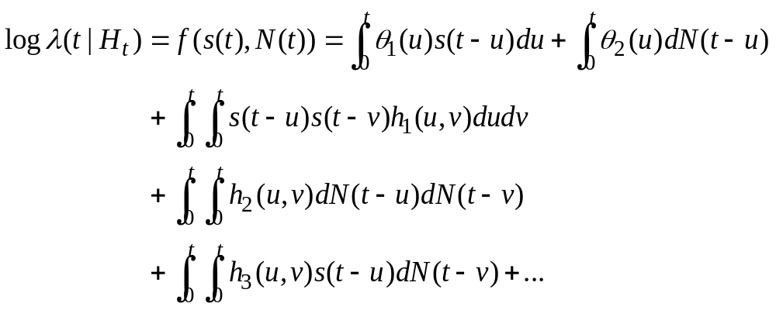
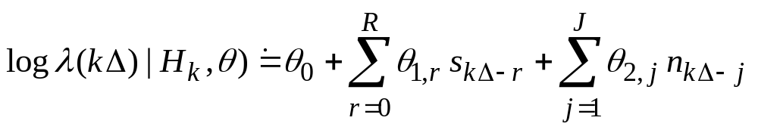
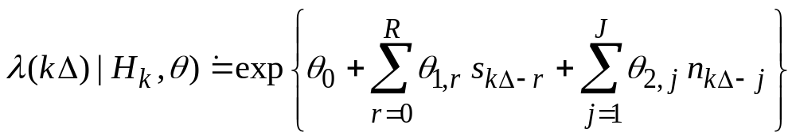
IV. Wiener-Volterra Kernels and the Generalized Linear Model
Wiener Volterra Kernel Expansion of the Log of the Rate (Conditional Intensity) Function
Discrete-Time Approximation

Slide 21

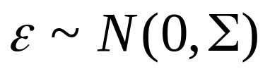
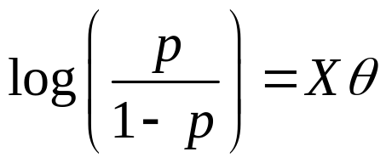
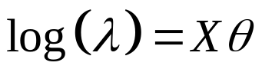
Generalized Linear Models Theory
McCullagh and Nelder (1989)
Linear regression models of the form:
are useful for relating continuous valued observations to a set of covariates.
Many types of data cannot be described by a Gaussian additive noise model.
Generalized linear models extend a simple class of models to other data types. In particular,
Count data:
Binary data:

Slide 22
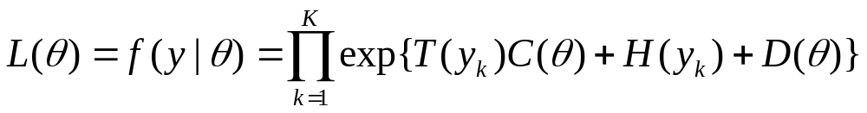
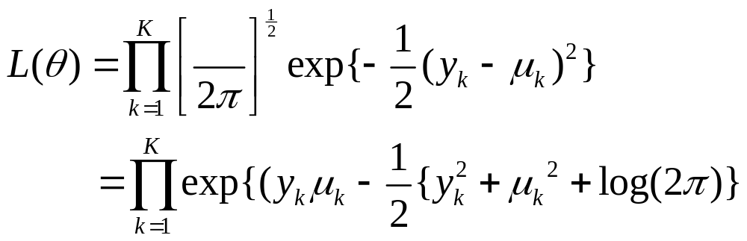
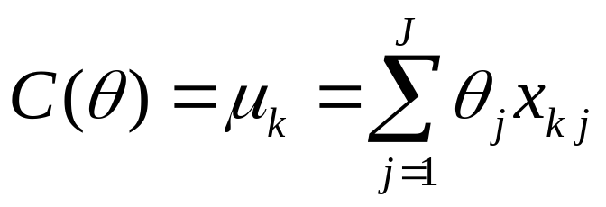
The Exponential Family
Gaussian Data
The natural parameter and canonical link are

Slide 23
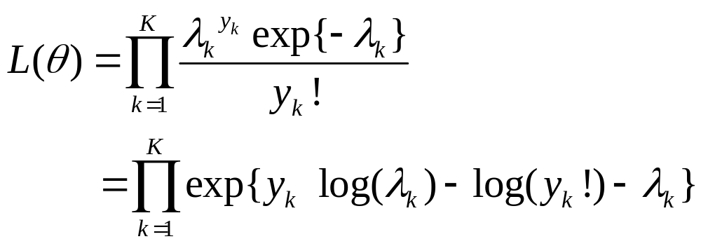
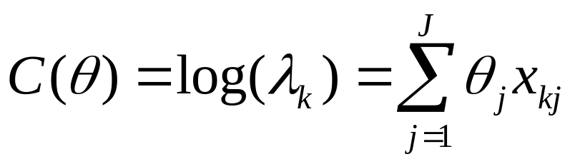
The Exponential Family
Poisson Data
The natural parameter and canonical link are

Slide 24
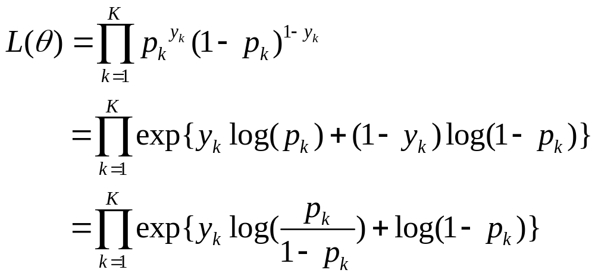
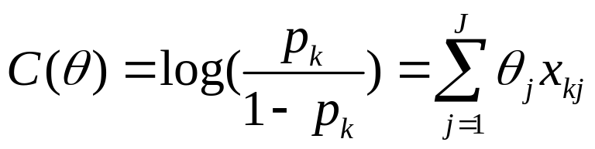
The Exponential Family
Binomial Data
The natural parameter and canonical link are

Slide 25
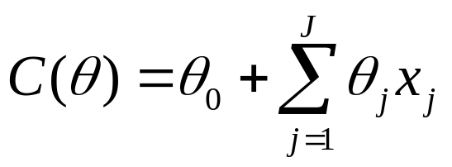
The Generalized Linear Model Theory
The Exponential Family of Distributions
To establish the Generalized Linear Model set the natural parameter to be a linear function of the covariates
All of the probability models we have studied, Bernoulli, binomial, Poisson, Gaussian, gamma, exponential, inverse Gaussian, beta belong to the exponential family.

Slide 26
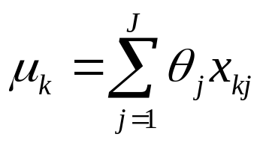
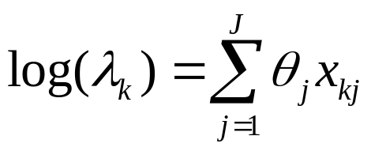
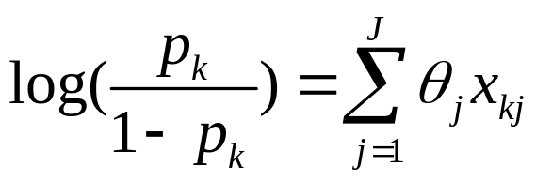
Generalized Linear Models
(Regression Models for non-Gaussian Data)
Model
Link Equation
Gaussian (Linear)
Poisson (Counts)
Binomial (Binary)

Slide 27
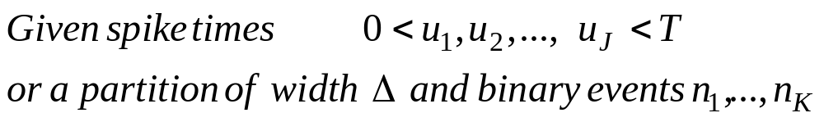
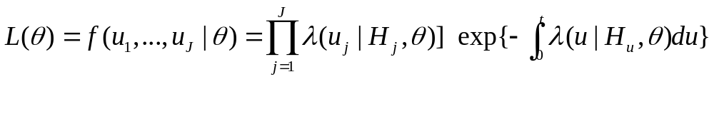
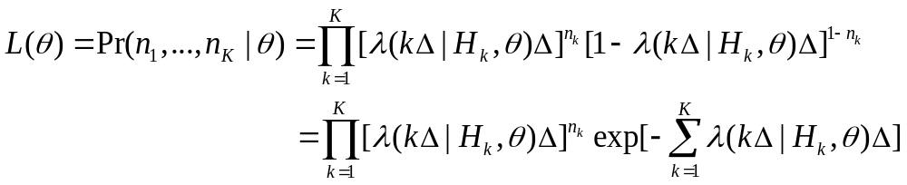
Continuous and Discrete Time Likelihood Functions
Continuous-Time Joint Distribution or Likelihood
Discrete-Time Joint Distribution Time or Likelihood
Conditional Bernoulli
Conditional Poisson

Slide 28




Model Goodness-of-Fit and Analysis
A. Deviance (Analog of the Residual Sum of Squares):
where in the Gaussian case
B. Akaike’s Information Criterion:
For maximum likelihood estimates it measures the trade-off
between maximizing the likelihood (minimizing
and the numbers of parameters p in the model.
C. Standard Errors of the Coefficients and t-tests
t-statistic = Coefficient Estimate/SE

Slide 29
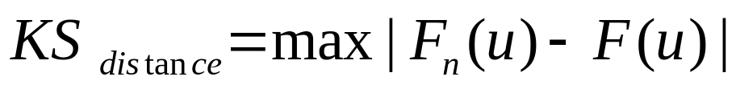
Model Goodness-of-Fit and Analysis
D. Kolmogorov-Smirnov Plot:
Graphical measure of goodness-of-fit, based on the time rescaling theorem, for comparing an empirical and model cumulative distribution function. If the model is correct, then the rescaled ISI,s are independent, identically distributed exponential 1 (uniform) random variables whose ordered quantiles should produce a 45° line.
KS Distance is the maximum distance between an empirical and a theoretical probability model.

Slide 30
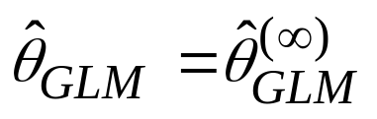
Computations for the Generalized Linear Model
The key unifying feature of the generalized linear model framework
is that all of the model estimation can be carried out very efficiently
using iteratively reweighted least squares.

Slide 31
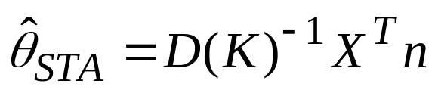
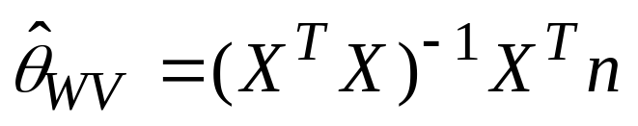
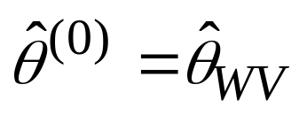
Spike Triggered Average and the Wiener-Volterra Kernel (PSTH) are suboptimal approximations the GLM estimates
Spike-Triggered Average
Wiener-Volterra Kernel (PSTH)
Generalized Linear Model (ML by IRLS)
ML Estimate
Initial Guess
Paninski (2004), Czanner et al. (2008)

Slide 32
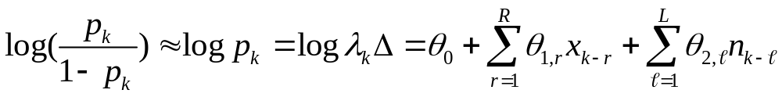

Point Process-Generalized Linear Models
Following the W-V expansion write the log of the CIF as a linear function of stimulus and spiking history (biophysical and network properties).
Binomial
Poisson
Fit the models by maximum likelihood in MATLAB using GLMfit.

Slide 33
Summary W-V Kernel and GLM Theory
We use the discretized form of the bivariate W-V kernel of the log conditional intensity function
Generalization of the Gaussian Linear Model (McCullagh and Nelder, 1989)
Can be used for any probability model in the exponential family.
Is a maximum likelihood analysis and has all of its optimality properties.
An efficient computational framework using iteratively reweighted least squares.
GLM is available as a toolbox in all major statistics packages e.g. R, Minitab, SAS, SPSS and Matlab.

Slide 34
IV. Applications
A. Retinal Neuron Spike Train
B. [Hippocampal Experiment ]
C. [Inferior Colliculus Experiment Lecture 3]

Slide 35


Point Process Data: Neural Spike Trains
Retinal neurons are maintained under constant light and environmental conditions. The spontaneous spiking activity of these neurons is recorded.
The objective of the study is to characterize the stochastic (random) structure in the spiking activity.
Iyengar and Liu, Biol. Cyber. (1997)

Slide 36



Question: Can we construct a history-dependent firing rate model to describe the retinal neuron spiking activity?
The ISI distribution model (exponential, gamma, inverse Gaussian) we constructed were
We use GLM to build history-dependent models as
Poisson Model:
Binomial Model:
How do we pick a model order?

Slide 37
Generalized Linear Model Analysis
Exploratory Analysis:
We plotted the data as a time-series.
We computed the partial autocorrelation coefficients of order up to 50.
Confirmatory Analysis:
We fit GLM models of orders varying from 1 to 120 (msec).
We computed the deviance, AIC, KS plots and the significance of the coefficients.

Slide 38
Partial Correlogram
0.1
0.08
0.06
0.04
Partial Correlation Coefficient
0.02
0
-0.02
-0.04
0
10
20
30
40
50
AR Order

Slide 39

AIC Model Order Analysis
AIC
GLM Order

Slide 40

GLM Coefficients
Coefficient Value
Lag (msec)

Slide 41

Generalized Linear Model Analysis Summary

Slide 42

Kolmogorov-Smirnov Plots
Model Quantiles
Empirical Quantiles

Slide 43

KS Plots for Different Order GLMs
Model Quantiles
Empirical Quantiles

Slide 44

GLM Model Classes
Model Quantiles
Empirical Quantiles

Slide 45

Correlation Function for Rescaled ISIs
Correlation
ISI Lag Order

Slide 46
AIC and KS Statistics
Poisson |  |  | Binomial
1 | 14 | 50 | 1 | 14 | 50
6589 | 5931 | 5892 | 8496 | 7792 | 7746
0.2525 | 0.0657 | 0.0462 | 0.2525 | 0.0822 | 0.0533
Order
AIC
KS
Exp | Gamma | Inv. Gauss.
0.2330 | 0.2171 | 0.1063
Parametric Models:
KS Statistic

Slide 47

Interspike Interval Models
Exponential
Gamma
Inverse Gaussian
Order 50 GLM
Probability Density
ISI (msec)

Slide 48
Inferences
Iyengar and Liu showed that a generalized inverse Gaussian model described these data well.
The fit of history-dependent GLM model improves appreciably on the fits of the exponential, gamma and inverse Gaussian models, most notably in terms of KS plots.
Our analysis shows that the GLM model describes the essential stochastic features in the data. There is a significant history dependence in the retinal neural spiking data extending back 14 msec.
There is another effect going back approximately 50 msec.
The shorter time-scale phenomena may reflect intrinsic dynamics of the individual neuron such as absolute and relative refractory periods and bursting, whereas the longer time-scale effects may also include network dynamics.

Slide 49
Conclusion
Only 14 parameters are used to fit ~ 30,000 data points!
This type of strong history dependent effect is something we have seen in neurons from a number of different brain regions, animal models and experimental protocols. It was all simply described by GLM fitting.
GLM provides a flexible framework for the analysis of neural spike train data. It has the spike triggered average the PSTH as special cases.

Slide 50
Acknowledgments
I am grateful to Uri Eden for conducting the data analysis and preparing the figures and to Julie Hartin for technical assistance.
Reference
McCullagh P, Nelder JA. Generalized Linear Model, 2nd Edition. Chapman and Hall, 1989.
Truccolo W, Eden UT, Fellow M, Donoghue JD, Brown EN. A point process framework for relating neural spiking activity to spiking history, neural ensemble and covariate effects. Journal of Neurophysiology, 2005, 93:1074-1089.
Kass RE, Ventura V, Brown EN. Statistical issues in the analysis of neuronal data. Journal of Neurophysiology, 2005, 94: 8-25.

