Slide 1
9.073/HST460 J
Introduction to the Generalized Linear Model: Part II
Emery N. Brown
March 22, 2017

Slide 2
Different Data Summaries
A
B
C
Spike Counts
PSTH
Raster Plot
Wirth et al., Science (2003), Czanner et al., J. Neurophys (2008)

Slide 3
How Big is the Stimulus Effect?
Czanner et al. J. Neurophys 2008

Slide 4
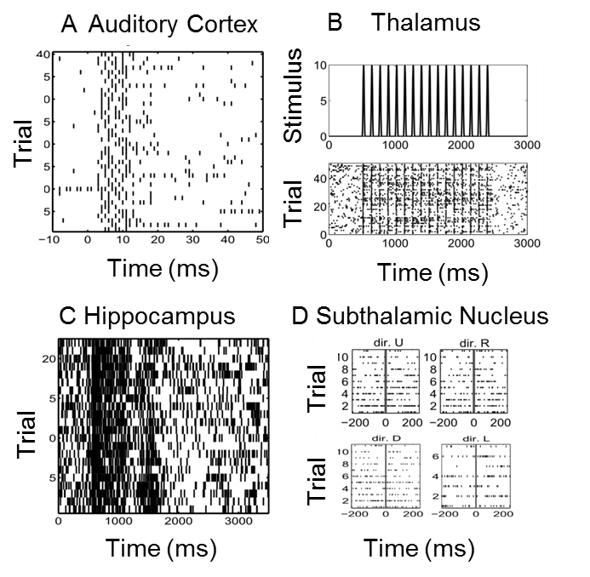
Examples of Stimulus-Response Experiments in Systems Neuroscience
Czanner et al. PNAS 2015

Slide 5
A Signal-to-Noise Ratio for Neural Systems
Deviance (Likelihood Ratio)
Saturated Likelihood
Difference of Deviance (~Difference in Sum of Squares)

Slide 6
A Signal-to-Noise Ratio for Neural Systems
Ratio of the decrease in the deviance due to the
signal (task-specific effect or stimulus) correcting
for the biophysical properties (spike history effect)
of the neuron.

Slide 7
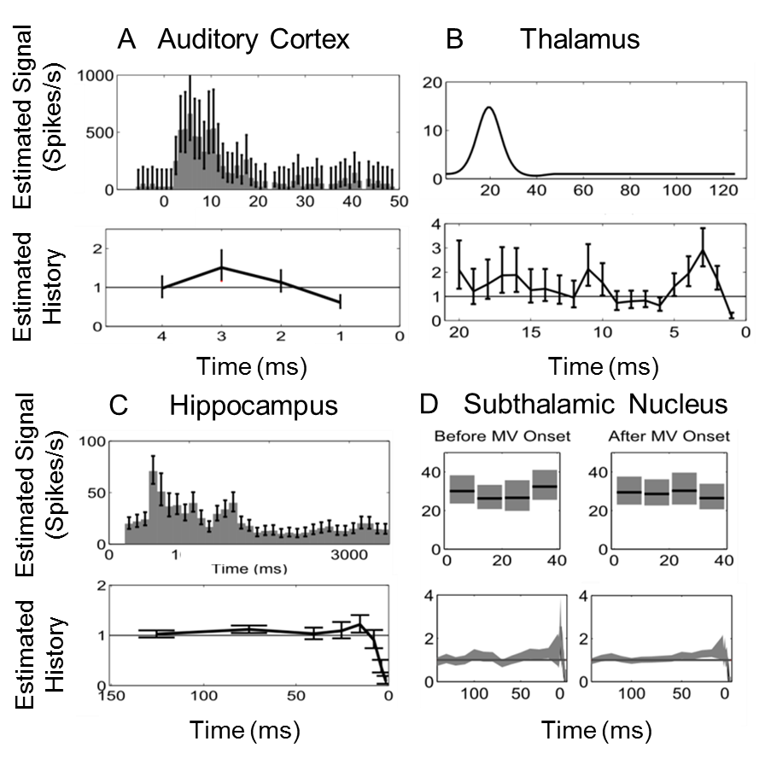
Examples of Stimulus-Response Experiments in Systems Neuroscience
Czanner et al. PNAS 2015

Slide 8
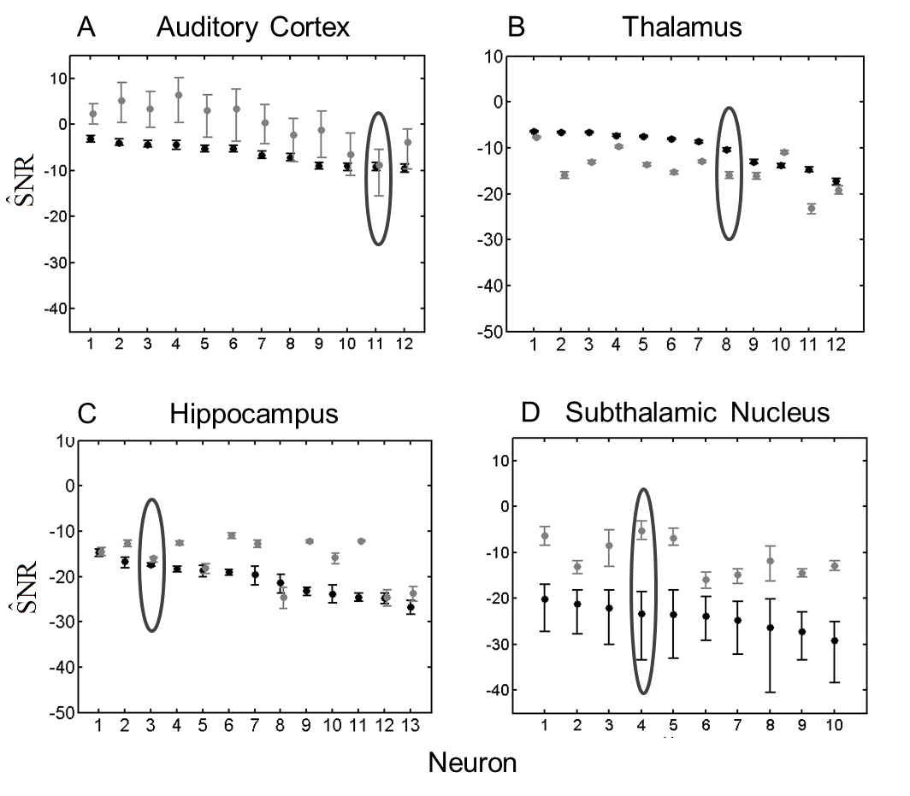
Signal-to-Noise Ratios for Stimulus and for Spike History Components
Czanner et al. PNAS 2015

Slide 9
Goodness-of-Fit Analysis: KS Plot and Partial Autocorrelations Plots
Czanner et al. PNAS 2015

