Slide 1
INTRODUCTION TO STATISTICS FOR NEUROSCIENCE
RESEARCH
9.073 HST 460
Introduction to Spectral Analysis II:
Nonparametric Spectral Analysis
April 26, 2017
Emery N. Brown
Sourish Chakravarty

Slide 2
Data
where
the sampling interval
the sampling rate
Assume that the data obey a second-order stationary process
for all

Slide 3
Fourier Transform
Power
Definition of the Spectrum
where we assume that the process is second-order stationary
so that the ensemble average is the equivalent of the time
average.

Slide 4
Intuition
1. Spectral Representation of a Second-Order Process
where the
are zero mean uncorrelated increments and
Inverse Fourier Transform
2. Harmonic Regression

Slide 5
Autoregressive Model of Order 6
Autocovariance Function
Spectrum

Slide 6
Sample Mean and Sample Covariance Estimates
Periodogram Spectrum Estimate
The Expected Value of the Periodogram is

Slide 7
The Expected Value of the Periodogram is
where
is Fejer’s kernel. The expected value of the periodogram
is a smoothed estimate of the underlying true spectrum.

Slide 8
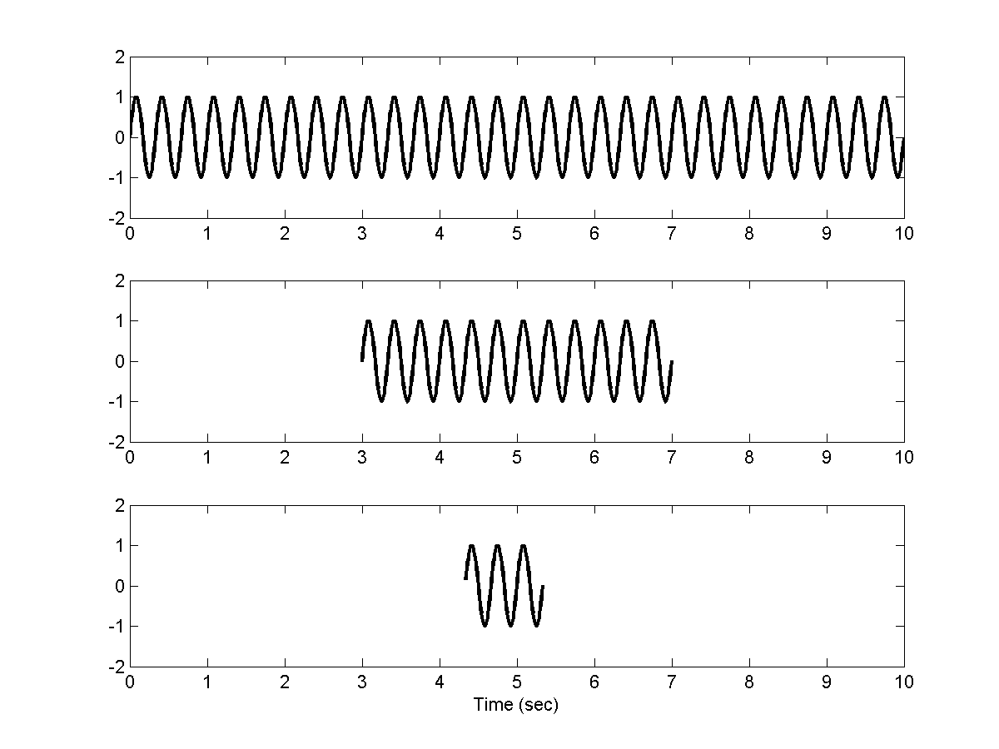
Intuition: Observations with different finite durations
3Hz Sine Wave

Slide 9
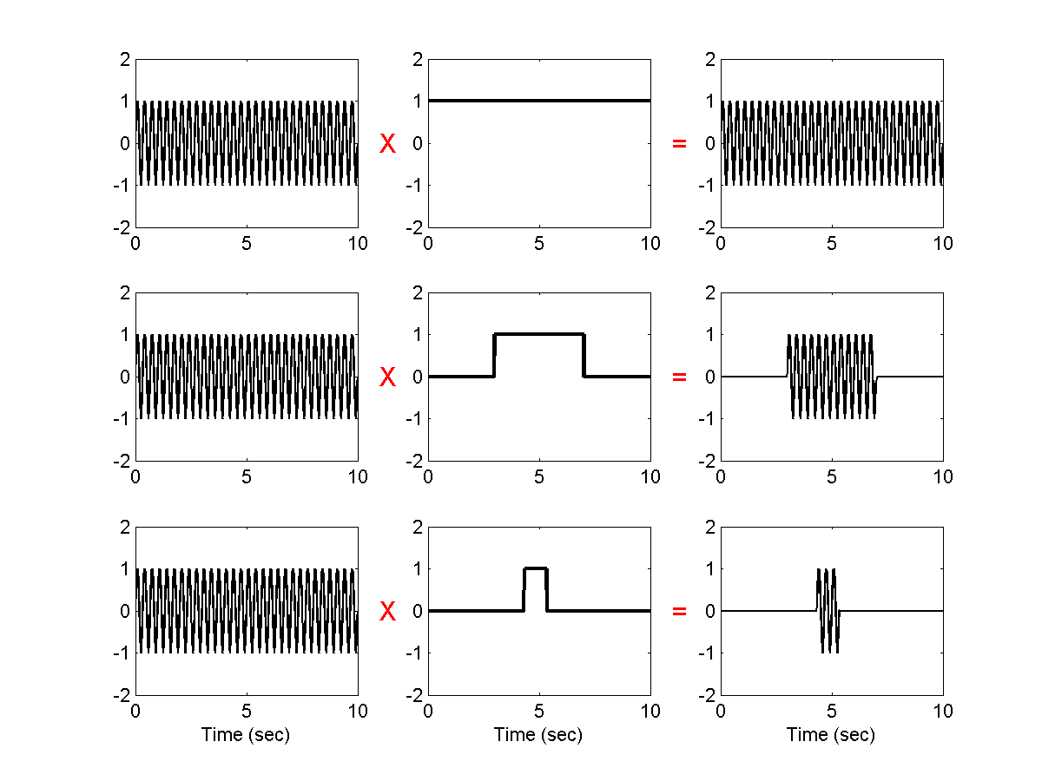
Finite window equals multiplication by a “tophat” function

Slide 10
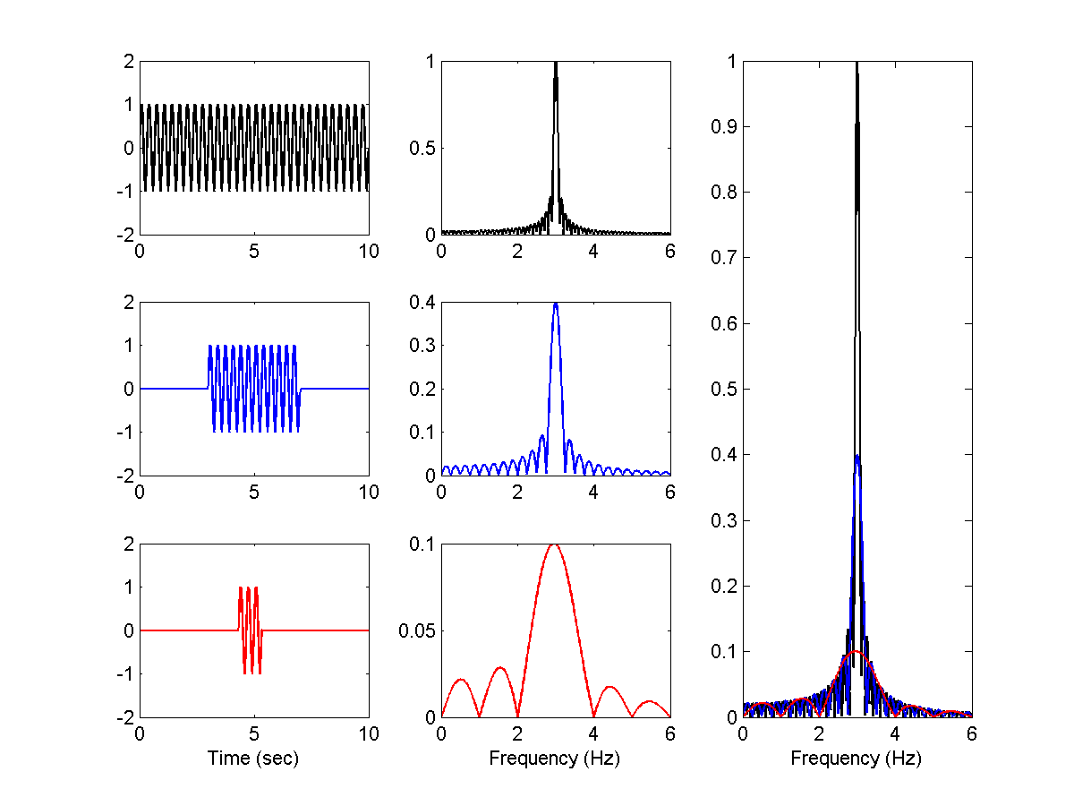
Finite window leads to bias
Data Absolute value of Fourier Transform

Slide 11
Periodogram Estimate of Spectrum of an AR (6) Process

Slide 12
Tapered Spectral Estimates
Multiply
Fourier transform and take the squared modulus
We can control the bias
Kernel Modulus
Example: Hanning Kernel

Slide 13
Hanning Tapered Spectral Estimates

Slide 14
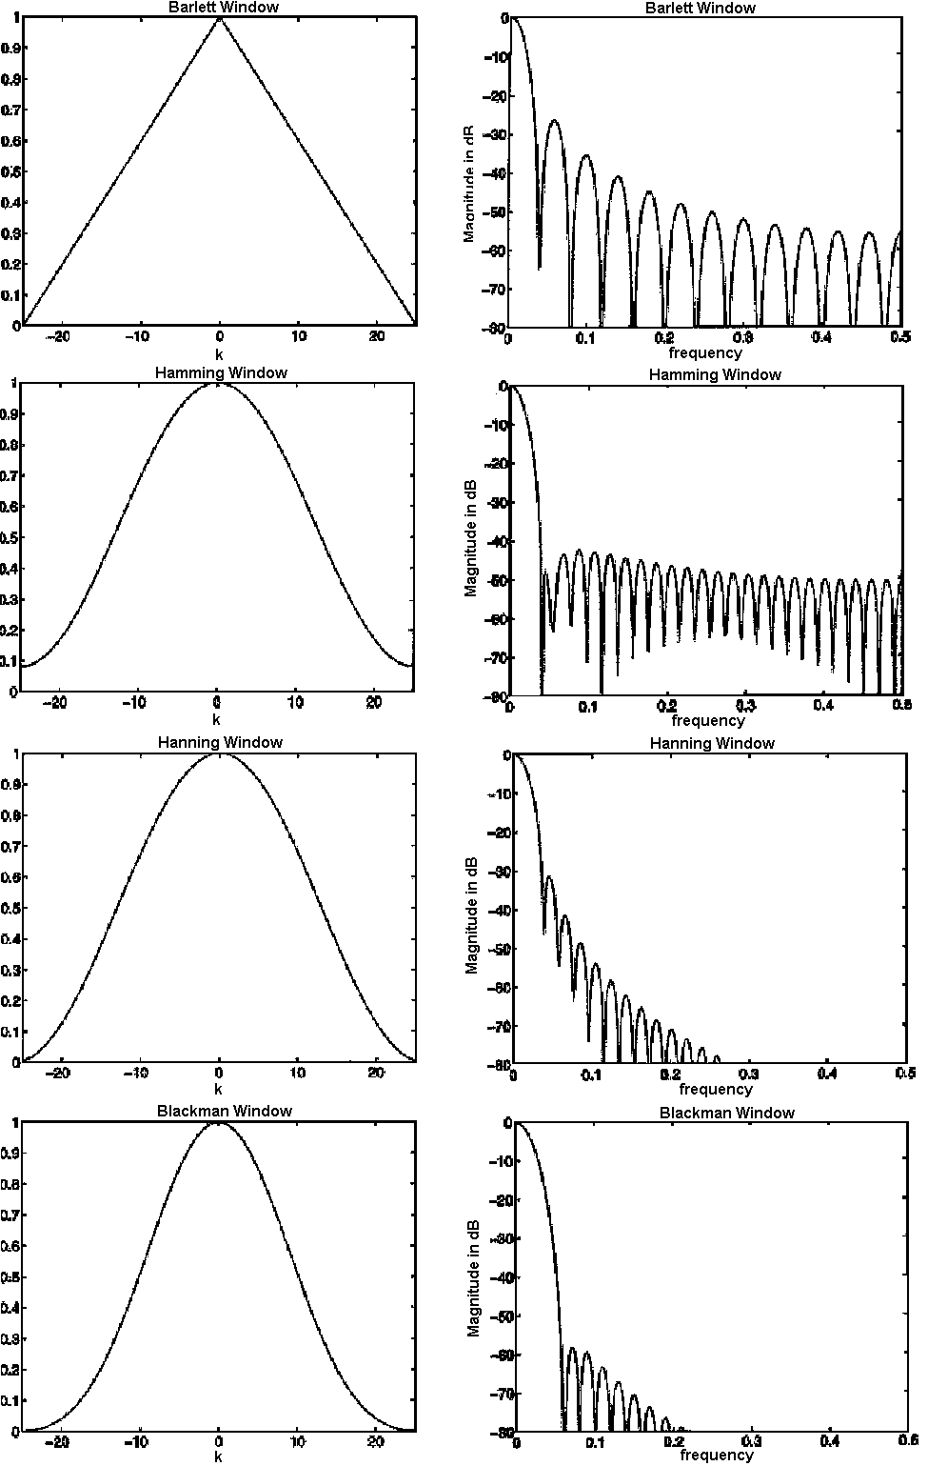
Other Windowing Functions
Bartlett
Hamming
Hanning
more narrow-band bias
Blackman
less broad-band bias
Stoica P. and Moses R., Introduction to Spectral Analysis (1997)

Slide 15
Multi-taper Spectrum and Spectrogram Estimation

Slide 16
Multi-taper Spectrum Estimation
Two Drawbacks of Periodogram and Tapered Estimates
Very variable
2. Decreasing the narrow-band bias increases the broad-
band bias
Question: Is there an optimal trade-off between broad-band bias and narrow-band bias that minimizes variance?
Answer: Multi-taper Spectrum Estimation

Slide 17
Multitaper Spectrum Estimation
The multi-taper spectral estimation prescription
Look for functions that are zero outside
[-T/2,T/2] and whose Fourier transforms is optimally concentrated in a frequency range ±W (bandwidth), i.e.
R = 2W is the spectral resolution.
W, or equivalently R, is allowable narrow-band bias (user-defined). We would like to decrease broad-band bias and pay a cost in terms of increased narrow-band bias.

Slide 18
The Multi-taper Spectrum Estimate
The ith Eigenspectrum Estimate
Orthonormalilty Condition on the Tapers
Expected Value of the Multi-taper Spectrum Estimate

Slide 19
Upperbound on the bias
Maximize
or equivalently
where

Slide 20
Solution: Choose the tapers to be the first L eigenvectors of
which are the discrete prolate spheroid sequence also
known as Slepian functions and we choose the number
of tapers so that
for
length of the stationary time interval
spectral resolution

Slide 21
Example
We want to find the multi-taper spectrum estimate of 3 sec of data: T = 3sec (length of the stationary interval)
We decide on a bandwidth parameter: R = 4Hz or
W=R/2=2Hz (Estimation of power at frequency f, will be mainly affected by frequencies between f-W and f+W)
We want to make L spectrum estimates using L Slepian functions: L=2TW-1=11
Multi-taper spectrum estimate is obtained by averaging L spectrum estimates

Slide 22
Multitaper Spectrum Estimation
1. Choose
and
2.Compute the number of tapers
3.Compute the L eigenspectra
4.Compute the multitaper spectral estimate as the average
of the L eigenspectra.

Slide 23
Slepian Tapers and the Modulus Squared of their Fourier Transforms
Taper 1
Taper 7
Taper 2

Slide 24
Multitaper Spectral Estimation AR (6): 4 Tapers versus Maximum Likelihood Estimate

Slide 25
Spectrogram Analysis
Raw EEG Trace
(Purdon et al, 2015, Anesthesiology)

Slide 26
Example: Sevoflurane Anesthesia

Slide 27
Spectrogram of EEG in Response to a Target-Controlled Infusion of Propofol
T= 2sec R=2Hz, L= 3

Slide 28
A Bootstrap Procedure for Inferences using Multitaper Spectral Estimation

Slide 29
Spectra of Anesthetized Children as a Function of Age
11 0 to 3 Months of Age
19 4 to 6 Months of Age
T= 3sec R=2Hz, L= 5
Cornelissen et al. eLife 2015

Slide 30
Spectra and 95% Confidence Intervals for
Spectral Differences
Cornelisson et al. eLife 2015

Slide 31
Comparing the Means of Two-Samples: Analytically
Compute the 95% Confidence Interval for

Slide 32
Comparing the Means of Two-Samples: Bootstrap
Approximate the distributions as
Compute the 95% Confidence Interval for
using the bootstrap.
1. Draw
2. Compute
3. Repeat steps 1 and 2 1,000 times.
4. Order
Lower Confidence Bound
Upper Confidence Bound

Slide 33
Comparing the Spectra of Two Time Series: Bootstrap
Estimate
and
by multitaper methods.
If
and
are assumed stationary.
where
is the Fourier transform.

Slide 34
Comparing the Spectra of Two Time Series: Bootstrap
Compute the 95% Confidence Interval for
using the bootstrap.
1. Draw
2. Compute
3. Repeat steps 1 and 2 1,000 times.
4. Order
Lower Confidence Bound
Ramos 1988;
Hurvich and Zeger, 1987
Upper Confidence Bound

Slide 35
Spectra and 95% Confidence Intervals for
Spectral Differences
Cornelissen et al. eLife 2015

Slide 36
Summary
The multitaper spectral methods provide an optimal approach to spectral estimation that balances the broad-band narrow-band trade off.
We make extensive use of these methods in our analyses of neurophysiological data recorded in patients and in animals receiving general anesthesia and sedation.
The real-time spectrogram can be used to monitor brain states of patients receiving general anesthesia and sedation.
These methods have been critical for providing robust information to support our model collaboration with the Kopell group.

