Slide 1
STATISTICS FOR NEUROSCIENCE RESEARCH
9.073 / HST 460
Class 9: Principal Components Analysis
Emery N. Brown
April 17, 2017

Slide 2
Example 17.1 : Probability Model for Spike Sorting
The data are tetrode recordings (four electrodes) of the peak voltages
(mV) corresponding to putative spike events from a rat hippocampal
neuron recorded during a texture-sensitivity behavioral task.
Each of the 15,600 spike events recorded during the 50 minutes is a
four vector.
The objective is to develop a probability model to describe the cluster
of spikes events coming from a single neuron.
Such a model provides the basis for a spike sorting algorithm.
Could data reduction be performed prior to formulating the model.

Slide 3
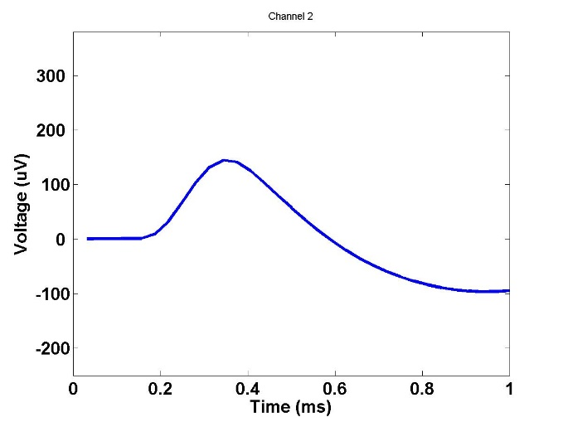
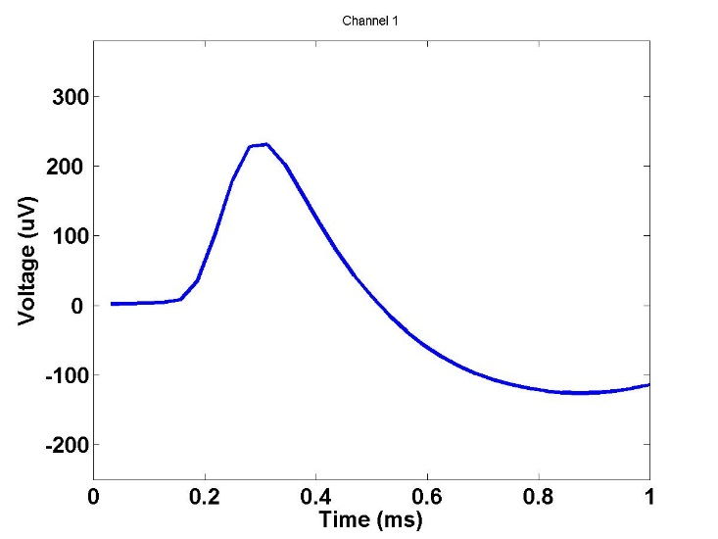
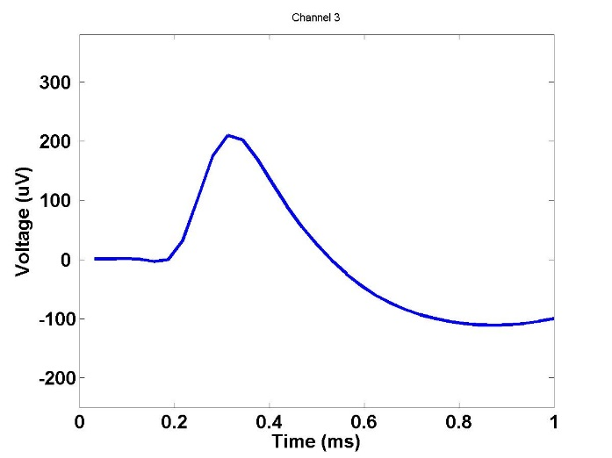
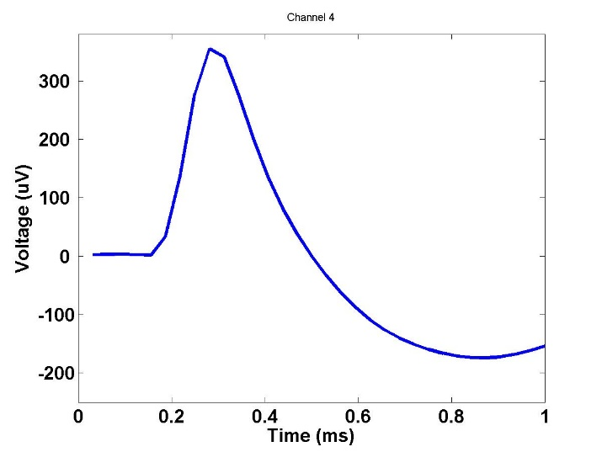
Tetrode
Recordings
Neuron

Slide 4
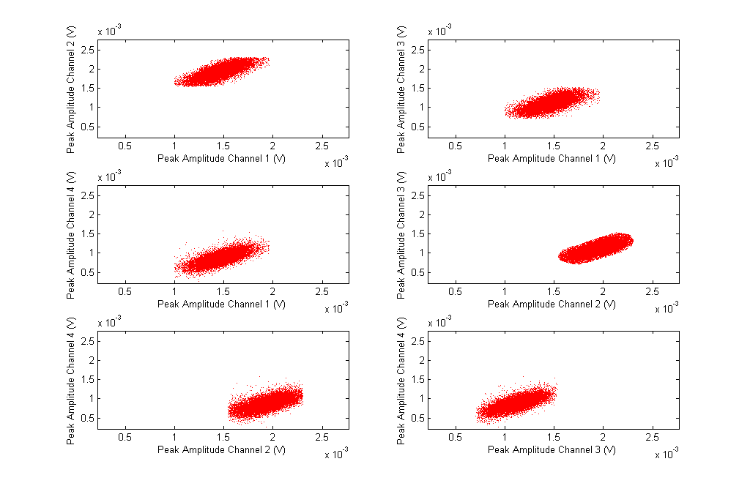
Six Bivariate Plots of Tetrode Channel Recordings

Slide 5
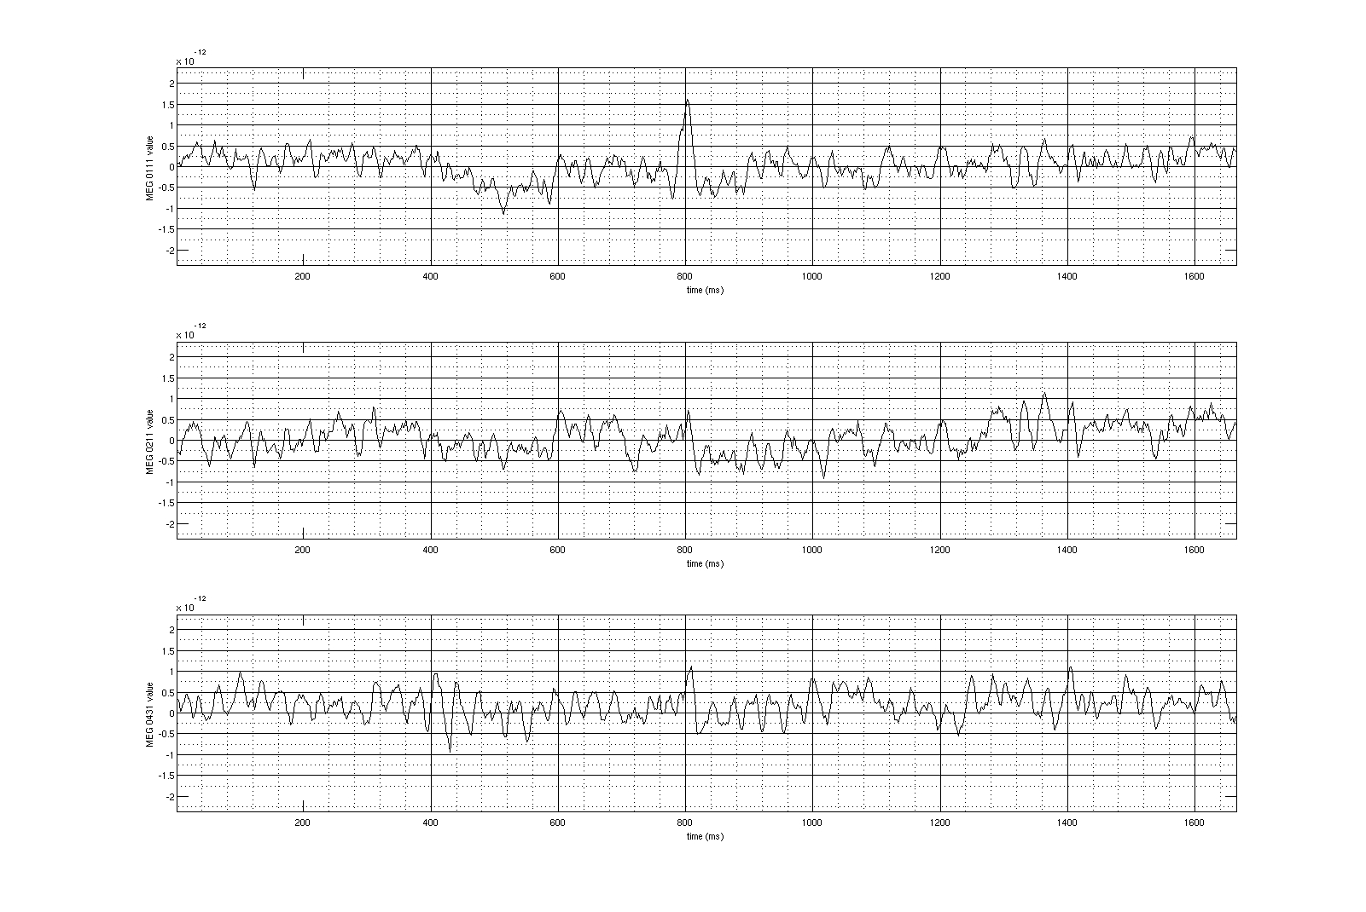
Example 17.2 Time Series Plots of MEG Sensor Background Noise
Sensor 1
Sensor 2
Sensor 4
Time (ms)
Data Analysis by Antonio Molins

Slide 6
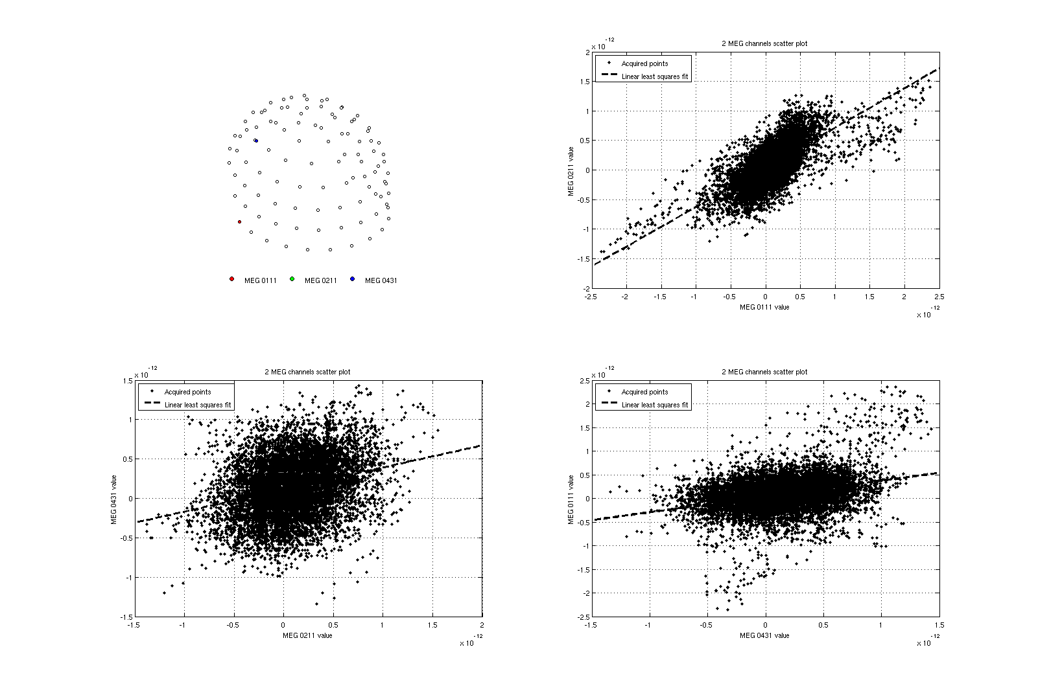
Bivariate Plots of MEG Sensor Background Noise
MEG Sensor
Configuration
Sensor 2
Sensor 1
Sensor 4
1
Sensor 2
Sensor 4

Slide 7
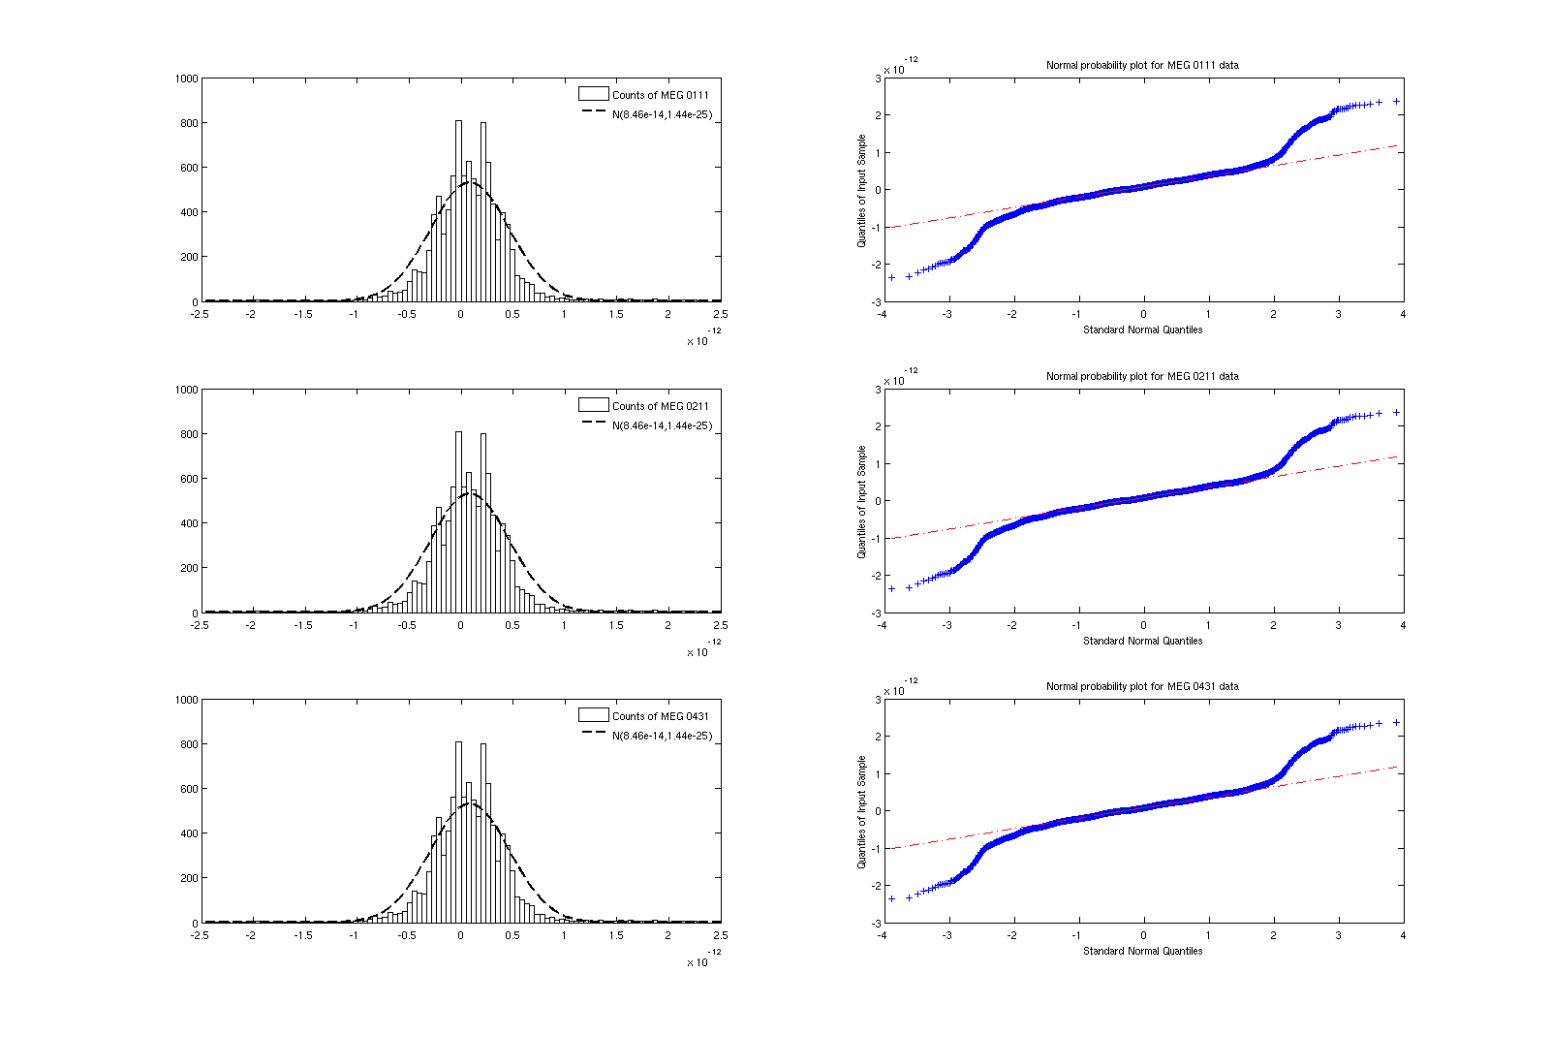
Histograms and Q-Q Plots of MEG Sensor Backgorund Noise
Sensor 1
Sensor 2
Sensor 4

Slide 8
Principal Components Analysis
Eigenvalues are
1e-23*[0.0397, 0.1072, 0.2596]
Percentage of Variance Explained
9.73%, 26.36%, 63.873%
Covariance Matrix of X.
1e-24*[ 0.1443 0.0967 0.0443
0.0967 0.1293 0.0363
0.0443 0.0363 0.1328 ]

Slide 9
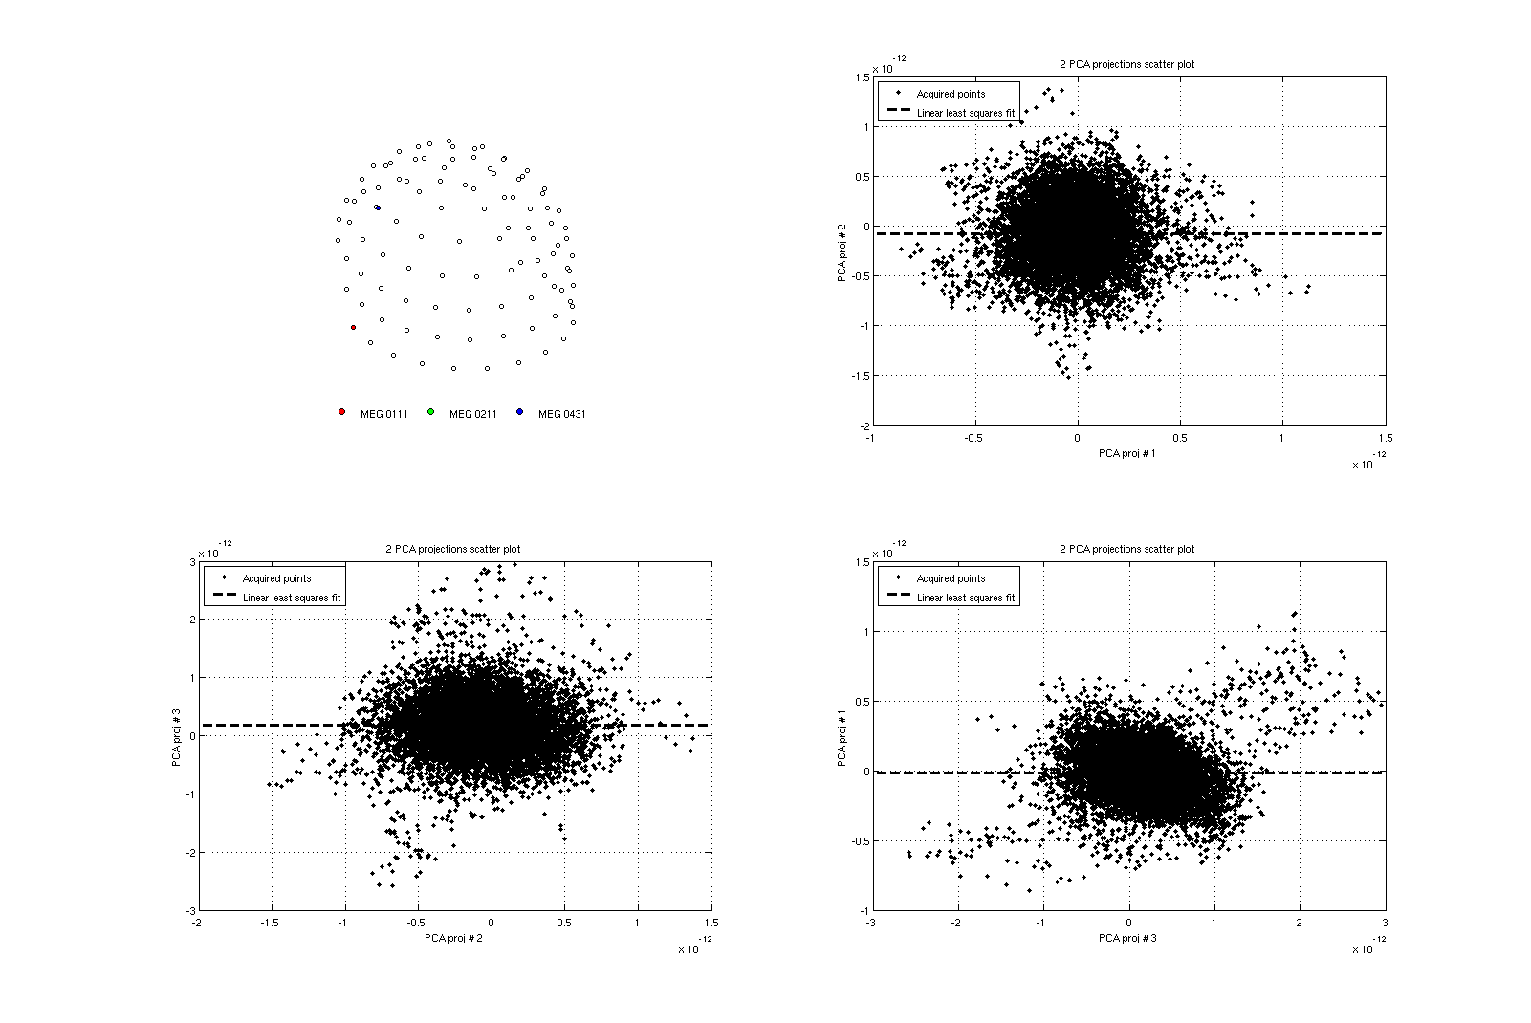
;
Bivariate Plots of MEG Sensor Data Displayed in the PCA Space
MEG Sensor
Configuration
Sensor 2
Sensor 1
Sensor 4
1
Sensor 4
Sensor 2

Slide 10
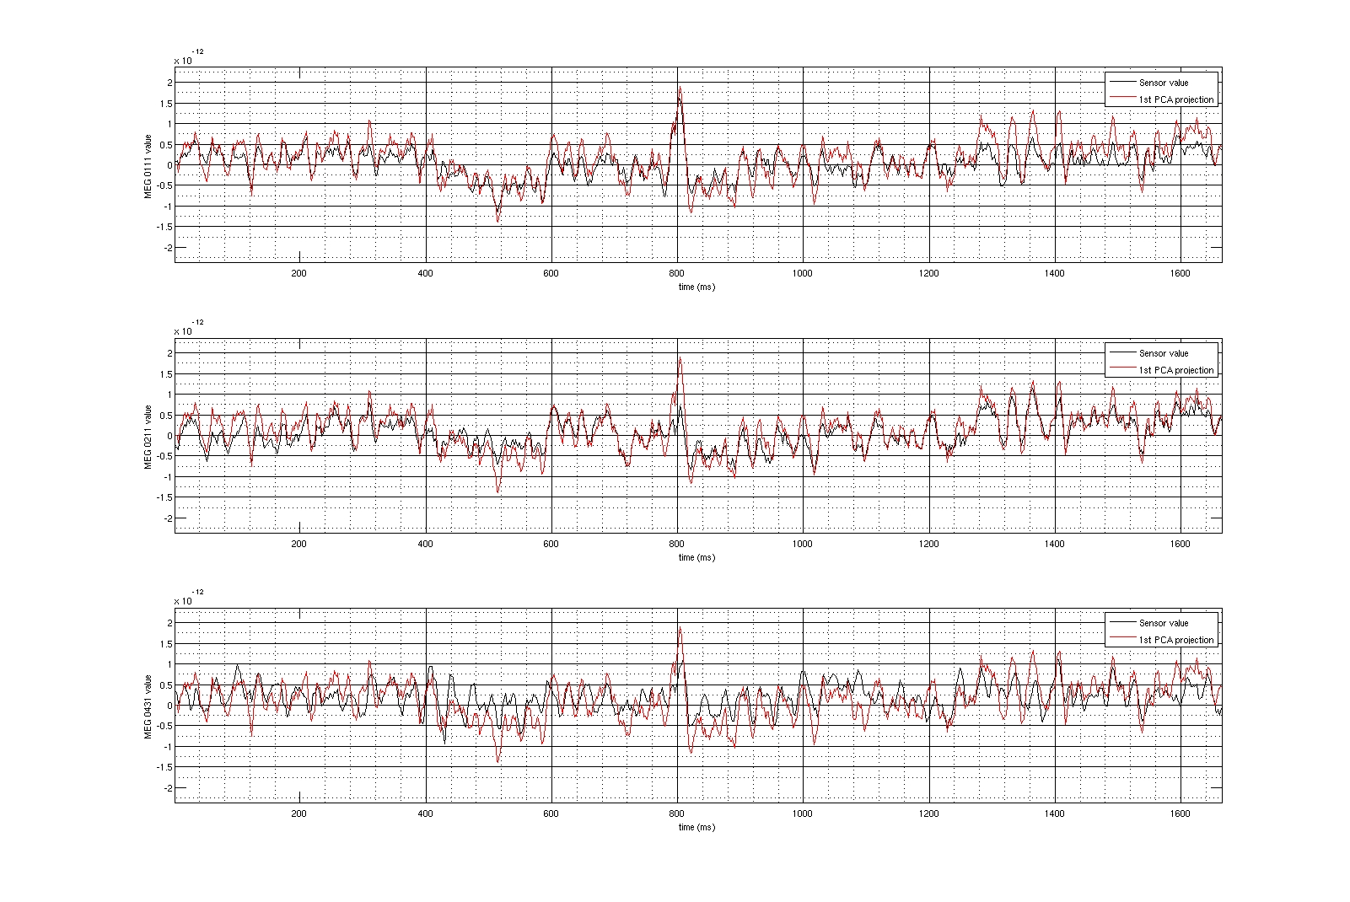
Time Series Plots of MEG Sensor Background Noise with
Superimposed 1st Principal Component
Sensor 1
Sensor 2
Sensor 4
Time (ms)

Slide 11
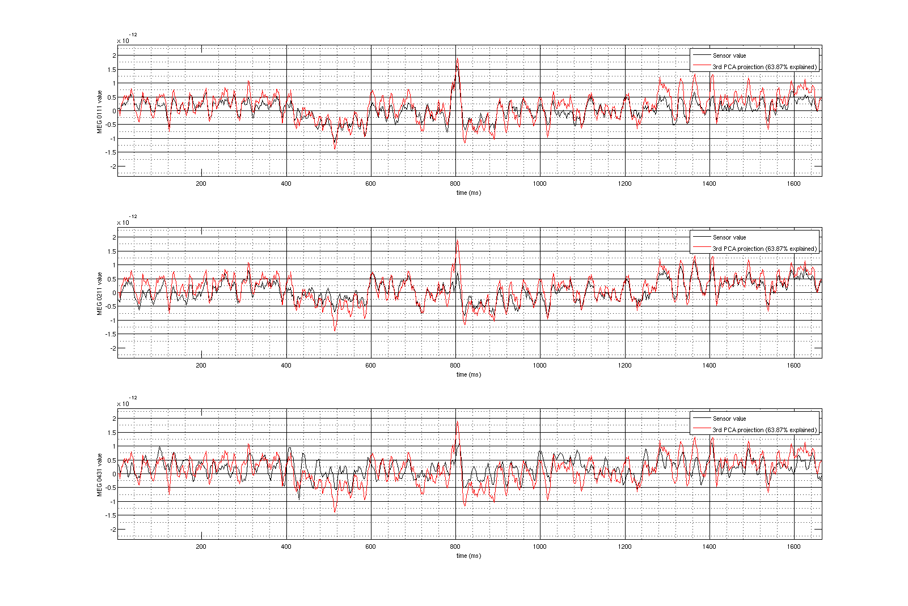
Time Series Plots of MEG Sensor Background Noise with
Superimposed 3rd Principal Component
Sensor 1
Sensor 2
Sensor 4
Time (ms)

Slide 12
Summary
Principal Components Analysis is one the most used
data reduction techniques.
We will next study a related, more recently developed
data reduction technique called independent components
analysis.

