Slide 1
STATISTICS FOR NEUROSCIENCE RESEARCH
9.073 / HST 460
Multiple Regression
Emery N. Brown
March 6, 2017

Slide 2
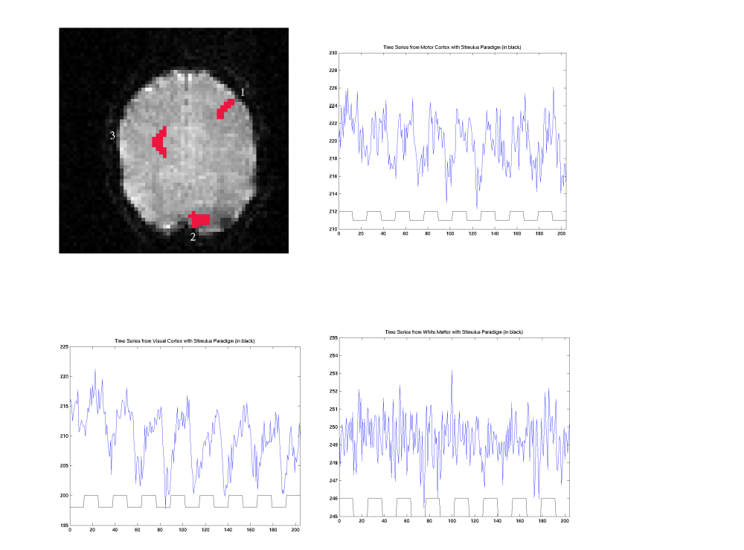
fMRI Combined Motor and Visual Experiment

Slide 3
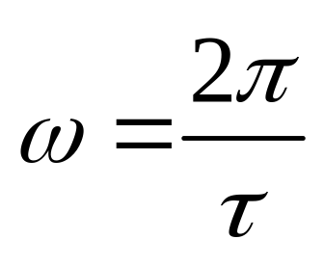

Harmonic Regression + Linear Drift Model
where
and
Is the period of the visual stimulus

Slide 4







fMRI Signal and Noise Model
Measurement on a single pixel at time
Physiologic response
Activation coefficient
Physiologic and Scanner Noise
We assume the
are independent, identically distributed
Gaussian random variables.

Slide 5



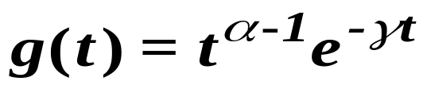
fMRI Signal Model
Physiologic Response
hemodynamic response
input stimulus
Gamma function as a model of the hemodynamic response
Assume we know the parameters of g(t).

Slide 6
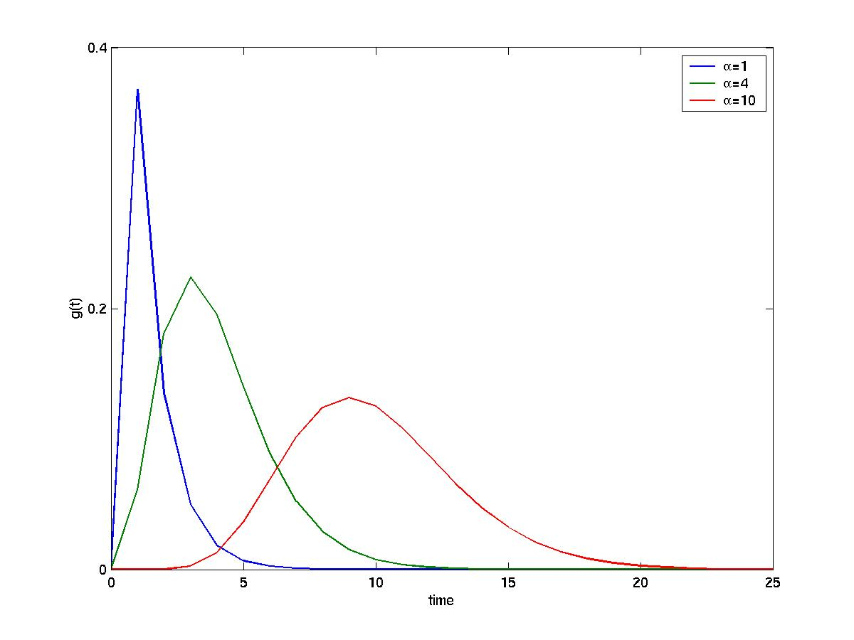
Gamma Hemodynamic Response Model

Slide 7
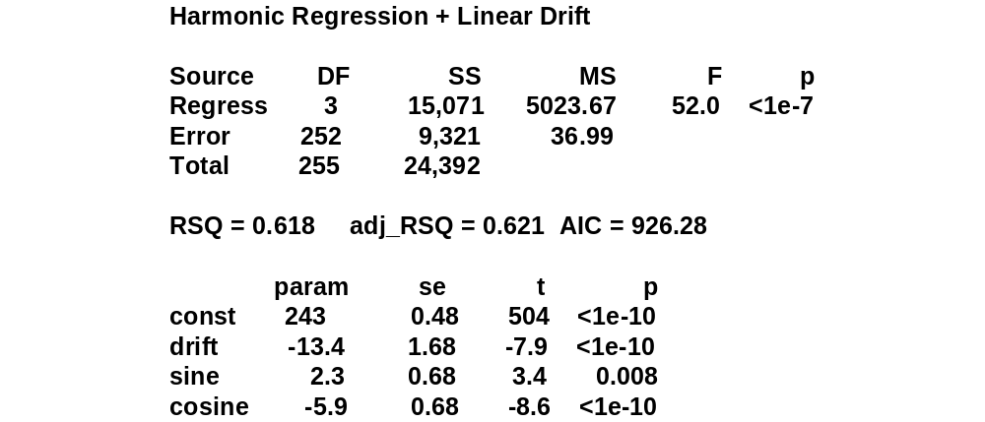
Analysis Summary: Harmonic Regression + Linear Drift

Slide 8
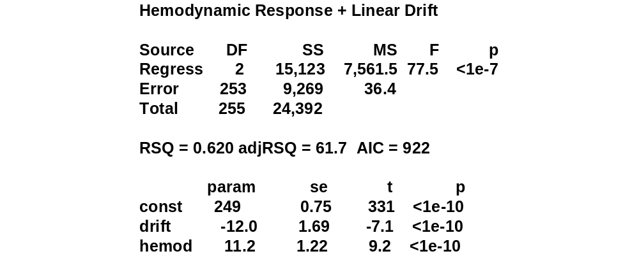
Analysis Summary: Hemodynamic Response + Linear Drift

Slide 9
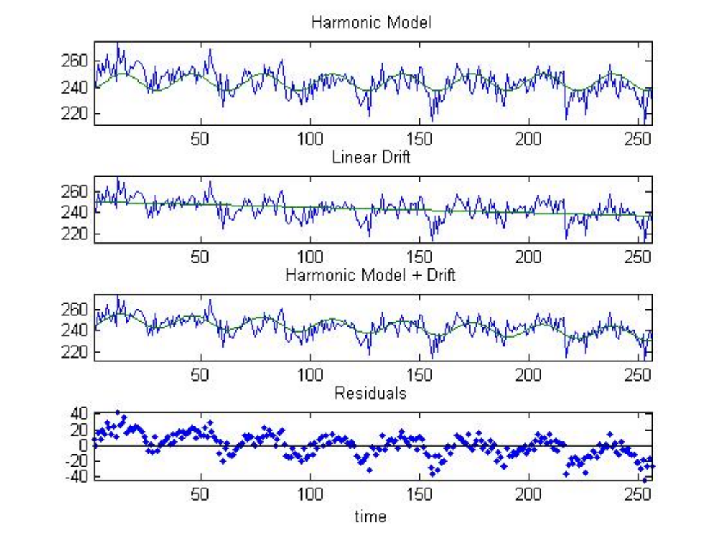
Harmonic Regression + Linear Drift

Slide 10
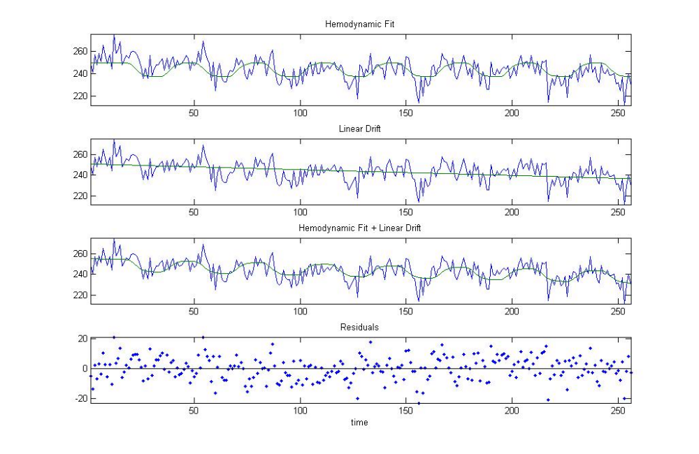
Hemodynamic Response + Linear Drift

Slide 11
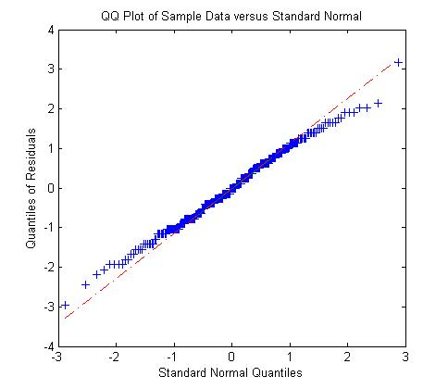
QQ Plot Harmonic Regression + Linear Drift

Slide 12
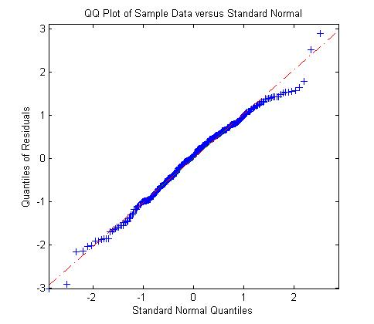
QQ Plot: Hemodynamic Response + Linear Drift

Slide 13
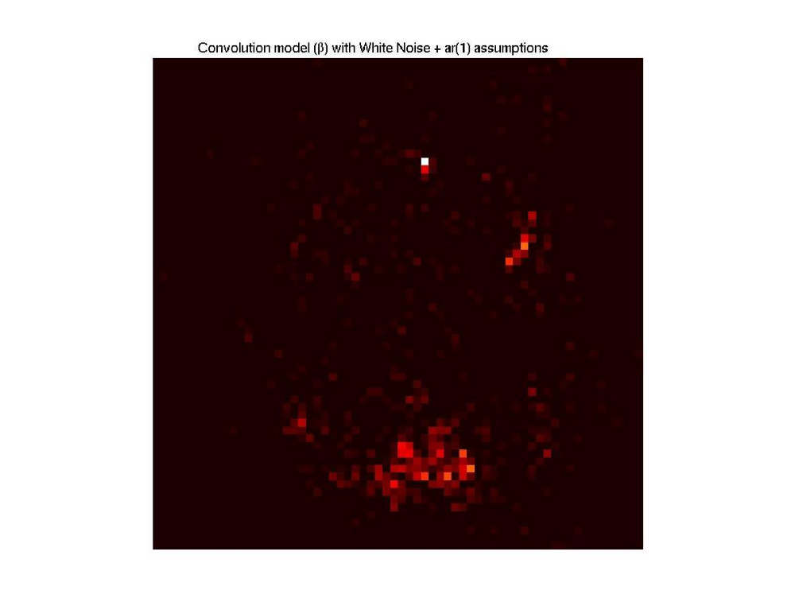
fMRI Image Constructed from the
Hemodynamic Response + Linear Drift

Slide 14
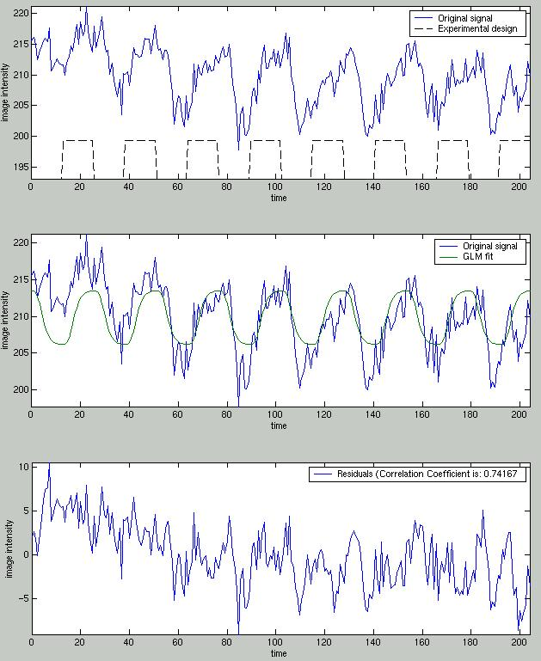
fMRI Signal Plus White Noise Model Fit

Slide 15
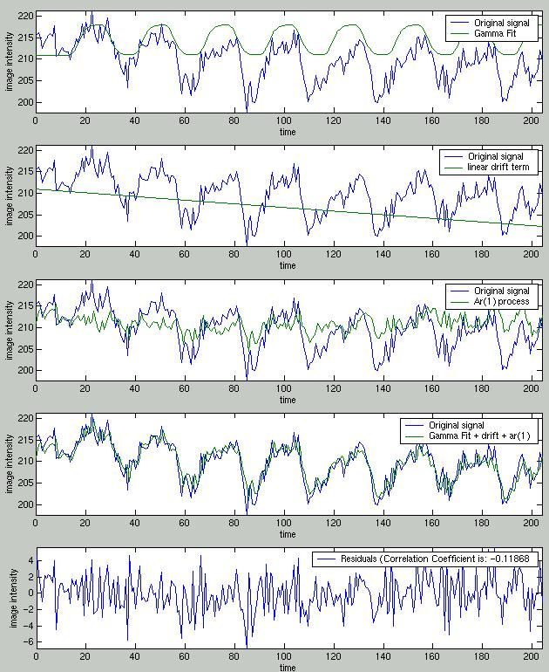
fMRI Signal Plus Drift
and Correlated Noise Model Fit

Slide 16
Summary
We see the pro and cons of building a phenomenologic (harmonic regression)
versus a physiologic (hemodynamic) model.
The inference here depends critically on the statistical model because it
determines how the image is constructed.
The concepts of the linear model will be crucial for our other model
building techniques and paradigms.

