Slide 1
LLC predictor
Morad Ghezaiel – Data scientist

Slide 2
Chronic lymphocytic leukemia (CLL)
CLL
- Most frequent leukemia
- Prevalence: elderly
- Early diagnostic and late treatment
- 95% b cells, 5% t cells
Epidemiology:
- 2:1 men/women ratio
- Incidence : 4500 new cases /year
Etiology:
- Alteration of b cell maturation
- Lymphocytosis with somatic mutation
- Abnormal expression of biomarkers
- Factors are not well understood

Slide 3
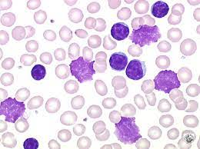
Diagnostic
Common blood test
Hemogram : number of B cells
Caryotype : presence of chromosomal anomalies
Immunophenotyping : expression of b cell maturation markers
Sever forms (Richeter’s syndrom) with deregulation of oncogens
Blood smear :
- Gumprecht shadows: large nucleus due to the lack of a structural protein (vimentin)
- Importance of early diagnostic

Slide 4
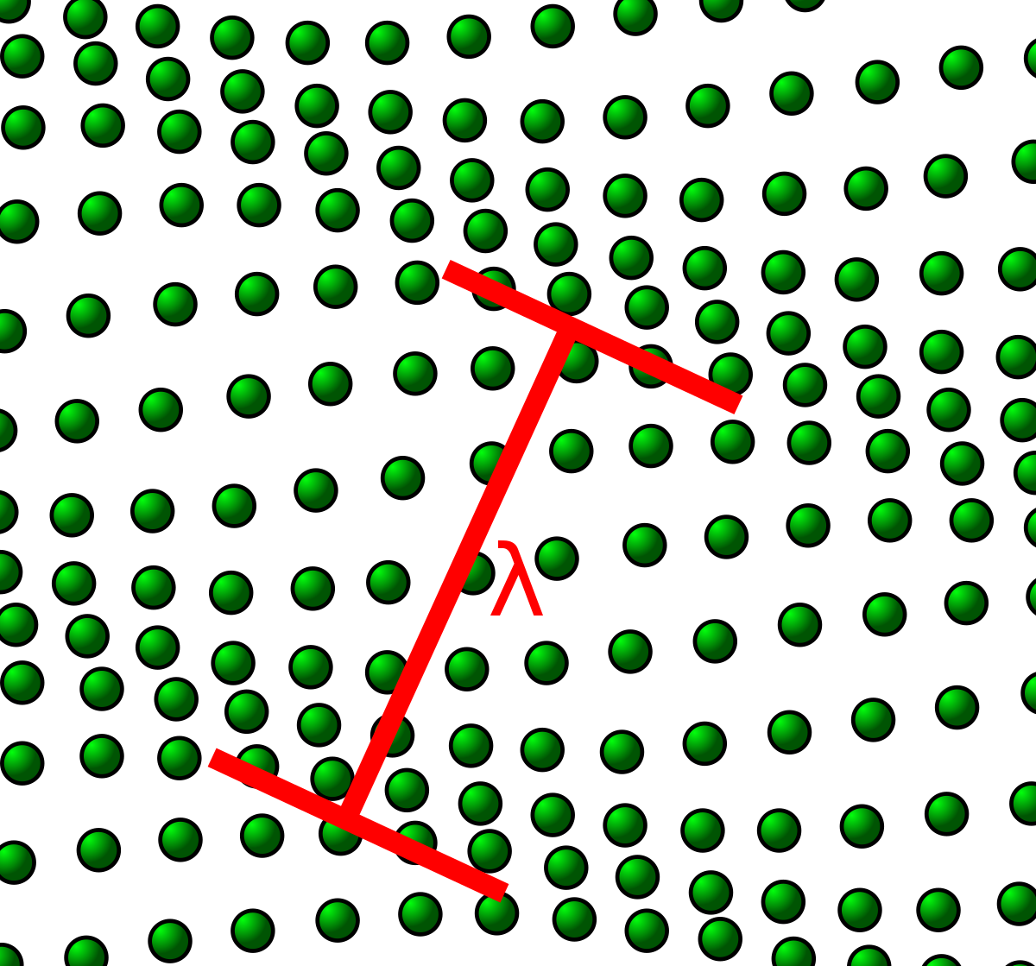
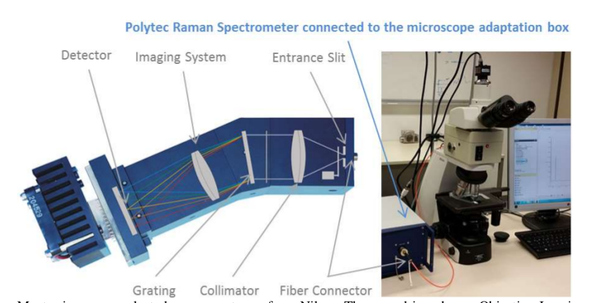
Raman spectroscopy
Measures the molecular composition
Molecules produce vibrations that act like particules (phonons)
The sample is illuminated by a monochromatic laser beam
Photons interact with phonons (variation of wavelength)
An optical system measures the light emitted by the sample

Slide 5
CLL and Raman spectroscopy
CLL is associated with morphological and molecular composition changements
Raman spectroscopy can be used to charcaterize lymphoid cell samples
The data is corrected for noise
Quality controlled samples are used to predict lymphoid cells counts

Slide 6
Project
Development of a tool to help the diagnosis of CLL
Data: 33 patients with Raman spectra from B and TNK cells
The spectrometer points to three random cell areas
- Plan:
1) Descriptive analysis of the data
2) Quality control: results and validation
3) Presentation of the tool

Slide 7
Data
Number of spectra
Number of cells
33 patients:
19 healthy
14 sick (CLL)
7197 spectra
Number of B spectra > TNK in CLL patients
 | B | TNK
Healthy | 637 | 3829
CLL | 2271 | 460
 | B | TNK
Healthy | 221 | 1333
CLL | 856 | 158
By patient number of cells (average)
 | B | TNK
Healthy | 11.6 | 70.1
CLL | 61.1 | 11.28

Slide 8
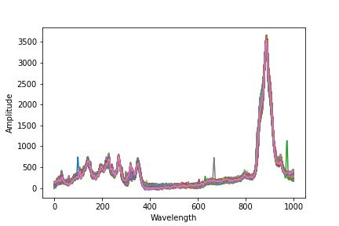
Data
No baseline correction is needed
Presence of low frequency components
Presence of spikes
QC should not affect by patient B/TNK ratio

Slide 9
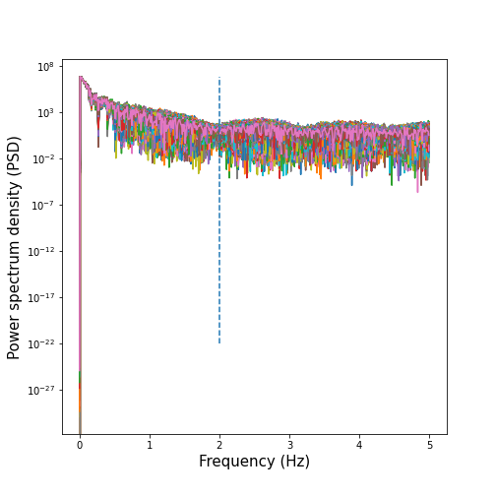
Periodogram
Amount of signal as a function of the frequency
Computed using Welch method
Noise is associated with constant PSD
Inflection at 2 Hz
Signal of interest corresponds to PSD above 2 Hz
2/5 = 40 % noise by spectra
QC: Filter the spectra according to log cumulated
spectral density (CSD >2 Hz) above median

Slide 10
QC validation
Spectra yield: 3598/7197 = 50 %
QC should not affect by patient B/TNK ratio
Fisher exact test:
Test if the filtering method is biased toward a particular cell type
All patient
By patient
 | Before | After
B | 1077 | 766
TNK | 1491 | 928
Q1 | Median | Q3
0.59 | 1.0 | 1.0
At α = 5%, the QC method does not affect B/TNK ratio

Slide 11
Conclusion
The QC method does not affect B/TNK ratio
This is important because B cell fraction:
- is informative of CLL
is affected by sample preparation
is affected by patient diversity

Slide 12
CLL predictor
Tool to help CLL diagnosis
Performs QC, validation and displays the results
Modulation of the filtering threshold while providing validation metrics to better evaluate cell counts

Slide 13
Thanks for your attention

Slide 14
Sources
Wikipedia
https://www.e-cancer.fr/Patients-et-proches/Les-cancers/La-prise-en-charge-de-la-leucemie-lymphoide-chronique/Diagnostic-et-bilan-initial
https://www.ncbi.nlm.nih.gov/pmc/articles/PMC6590062/

