Slide 1
The Effect of Vitamin E Diet Supplement on The Growth Of Guinea Pigs
Maryam Gholami

Slide 2
Table of Content
Project Description:
Two Stages of the Experiment.
Data Description.
Statistical Analysis:
Treatment 1: Growth-inhibiting substance.
Treatment 2: vitamin E.
Different correlation structures.
Conclusion.
References.

Slide 3
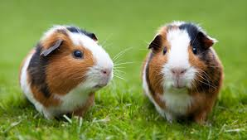
Project Description
Purpose of the study
Effect of vitamin E on guinea pig’s growth
Experiment:
15 guinea pigs, supposedly of the same age
Three groups: control, low dose and high dose
Two stages of the experiment
Growth-inhibiting stage: week 1 to week 4
Growth-promoting stage: Week 5 to week 7

Slide 4
Two Stages of the Experiment
Growth-inhibiting stage: week 1 to week 4
In week 1, growth-inhibiting substance were fed to all 15 animals
Between week 1 to week 4, growth slowing down period
Growth-promoting stage: Week 5 to week 7
In week 5, three different doses of vitamin E are applied to control, low dose and high dose groups
Between week 5 and week 7, observation period

Slide 5
Data Description

Slide 6
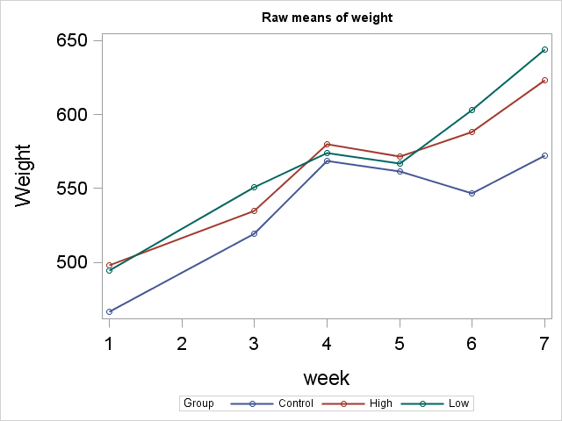
Data Description

Slide 7
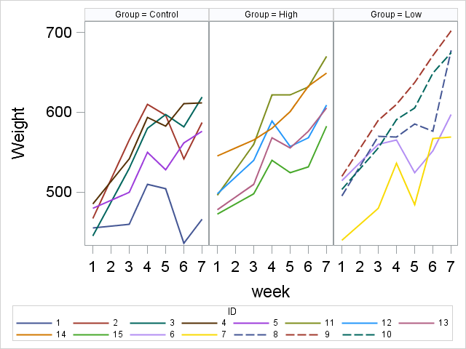
Data Description

Slide 8
Statistical Analysis
There were two treatments that were applied to the pigs sequentially:
Treatment 1: Growth-inhibiting substance
applied to all animals in week 1
Treatment 2: Vitamin E
applied differently to different groups in week 5.

Slide 9
Treatment 1: Growth-inhibiting substance
Question of interest:
Is the growth-inhibiting substance effective in slowing down the growth and in synchronizing the growth in different groups?
General linear model (GLM) , linear mixed model (LMM) and repeated measure ANOVA analysis are employed here answer this question.
Both R and SAS packages used to analysis.

Slide 10
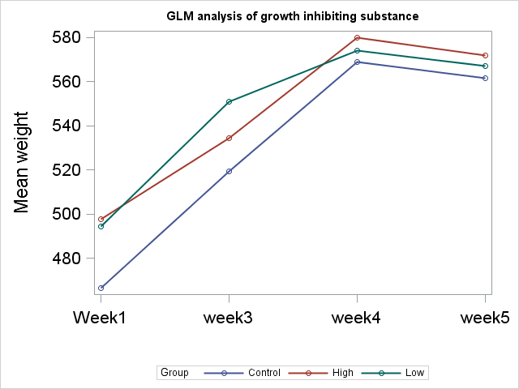
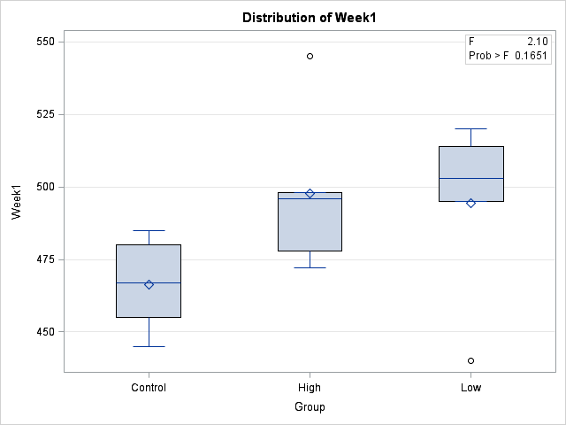
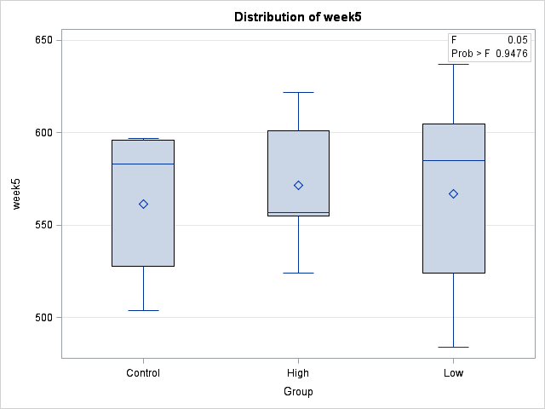
Treatment 1: Growth-inhibiting substance
The beginning of study in week 1, the means of weights in different groups were a little different, whereas in week 5, they became much closer.

Slide 11
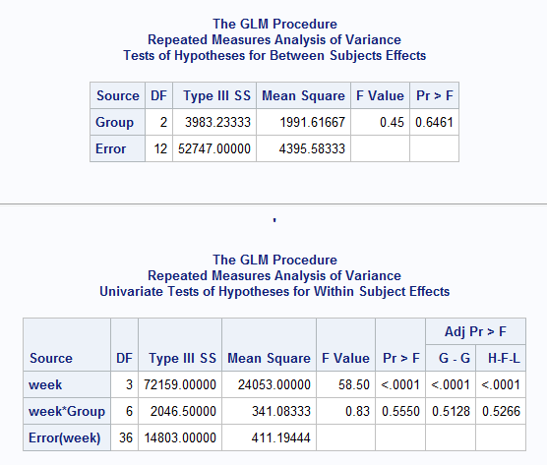
Treatment 1: Growth-inhibiting substance
There is no significant difference in the growth in different groups.
Only the effect of “week” is significant
indicating a natural growth in all groups during the period.

Slide 12
Treatment 2: Vitamin E
Question of interest:
Do the growth rates in the three different groups differ after the treatments?
The general linear model (GLM) , linear mixed model (LMM) and repeated measure analysis are employed here answer this question.
Both R and SAS packages used to analysis.

Slide 13
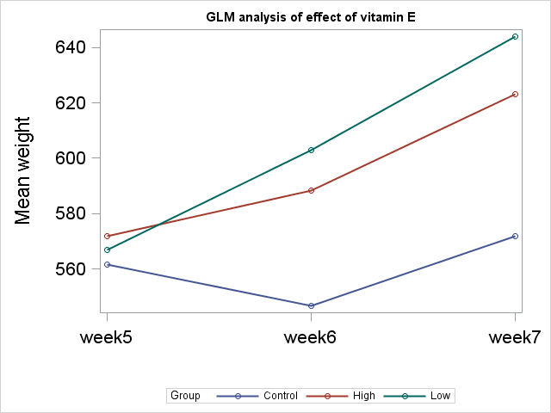
Treatment 2: Vitamin E
fastest growth among the three groups.
There is growth in the two groups with treatment, right after the treatment applied.
it appears that the three groups have slightly different growth rate.
negative growth in week 6 due to the carryover effect of the growth-inhibiting substance

Slide 14
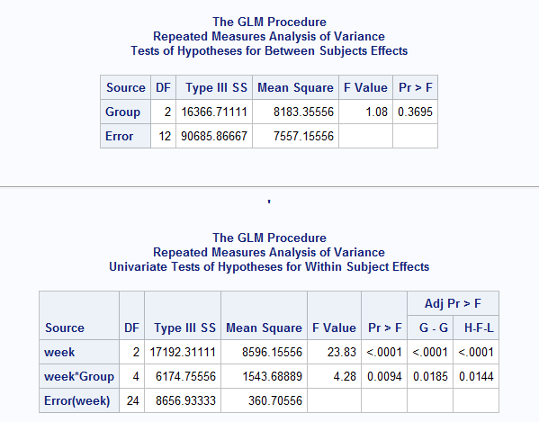
Treatment 2: Vitamin E
The group effect is insignificant
both the effect of week and week*group interaction are significant.
Reason for the significant interaction:
it might have caused by the carryover effect of the growth-inhibiting substance in week 5 and 6.
we have indeed seen some carryover effect in the control group.
This result is consistent with where we have used LMM analysis.

Slide 15
Different correlation structures
Different correlation structures of repeated measurements have been tested:
compound symmetry (CS)
unstructured (UN)
autoregressive (AR(1)
The model with UN correlation matric has the smaller log likelihood, whereas the model based on CS has smaller values in all the other information criteria due to its simplicity.
For models based on CS and UN, the fitting results are almost identical.

Slide 16
Conclusion
The time effect in the growth rate is significant
The effect of the vitamin E, either low or high dosage, isn’t significant on the growth rate of guinea pigs
There appears to be a significant interaction between group/dosage and time.
However, no firm conclusions can be drawn on the effect of vitamin E and, in particular, on the interaction between treatment and time, as the carryover effect of growth-inhibiting substance at the beginning of the experiment might have distorted the association.
Longer observation period is required to make a firm conclusion on the results.

Slide 17
Comments:
Separate the time period into 3 parts
Look at trend in percentage change, instead of the absolutely weight
Look at the trend in difference, instead of the weight
Compare the slope of growth-inhibiting stage and growth promotion stage
Focus on net growth in the last week, and check whether they are significantly different

Slide 18
Separate the time period into 3 parts

Slide 19
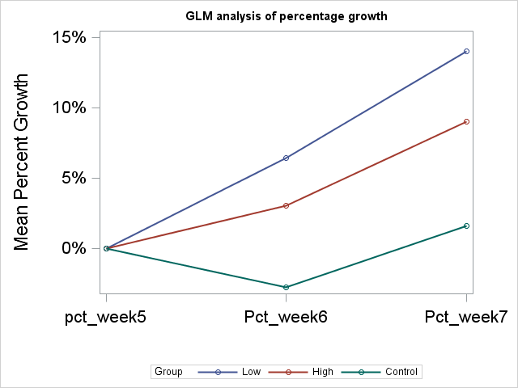
Look at trend in percentage change, instead of the absolutely weight

Slide 20
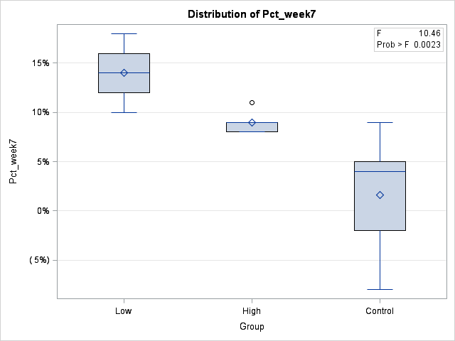
Look at trend in percentage change, instead of the absolutely weight

Slide 21
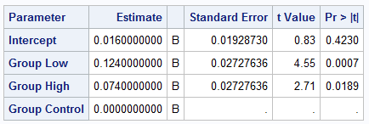
Look at trend in percentage change, instead of the absolutely weight

Slide 22
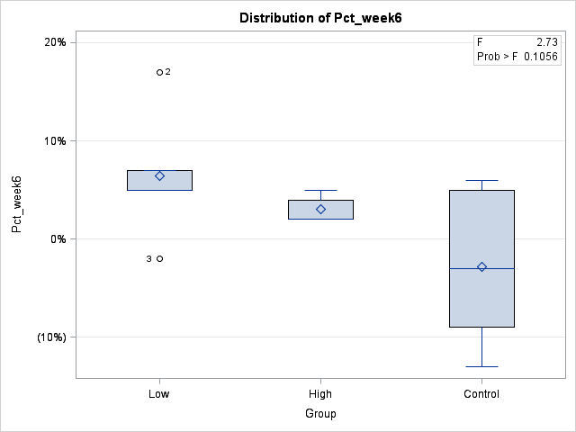
Look at trend in percentage change, instead of the absolutely weight

Slide 23
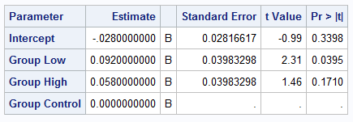
Look at trend in percentage change, instead of the absolutely weight

Slide 24
Compare the slope of growth-inhibiting stage and growth promotion stage

Slide 25

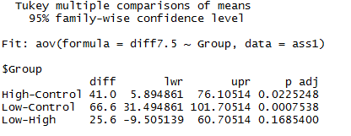
Focus on net growth in the last week, and check whether they are significantly different
Examined the difference of weight between three groups:
Calculate difference between weights

Slide 26
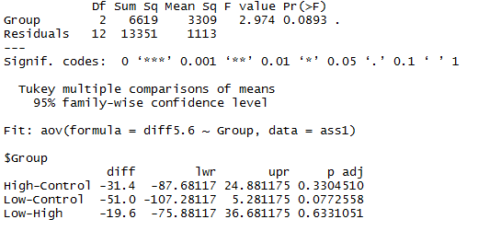
Focus on net growth in the last week, and check whether they are significantly different
Examined the difference of weight between three groups:
Calculate difference between weights

Slide 27
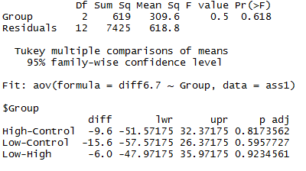
Focus on net growth in the last week, and check whether they are significantly different
Examined the difference of weight between three groups:
Calculate difference between weights

Slide 28
Conclusions revisited
Earlier conclusions
The time effect in the growth rate is significant
The effect of the vitamin E, either low or high dosage, isn’t significant on the growth rate of guinea pigs
New conclusions
Based on both the percentage change and net-increase of weight, the vitamin E indeed has some effect on the weight .

Slide 29
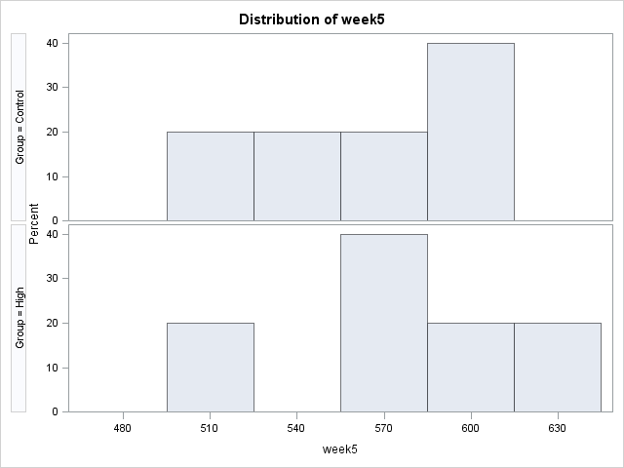
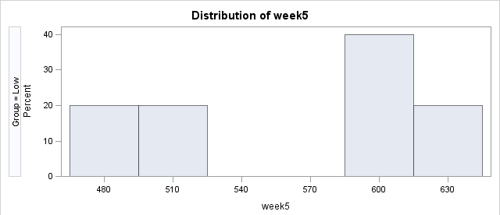

Slide 30
Thank You
For Your Attention.

Slide 31
References
[1] J. E. Wagner (2014), The Biology of the Guinea Pig,.
[2]. M. J. Crowder and D. J. Hand (1990). Analysis of Repeated Measures.
[3] C. S Davis (2002), Statistical methods for the analysis of repeated measurements
[4]. http://www.ats.ucla.edu/stat/r/seminars/Repeated_Measures/repeated_measures.htm
[5]. http://www.ats.ucla.edu/stat/sas/seminars/sas_repeatedmeasures/

