Slide 1
In-Class Interaction
We have studied the various student-student and student-professor interaction within the confines of the IDS-564 classroom for exchange of information to determine the nature and characteristics of various relationships across and within each study group.
Since we have restricted the nature of information exchange to academics, we only consider the in-class activity as a measure of each node’s relationship

Slide 2
We create a dataset considering each student/professor as a data point, and a weighted measure of their edges depending on the strength of interactions (A more frequent conversation leading to a stronger connection and more exchange of ideas)
We have considered a number of parameters as being a determinant for formation of study groups (clusters) :
1. Same term joinee : It is a common phenomenon of students bonding when they already know each-other from previous classes, or via mutual friends. As our classroom has a combination of people across various batches, we include this point as a parameter to formation of groups between same batch students. We have considered this parameter to be of type polynomial as the classroom consists of batches from : Fall 2016, Summer 2017, Fall 2017 and PhD students (Others)

Slide 3
2. Common classes – Apart from having common batch, another basis for interaction among students could be their number of common classes together. Students have a tendency to share their struggle in assignments , and update each-other on their level of preparations for upcoming mid-terms when they come across people in the same class. We have considered this parameter as a binary class (1 for Yes they have a common class, and 0 for No they don’t share a common class together)
3. Mother-tongue - Students generally tend to gel along well with people having with a common mother-tongue, as they find it comfortable to express themselves. We have considered this as a binary class and expect a higher probability of cluster formation for the ones with value 1.

Slide 4
4. Seat Proximity – It is very common to see someone strike a conversation with people who sit around them. This, as we have observed in our class, is a major basis for formation of a bond. We consider this as a binary class as well.
5.Interaction with Instructor – We have assumed that the most active students, who usually tend to keep their doubts clarified much often by visiting the Professor have a high chance of getting together into a discussion and having a clear exchange of ideas. We have taken this into account

Slide 5
0.373
Transitivity: If refers to the extent to which the relation that relates two nodes in a network that are connected by an edge is transitive
Transitivity gives us the Transitivity is 0.3733 i.e. the percentage of 3 users are connected to each other in a close form triangle is less than . So, the possibility that the structure has triadic closure is just 37.3%.

Slide 6
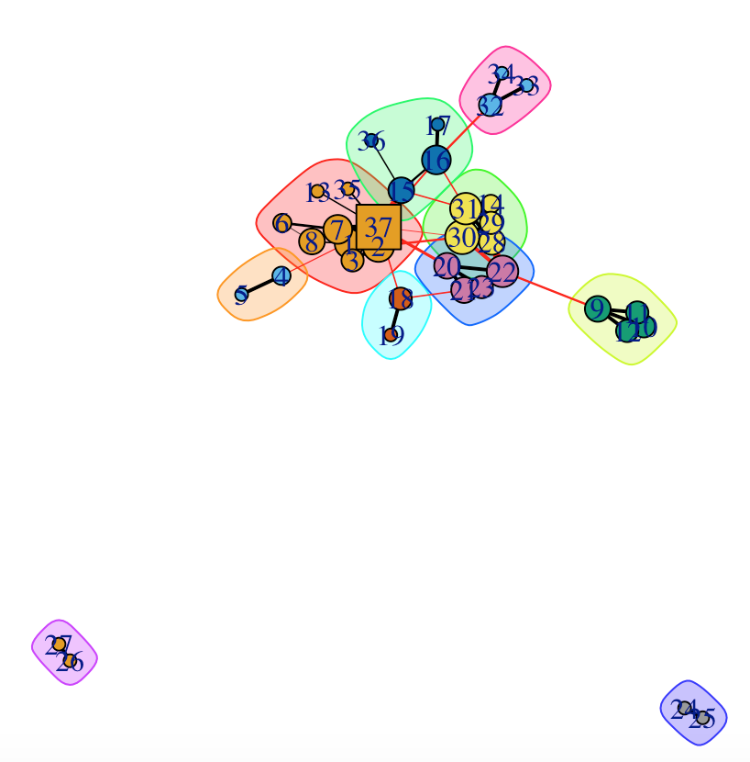
Upon application of edge betweenness to determine our cluster, we get ---------->
Node 37 here is our central source of information (Prof Tafti)
The largest cluster formed is the group of most active individuals in class.
Community sizes
1 2 3 4 5 6 7 8 9 10
9 2 4 5 4 2 4 2 2 3

Slide 7
Network Connectivity
Transitivity gives us the Transitivity is 0.3733 i.e. the extent that 3 student are connected to each other in a close form triangle is less as the possibility the structure has triadic closure is just 37.3%.
If two students have a friend in common, then it is 37.33% likely that they will become friends.
The network is neither strongly connected (there is no direct path connecting the students) nor weakly connected (there is no path between every two students in the underlying undirected graph)
Average shortest path between any 2 nodes is 3.07 and the value of the longest diameter in the network is not large, 7 approx

