Slide 1
ReadyAgent
Software Update Framework
Sierra Wireless Proprietary and Confidential

Slide 2
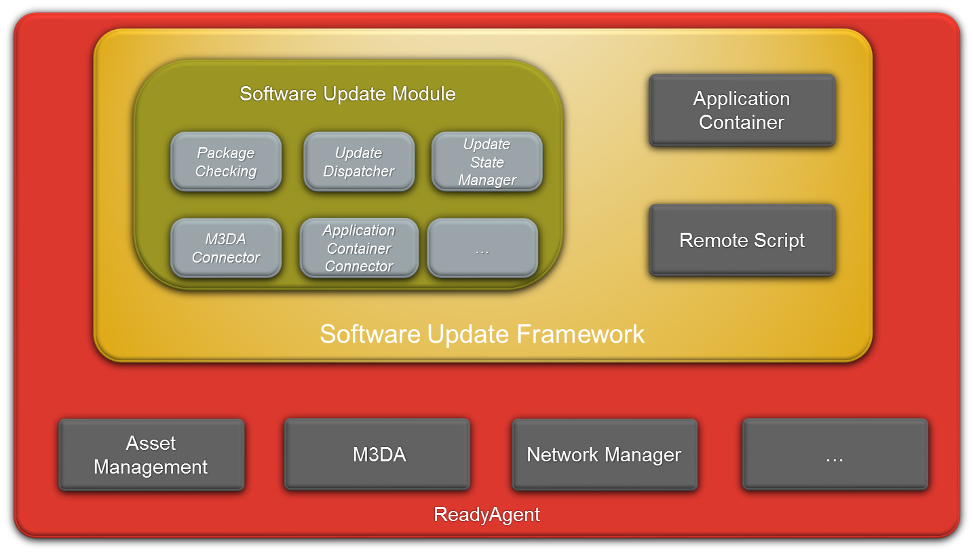
General presentation
Sierra Wireless Proprietary and Confidential

Slide 3
Key Points
Main Software Update Framework functionalities
  Update Module
  Application Container
  Remote Script
Interaction with ReadyAgent features
  Asset / Data management (M3DA)
  Device Management (monitoring)
  …
Sierra Wireless Proprietary and Confidential

Slide 4
Features Description 1/2
Remote Script
  Execution of Lua script remotely
  Security: MD5 hash of the script for now
  M3DA command
Application Container
  Install, uninstall, start, stop applications
  Application monitoring tool
    monitor “generic” apps integrated in Application Container
    (app can be Lua app or any other executable file)
    monitor the ReadyAgent itself!
Sierra Wireless Proprietary and Confidential

Slide 5
Features Description 2/2
Update module
  Component management
  Update package processing
    Update several components in one job / package
    Order components update within the package
    Dependency checking
  M3DA command package delivery
  or custom/manual copy of the package on
  device
  Component to be updated by the Assets or by
    the ReadyAgent itfself!
  Security: MD5 hash of the update package for now
  Note: This feature runs on Linux devices only, for update capabilities on Open AT, see IDS client documentation.
Sierra Wireless Proprietary and Confidential

Slide 6
Which feature for which need ?
  Run simple command within the ReadyAgent (ex. maintenance)?
  => Use Remote Script so you can send it to several devices!
  Add a small Lua application?
  => Use Remote Script to transport the application code
  => Use Application Container to install it!
  Add full external application on Linux Device?
  => Add the application as new component in Update Package
  => Install it using Application Container!
Sierra Wireless Proprietary and Confidential

Slide 7
What’s next !?
  Better security, to fit security level to be introduced in Services Platform
Sierra Wireless Proprietary and Confidential

