Slide 1
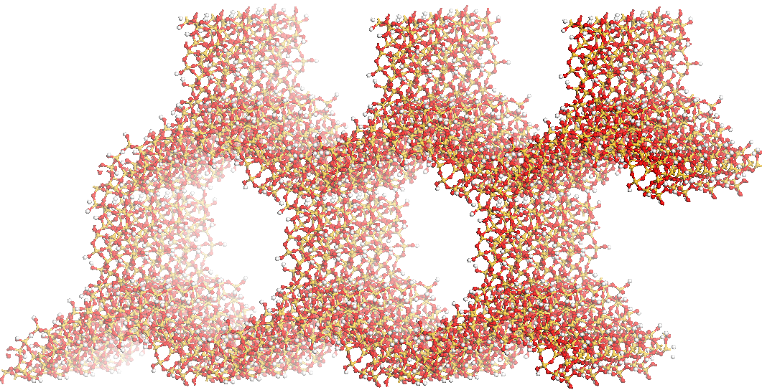
Cr
Maciej Gierada’s Personal Website

Slide 3
Cr

