Slide 1
With experimental data
Using FBA to minimize the difference between measured fluxes and model-derived flux distributions, aligning with experimental data under stoichiometric constraints. The optimized flux distribution is then used to predict targeted metabolic outcomes by integrating measured extracellular titers and expanded matrix.

Slide 2
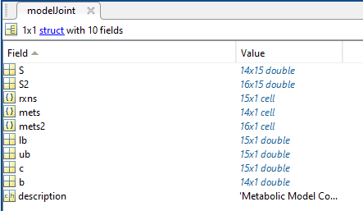
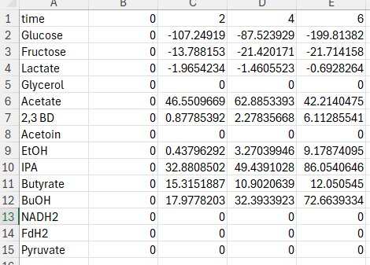
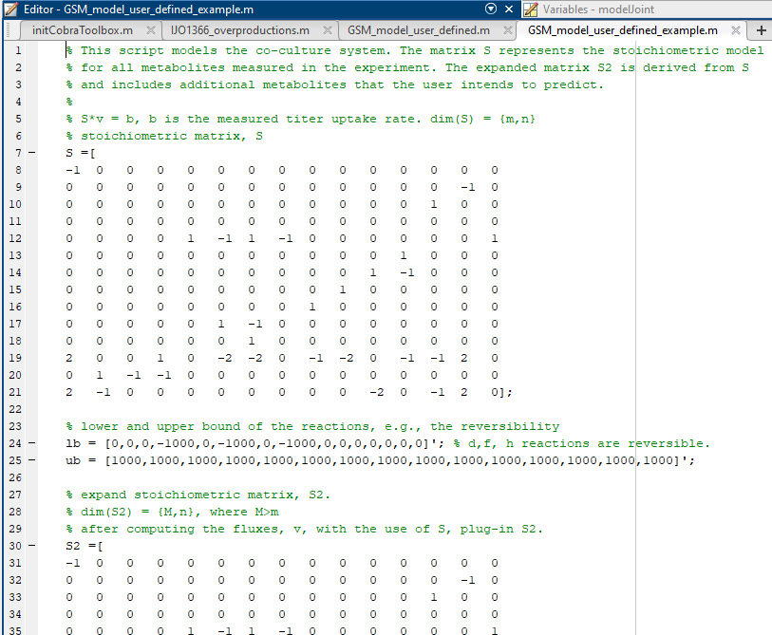
Model and data structure
Model structure (.mat file)
Data format: excel (xlsx)
First raw: time
Please follow the naming.
Define models? see GSM_model_user_defined_example (.m file)
First column: exp data item name

Slide 3
Model and data structure
v*
Min the difference of measured flux and FBA-derived flux distribution (v*)
st. S . v* = measured extracellular titers
Use v* to plug back into S2, and get flux^{desired}
st. S2 . v* = [measured extracellular titers ; flux^{desired}]
measured extracellular titers
Stoichiometric matrix
S = {m,n}
flux^{desired}
S2 = {m2,n}

Slide 4
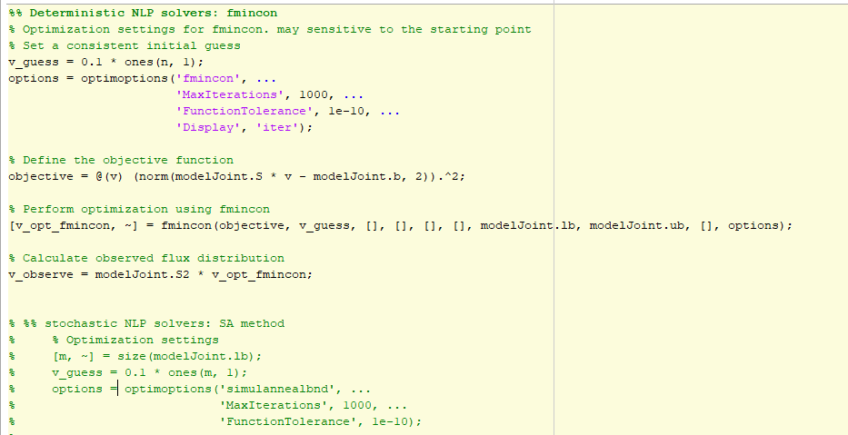
Objective function
Define the objective as minimizing the sum of squared errors between the predicted fluxes and experimental data
See userdefinedFBA (.m file). Weighting coefficient can be added to tune the flux distribution

Slide 5
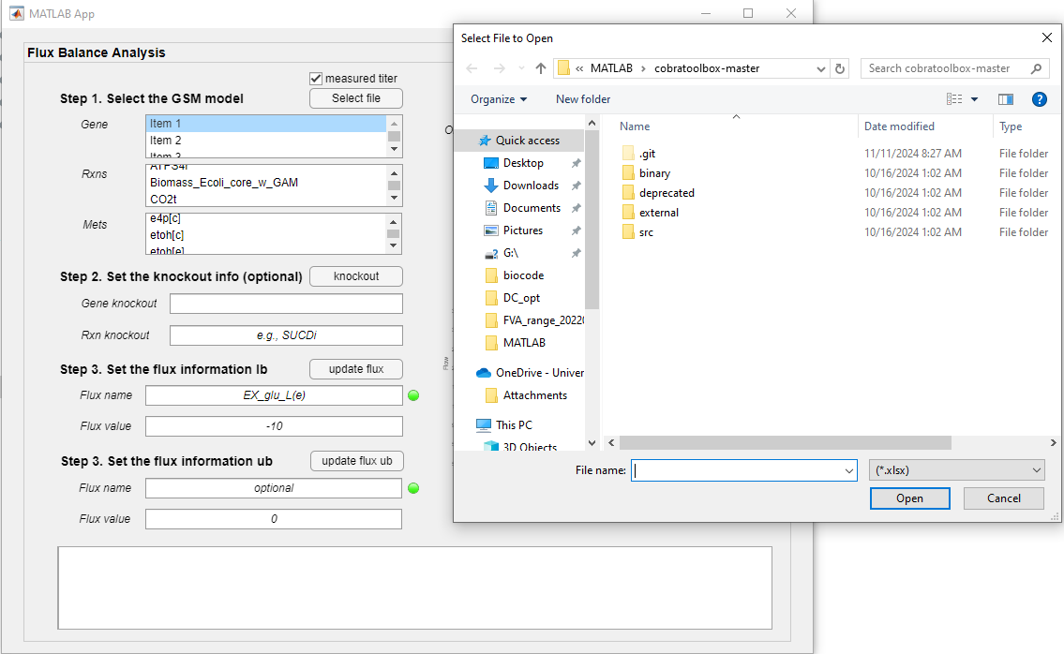
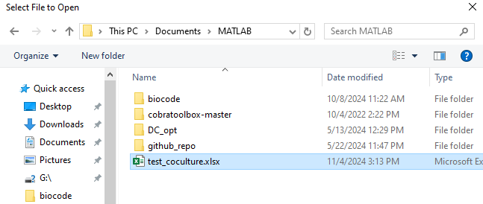
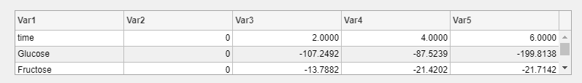
Select data
Step 1 : check the box “measured titer” to load the data
window jump out
Step 2 : select the file
The window will be updated with the loaded data

Slide 6
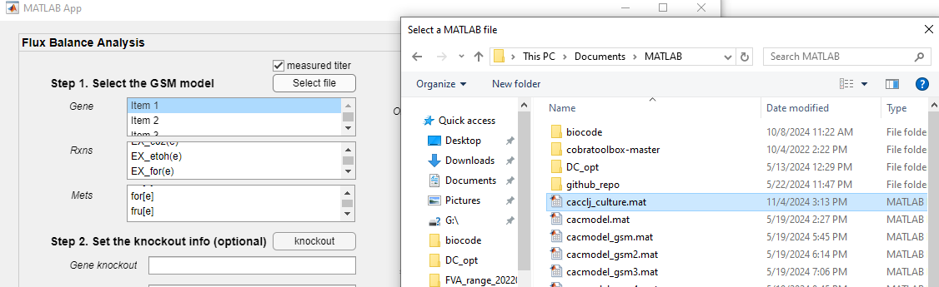
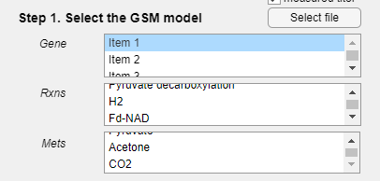
Select model
Step 3 : Select the model
The model information will be updated

Slide 7
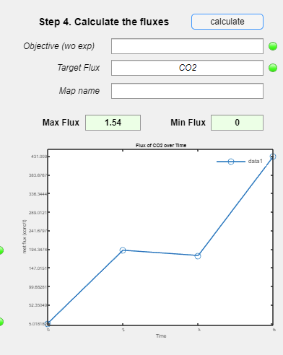
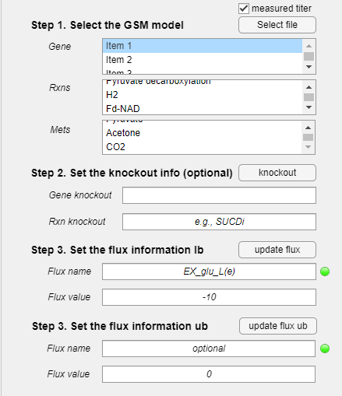
Set the NLP information
Do not set the objective. The objective is default (minimizing the sum of squared errors between the predicted fluxes and experimental data)
Step 4 : Select the reactions you want to observe/ predict
This is not the result
Predicted results will be presented in the figure section.
Do not use the function

Slide 8
With limiting experimental data
Utilizes stoichiometric and uptake constraints in FBA to optimize and observe metabolic fluxes

Slide 9
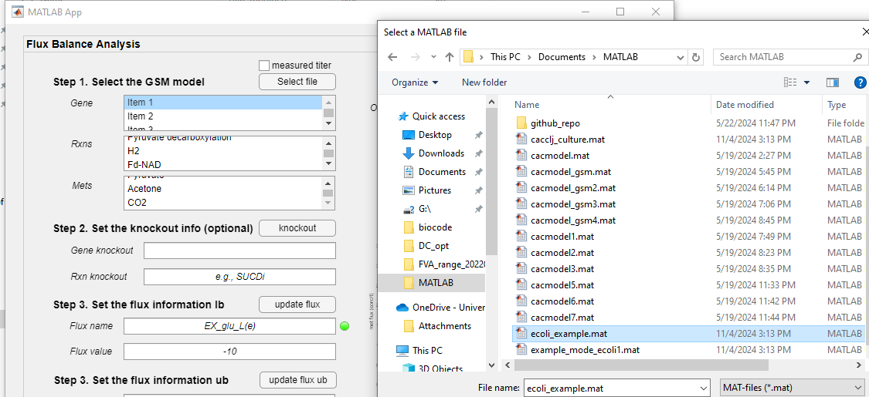
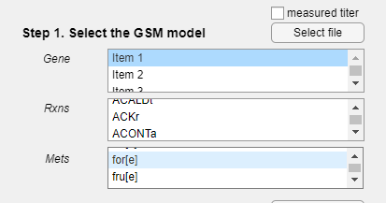
Select model
Step 1 : Select the model (unclick the measured titer box)
The model information will be updated

Slide 10
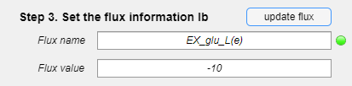
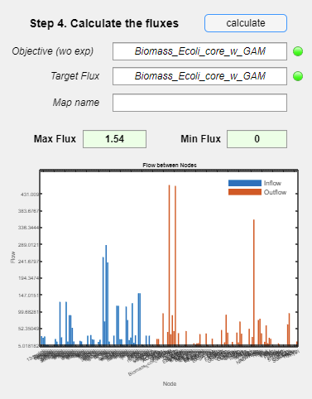
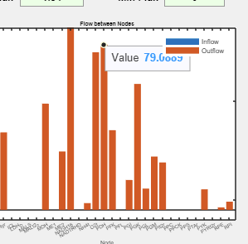
Set the LP information
Step 2 : set the bounds (e.g., the glucose uptakes rate = 10)
Click update information (repeat it if you have more information)
Key in the data
Define the objective reaction (flux), e.g., Biomass
Zoom in the figure and check the value
Define the flux you want to observe under defined objective reaction (flux)
Max and min flux (feasible solutions)
Based on max the defined objective (reaction), the possible value of the other fluxes

