Slide 1




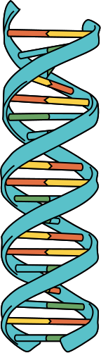


Implementasi Random Forest untuk Klasifikasi dan Menganalisis Aktivasi AMPK (AMP-Activated Protein Kinase) Pada Metabolisme dan Penyakit Metabolik
Kelompok 2 - Bioinformatika

Slide 2


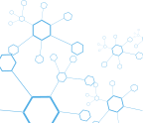
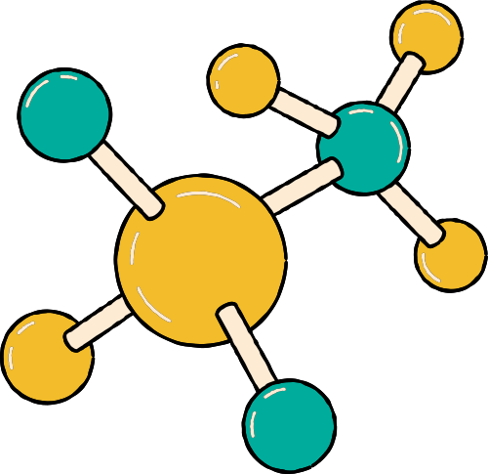

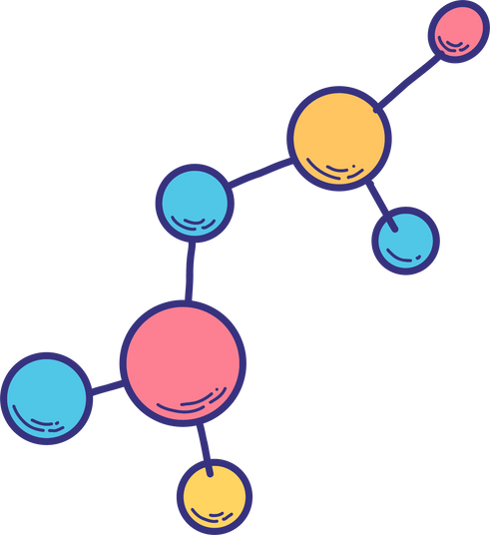
ANGGOTA
KELOMPOK
Ketut Susilo
Aaron Loeb
Drew Feig

Slide 3




Pendahuluan
DNA (deoxyribonucleic acid) is genetic material found in the nucleus of cells. It is a complex polymer which carries the genetic code. This determines all of the characteristics of a living organism.

Slide 4

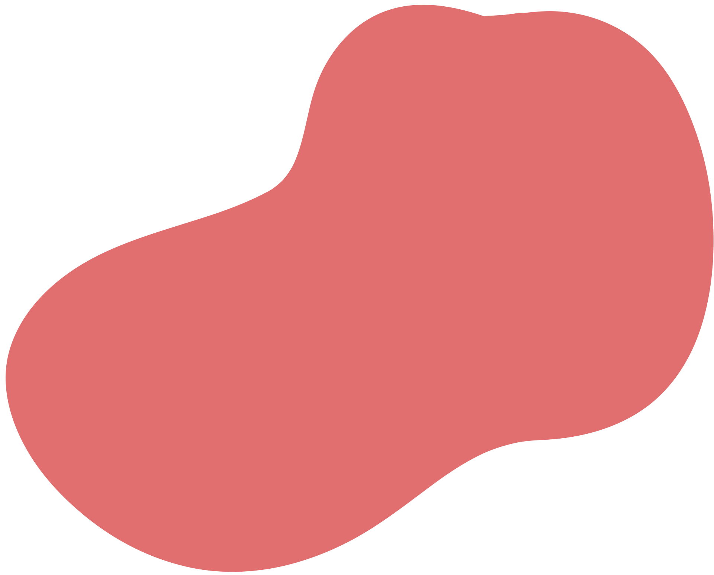




Tujuan Penelitian
Explain the structure of a nucleotide and the complementary bases.
State what DNA is and where it can be found.
Describe the double helix and its discovery.

Slide 5
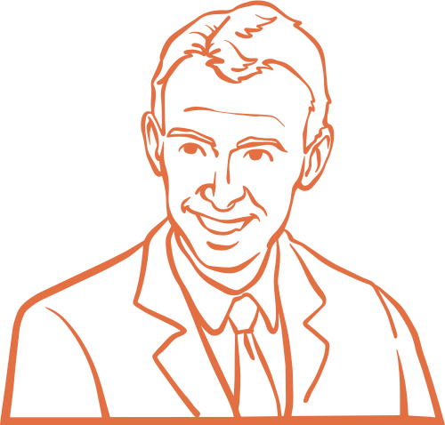

Metode Penelitian
Scientists James Watson (pictured) and Francis Crick built on the work of other scientists to discover the structure of DNA in 1953.
Using X-ray crystallography techniques, they discovered that DNA is made of two strands coiled into a double helix shape.

Slide 6


What is a
double helix?
DNA is in a double helix shape.
It consists of two parallel strands of DNA twisted around each other.

Slide 7

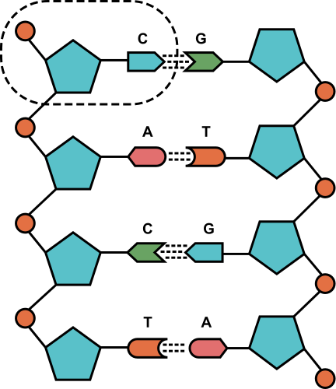
Flowchart
Nucleotides are the units which DNA is composed of.
Each nucleotide includes a phosphate group, a sugar section and one of the four bases.

Slide 8


Parts of a nucleotide
Phosphate
Base
Sugar

Slide 9
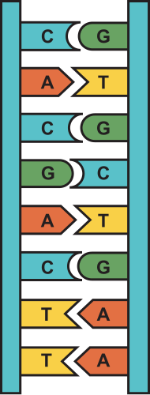
Base pairs
Each nucleotide has a base. There are four different bases in DNA: thymine (T), adenine, (A), guanine (G) and cytosine (C).
A and T are a pair. G and C are another pair. The complementary pairs are hydrogen bonded together. This maintains the DNA structure.

Slide 10
A closer look

Slide 11
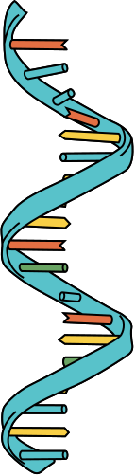

Triplet code
A triplet code is a sequence of three bases which codes for a particular amino acid. The sequence order of the amino acids determines the particular protein produced.

Slide 12
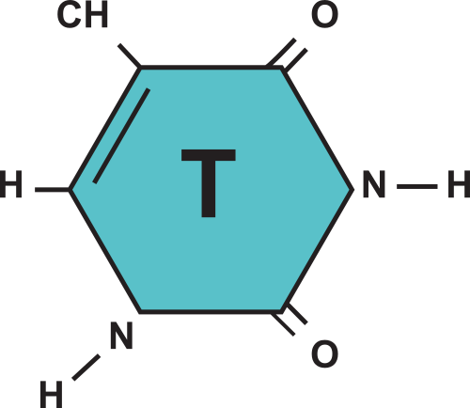
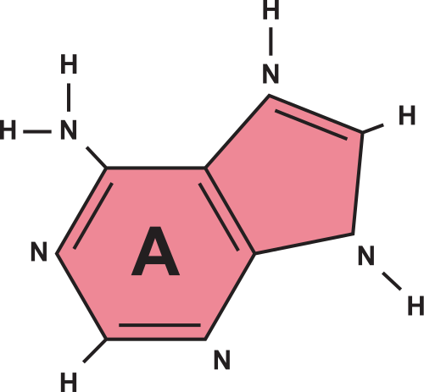
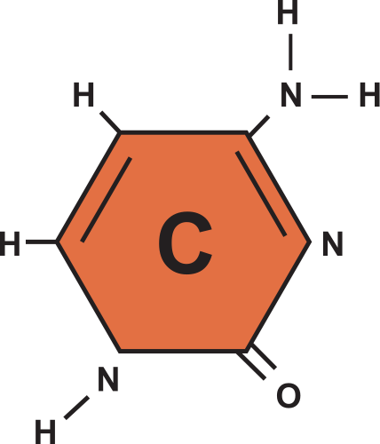
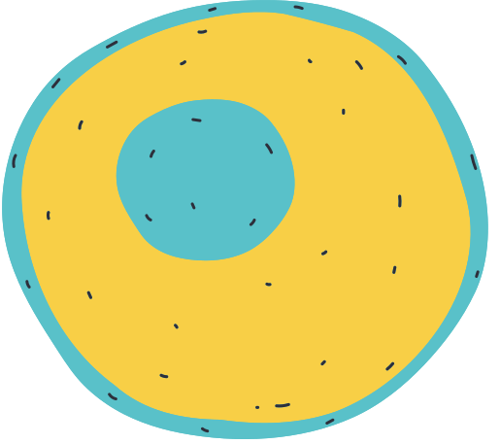
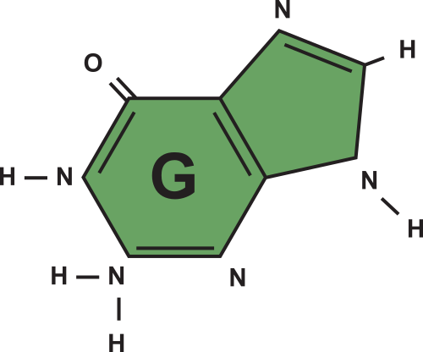
Teacher resource page
Use these elements in your presentation to keep it cohesive!

