Slide 1
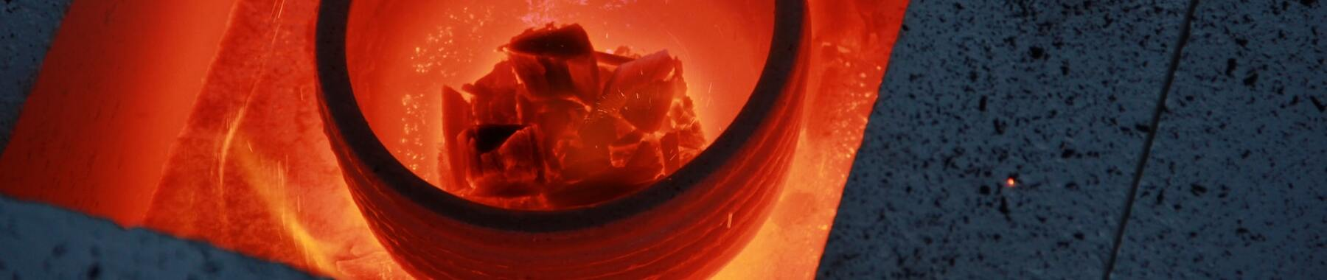
Miguel Gil Jimenez
Kaggle Competition –
Feature Imputation with a Heat Flux Dataset
https://github.com/mgiljimenez
htttps://www.linkedin.com/in/miguel-gil-jimenez
https://www.kaggle.com/competitions/playground-series-s3e15/overview
Kaggle Competition - Feature Imputation with a Heat Flux Dataset

Slide 2
presentation.index()
Miguel Gil Jimenez
Competición
Dataset Original
¿Cómo abordar los valores Nulos?
Modelos
Conclusion
Kaggle Competition - Feature Imputation with a Heat Flux Dataset

Slide 3
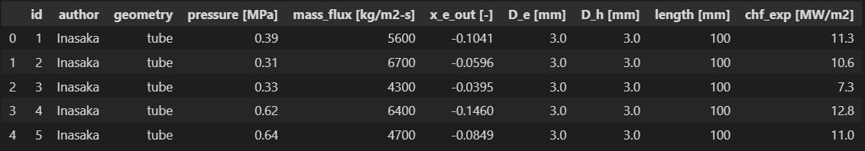
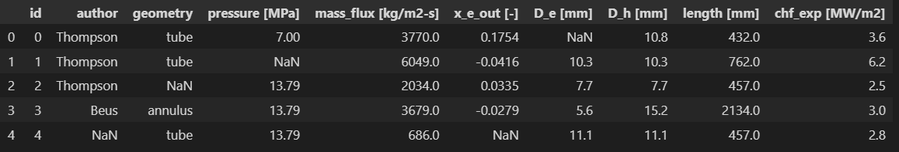
print(Dataset_Original)
Miguel Gil Jimenez
print(Dataset_Generado)
Kaggle Competition - Feature Imputation with a Heat Flux Dataset

Slide 4
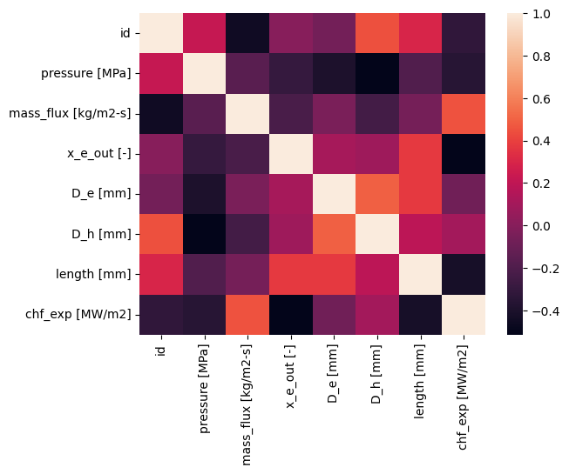
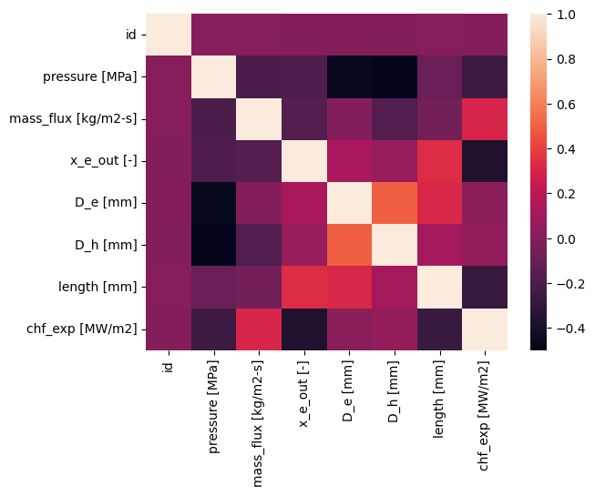
print(Comparacion_Datasets)
Miguel Gil Jimenez
Dataset Original
Dataset Generado
Kaggle Competition - Feature Imputation with a Heat Flux Dataset

Slide 5
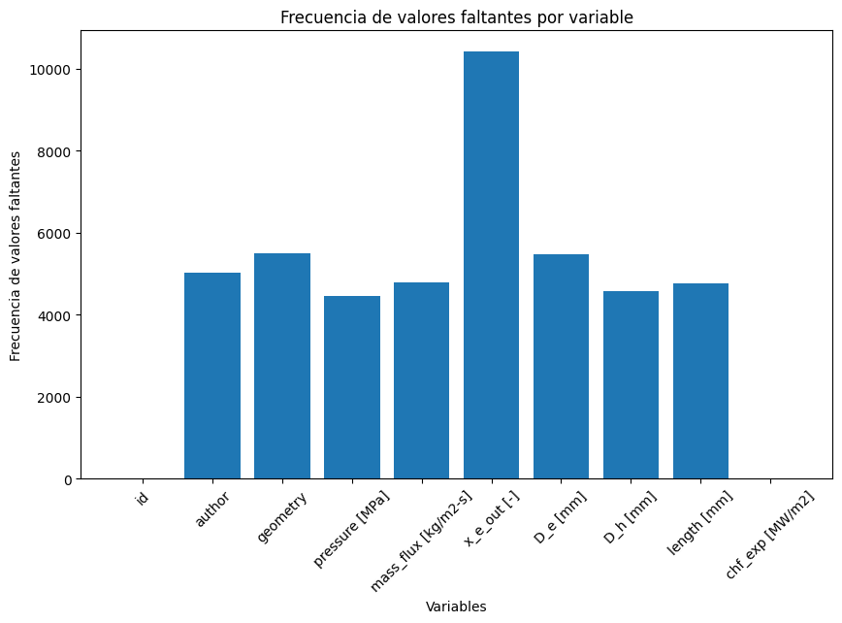
print(Dataset_Generado.isnull())
Miguel Gil Jimenez
Chf_exp [MW/m2]:
-Sin nulos
-Exactamente los mismos
números que el original
-Relación con variables
Kaggle Competition - Feature Imputation with a Heat Flux Dataset

Slide 6
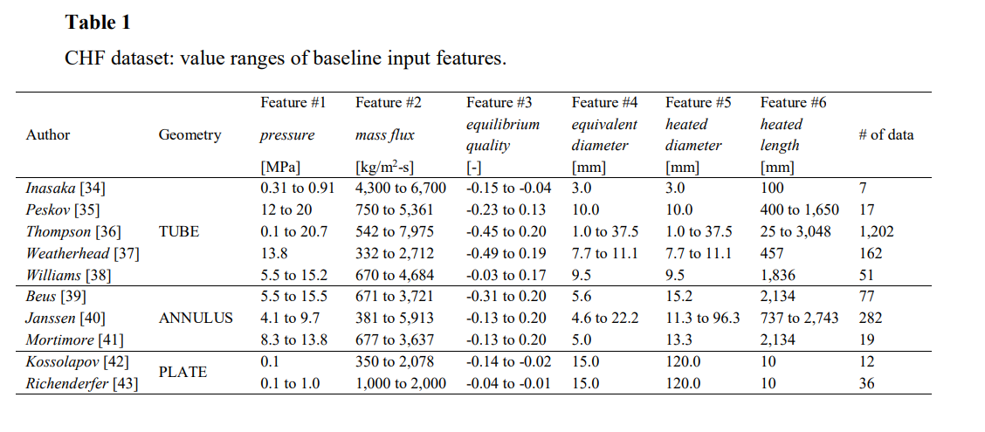
print(¿Cómo abordar los Nulos?)
Miguel Gil Jimenez
Kaggle Competition - Feature Imputation with a Heat Flux Dataset

Slide 7
print(primeros_Modelos)
Miguel Gil Jimenez
MODELO | RSME
LinearRegression | 0.08507347170450172
DecisionTreeRegressor | 0.10578942115781917
RandomForestRegressor | 0.07474934975675115
SVR | 0.07965810821588803
Ensamble DecisionTreeRegressor + RandomForestRegressor + SVR | 0.0745267882866566
Datos:
-Encontrando otras relaciones del Dataset Original
(no Chf_exp [MW/m2])
Kaggle Competition - Feature Imputation with a Heat Flux Dataset

Slide 8
print(mejores_Modelos)
Miguel Gil Jimenez
MODELO | RSME
XGB | RMSE: 0.0749205441573825 R^2: 0.4488898381415902 MAE: 0.05306506898318904
RandomForestRegressor | RMSE: 0.07251644918062068 R^2: 0.4836910734283302 MAE: 0.05035068676579741
Ensamble | RMSE: 0.07213794400585104 R^2: 0.4836910734283302 MAE: 0.05035068676579741
GridSearchCV
Kaggle Competition - Feature Imputation with a Heat Flux Dataset

Slide 9
print(resultados)
Miguel Gil Jimenez
-existe una fuerte relación entre las variables Chf_exp [MW/m2]
-Los ensambles siempre han mejorado los modelos
MODELO | RSME
XGB | RMSE: 0.0749205441573825 R^2: 0.4488898381415902 MAE: 0.05306506898318904
RandomForestRegressor | RMSE: 0.07251644918062068 R^2: 0.4836910734283302 MAE: 0.05035068676579741
Ensamble | RMSE: 0.07213794400585104 R^2: 0.4836910734283302 MAE: 0.05035068676579741
Kaggle Competition - Feature Imputation with a Heat Flux Dataset

Slide 10

print(Conclusion)
-existe una fuerte relación entre las variables Chf_exp [MW/m2]
-Los ensambles siempre han mejorado los modelos
- primera Submission: 0.077308
- quinta Submission : 0.0756

Slide 11
def final(): print(“Muchas gracias”) final()
Miguel Gil Jimenez
Kaggle Competition - Feature Imputation with a Heat Flux Dataset

