Slide 1
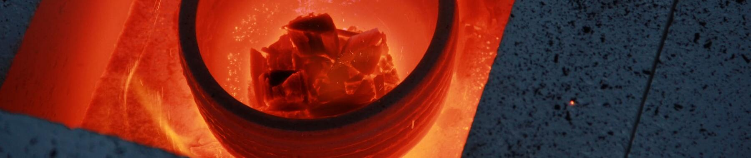
Miguel Gil Jimenez
Kaggle Competition –
Feature Imputation with a Heat Flux Dataset
https://github.com/mgiljimenez
htttps://www.linkedin.com/in/miguel-gil-jimenez
https://www.kaggle.com/competitions/playground-series-s3e15/overview
Kaggle Competition - Feature Imputation with a Heat Flux Dataset

Slide 2
presentation.index()
Miguel Gil Jimenez
Dataset Original
¿Cómo abordar los valores Nulos?
Modelos
Conclusión
Kaggle Competition - Feature Imputation with a Heat Flux Dataset

Slide 3
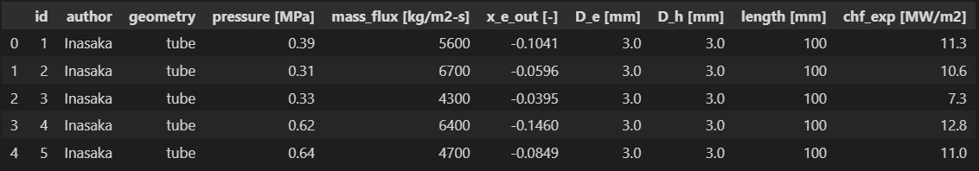
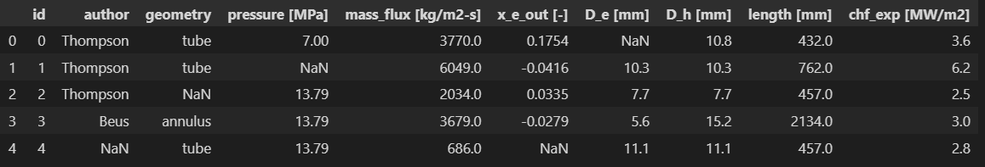
print(Dataset_Original)
Miguel Gil Jimenez
print(Dataset_Generado)
Kaggle Competition - Feature Imputation with a Heat Flux Dataset

Slide 4
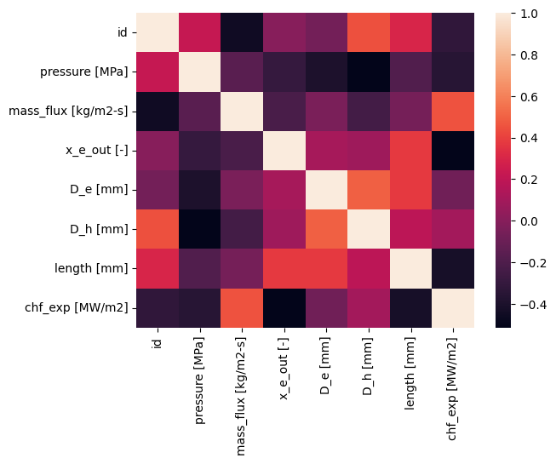
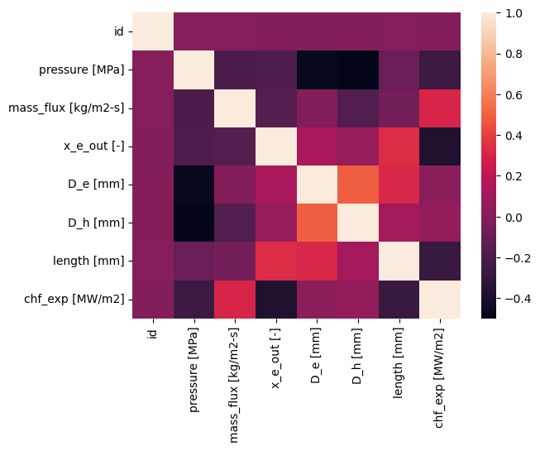
print(Comparacion_Datasets)
Miguel Gil Jimenez
Dataset Original
Dataset Generado
Kaggle Competition - Feature Imputation with a Heat Flux Dataset

Slide 5
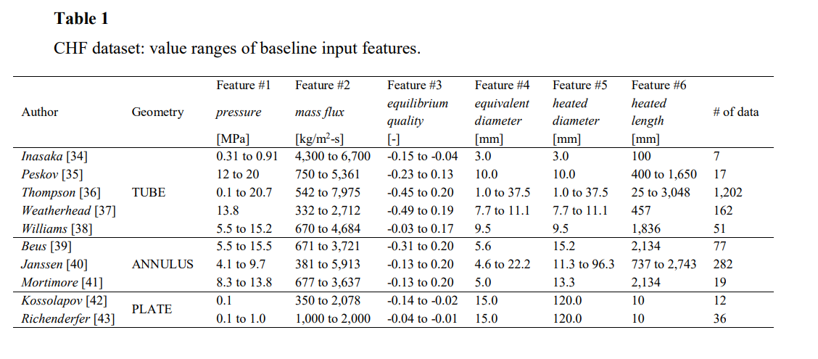
print(¿Cómo abordar los Nulos?)
Miguel Gil Jimenez
Kaggle Competition - Feature Imputation with a Heat Flux Dataset

Slide 6
print(Primeros_Modelos)
Miguel Gil Jimenez
MODELO | RSME
LinearRegression | 0.08507347170450172
DecisionTreeRegressor | 0.10578942115781917
RandomForestRegressor | 0.07474934975675115
SVR | 0.07965810821588803
Ensamble DecisionTreeRegressor + RandomForestRegressor + SVR | 0.0745267882866566
GridSearchCV
Nulos:
Comparación con tabla de la fuente del Dataset original
Kaggle Competition - Feature Imputation with a Heat Flux Dataset

Slide 7
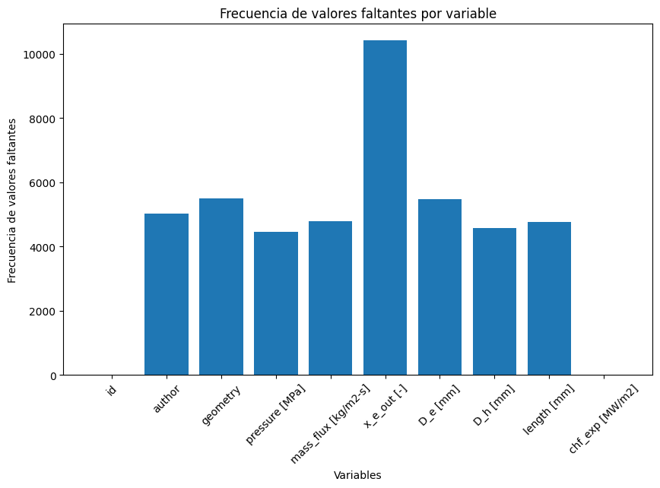
print(Dataset_Generado.isnull())
Miguel Gil Jimenez
Chf_exp [MW/m2]:
-Sin nulos
-Exactamente los mismos
números que el original
-Relación con variables
Kaggle Competition - Feature Imputation with a Heat Flux Dataset

Slide 8
print(¿Cómo abordar los Nulos?)
Miguel Gil Jimenez
Kaggle Competition - Feature Imputation with a Heat Flux Dataset

Slide 9
print(Mejores_Modelos)
Miguel Gil Jimenez
MODELO | RSME
XGB | RMSE: 0.0749205441573825 MAE: 0.05306506898318904
RandomForestRegressor | RMSE: 0.07251644918062068 MAE: 0.05035068676579741
Ensamble | RMSE: 0.07213794400585104 MAE: 0.05035068676579741
GridSearchCV
Kaggle Competition - Feature Imputation with a Heat Flux Dataset

Slide 10
print(Hiperparámetros)
Miguel Gil Jimenez
RandomForestRegressor
n_estimators=200
max_features="sqrt“
min_samples_leaf=2
min_samples_split=10
MODELO | RSME
XGB | RMSE: 0.0749205441573825 MAE: 0.05306506898318904
RandomForestRegressor | RMSE: 0.07251644918062068 MAE: 0.05035068676579741
Ensamble 0.3, 0.7 | RMSE: 0.07213794400585104 MAE: 0.05035068676579741
XGBRegressor
n_estimators=2180
max_depth=3
learning_rate=0.099
objective=
'reg:squarederror'
min_child_weight=9.078
subsample= 0.934
colsample_bytree= 0.55
Kaggle Competition - Feature Imputation with a Heat Flux Dataset

Slide 11
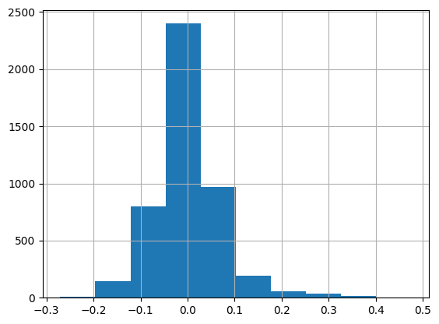
print(Hiperparámetros)
Miguel Gil Jimenez
Histograma de errores
Kaggle Competition - Feature Imputation with a Heat Flux Dataset

Slide 12
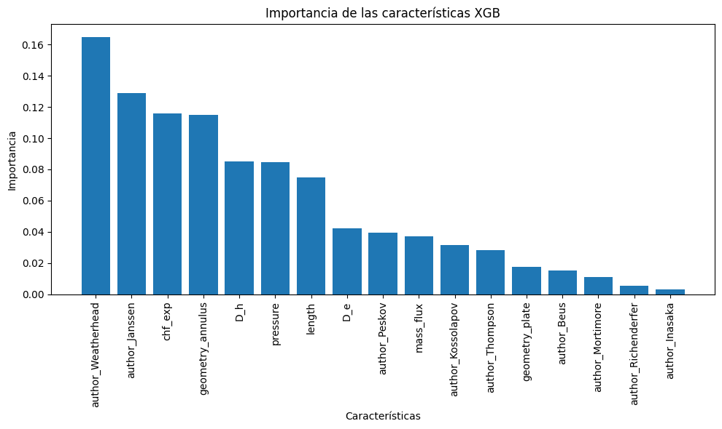
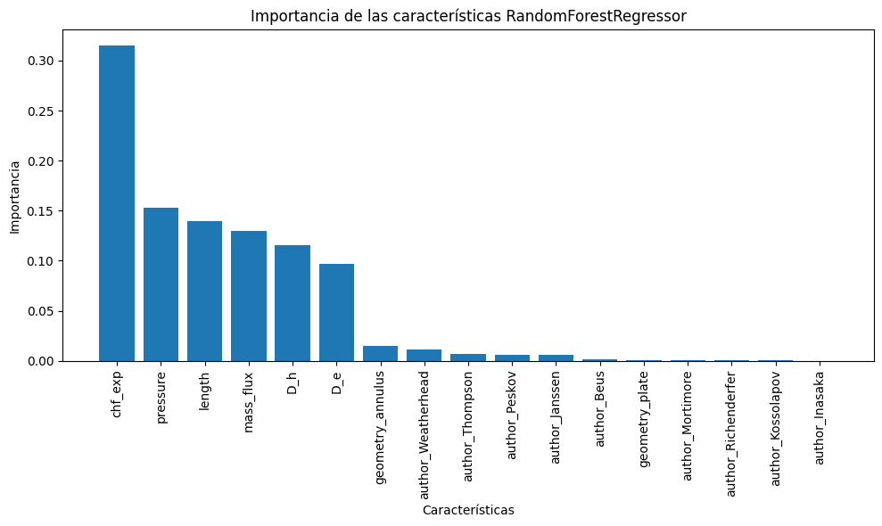
print(Importancia_Variables)
Miguel Gil Jimenez
Kaggle Competition - Feature Imputation with a Heat Flux Dataset

Slide 13

print(Conclusion)
-existe una fuerte relación entre las variables Chf_exp [MW/m2]
-Los ensambles siempre han mejorado los modelos
- primera Submission: 0.077308
- quinta Submission : 0.0756

Slide 14
def final(): print(“Muchas gracias”) final()
Miguel Gil Jimenez
Kaggle Competition - Feature Imputation with a Heat Flux Dataset

