Slide 1
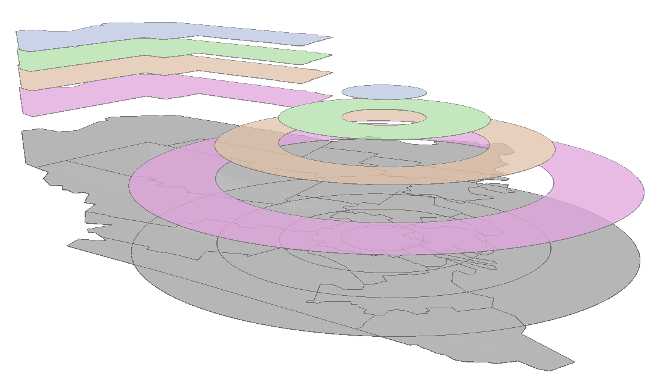
Each geometry of the s1.sf layer is paired with each geometry of the s2.sf layer

