Slide 1
Virtualization for autonomous administration of servers

Slide 2
Plan
Context
Client Specifications
Xen setting up
Preliminary study
Requirements
Architecture
Test Scheme
Integration in TUNe
Introduction to TUNe
Architecture
Wrappers and Reconf diagrams
Project Management
Conclusion

Slide 3
Context

Slide 4



Context
Context | Servers cost | Electrical Consumption | Distributed Servers
Metric | Server reservation price | Per server electrical consumption | Network load and servers distances
Goal | Minimizing costs = Bringing together low CPU consumers | minimizing electrical consumption = Shutting down low CPU consumers | minimizing communication times = Bringing together highly communicating servers

Slide 5


Context
Expansion
Criteria
Shrink
Criteria
Virtual Machine 1
Virtual Machine 2

Slide 6
Clients Specification

Slide 7
Client Specifications
Xen Paravirtualization Tools
TUNe
NFS
A working scenario

Slide 8
Client Specifications
Request number rising
Request number reduction
Virtual Machine 1
Virtual Machine 2

Slide 9
Preliminary Study
Xen Control
Software
User Applications
User Applications
User Applications
Domain 0
User Domain 1
User Domain 2
Abstraction Layer
Xen Control
Interface
Abstraction Layer
Abstraction Layer
Modified Drivers
Modified Drivers
Modified Drivers
Xen Hypervisor
Hardware

Slide 10
Preliminary Study
DomU
xm migrate
Dom0-1
Dom0-2

Slide 11
Preliminary Study
DomU-1
DomU-2
eth0
eth1
eth0
vif1.0
vif2.0
vif2.0
vif0.0
peth0
xenbr0
eth0
Dom0
Physical Machine

Slide 12
Preliminary Study
DomU
xm migrate
Dom0-1
NFS server
Dom0-2

Slide 13
Requirements
Migration requirements:
no task interruption
TCP connection keeping
Results consistency
CPU load independence
Migration performance study:
Interruption duration
Migration duration
Delay
Integration in TUNe

Slide 14



Architecture
DNS Server
DHCP Server
NTP Server
NFS Server
A-204-06
Switch
A-204-02
A-204-05
A-204-03
A-204-04

Slide 15
Architecture
GNU/Linux Debian Etch / NFS root
Ubuntu Dapper Drake / NFS root
domU-1
domU-1
Xend Daemon
Ubuntu Gutsy Gibbon / Xen Management
dom0

Slide 16
Tests

Slide 17
Test Scheme
TCP connections preservation |  |  | Migration of streaming server
Results integrity |  |  | Writting in a file
CPU load independency |  |  | Migration with different CPU loads
Interruption duration |  |  | Ping probing
Delay |  |  | Comparison with local execution of LU factorizations
Migration duration |  |  | Comparison with equivalent RMI calls

Slide 18

Test Scheme Results consistency
DomU
Writting
in a file
Migration
Dom0-1
Dom0-2

Slide 19
Test Scheme CPU Load Independence
DomU
Migration
Dom0-1
Dom0-2
CPU loading

Slide 20
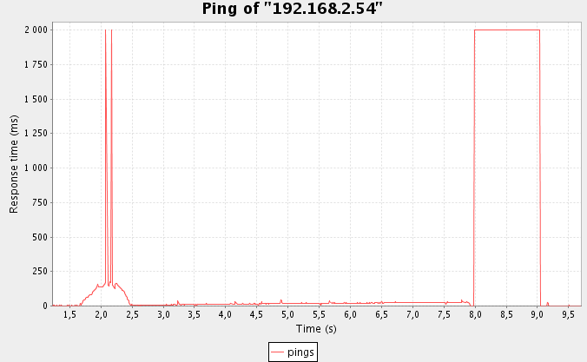
Test Scheme Interruption Duration
Monitor Computer
Pings
DomU
Migration
Dom0-1
Dom0-2
Results: 1s

Slide 21
Test Scheme Delay
DomU
LU
Factorizations
Migration
Dom0-1
Dom0-2

Slide 22

Test Scheme Delay
DomU
Ping pong Migration
Dom0-1
Chrono
Dom0-2

Slide 23



Test Scheme TCP Connection Preservation
Streaming Client
DomU
Streaming
Server
Migration
Dom0-1
Dom0-2

Slide 24
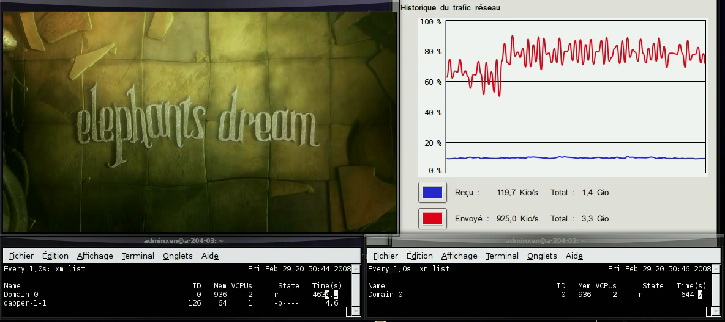
Test Scheme TCP Connection Preservation
Streaming Client Output
Network Traffic Monitor
Dom0 Source
Dom0 Destination

Slide 25
TUNe

Slide 26

TUNe Presentation Component-Based Architecture
Fractal Components
ADL
Architecture Description Languague

Slide 27
TUNe Presentation High Level management tools
Wrappers
Stubs
Tune Wrapper
Legacy Software

Slide 28
TUNe Presentation Deployment diagrams
S2
+wrapper : String = S2.xml
+legacyFile : String = S2.tgz +host-family : String = localhost
S1.configure
S2.configure
1
1
S2
S1.start
+wrapper : String = S2.xml
+legacyFile : String = S2.tgz +host-family : String = localhost
S2.start

Slide 29
TUNe Presentation Reconfiguration diagrams
event
this.stop
this.reconfigure
this.start

Slide 30
Pool Architecture
DomU
Migration
Dom0-1
Migrate
Dom0-2
Probe0-1
Probe0-2
Event
TUNe Administrator

Slide 31
Pool Architecture TUNe wrappers
Start
Stop
Migrate
Start
Stop
domU wrapper
domU
Probe wrapper

Slide 32
Pool Architecture TUNe Diagrams
Start
Stop
Migrate
etch1-1.start
etch1-1.stop
this.probed.migrate
etch1-1-Probe.start
etch1-1-Probe.stop

Slide 33
Project Management

Slide 34
Project Management
Google Code version control software
Specification document
Architecture document
Risk Analysis
Action List
Schedule
Tutorials

Slide 35
Project Management Specification document
R3 | Requirement Formulation | Calculation results will not be affected by virtual machine migration.
 | Rational | Migration should keep virtual machine memory state and hosted applications execution background.
 | Priority | P0
 | Demand Reference | D4
 | Test Reference | T3

Slide 36
Project Management Risk Analysis
Risk | Probability | Criticality | Product | Preventive Actions | Corrective Actions
Data loss (large size) | 2 | 1 | 2 | Copy on external hard drive | Backup
Data loss (small size) | 2 | 3 | 6 | Copy on SVN repository | Backup
Network breakdown | 1 | 2 | 2 | Local copy of documentation and API | Schedule adaptation
System crash (OS, VM) | 1 | 2 | 2 | Installation guide | Reinstall

Slide 37
Project Management Action List
Deadline | Whole team (Xen Attitune Team) | Julien C (Doudou) | Julien L (Juju) | Ezequiel (L’Argentin) | Hery | Mathieu (Le J)

Slide 38
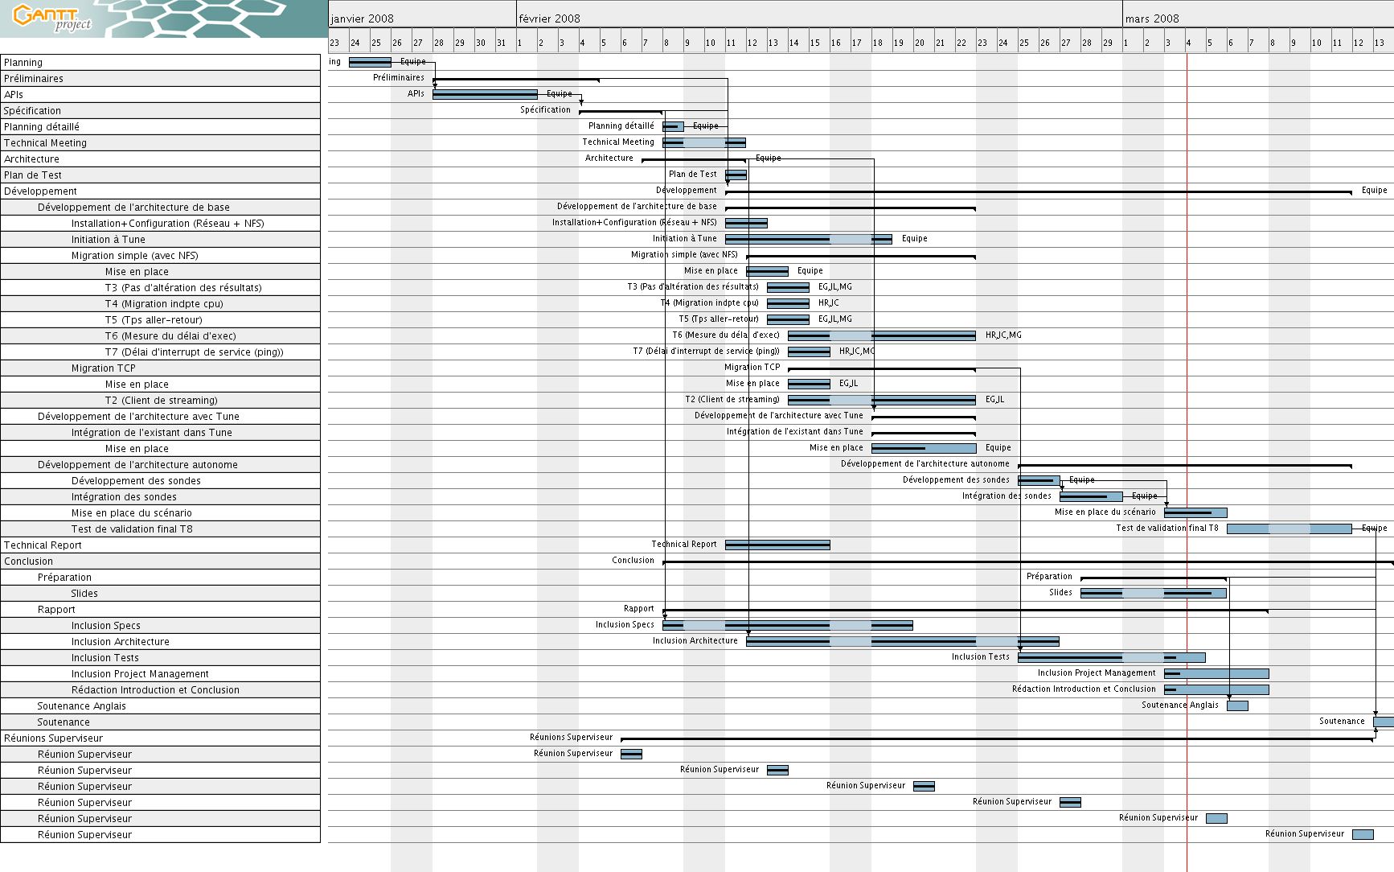
Project Management Schedule

Slide 39
Project Management Tutorials
Xen installation and setting up
NFS server
DNS server
DHCP server
NTP server
TUNe

Slide 40
Conclusion

Slide 41
Conclusion
Further improvements
Total Autonomy
Kdeploy -> Grid
J2EE
Other administration policies

Slide 42
Conclusion
Hardware Architecture
Network Architecture
Tests
TUNe
Improvements
Xen 3.1
DHCP Server
Kernel 22-14
Bug
Kernel 19-6
Filesystem
NFS Server
NFS Boot on DomU
CPU Load OK
Migration OK
Interruption OK
Integrity OK
Delay NOK
Streaming NOK
Kernel 18.8
NFS root (domU)
Functionnal configuration
Kernel 18.8
Clock issues
Xen (dom0)
Delay OK
Streaming OK
Wrappers,
Deployment diagram
Synchronisation
issues
NTP Server
Issues
resolved
Name resolution
DNS Server
Reconf Diagram,
Probe
TUNe modifications
Streaming scenario
kdeploy
J2EE
Policies

Slide 43
Conclusion
Hardware Architecture
Network Architecture
Tests
TUNe
Improvements
Xen 3.1
DHCP Server
Kernel 22-14
Bug
Kernel 19-6
Filesystem
NFS Server
NFS Boot on DomU
CPU Load OK
Migration OK
Interruption OK
Integrity OK
Delay NOK
Streaming NOK
Kernel 18.8
NFS root (domU)
Functionnal configuration
Kernel 18.8
Clock issues
Xen (dom0)
Delay OK
Streaming OK
Wrappers,
Deployment diagram
Synchronisation
issues
NTP Server
Issues
resolved
Name resolution
DNS Server
Reconf Diagram,
Probe
TUNe modifications
Streaming scenario
kdeploy
J2EE
Policies

Slide 44
Conclusion
Hardware Architecture
Network Architecture
Tests
TUNe
Improvements
Xen 3.1
DHCP Server
Kernel 22-14
Bug
Kernel 19-6
Filesystem
NFS Server
NFS Boot on DomU
CPU Load OK
Migration OK
Interruption OK
Integrity OK
Delay NOK
Streaming NOK
Kernel 18.8
NFS root (domU)
Functionnal configuration
Kernel 18.8
Clock issues
Xen (dom0)
Delay OK
Streaming OK
Wrappers,
Deployment diagram
Synchronisation
issues
NTP Server
Issues
resolved
Name resolution
DNS Server
Reconf Diagram,
Probe
TUNe modifications
Streaming scenario
kdeploy
J2EE
Policies

Slide 45
Conclusion
Hardware Architecture
Network Architecture
Tests
TUNe
Improvements
Xen 3.1
DHCP Server
Kernel 22-14
Bug
Kernel 19-6
Filesystem
NFS Server
NFS Boot on DomU
CPU Load OK
Migration OK
Interruption OK
Integrity OK
Delay NOK
Streaming NOK
Kernel 18.8
NFS root (domU)
Functionnal configuration
Kernel 18.8
Clock issues
Xen (dom0)
Delay OK
Streaming OK
Wrappers,
Deployment diagram
Synchronisation
issues
NTP Server
Issues
resolved
Name resolution
DNS Server
Reconf Diagram,
Probe
TUNe modifications
Streaming scenario
kdeploy
J2EE
Policies

Slide 46
Questions

