Slide 1
Plan
Introduction
Client Specifications
Xen setting up
  Preliminary study
  Requirements
  Architecture
Test Scheme
Integration in TUNe (prsentation TUNe)
  Architecture
  Wrappers and Reconf diagrams
Project Management
Conclusion

Slide 2
Introduction

Slide 3

Introduction
Expansion
Criteria
Shrink
Criteria
Virtual Machine 1
Virtual Machine 2
migration
migration

Slide 4
Client Specifications
Xen Paravirtualization Tools
TUNe
NFS
A working scenario

Slide 5
Client Specifications
Requests number rising
Requests number reduction
Server 1
Server 2
migration
migration

Slide 6
Preliminary Study
Xen Control
Software
User Applications
User Applications
User Applications
Domain 0
User Domain 1
User Domain 2
Abstraction Layer
Xen Control
Interface
Abstraction Layer
Abstraction Layer
Modified Drivers
Modified Drivers
Modified Drivers
Xen Hypervisor
Hardware

Slide 7
Preliminary Study
domU-1
migration
dom0-1
dom0-2

Slide 8
Preliminary Study
DomU-1
DomU-2
eth0
eth1
eth0
vif1.0
vif2.0
vif2.0
vif0.0
peth0
xenbr0
eth0
Dom0
Physical Machine

Slide 9
Preliminary Study
domU-1
domU-1
migration
dom0-1
NFS Server
dom0-2

Slide 10
Requirements
Migration requirements:
  no task interruption
  TCP connection keeping
  Results consistency
  CPU load independence
Migration performance study:
  Interruption duration
  Migration duration
  Delay
Integration in TUNe

Slide 11


Architecture
DNS Server
DHCP Server
NTP Server
NFS Server
A-204-06
Switch
A-204-02
A-204-05
A-204-03
A-204-04

Slide 12
Architecture
GNU/Linux Debian Etch / NFS root
Ubuntu Dapper Drake / NFS root
domU-1
domU-1
Xend Daemon
Ubuntu Gutsy Gibbon / Xen Management
dom0

Slide 13
Test Scheme
Keep TCP connections
not affect results
independant of CPU
interruption duration
delay
migration duration
streaming
write in a file + comparison
migration diff CPU
ping
loc + mig
rmi + mig

Slide 14
Test Scheme
Results consistency
domU
Writing in a file
migration
dom0-1
dom0-2

Slide 15
Test Scheme
CPU load independence
domU
migration
dom0-2
dom0-1
CPU loading

Slide 16
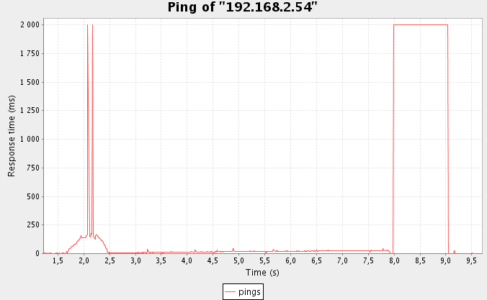
Test Scheme
Interruption Duration
Pings
domU
migration
dom0-1
dom0-2
Results: 1s

Slide 17
Test Scheme
Delay
domU
LU factorizations
migration
dom0-1
dom0-2

Slide 18
Test Scheme
Migration Duration
domU
migration
dom0-1
Chrono
dom0-2

Slide 19
Test Scheme
TCP connections keeping
Streaming client
domU
Streaming server
migration
dom0-1
dom0-2

Slide 20
TUNe Presentation

Slide 21
Architecture
domU
migration
dom0-1
migrate
dom0-2
Probe0-1
Probe0-2
event
TUNe administrator

Slide 22
Wrappers & Reconfiguration Diagrams
Start
Stop
Migrate
ici viendra en son taon...
LE DIAGRAMME DE RECONF
DE LA MIGRATION
domU wrapper
domU
Start
Stop
Probe wrapper

Slide 23
Project Management
- Google Code version control software
- Specification doc
- Architecture doc
- Risk Analysis
- Action List
- Schedule
- Tutorials

