Slide 1
Virtualization for autonomous administration of servers
Technical Project ENSEEIHT 2008

Slide 2
Our goals

Slide 3

Validation test
Requests number rising
Requests number reduction
Server 1
Server 2
migration
migration

Slide 4
Paravirtualization with Xen
Architecture
domU-1 (user domain 1)
Linux kernel / Xen
domU-2 (user domain 2)
dom0 ( host domain )
Linux kernel / Xen
Linux kernel
Xen
.
.
.

Slide 5
Paravirtualisation with Xen
Migration
domU-1.1
domU-1.2
migration
dom0-1
dom0-2

Slide 6
NFS
Migration with Xen and NFS
domU-1.1
NFS Server
migration
dom0-1
dom0-2
Network

Slide 7
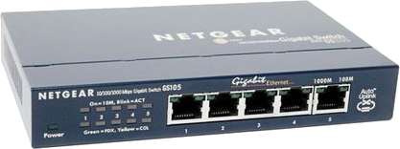
DHCP Server
NFS Server
NFS Server
NFS Server
Xen
NFS Server
Xen
Xen
NFS Server
Xen
Xen
Switch

Slide 8
Functional requirements

Slide 9
Functional requirements

Slide 10
Functional requirements

Slide 11
Functional requirements

Slide 12
Functional requirements

