Slide 1
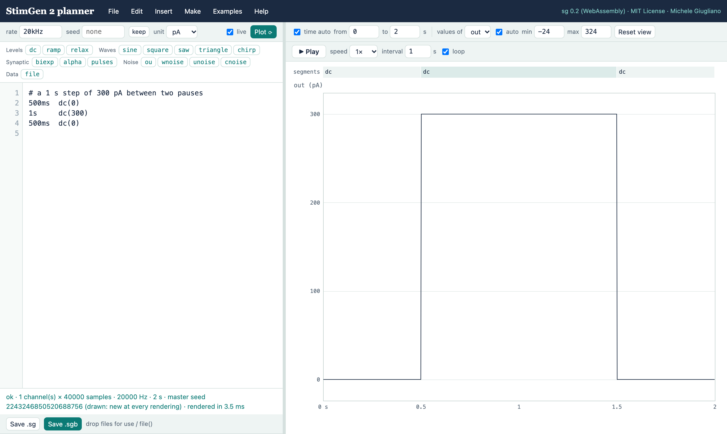
Plan your stimuli in the browser
A hands-on tutorial for the StimGen 2 planner: from a first current step to shuffled, repeated protocols
blog.giugliano.info/StimGen2
Michele Giugliano · MIT License
Notes:
This tutorial shows how to plan electrophysiology stimuli in a web browser with the StimGen 2 planner. Nothing needs to be installed: open the address on the slide. By the end you will be able to build a family of current steps, repeated and shuffled, by clicking or by writing a few readable lines.

Slide 2

A protocol is a sentence
steps.sg — what you write
What you would tell a colleague
sg 2 protocol
sweep amp = from -300pA to 300pA step 50pA
repeat 3
order shuffled-blocks
period 5s
stimulus {
500ms dc(0)
1s dc($amp)
500ms dc(0)
}
“Inject current steps from −300 to +300 pA, every 50 pA. Each step lasts 1 s, with half a second of rest before and after. Play every step 3 times, in a shuffled order, one trial every 5 seconds.”
The same information, almost word for word. Ten short lines describe 39 trials, cannot be misread, and can be checked, plotted and reused. The planner helps you write them — by typing or by clicking.
Notes:
Every protocol you run can be said in one or two sentences. StimGen 2 lets you write it almost as you would say it: sweep the amplitude, repeat three times, shuffle, one trial every five seconds. Ten lines describe thirty-nine trials. Nobody has to guess what was played, and the file is saved with every recording.

Slide 3
What you see when you open it
1
1
Menus file, edit, insert, examples, help
2
7
2
Palette a button per generator
5
3
6
3
Text the description itself
4
Status ok, warnings, errors
5
Segments click one to edit it
6
Plot updates as you type
7
Play animate the stimulus
4
8
Save the .sg text, the .sgb samples
8
Notes:
The window has two sides. On the left, the text of the stimulus, with a palette of generators above it and a status line below. On the right, the plot: it is redrawn as you type. Above the plot, a strip of segments that you can click, and a play bar to animate the stimulus. The menus at the top do the rest.

Slide 4
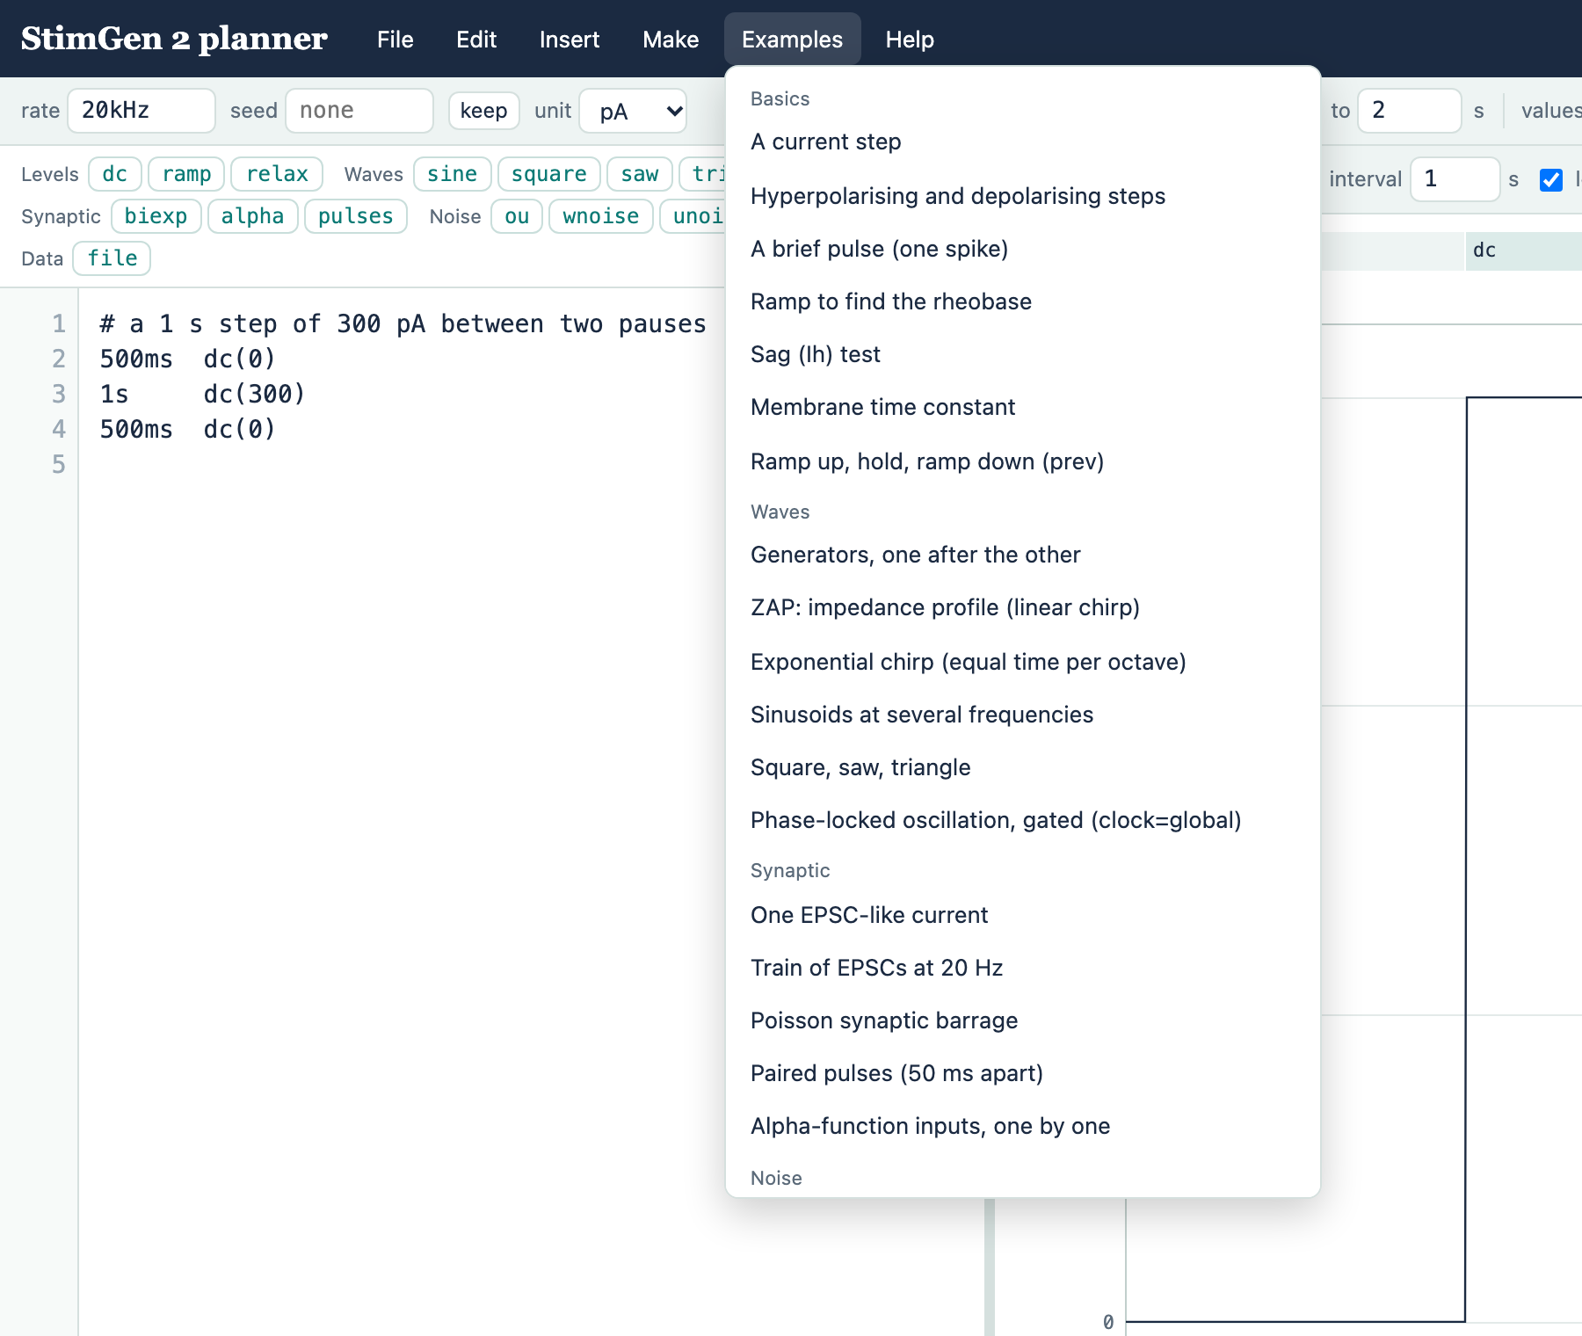

Start from an example
43 ready-made stimuli
Basics
steps, rheobase ramp, sag, membrane time constant
Waves · Synaptic · Noise
ZAP chirps, EPSC trains, Poisson barrages, frozen noise
Stimuli
two cells, voltage clamp, dynamic clamp, optogenetics
Protocols
f–I curve, reliability, paired-pulse ratio, I–V
Pick one, change a number, watch the plot. Your text is kept in the browser.
Notes:
The quickest start is the Examples menu: forty-three complete stimuli, grouped from basic steps to full protocols. Choose one that resembles what you need, then change its numbers. The planner remembers your text, so you can close the tab and come back.

Slide 5
Type, and the plot follows
three lines = a current step
500ms dc(0) # rest
1s dc(300) # 300 pA
500ms dc(0) # rest
500ms
how long
always with a unit: ms, s, min
dc
what
a generator: dc, ramp, sine, pulses, ou…
(300)
how much
parameters, by position or by name
live on: the plot follows every key. Off: press Plot ⟳ (⌘/Ctrl+Enter) when you are ready.
Notes:
Each line is a segment: how long, then what the output does. dc means a constant level. Write three lines and the plot shows a current step. Units are part of the language: 500 ms, 1 s. If live is switched off, nothing is redrawn until you press Plot, which is handy for very long stimuli.

Slide 6
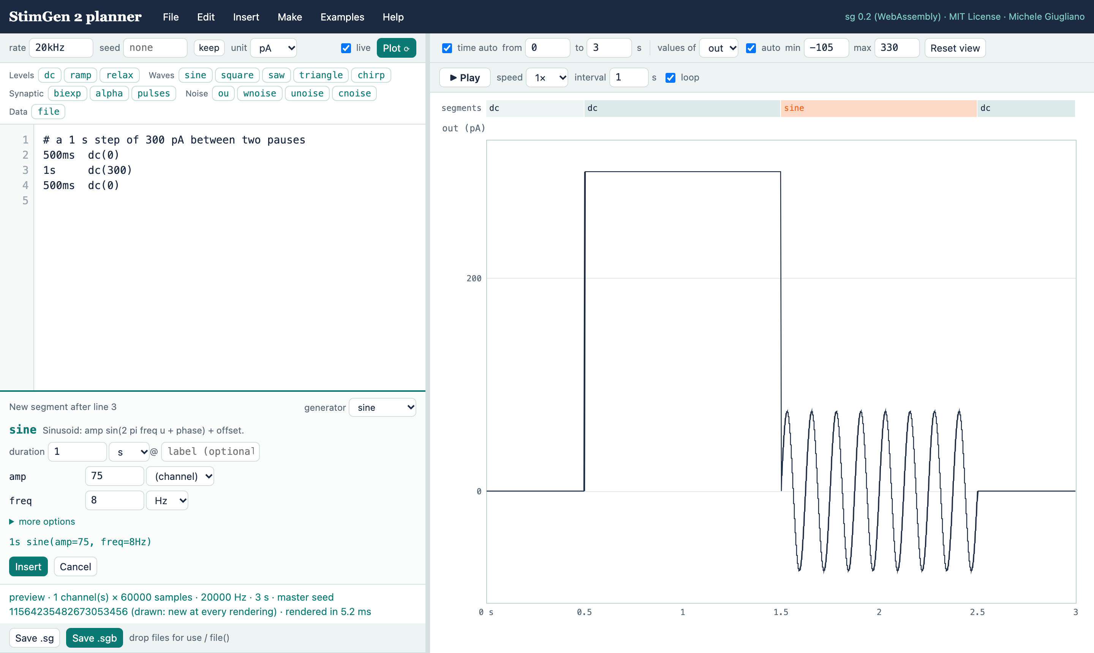
Build a segment without typing
1
Click a generator here: sine
1
2
Fill in the form units from the menus; extras under “more options”
5
3
Read the line this is what will be written
2
4
Insert or Cancel (Esc)
3
5
See it first the plot previews the new segment
4
Notes:
You never have to remember a parameter name. Click a generator in the palette and a form opens under the text, with sensible starting values and units chosen from menus. The plot already shows the result, and the line that will be written is printed in green. Insert writes it into the text; Cancel leaves everything as it was.

Slide 7
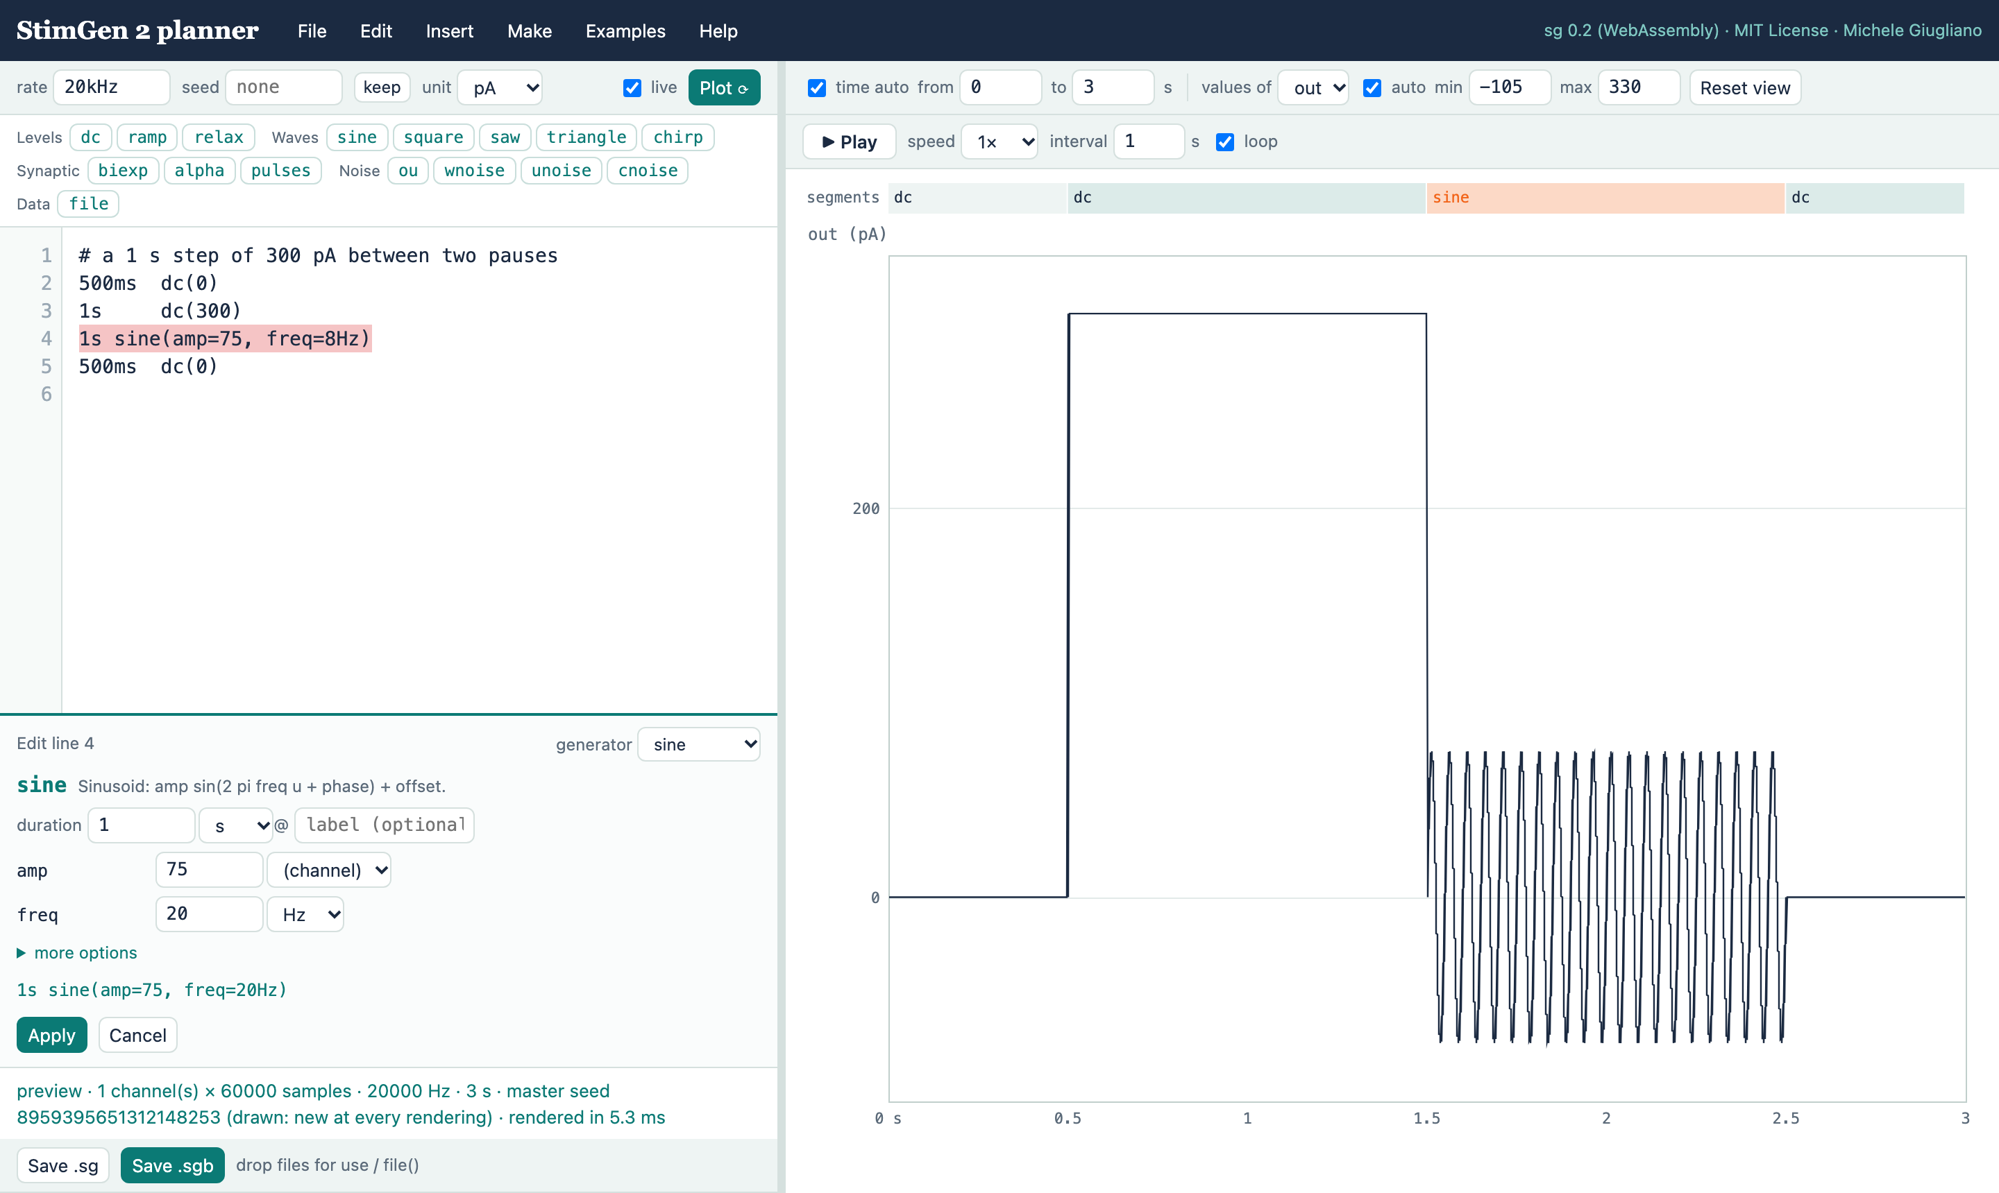
Change a segment: just click it
1
Click a segment in the strip above the plot
1
3
2
Edit its values the same form, already filled in
3
Apply only that line changes
2
Or put the cursor on a line and choose Edit → Edit the segment at the cursor.
Notes:
To change a segment, click it in the strip above the plot. The same form opens with the current values, read back from the text. Change the frequency, press Apply, and only that line of text is rewritten. The text always remains the master copy.

Slide 8
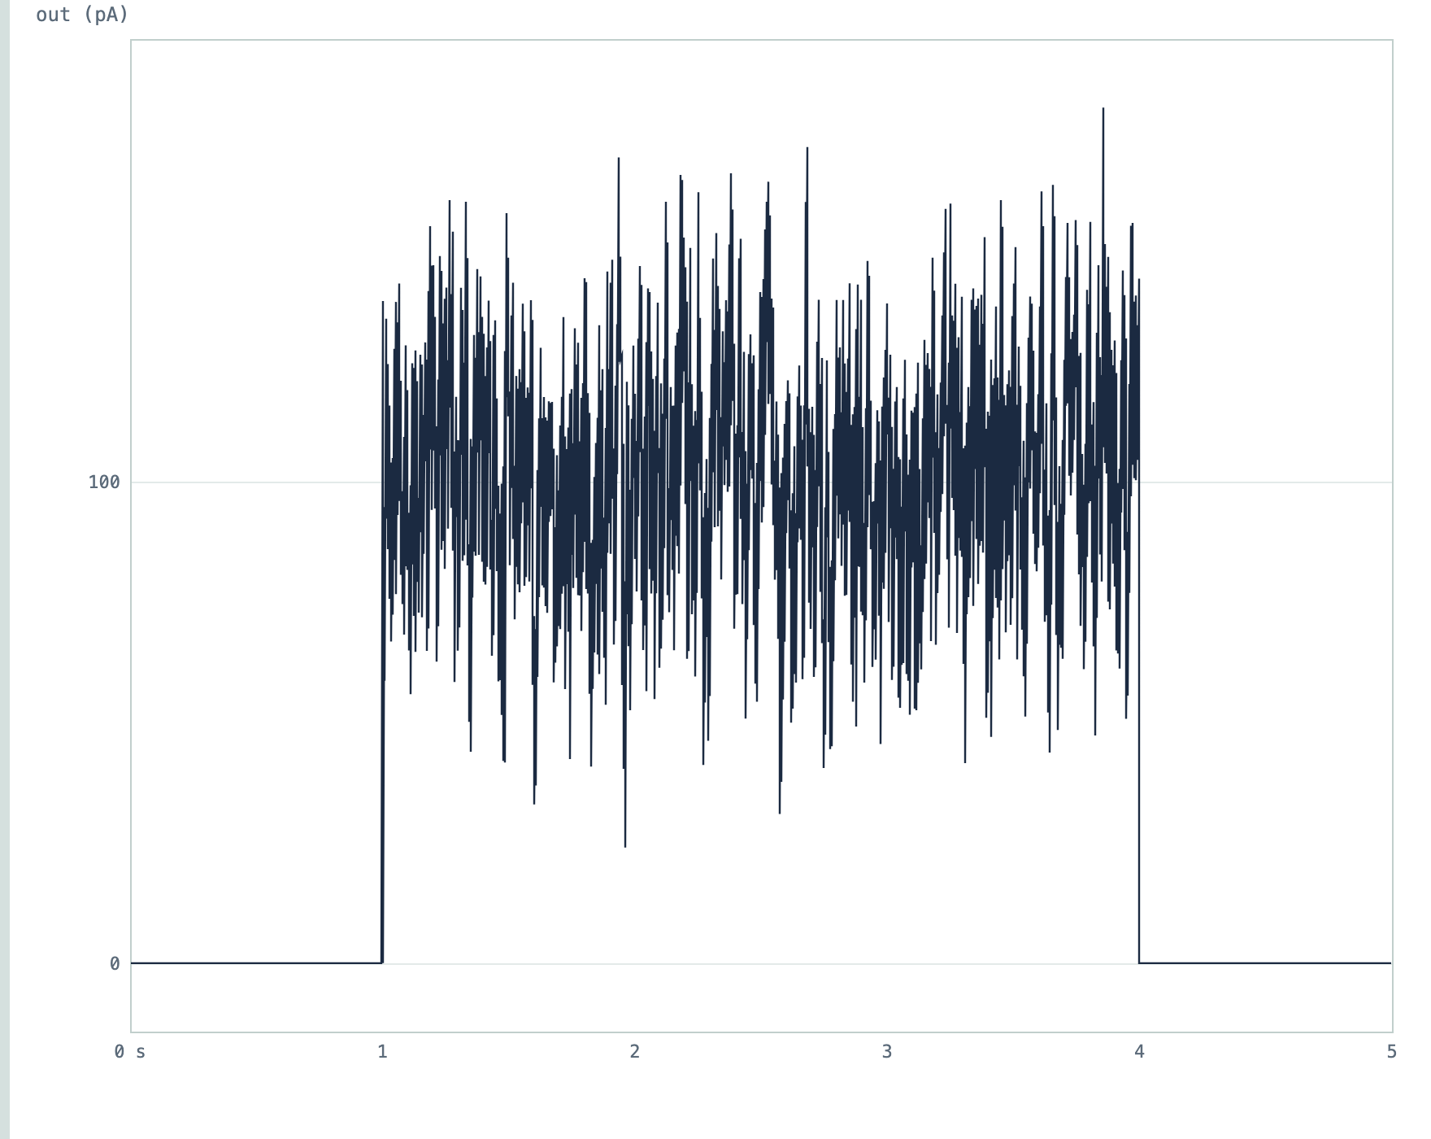
Combine: a step with noise on top
before: select line 2
1s dc(0)
3s dc(100)
1s dc(0)
Edit → Combine the selection with a generator → ou, operation + add
after
1s dc(0)
3s (dc(100)) + ou(mean=0,
sd=20, tau=5ms)
1s dc(0)
The same way: multiply by an envelope, Edit → Repeat lines N times, add a marker for the analysis.
Notes:
Real stimuli are often combinations: a step with noise on top, a sine under an envelope. Select the line, choose Edit, Combine, pick a generator and the operation. The planner writes the combined line for you. Repeat and markers work the same way, from the Edit menu.

Slide 9
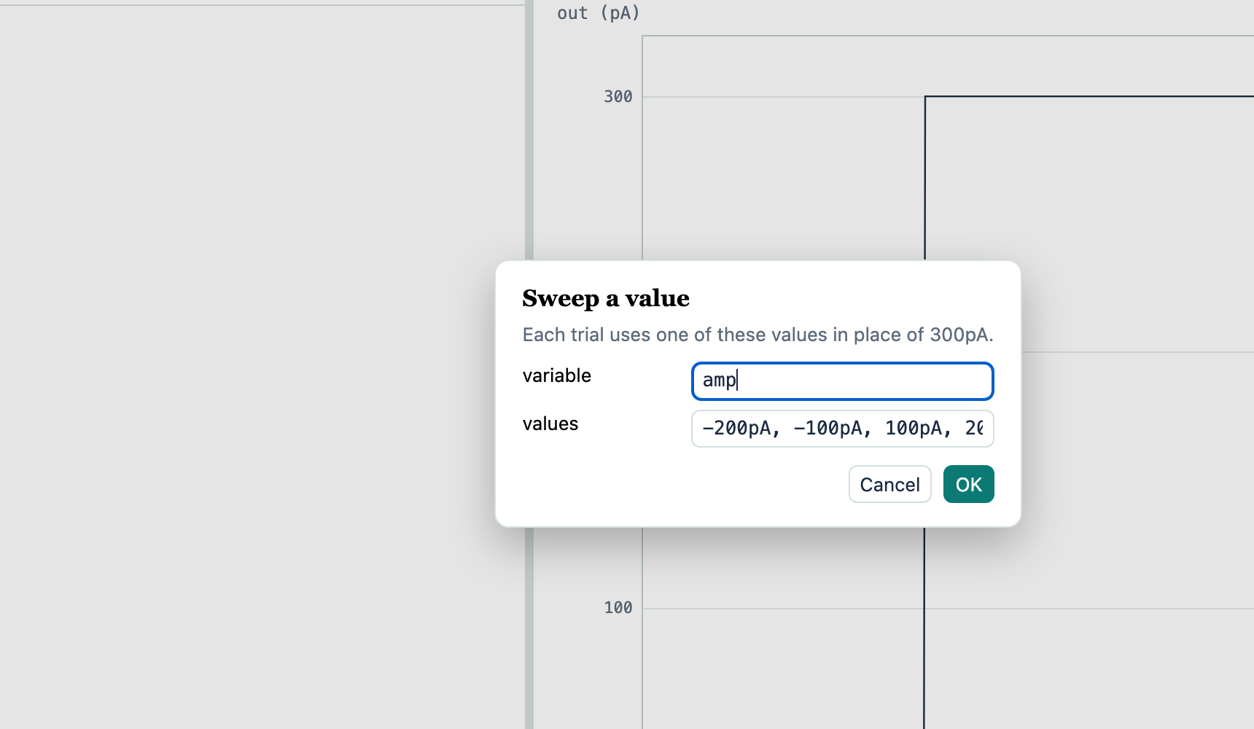
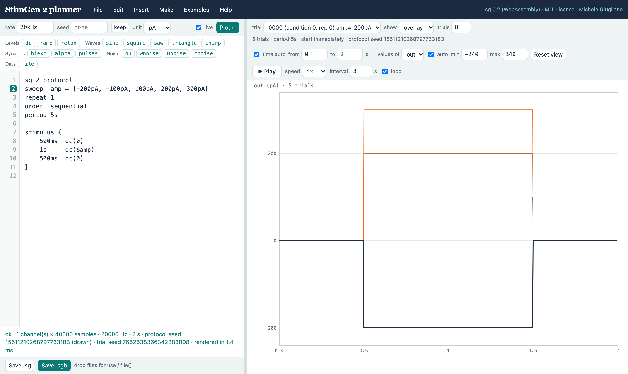
From one step to a whole protocol
1
Select a value in the text: 300pA
2
Make → Sweep give the values
3
Done a protocol, one trial per value
Notes:
This is the most useful trick. Select a number in the text, for example the amplitude of a step, and choose Make, Sweep. Give the values you want. The planner turns your stimulus into a protocol: one trial per value, with the value replaced by a variable. Repetitions, order and timing are one line each, as on the next slide.

Slide 10
The protocol language reads like English
you write | it means
sweep amp = from -300pA to 300pA step 50pA | amplitudes −300 … +300 pA, every 50 pA
sweep f = [5Hz, 10Hz, 20Hz] | these three frequencies
repeat 3 | play every condition 3 times
order shuffled-blocks | random order; every condition once before any repeats
period 5s · gap 2s | one trial every 5 s · 2 s of pause between trials
noise per-condition | repetitions get the same noise (frozen noise)
let charge = amp * dur | a quantity computed from other variables
dc($amp) | $amp is replaced by the value of each trial
Several sweeps combine into every combination. Help → protocol lists everything.
Notes:
These are the words of the protocol language. Sweep gives a variable its values, as a list or a range. Repeat sets the repetitions. Order says how trials are shuffled; shuffled-blocks plays every condition once before any is repeated, which protects against slow drifts. Period or gap set the timing. Noise per-condition freezes the noise across repetitions, for reliability experiments.

Slide 11
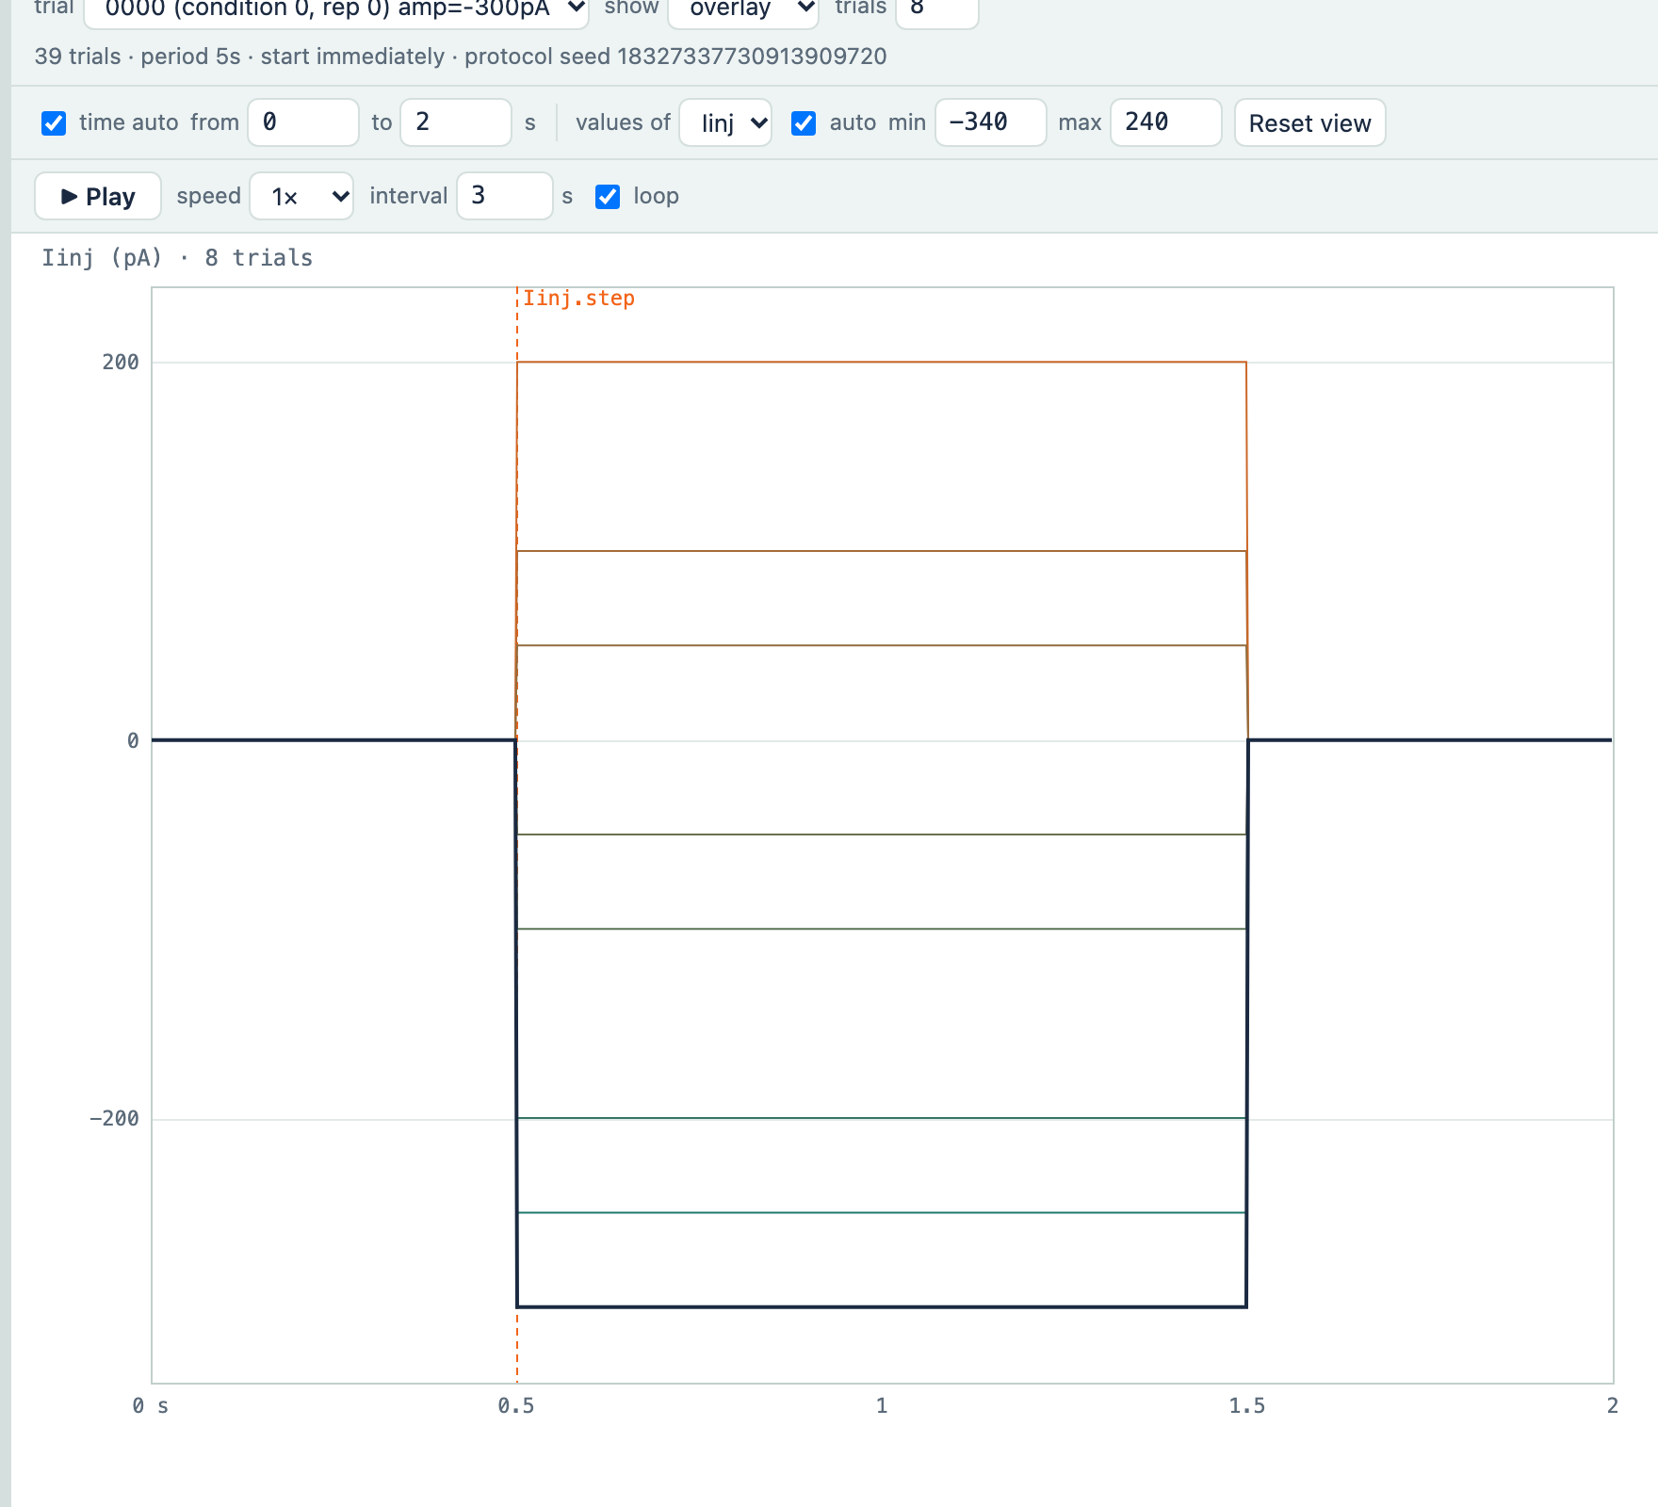
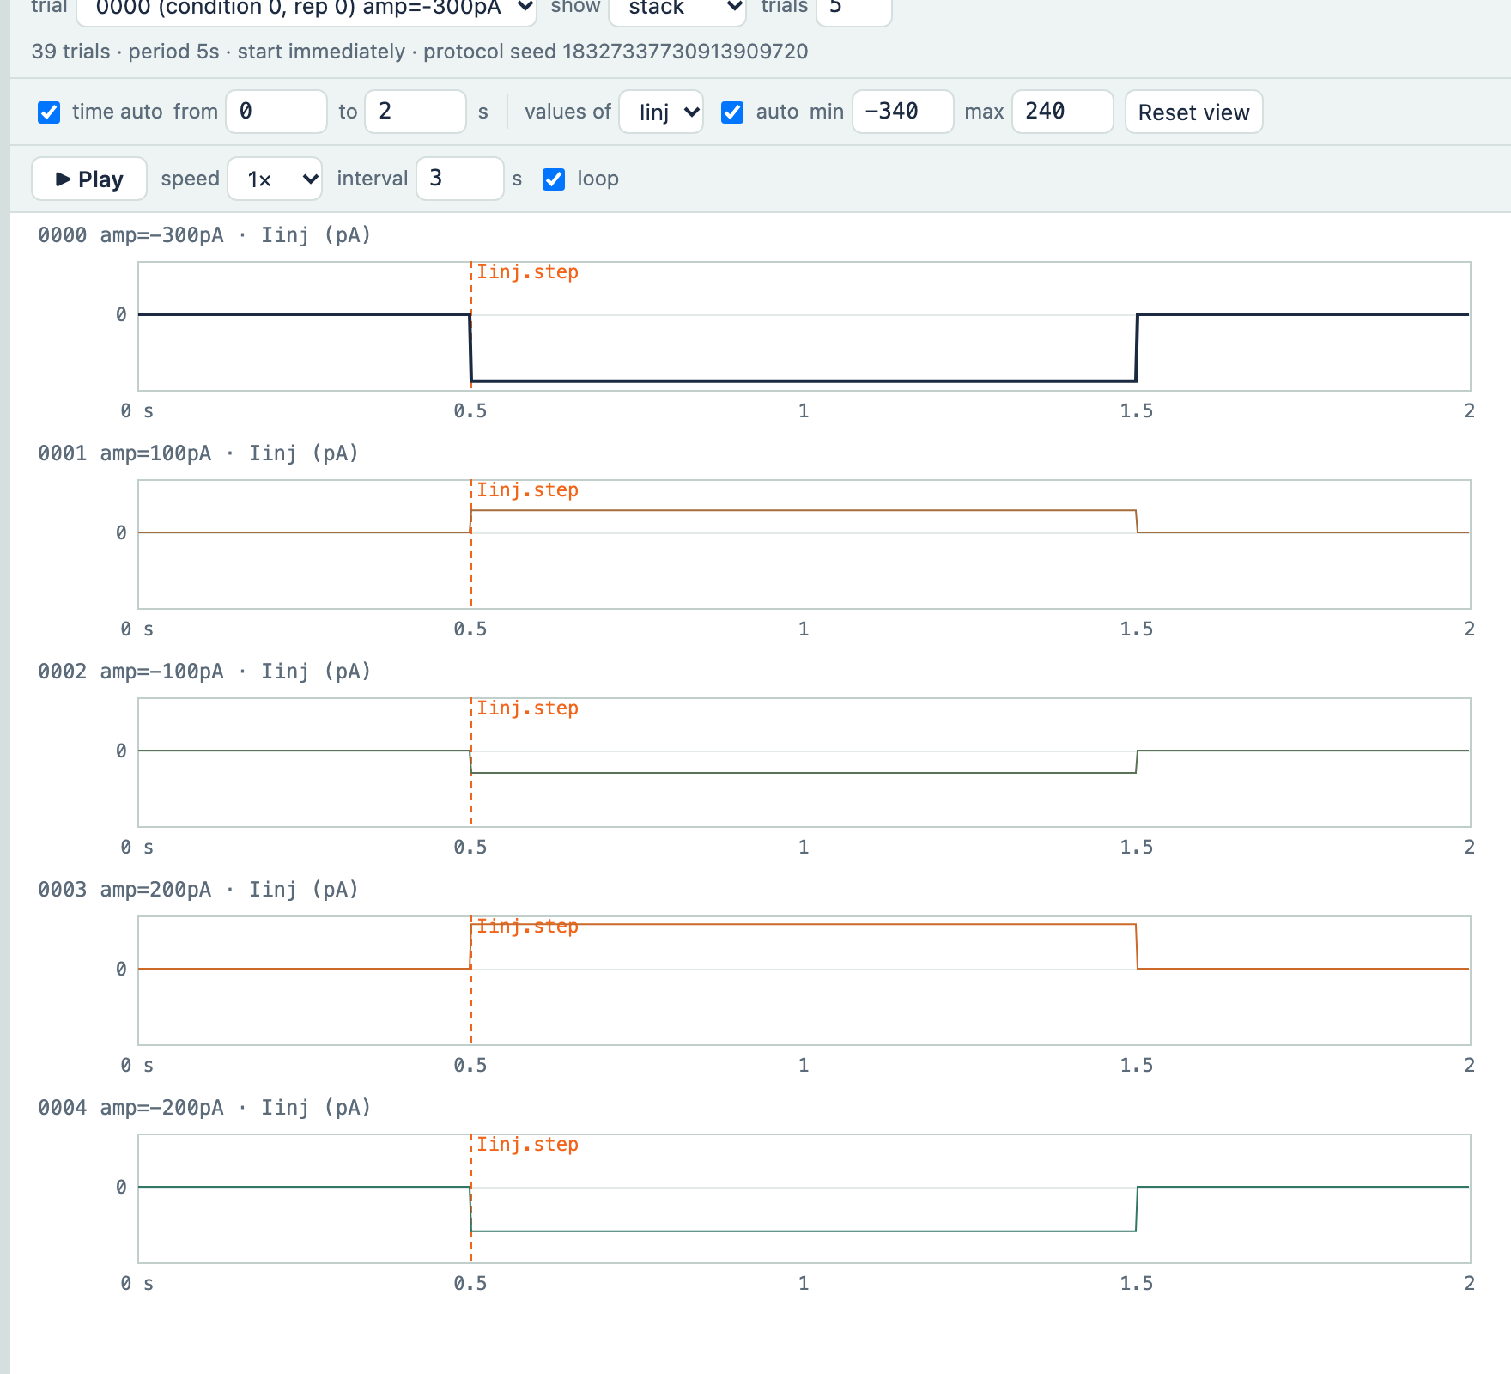
See all the trials, or one at a time
1
2
3
1
Trial pick any trial from the list
2
Show this trial · overlay · stack
3
Trials how many, from the selected one
Notes:
A protocol produces many trials. Choose any trial from the list to see it alone, or show several: overlay draws them on the same axes, coloured by condition, with the selected trial in bold; stack gives each trial its own row. The number of trials shown is up to you.

Slide 12
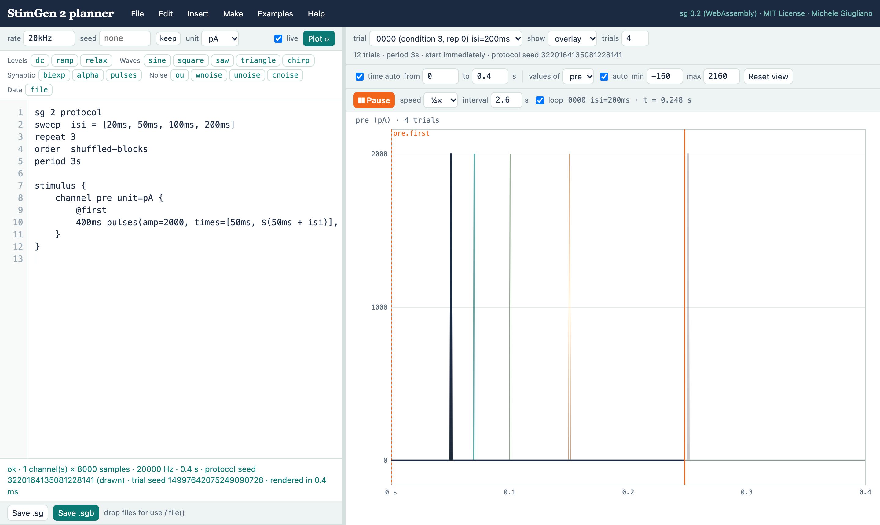
Watch it play
1
Play / Pause a cursor runs through the stimulus
1
2
3
2
Speed ¼× to 20×; 1× is real time
4
3
Interval time between trials, taken from the protocol
4
Trial after trial highlighted in turn; loop if you like
Notes:
Press Play and a cursor runs through the stimulus at the speed you choose. After each trial the planner waits the interval, taken from the protocol's period, and moves to the next trial. It is the easiest way to explain a protocol to a student, or to check its timing before an experiment.

Slide 13
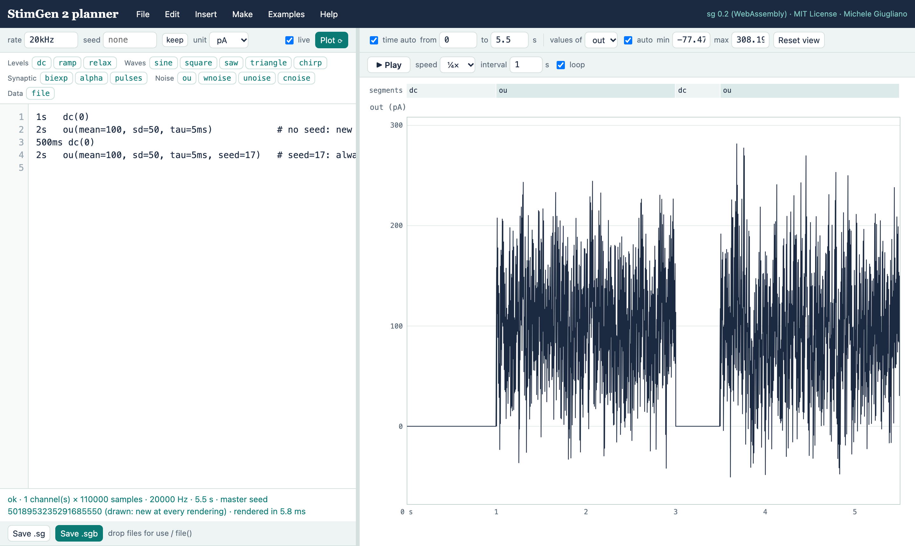



Noise: new every time, or frozen
No seed
1
2
a new realisation at every rendering (Plot ⟳ draws again)
seed=17 in the text
that segment is identical, always (frozen noise)
keep
freeze the noise you are looking at
3
The status line always says which seed was used, and where it came from.
Notes:
Noise follows the rules of the specification. Without a seed, every rendering draws a new realisation, exactly as in an experiment. A seed written in the text freezes that noise, wherever it appears. The keep button copies the seed you are looking at, so the same noise stays on the screen. The status line tells you which seed was used.

Slide 14
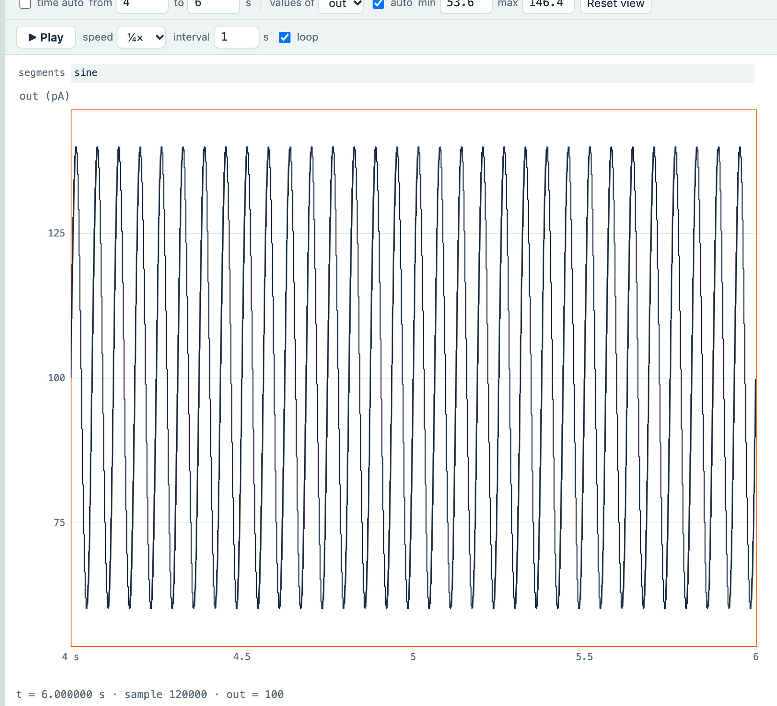
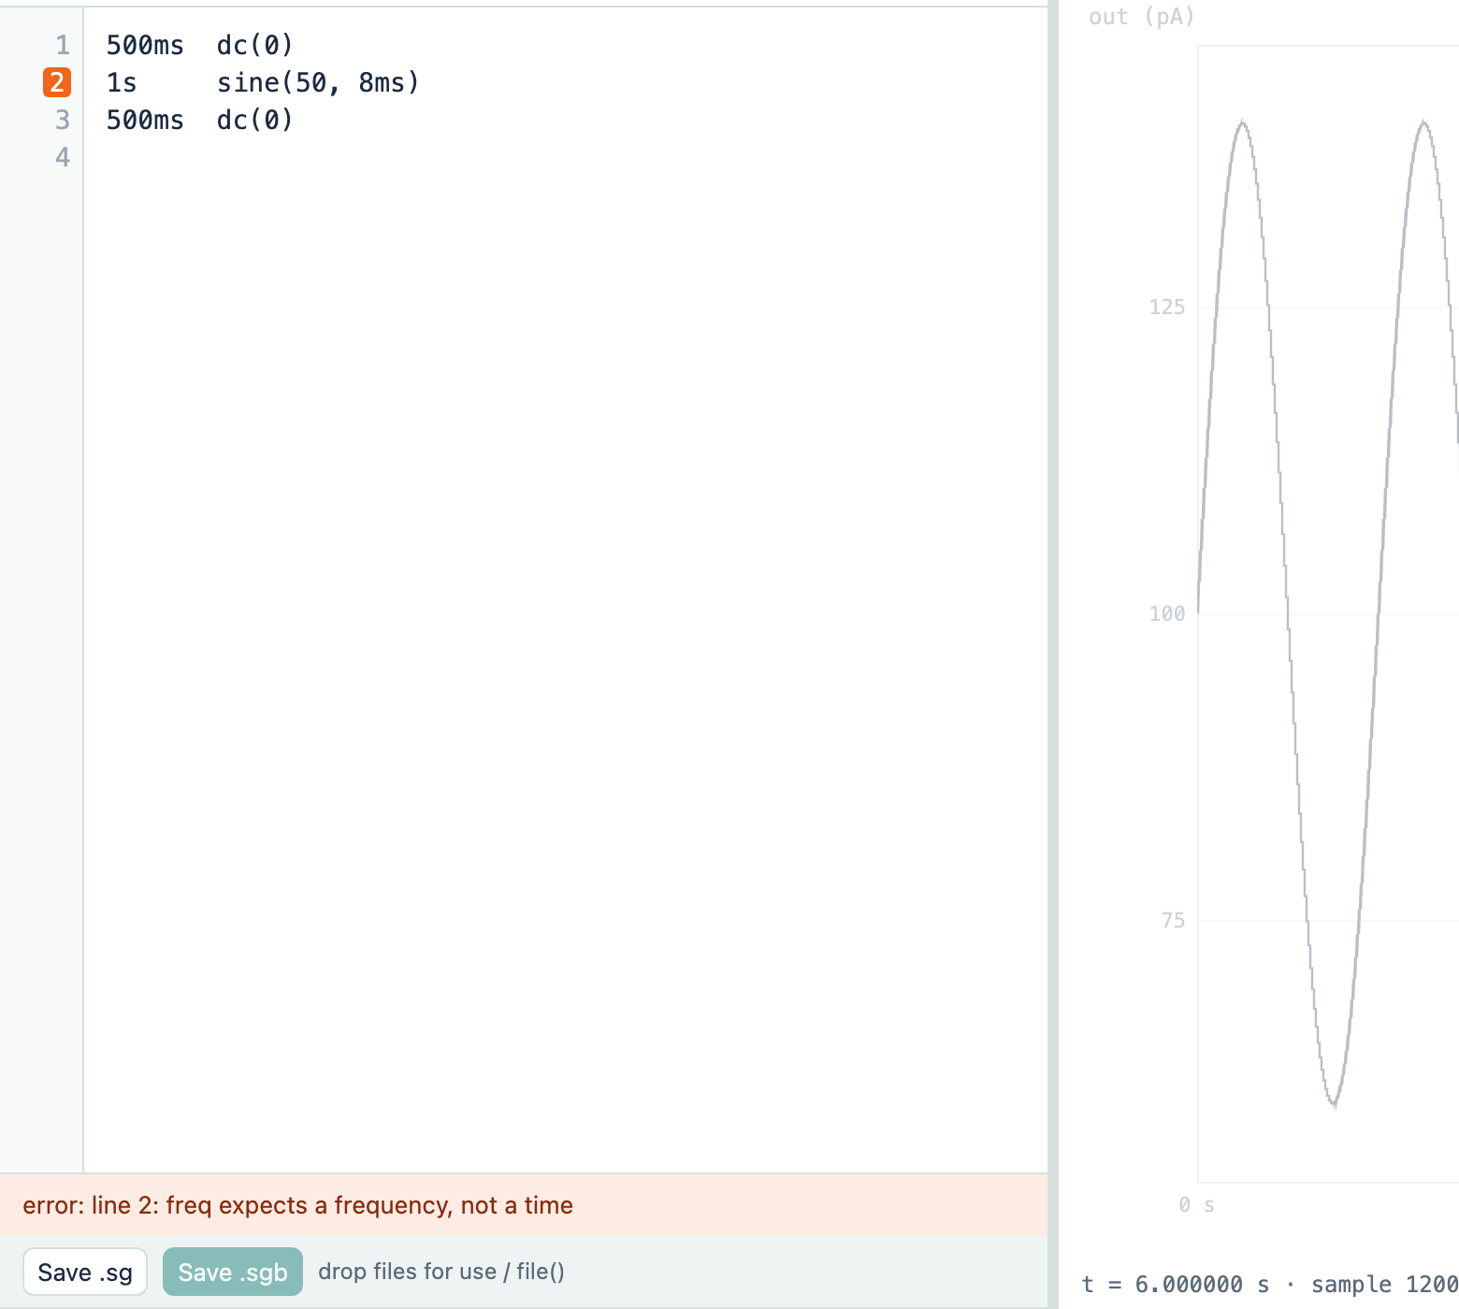
Zoom, check, fix
Axes. Drag on the plot to zoom time, Shift+drag for values, double-click to go back. Or type the limits; fixed limits are kept while you edit.
Errors. A mistake marks its line in orange and says what is wrong (here: a frequency written as a time). Nothing is played until it is fixed.
Notes:
To look closer, drag across the plot to zoom in time; hold Shift to zoom the values; double-click to return to automatic. If you make a mistake, the line turns orange and the status line explains it, here a frequency written in milliseconds. A wrong stimulus can never be played by accident.

Slide 15
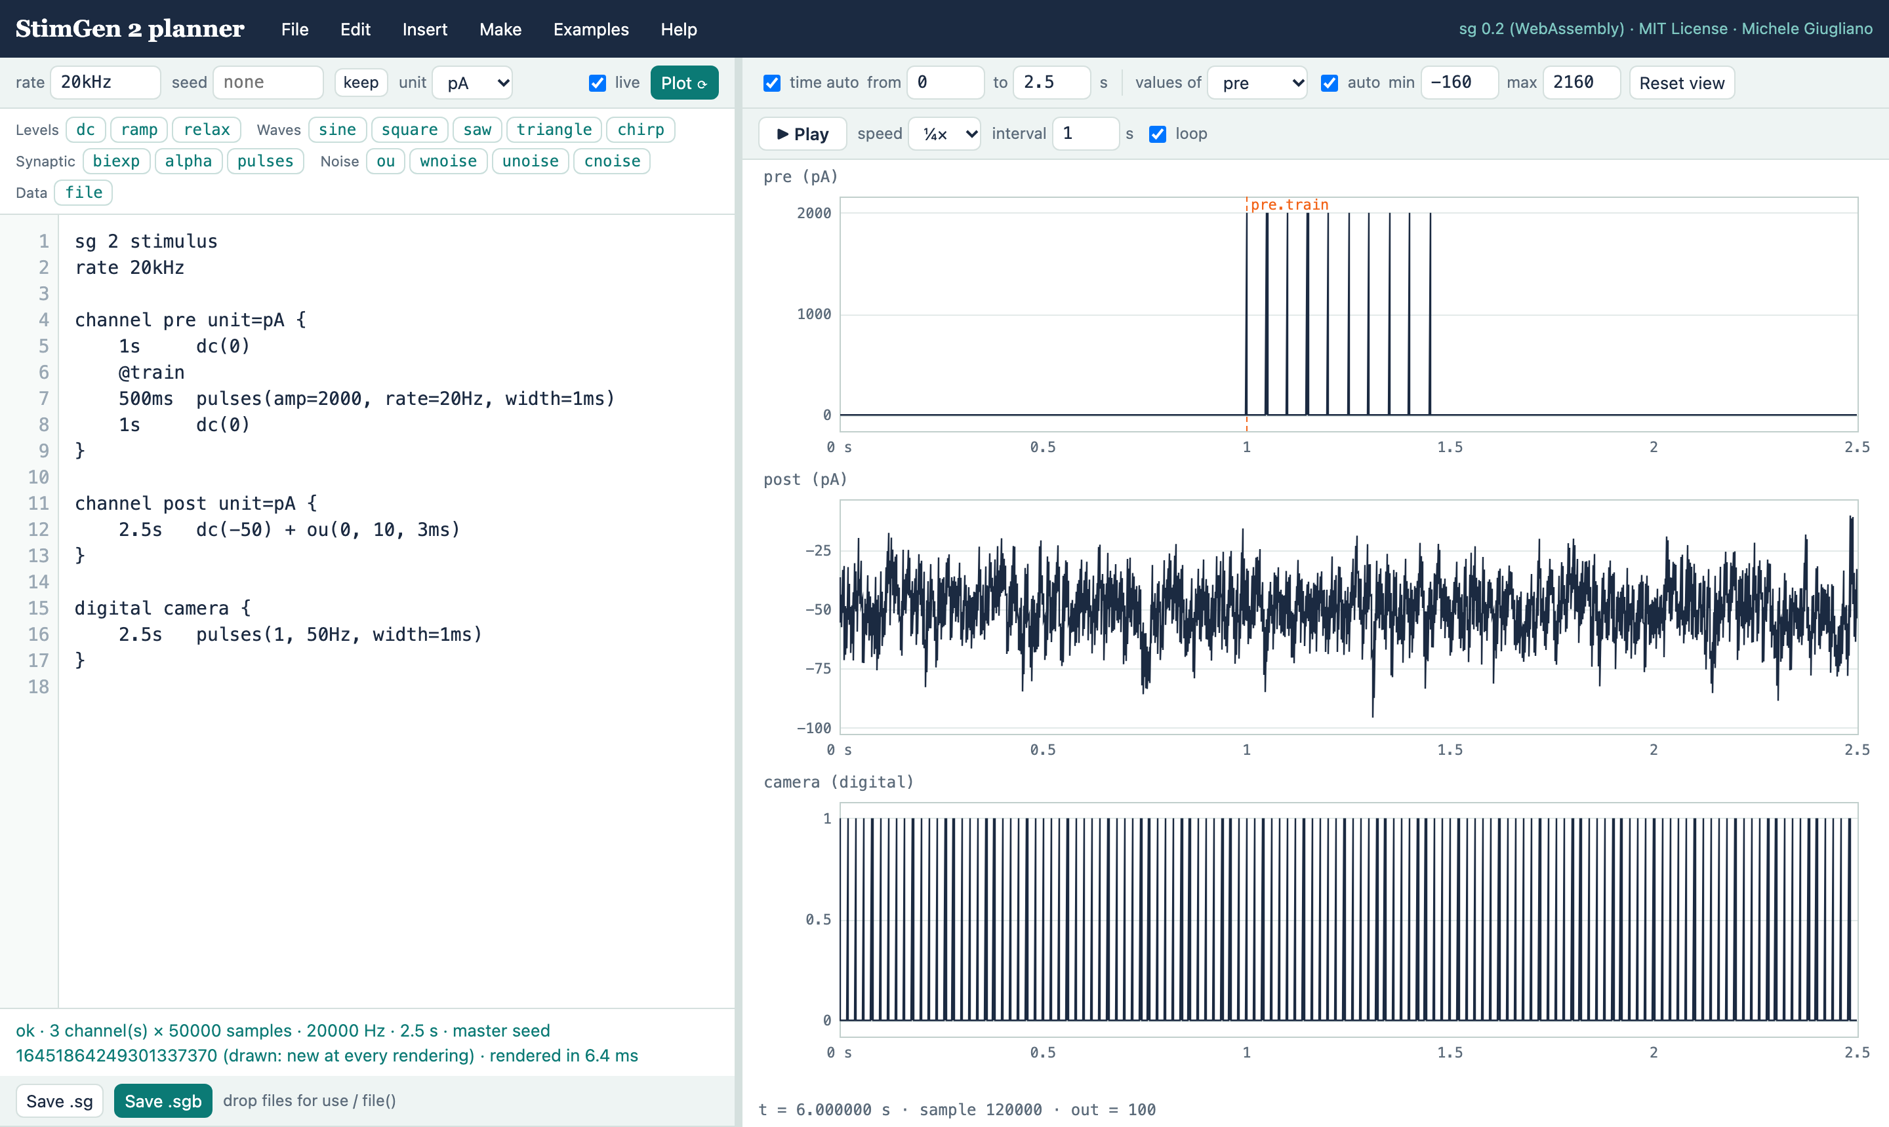
Several outputs at once
channel pre unit=pA
a current for the first cell
channel post unit=pA
a current for the second
digital camera
TTL pulses for a camera
@train
a marker saved with the data
Make → Waveform → stimulus and Make → Add a channel write these lines for you.
Notes:
Many experiments drive several outputs: two cells in a pair, a camera trigger, a light source. A stimulus file lists them as channels with their units, on one time base. The Make menu converts a waveform into a stimulus and adds channels; markers label the moments you will want to find in the analysis.

Slide 16




Take it to the rig
Planner
Save .sg
sg · Gecko
NI board
plan, check, animate
a few lines of text
rendered, then played at the rig
the cell receives it
the same file, on the command line
Save .sg keeps the text: it is the protocol. Save .sgb keeps the rendered samples with a full record (text, seed, rate), so any trial can be regenerated years later.
$ sg check steps.sg # 39 trials
$ sg render -r 20kHz steps.sg # samples
# Gecko, the rig program, plays the trials
Notes:
When the stimulus is right, save it. The .sg file is the protocol itself: a few lines that the command-line program sg checks and renders it, and Gecko, the separate program that drives the National Instruments board, plays it at the rig. The .sgb file keeps the samples together with the record needed to regenerate them.

Slide 17




Why this works so well in a browser: WebAssembly
The planner does not imitate StimGen 2: it runs the very same C program as the command line, compiled to WebAssembly, a format every modern browser executes at near-native speed.
Nothing to install
Nothing uploaded
any computer, any system: open the page
everything runs on your machine; it even works offline
The same results
Small and fast
same seeds, same samples as the sg command line — checked by 76 automatic tests
170 KB; minutes of stimulus render in about a second
Notes:
One technical point worth knowing. The planner is not a separate imitation of StimGen: it is the same C program as the command-line tool, compiled to WebAssembly so that the browser runs it directly. That is why there is nothing to install, why your stimuli never leave your computer, and why what you see is exactly what the rig plays.

Slide 18
Cheat sheet
I want to … | do this
start quickly | Examples menu
add a segment | click a generator in the palette → Insert
change a segment | click it in the segment strip → Apply
add noise or an envelope | select the line → Edit → Combine
repeat part of a stimulus | select the lines → Edit → Repeat
vary a value across trials | select the value → Make → Sweep
see several trials | show: overlay or stack
freeze the noise | keep (or seed=17 in the text)
zoom | drag on the plot · double-click to reset
take it to the rig | File → Save .sg
Notes:
Everything on one page. Keep it next to the computer for the first sessions.

Slide 19
Open it and try
blog.giugliano.info/StimGen2
1. Examples → A family of steps
press Play
2. Change 50pA into 100pA
watch the trials change
3. Make it yours
Save .sg and bring it to the rig
StimGen 2 · Michele Giugliano · MIT License · Help → Generators and topics
Notes:
Open the planner now and try three things: load the family of steps and press Play; change the step size and watch the trials change; then make a protocol of your own and save it for the rig.

