Slide 1
Stimuli as text
step.sg
500ms dc(0)
1s dc(300)
500ms dc(0)
A beginner's guide to generating electrophysiology stimuli with StimGen 2
three lines = a current step
Michele Giugliano · sg 0.2 · MIT License
Notes:
StimGen 2 lets you write a stimulus the way you would describe it to a colleague: half a second at rest, one second at 300 pA, half a second at rest. This tutorial shows how to write such texts, check them, look at them, and play them on the National Instruments board.

Slide 2





From a line of text to a neuron
1. Write
2. Check & look
3. Play
4. NI board
5. Amplifier
step.sg
sg
sgplay
AO · AI · DO
→ cell
a short text file
checks it, renders it, plots it
reads the text, drives the board
converts numbers to volts
current or voltage clamp
You only write step 1. sg turns the text into samples and checks it; sgplay plays it on the board and records the response.
sgplay stands for the acquisition program that talks to the National Instruments board. Its name and options in this tutorial are a proposal.
Notes:
Only step one is your job: a text file. The program sg checks the text, turns it into samples and lets you plot them before any cell is involved. The acquisition program, called sgplay here, reads the same text, converts it to volts for the NI board, plays it and records. The name sgplay is a placeholder for that program.

Slide 3



Why write a stimulus as text
Short
Repeatable
Portable
1 line
same text + seed
no rate, no board
10 minutes of noise fit in one line: the text does not grow with the duration.
gives the same samples on any computer, today or in ten years.
inside the file: the same text plays at 10 kHz on one rig, 50 kHz on another.
Notes:
Three reasons. A description is short, because it describes the shape, not every sample. It is repeatable: the noise comes from a seed that is always saved. And it is portable: nothing in the file depends on the sampling rate or on the board.

Slide 4
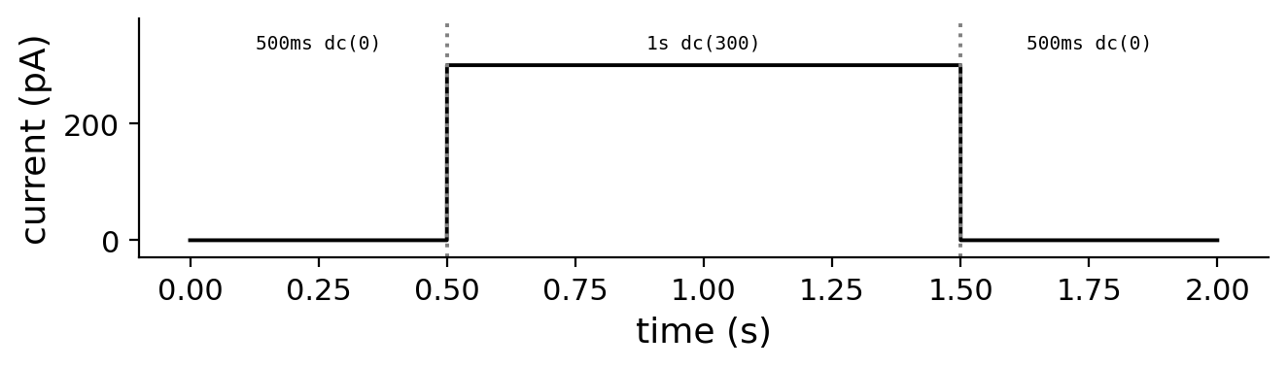
Your first stimulus in three lines
step.sg
500ms dc(0) # rest
1s dc(300) # step
500ms dc(0) # rest
terminal
$ sg render -r 20kHz -u pA step.sg
# writes step.sgb
One segment per line: a duration, then what the output does.
the result, plotted with tools/sgplot.py
Notes:
Write these three lines in a file called step.sg. Each line is a segment: how long, and what. dc means a constant level. Then run sg render with a sampling rate and the unit of the channel. The result is step.sgb, which you can plot with python3 tools/sgplot.py step.sgb.

Slide 5
Reading one line
1s sine(amp=50, freq=8Hz)
how long
what
how
units
s ms us min
Hz kHz
rad deg %
pA nA mV nS
a duration, always with a unit: 500ms, 1s, 2min
a generator: dc, ramp, sine, pulses, ou, ...
parameters by name (or by position); units are checked
Rules of thumb: # starts a comment · ; separates segments on one line · a wrong unit (freq=10ms) is an error, never a guess
Notes:
Every line has three parts. First how long, always with a unit. Then what: the name of a generator. Then the parameters in parentheses, by name or by position. Units are part of the language: writing a time where a frequency is expected is an error, not a silent mistake.

Slide 6
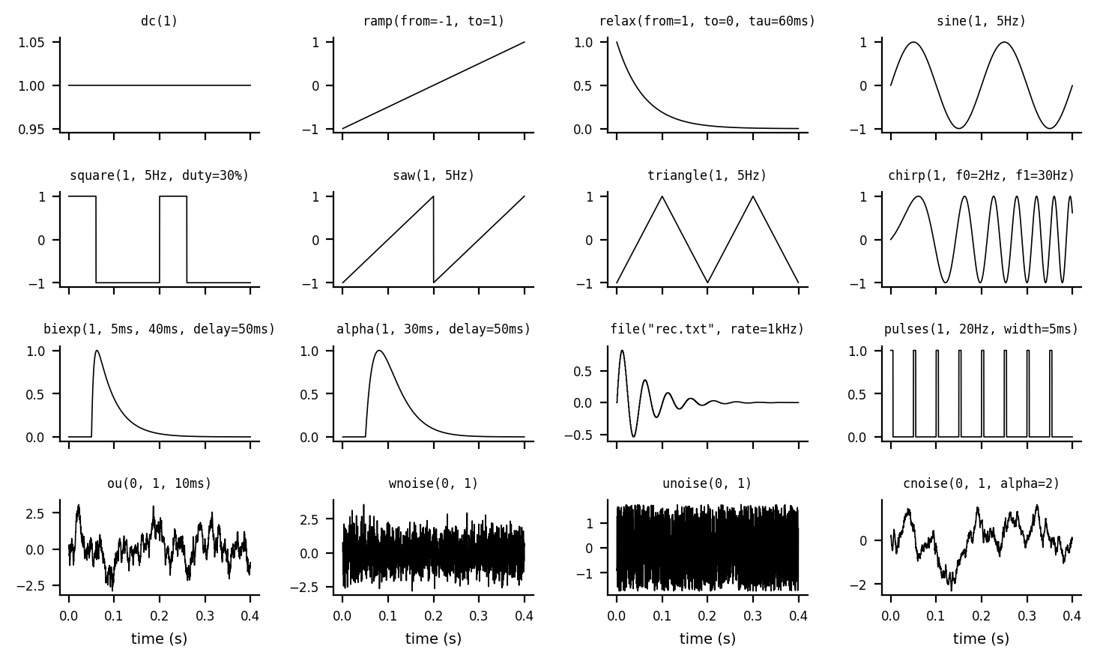
A toolbox of 16 generators
levels
dc ramp relax
waves
sine square saw
triangle chirp
synaptic, pulses
biexp alpha pulses
noise
ou wnoise unoise cnoise
recorded
file
$ sg help sine
Notes:
Sixteen generators cover almost every protocol: levels and ramps, periodic waves and frequency sweeps, synaptic-like waveforms and pulse trains, four kinds of noise, and samples read from a file. sg help followed by a name lists the parameters, their units and defaults.

Slide 7

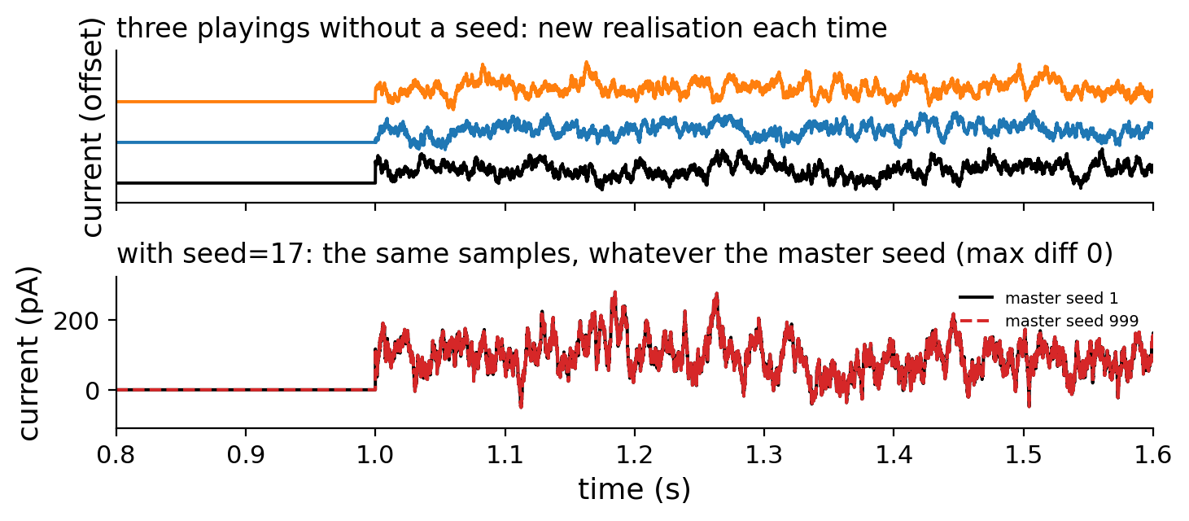

Noise you can repeat
new noise every time
10s ou(100, 50, 5ms)
the same run again
sg render -s 42 ...
frozen noise, always
10s ou(100, 50, 5ms, seed=17)
The seed actually used is always saved in the output file.
Notes:
Without a seed, each playing gives new noise with the same statistics. With -s on the command line you can reproduce a run. With seed= inside the text the noise is frozen: identical wherever you use it, which is what you need to measure spike-time reliability.

Slide 8
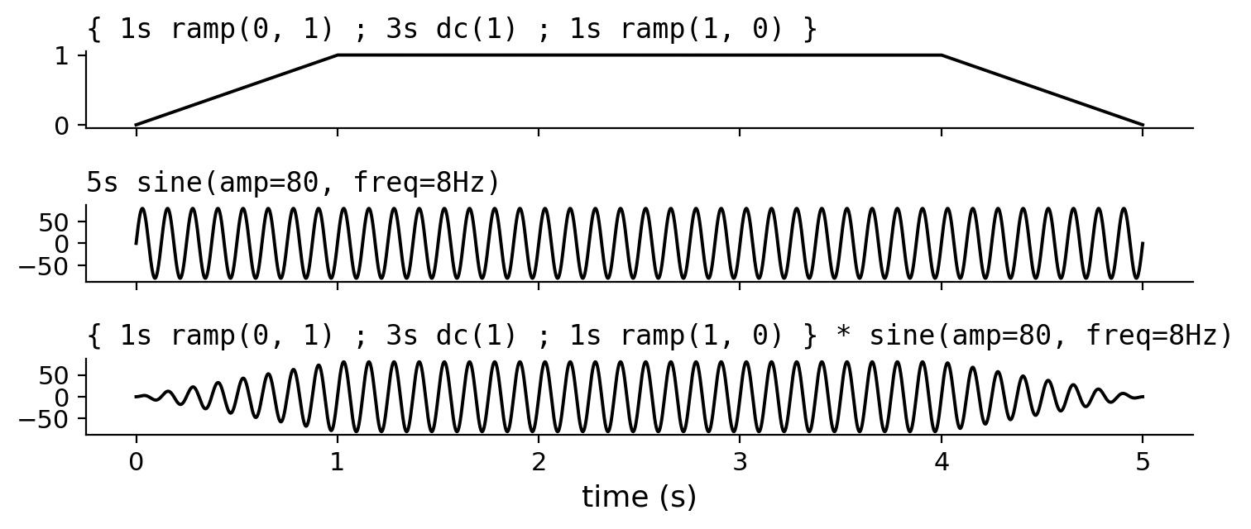
Combine generators like arithmetic
examples
5s sine(50, 8Hz) + ou(0, 20, 5ms)
5s (1 + 0.5*sine(1, 2Hz)) * sine(80, 40Hz)
10s pos(ou(10, 5, 3ms)) # never < 0
repeat 10 {2ms dc(1000); 48ms dc(0)}
{1s ramp(0,1); 3s dc(1); 1s ramp(1,0)}
* sine(80, 8Hz) # envelope
+ − × ÷ act sample by sample. { … } groups segments into a block you can multiply.
Notes:
Generators can be added and multiplied like numbers, sample by sample. Functions such as pos or abs transform them. repeat repeats part of a waveform, and braces make a block: here a trapezoid multiplies a sine to make an oscillation that fades in and out.

Slide 9
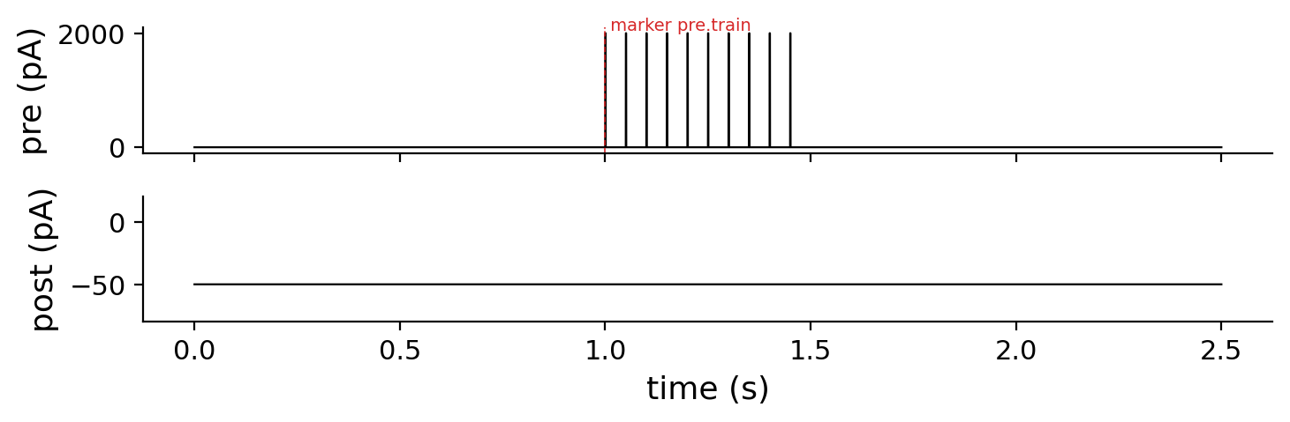
Several outputs at once
pair.sg
sg 2 stimulus
channel pre unit=pA {
1s dc(0)
@train # a marker
500ms pulses(2000, 20Hz,
width=1ms)
1s dc(0)
}
channel post unit=pA { 2.5s dc(-50) }
Channels have names, not wires. Which board output each name uses is set once, in the rig file of sgplay. @train saves a marker for the analysis.
Notes:
A stimulus file lists several channels on one time base, for example a presynaptic and a postsynaptic cell. Channels have names; the mapping to physical outputs lives in the rig file of the acquisition program, so the same file runs on any set-up. A label such as @train becomes a marker stored with the data.

Slide 10
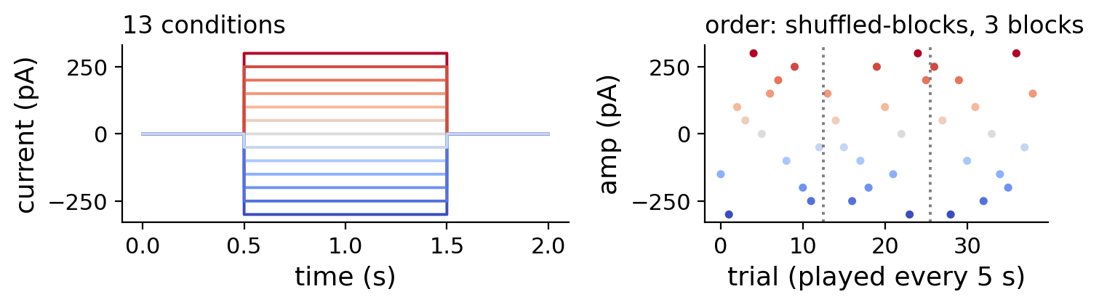
Families of trials: protocols
steps.sg
sg 2 protocol
sweep amp = from -300pA
to 300pA step 50pA
repeat 3
order shuffled-blocks
period 5s
stimulus { channel Iinj unit=pA {
500ms dc(0); 1s dc($amp)
500ms dc(0) } }
One file, 39 trials: 13 amplitudes × 3 repetitions, in a random but recorded order, one every 5 s. $amp is replaced by each value.
Notes:
A protocol describes a whole series of trials. sweep defines a variable and its values, repeat the number of repetitions, order how they are shuffled, and period the time between trials. In the stimulus, $amp is replaced by each value. sg expand writes all 39 trials as files if you want to inspect them one by one.

Slide 11



Before the cell: check, look, render
Check
Look
Keep
$ sg check steps.sg
steps.sg: ok, 39 trial(s)
$ sg render -r 20kHz step.sg
$ python3 tools/sgplot.py \
step.sgb
$ sg expand steps.sg steps
steps/0000.sg ... 0038.sg
Syntax, units, durations, every trial.
See the waveform before a cell sees it.
Every trial as a plain file, if you want.
$ sg examples # 40 ready-to-run commands, from a first step to protocols
Notes:
Three habits save experiments. Check every file with sg check: it reports the line of any mistake. Look at the waveform with sgplot before a cell sees it. And if you like, expand a protocol into plain files. sg examples prints forty commands you can paste into a terminal.

Slide 12




Playing it on the NI board with sgplay
terminal (proposed interface)
reads the .sg text, renders it with sg's rules at the board's rate
$ sgplay step.sg # play once
$ sgplay -n 10 -i 5s step.sg # 10 times
$ sgplay steps.sg # a protocol
$ sgplay steps/ # its directory
$ sgplay --dry-run pair.sg # show the map
$ sgplay --rig rig2.cfg pair.sg
maps channel names to board lines with the rig file
converts to volts with the amplifier gains; refuses clipping
streams AO, records AI, sends triggers on DO
saves the recording together with the stimulus record
sgplay is the acquisition program assumed by this tutorial: it receives the same text files, and is the only part that knows the National Instruments board.
Notes:
This is how a session would look at the rig. sgplay receives the same text files; it renders them with exactly the rules of sg at the sampling rate of the board, looks up which board output each channel uses, converts the numbers to volts with the amplifier gains, refuses anything that would clip, plays and records, and stores the recording with the full stimulus record. The interface shown is a proposal for that program.

Slide 13

The rig file connects names to wires
channel in the .sg | NI board line | gain | meaning
Iinj | Dev1/ao0 | 400 pA/V | current command
Vcmd | Dev1/ao1 | 20 mV/V | voltage command
cam (digital) | Dev1/port0/line0 | — | camera trigger
Vm (recorded) | Dev1/ai0 | 100 mV/V | membrane potential
rig.cfg (proposed)
board Dev1
rate 20kHz
Iinj ao0 400pA/V
Vcmd ao1 20mV/V
cam port0/line0
Vm ai0 100mV/V
Same stimulus, any rig. Move to another set-up and change only the rig file: the .sg files, and the stimuli they describe, stay identical.
Notes:
The rig file is the only place where wires appear. It names the board, the sampling rate, and for each channel name the board line and the gain of the amplifier. Change rigs, change this file; the stimulus files stay as they are. The format of the rig file is a proposal.

Slide 14

Nothing gets lost
from the saved record
the stimulus text
the seed
# regenerate any trial,
# years later:
$ sg render -r 20kHz -s SEED \
trial.sg
every line you wrote
of every noise segment
the sampling rate
a digest
Every .sgb file, and every recording made by sgplay, carries this record in its header.
and the program version
to prove the samples are intact
Notes:
Each output file carries a record of how it was made: the full text, the seed, the rate, the program version, and a digest of the samples. From that record alone, any trial can be regenerated exactly, which is what makes old recordings re-analysable.

Slide 15
Cheat sheet
I want to … | type
make a step | 500ms dc(0); 1s dc(300); 500ms dc(0)
check a file | sg check file.sg
get the samples | sg render -r 20kHz file.sg
see them | python3 tools/sgplot.py file.sgb
repeat the same noise | ou(..., seed=17) or sg render -s 42
play it on the board | sgplay file.sg
know a generator | sg help pulses
see 40 examples | sg examples
Notes:
Everything in one table. Keep it next to the rig.

Slide 16
Start with one line
sg help
1s dc(300)
all topics; sg help NAME for a generator
sg examples
forty commands to paste and run
docs/build/stimgen2-spec.pdf
the tutorial and the full reference
docs/build/sgb-access.pdf
reading .sgb files from C, Python, Julia
StimGen 2 and sg · Michele Giugliano · MIT License
Notes:
Start with a single line, check it, look at it, then build up. The built-in help and the examples cover the rest; the specification explains every detail.

