Slide 1
Social Media and the curve
STA 546 Final Project
Matthew Jehrio

Slide 2
Flattening the Curve
Epidemics follow a curve of infection
Idea: flattening the curve means hospitals aren’t overrun by infections
Flattening happens when transmission rates are lowered

Slide 3
Flattening the Curve (cont’d)
Social distancing and staying home are important factors in flattening curve
Requires public cooperation
Theoretically, social media of public officials should be factor in compliance

Slide 4
Visualizing the curve
FIPS codes represent counties
Earliest cases appeared ~ late January
Each iteration represents the percent increase in deaths relative to the population of that county

Slide 5
<Animation>

Slide 6
Visualizing the curve (cont’d)
Might not be fair comparison
Cities will be on different curves based on when coronavirus arrived
Need better approach

Slide 7
Idea:
Use an aggregate measure instead of time series
Requires assumption that cities have reached some kind of steady state

Slide 8
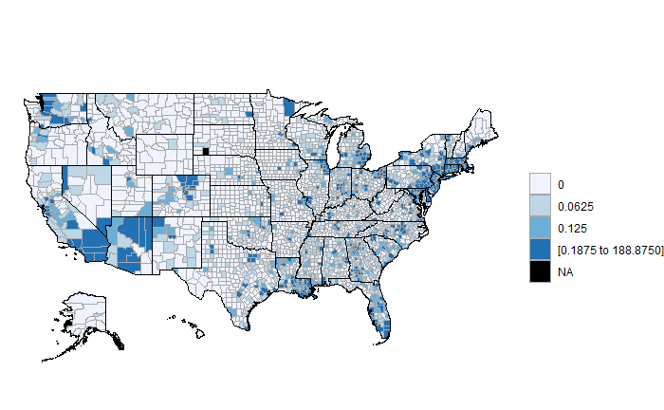
Maximum Percent Increase in Deaths by Relative to Population

Slide 9
Social Media’s Role

Slide 10
Approach
What do public officials have to say about coronavirus?
What kinds of language do they use to talk about it?
Twitter should provide a sample of thee officials’ thoughts and approaches

Slide 11
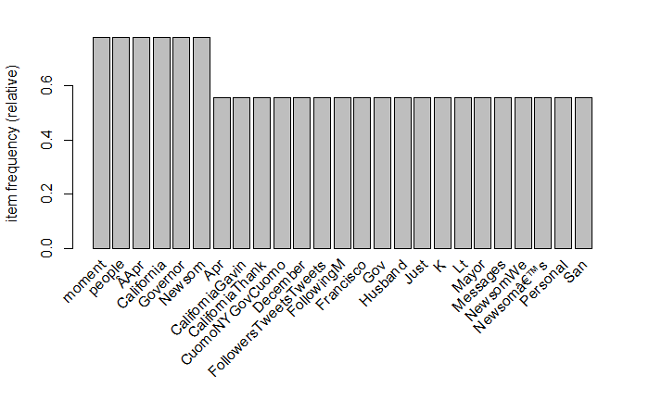
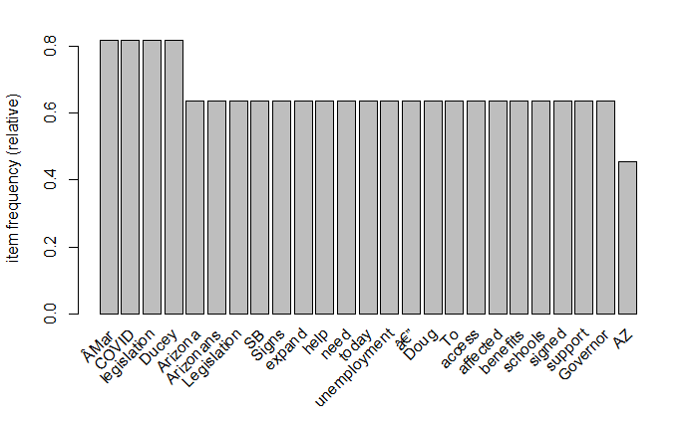
Word Frequency Counts
Gavin Newsom, CA
Doug Ducey, AZ

Slide 12
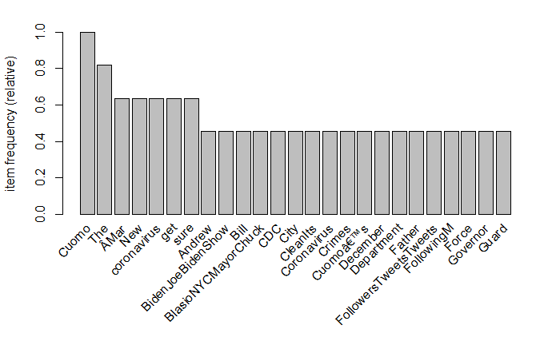
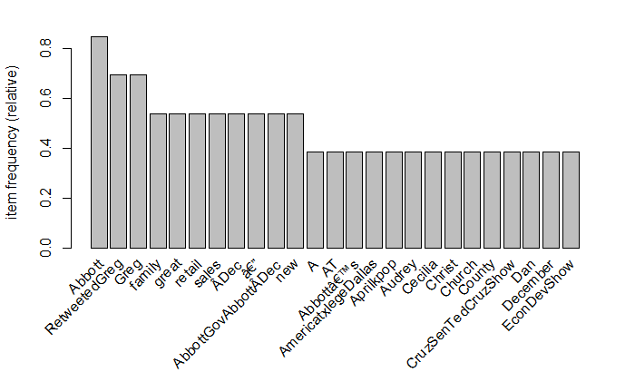
More Word Frequency Counts
Andrew Cuomo, NY
Greg Abbott, Tx

Slide 13
Associations
We can go further than just word frequency though!
Think of every tweet in an official’s twitter feed as a transaction
Use apriori algorithm to perform market basket analysis
This shows what words are most closely associated with other words
Take a look at words that are associated with COVID-19
If you look at officials from different areas, do their twitter feeds associate different words with COVID-19 related terms?

Slide 14
A few vignettes of Associations…

Slide 15
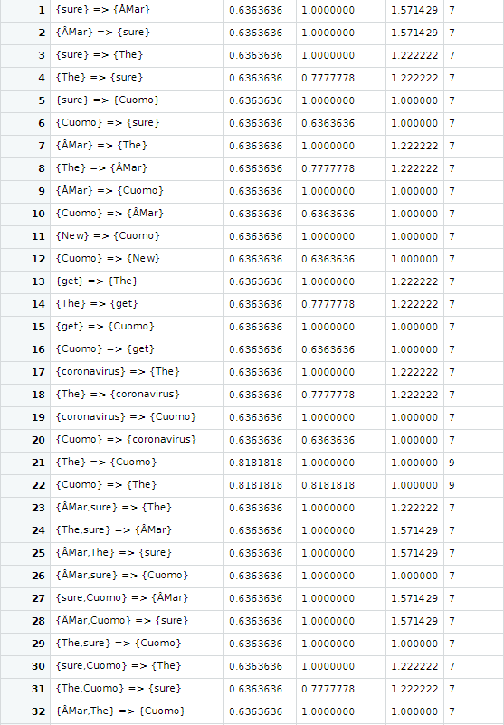
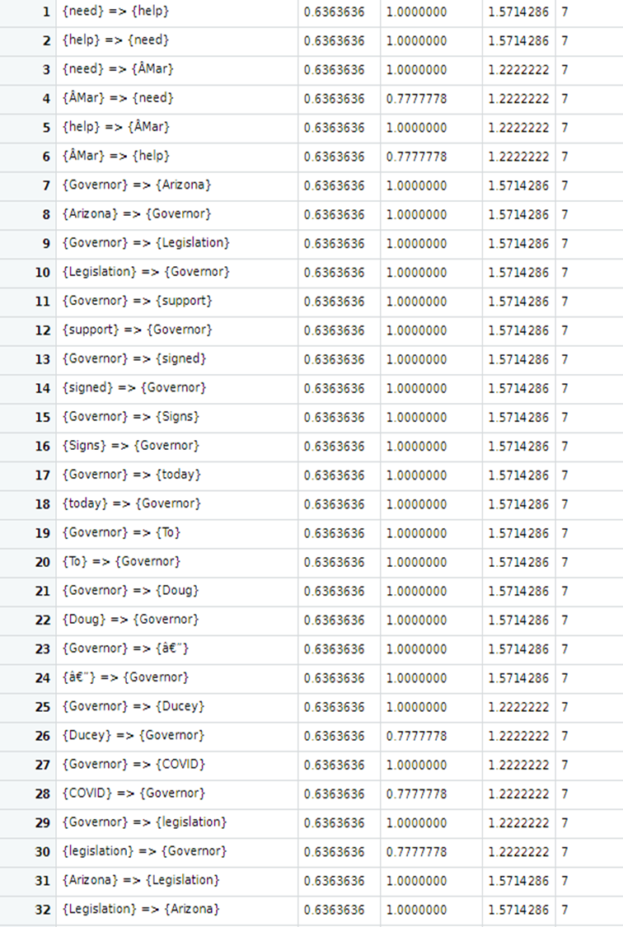
Andrew Cuomo, NY
Doug Ducey, AZ

Slide 16
Discussion
These findings are only a first step
Increased computing resources would provide better results
Results tracked fairly well between curve flattening and tweeting about coronavirus
This approach still limited by time series element
Including Senators and pop culture figures should give this approach more power

Slide 17
Future Directions
As states open up, these results and subsequent measures could predict how well states do.
A subsequent model could be used to help predict and mitigate the “second wave” of the epidemic
You could also look for “differentially expressed” words or phrases
You could also look for similarities between groups of states of interest by joining the data together and rerunning the algorithm

Slide 18
Thank You!

Slide 19
References
https://simplemaps.com/data/us-cities
https://www.nrcs.usda.gov/wps/portal/nrcs/detail/national/home/?cid=nrcs143_013697
https://www.census.gov/data/tables/time-series/demo/popest/2010s-counties-detail.html#par_textimage_1383669527
https://datahub.io/core/covid-19#resource-us_deaths
https://www2.census.gov/programs-surveys/popest/technical-documentation/file-layouts/2000-2005/cc-est2005-alldata_layout.txt

