Slide 1
SEASONS OF LIBRARY CHECKOUTS
By Melanie Langston

Slide 2

HELLO!
Do the seasons and time of year impact how much people read?
Notes:
Today we will explore how the seasons and time of year impact how much people read, and how significant those differences are. Do people read more in the winter when it’s cold and dark and they’re cooped inside, or during the summer when they’re lounging by the pool.

Slide 3
THE DATA
Seattle Public Library -
Checkouts by Title
https://data.seattle.gov/Community/Checkouts-by-Title/tmmm-ytt6
Notes:
In my preliminary research I discovered that book sales data is hard to come by. It has been largely protected by Amazon and there are little to no free resources for sales figures. So instead we will be looking at library checkouts from the Seattle Public library. Their API holds checkout records for every title since 2005. The full dataset was over 34M records and far too large, so I filtered for 2018 and books categorized as fiction.

Slide 4
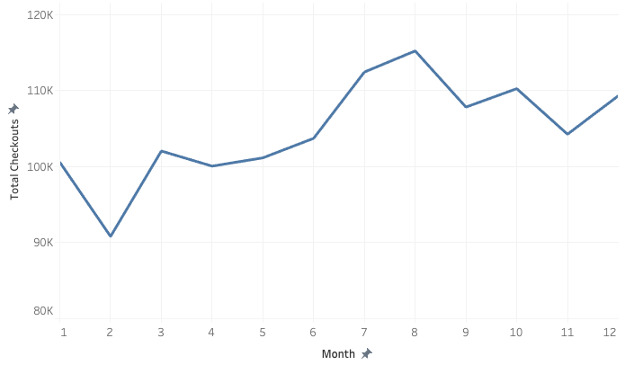
2018 CHECKOUTS BY MONTH
Total Checkouts
Month
Notes:
Even with those filters in place, we’re looking at over 350K records for the year. Here I have provided a visual of total checkouts over the months in 2018. We can already see that checkouts are much higher in July and August, and lowest in the early winter months. That makes sense, with kids out of school and families taking vacations. Let’s find out if that’s statistically significant.

Slide 5
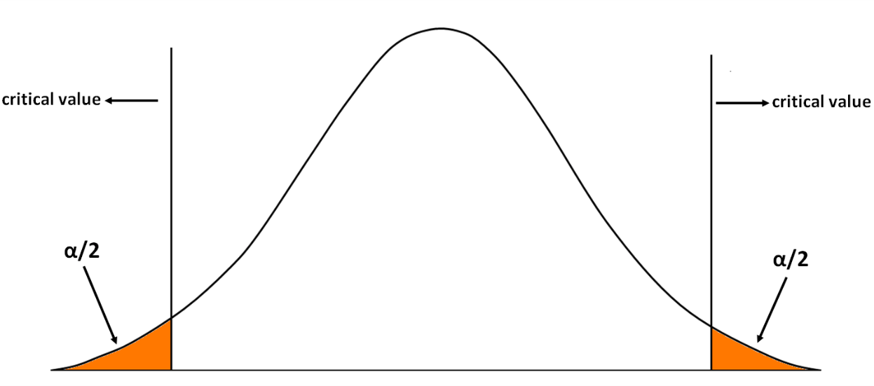
HYPOTHESIS TESTING
CI lower 0.075
CI upper 0.22
P value = 9.357288784810133e-05
Notes:
For hypothesis testing I grouped the data into seasons. It’s important to note that because of the way the data was recorded, this test is calculated based on checkouts per title. So here I ran a t-test comparing checkouts in the summer vs winter. The test reveals a statistically significant difference between summer and winter months, with library checkouts higher in the summer months by between 0.075 and 0.22 per title.

Slide 6
SUMMER READING
Pool side, road trips, summer reading lists
Notes:
So it’s true that people read more in the summer, or at least check out more books from the library. People are grabbing books to keep up with summer reading lists, beach lounging and road trips. Well now I’m curious to see what people are reading…Let’s explore further

Slide 7
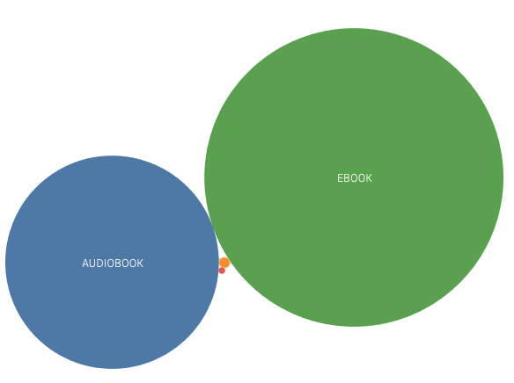
2018 CHECKOUTS
EBOOK | 831790
AUDIOBOOK | 424297
BOOK | 1101
COMIC | 416
REGPRINT | 26
CR | 9
SOUND DISC | 2
Notes:
OK so Ebook and audiobook checkouts are so exponentially higher than any other material, that the other types don’t even show up in our bubble chart! 2018 checkout totals are listed there on the left. I find it interesting that there were only 1101 regular book checkouts for all of 2018, though keep in mind that we’re only looking at fiction checkouts. There are apps that make it possible to checkout e-book and audio books from home, and never have to make the trip to the library. Technology really has changed the way we read! And has also made the library more convenient. This is important for libraries so that they can keep appropriate inventory, and may need to redistribute budget allocations for digital vs print. Just for fun, let’s see what the top 10 titles were in 2018.

Slide 8
TOP 10 TITLES
Little Fires Everywhere
The Goldfinch
Artemis
The Handmaid’s Tale
Today Will Be Different
Origin
Into the Water
Manhattan Beach
All the Light We Cannot See
A Gentleman in Moscow
3443
2792
2547
2322
2265
2169
1800
1789
1769
1728
Notes:
And there you have it. The top 10 fiction titles checked out at Seattle Public Libraries in 2018. Have you read any? What was your favorite book last year?

Slide 9
THANKS!
Any questions?
You can find me at:
melanieglangston@gmail.com
Notes:
I appreciate your time today and am so grateful for the opportunity to share my research with you. I can send out a link to my notebook to anyone interested and if you have any questions please reach out. Thank you!

