Slide 1


git
Or how I learned to stop worrying and love version control
Mike Glazer

Slide 2

How often has this happened to you?
Gee, I sure wish I could version control this project
Find server to host subversion repository
If server doesn’t already have subversion installed, go and install it (along with Apache if required)
Configure subversion repository
svn admin create /path/to/repos
Configure server to export repository (if desired)
Import base directory structure into repository
Checkout trunk from repository
So where do I start?
Yikes!

Slide 3
How about this?
Gee, I sure wish I could save my progress right now
But I’m on a plane
cp current_file.txt current_file.txt.bak1

Slide 4
What is this tutorial?
A brief introduction to git
Usage of various commonly used commands
What this tutorial is not
In depth
Think 5km wide, 5m deep
Talk to me afterwards if you’re interested in a more in depth talk

Slide 5
Enter git
Decentralized
Anybody can pull or push changes to anybody else
I don’t need to be connected to a network to save my changes
If the central server goes down, nothing is lost, all of the individual nodes can still construct the most recent copy

Slide 6
Creating a new repository
% mkdir GitPresentation
% cd GitPresentation
% git init
% ls -a
.git

Slide 7
Adding files
% edit presentation.markdown
% git add presentation.markdown
% git commit -m “Added presentation”

Slide 8
Deleting files
% rm presentation.markdown
% git commit -am “rm Presentation”
Have you ever tried doing that with subversion?

Slide 9
Working with remote repositories
% git remote add origin git@github.com/mglazer/GitPresentation.git
% git push origin master
% git remote -v
origin git@github.com:mglazer/GitPresentation.git (fetch) origin git@github.com:mglazer/GitPresentation.git (push)
Logical name of destination
repository
The name of the branch to push
and update on the remote side*
* It’s slightly more complicated than this, refer to manpage for full explanation.

Slide 10
Cloning a remote repository
% git clone git://github.com/mglazer/GitPresentation.git
% ls
GitPresentation/
% cd GitPresentation
% git remote -v
origin git://github.com/mglazer/GitPresentation.git (fetch) origin git://github.com/mglazer/GitPresentation.git (push)
% edit presentation.markdown
% git commit -am “Made changes”
% git push origin master

Slide 11
Pulling in changes
% git commit -am “Committing before pull”
% git pull origin master
Note the same syntax as ‘git push’
At this point there may be merge conflicts, this is outside of the scope of this tutorial
See: http://gitguru.com/2009/02/22/integrating-git-with-a-visual-merge-tool/ for more info

Slide 12
Working with branches
Confession: branches in subversion scare me
When I think of branches in subversion I think of:
code that diverges so far from trunk, that you might as well just call it a separate project
everything that could possibly go wrong
that painful merge back to trunk
baby angels losing their wings

Slide 13
Working with branches
Creating a new branch
% git branch master 1234-spelling-mistake
% git checkout 1234-spelling-mistake
% edit presentation.markdown
% git commit -am “Fixed mistake”

Slide 14
Working with branches
Merging back to master
% git checkout 1234-spelling-mistake
% git fetch origin master
% git rebase origin/master
% git checkout master
% git merge 1234-spelling-mistake
% git push origin master
Notice the slight syntax differences between the fetch and the rebase
The fetch command says: “Get the latest copy of the master branch, from origin”
The rebase command says: “Fast forward our current working branch to the upstream master”

Slide 15
Differences between rebase and merge
Rebase
Merge
Pass changes from top of hierarchy down to branches
Pass changes from a branch up to a higher hierarchy level
A4
A4
Rebase
Merge
B2
B2
A3
A3
B1
B1
A1
A1
B0
B0
Branch
A0
Branch
A0

Slide 16
Working with branches
Interactive Rebase
Say you’ve made a lot of small commits to your local copy and you’d like to merge those changes upstream
You probably don’t want all of those commit messages to appear in your merge patch
Use interactive rebase to solve this

Slide 17
Working with branches
Interactive Rebase
% git rebase -i
An $EDITOR window will appear:
pick 341e027 Added a new bullet point pick 12fd986 Added an important bullet point pick ae29d44 Done adding bullet points
Change ‘pick’ to ‘squash’ for commits you don’t want to see
pick 341e027 Added a new bullet point squash 12fd986 Added an important bullet point squash ae29d44 Done adding bullet points

Slide 18
Working with branches
Interactive Rebase
Save and quit, a new editor will appear enter your actual commit message
[#1234] Fixed spelling mistakes * Added a few bullet points * Fixed a few spelling mistakes
Save and quit
% git checkout master
% git merge 1234-spelling-mistake
% git push origin master

Slide 19
Tagging
Creating
% git tag v1.0
% git tag
v1.0
Switching to
% git checkout v1.0

Slide 20
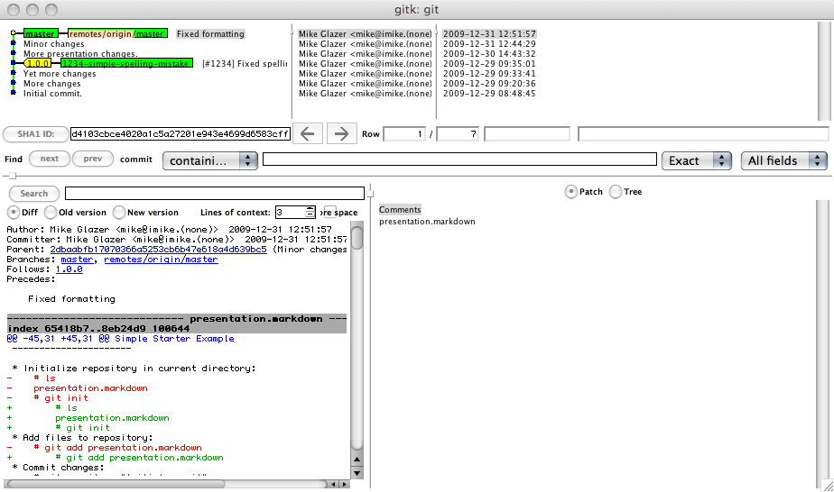
GUIs
gitk
Provides visual of repository history
Comes with git
Can’t edit, not pretty

Slide 21
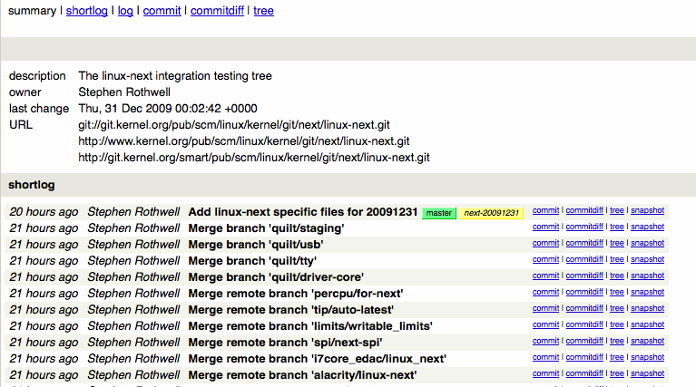
GUIs
gitweb
Nice web interface for git
Comes with distribution

Slide 22
GUIs
Others do exist, but they’re still kinda flakey
Nothing quite beats the command line
Checkout zsh with vcs_info:
http://kriener.org/articles/2009/06/04/zsh-prompt-magic

Slide 23
But I’m forced to use subversion
Check out svk: http://svk.bestpractical.com/view/HomePage
Distributed version control built on subversion
Really just a bunch of perl scripts
git svn provides upstream and downstream interaction with a subversion repository
I’ve never used it
I don’t plan on using it

Slide 24
Other neat git features
Look in the .git directory, it has a lot of handy files
.git/config: Holds configuration data
.git/description: Read by gitweb to provide repository description
.git/hooks: Same concept as subversion hooks

Slide 25
What next?
http://git-scm.com

