Slide 1
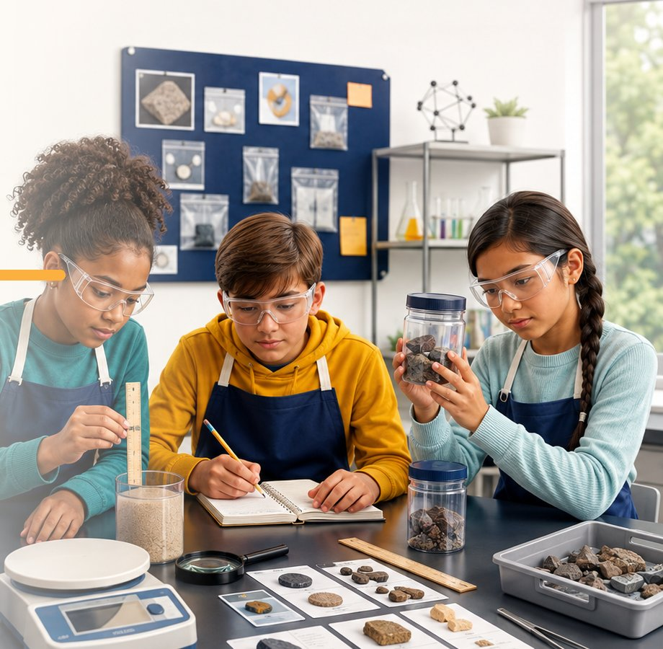
STUDENT PACKET · CER
CASES 01–05
RESPONSE FORMAT · CER
GRADES 5–8 CORE · K–16 ADAPTABLE
Science Detective
Cases
OBSERVE. TEST. EXPLAIN. EXTEND.
Five reusable investigations in matter, energy, magnetism, and conductivity. Every case uses the same reasoning routine. Your response pages use Claim · Evidence · Reasoning.
01
Mystery Mixture
Which method separates each mixture
02
Density Deception
Which cube matches an unknown material
03
State Detectives
What changed and where energy moved
04
Magnet or Mimic?
Which objects respond to a magnet and why
05
Conductor Clues
Which materials complete a low-voltage circuit
NAME
CLASS / PERIOD
TCEA · CLASSROOM PACKET
GRADES 5–8 CORE · K–16 ADAPTABLE

Slide 2
ROUTINE
CER & ACE CASE FILES
CER
The Case File Routine
Use the same four moves in every case
01
Observe
Record what you notice before naming the object or explaining the result.
02
Test
Choose a property, tool, or measurement that can produce useful evidence.
03
Explain
Connect the result to a science idea. Tell why the evidence matters.
04
Check
Retest, consider another explanation, and state what still feels uncertain.
TEAM ROLES
YOUR PAGE 2 RESPONSE
EVIDENCE MANAGER
Handles tools and samples safely
Claim · Evidence · Reasoning
Claim answers the mystery. Evidence names specific observations or data. Reasoning explains why the evidence supports the claim using a science concept.
RECORDER
Writes observations and measurements
SKEPTIC
Checks whether the evidence supports the claim
REPORTER
Shares the group's explanation and uncertainty
EVIDENCE RULE
A result is not automatically evidence. Explain what the result tells you and why it matters.
ROUTINE · CER
2

Slide 3
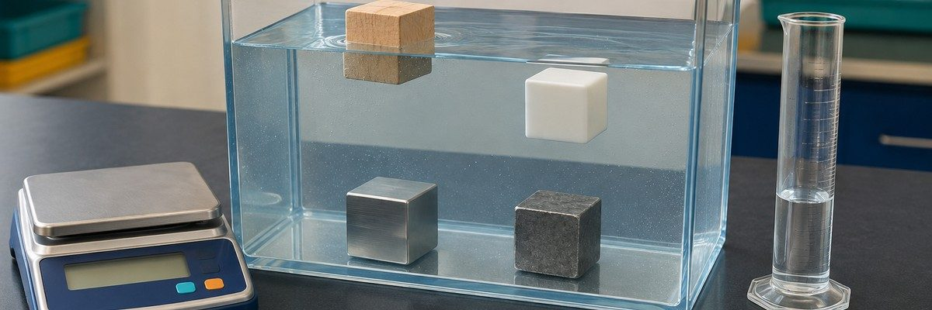
CASE 00
CER & ACE CASE FILES
PAGE 1 · CER
Worked Example: Density Deception
How evidence becomes an explanation
NAME
DATE
GROUP
THE MYSTERY
Four equal-volume cubes were tested. Which cube is aluminum, and how does the density evidence support the identification?
CASE 00 · EVIDENCE TRAY
MATERIALS
Four 2 cm cubes, balance, ruler, water tub, paper towels, calculator
SAFETY
Wipe spills. Lower cubes gently and keep the balance dry.
STEP 1 · OBSERVE BEFORE YOU EXPLAIN
SAMPLE / OBJECT | WHAT I OBSERVE | TOOL OR TEST USED
Cube A | Light tan; floats high | Hands; water
Cube B | White; floats low | Hands; water
Cube C | Silver-gray; sinks | Hands; water
Cube D | Dark gray; sinks fast | Hands; water
STEP 2 · COLLECT EVIDENCE
TEST PERFORMED | RESULT / DATA | WHAT IT TELLS ME
Mass | A=4.0 g; B=7.6 g; C=21.6 g; D=56.8 g | Mass differs at equal volume
Volume | All cubes = 8 cm³ | Volume is controlled
Density | A=0.50; B=0.95; C=2.70; D=7.10 | C matches aluminum
WORKED EXAMPLE · PAGE 1 · CER
3

Slide 4
CASE 00
CER & ACE CASE FILES
PAGE 2 · CER
Worked Example: Density Deception
Build an argument from the evidence
HOW TO USE THIS SLIDE
Answer the mystery. Use specific data from Page 1, then explain the science idea that connects the evidence to your claim.
1 Claim
One clear sentence that answers the mystery.
Cube C is aluminum.
2 Evidence
Name the measurements and observations that best support the claim.
All four cubes had the same 8 cm³ volume. Cube C had a mass of 21.6 g, so its density was 2.70 g/cm³. That value matches the aluminum reference value, and Cube C sank in water as predicted.
3 Reasoning
Explain why the evidence supports the claim. Name the science concept that makes the evidence matter.
Density is mass per unit volume and is a characteristic physical property under stated conditions. Dividing 21.6 g by 8 cm³ gives 2.70 g/cm³. Because this matches the reference value for aluminum, the measurements support the identification.
4 Alternative explanation
What else might explain the result, and what evidence makes it less likely?
Cube D is also metallic and sank, but its density of 7.10 g/cm³ matches zinc, not aluminum.
5 Confidence check
What increases or limits your confidence?
High, because the calculated density matches the reference value; the water test is supporting evidence, not enough by itself.
STEMS Based on my investigation, I claim… | The strongest evidence is… | This supports my claim because…
CASE 00 · PAGE 2 · CER
4

Slide 5
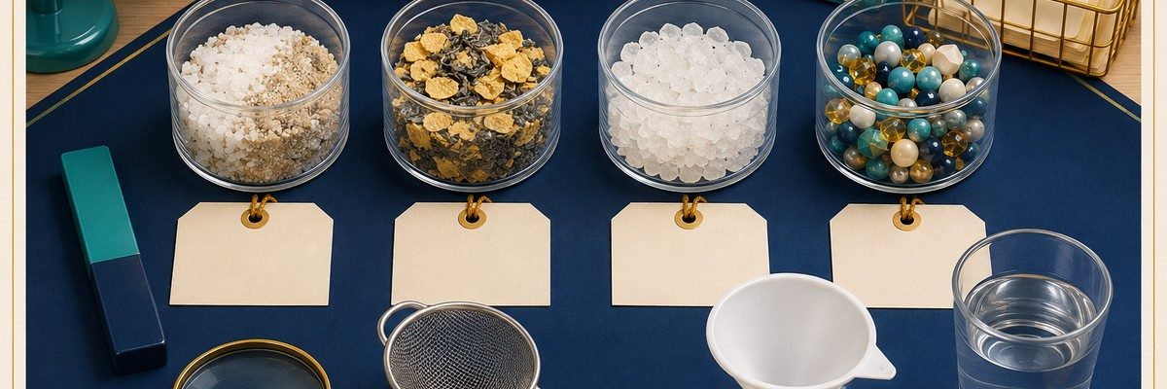
CASE 01
CER & ACE CASE FILES
PAGE 1 · CER
Mystery Mixture
Separate the evidence without changing it
NAME
DATE
GROUP
THE MYSTERY
Four mixtures are made from familiar solids. Choose a separation method for each sample, then use physical properties to explain why your method worked.
CASE 01 · EVIDENCE TRAY
MATERIALS
Samples A–D, trays, magnet wand, sieve, water cups, filter funnel, filter paper, scoop, magnifier
SAFETY
Wear goggles. Do not taste samples. Keep iron filings contained; do not rinse them into a sink.
STEP 1 · OBSERVE BEFORE YOU EXPLAIN
SAMPLE / OBJECT | WHAT I OBSERVE | TOOL OR TEST USED
Sample A
Sample B
Sample C
Sample D
STEP 2 · COLLECT EVIDENCE
TEST PERFORMED | RESULT / DATA | WHAT IT TELLS ME
Magnetism
Particle size / sieve
Solubility + filtration
CASE 01 · PAGE 1 · CER
5

Slide 6
CASE 01
CER & ACE CASE FILES
PAGE 2 · CER
Mystery Mixture
Build an argument from the evidence
HOW TO USE THIS SLIDE
Answer the mystery. Use specific data from Page 1, then explain the science idea that connects the evidence to your claim.
1 Claim
One clear sentence that answers the mystery.
2 Evidence
Name the measurements and observations that best support the claim.
3 Reasoning
Explain why the evidence supports the claim. Name the science concept that makes the evidence matter.
4 Alternative explanation
What else might explain the result, and what evidence makes it less likely?
5 Confidence check
What increases or limits your confidence?
STEMS Based on my investigation, I claim… | The strongest evidence is… | This supports my claim because…
CASE 01 · PAGE 2 · CER
6

Slide 7
CASE 02
CER & ACE CASE FILES
PAGE 1 · CER
Density Deception
Use mass and volume to identify the unknown
NAME
DATE
GROUP
THE MYSTERY
Four equal-size cubes look similar. Which cube is aluminum? Measure mass and volume, calculate density, and compare your results with the reference table.
CASE 02 · EVIDENCE TRAY
MATERIALS
Cubes A–D, digital balance, metric ruler or graduated cylinder, water tub, paper towels, calculator
SAFETY
Wipe spills at once. Lower cubes into water gently. Keep the balance dry.
STEP 1 · OBSERVE BEFORE YOU EXPLAIN
SAMPLE / OBJECT | WHAT I OBSERVE | TOOL OR TEST USED
Cube A
Cube B
Cube C
Cube D
STEP 2 · COLLECT EVIDENCE
TEST PERFORMED | RESULT / DATA | WHAT IT TELLS ME
Mass (g)
Volume (cm³)
Density (g/cm³)
CASE 02 · PAGE 1 · CER
7

Slide 8
CASE 02
CER & ACE CASE FILES
PAGE 2 · CER
Density Deception
Build an argument from the evidence
HOW TO USE THIS SLIDE
Answer the mystery. Use specific data from Page 1, then explain the science idea that connects the evidence to your claim.
1 Claim
One clear sentence that answers the mystery.
2 Evidence
Name the measurements and observations that best support the claim.
3 Reasoning
Explain why the evidence supports the claim. Name the science concept that makes the evidence matter.
4 Alternative explanation
What else might explain the result, and what evidence makes it less likely?
5 Confidence check
What increases or limits your confidence?
STEMS Based on my investigation, I claim… | The strongest evidence is… | This supports my claim because…
CASE 02 · PAGE 2 · CER
8

Slide 9
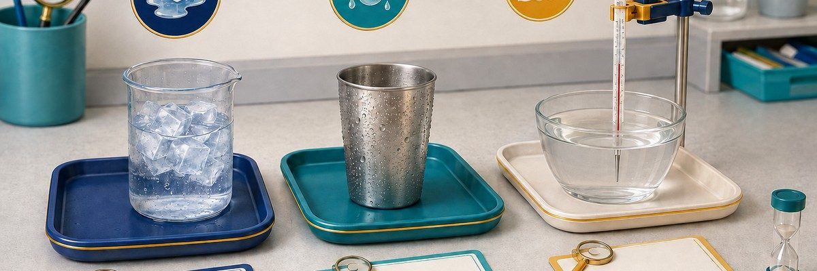
CASE 03
CER & ACE CASE FILES
PAGE 1 · CER
State Detectives
Follow the water and the energy
NAME
DATE
GROUP
THE MYSTERY
Water is changing at three stations. Identify melting, condensation, and evaporation, then explain whether the water undergoing each state change absorbs or releases energy.
CASE 03 · EVIDENCE TRAY
MATERIALS
Ice and beaker, cold metal cup, shallow warm-water dish, thermometers, timer, balance, trays, paper towels
SAFETY
Teacher provides warm water below 45 °C. No hot plates or open flames. Wipe condensation and spills.
STEP 1 · OBSERVE BEFORE YOU EXPLAIN
SAMPLE / OBJECT | WHAT I OBSERVE | TOOL OR TEST USED
Station A: ice
Station B: cold cup
Station C: warm water
Room air
STEP 2 · COLLECT EVIDENCE
TEST PERFORMED | RESULT / DATA | WHAT IT TELLS ME
Start / end temperature
Visible change / mass
Energy absorbed or released
CASE 03 · PAGE 1 · CER
9

Slide 10
CASE 03
CER & ACE CASE FILES
PAGE 2 · CER
State Detectives
Build an argument from the evidence
HOW TO USE THIS SLIDE
Answer the mystery. Use specific data from Page 1, then explain the science idea that connects the evidence to your claim.
1 Claim
One clear sentence that answers the mystery.
2 Evidence
Name the measurements and observations that best support the claim.
3 Reasoning
Explain why the evidence supports the claim. Name the science concept that makes the evidence matter.
4 Alternative explanation
What else might explain the result, and what evidence makes it less likely?
5 Confidence check
What increases or limits your confidence?
STEMS Based on my investigation, I claim… | The strongest evidence is… | This supports my claim because…
CASE 03 · PAGE 2 · CER
10

Slide 11
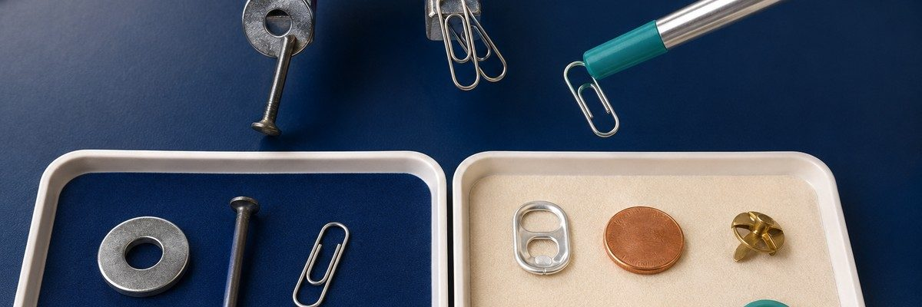
CASE 04
CER & ACE CASE FILES
PAGE 1 · CER
Magnet or Mimic?
Metallic shine is not enough evidence
NAME
DATE
GROUP
THE MYSTERY
Several objects look metallic, but only some respond strongly to a magnet. Which objects are magnetic, and what second property could help you classify the mimics?
CASE 04 · EVIDENCE TRAY
MATERIALS
Magnet wand, steel washer, iron nail, paper clip, aluminum tab, copper disk, brass fastener, wood, plastic
SAFETY
Keep magnets away from electronics. Test objects on a tray and return every small item after use.
STEP 1 · OBSERVE BEFORE YOU EXPLAIN
SAMPLE / OBJECT | WHAT I OBSERVE | TOOL OR TEST USED
Object 1
Object 2
Object 3
Object 4
STEP 2 · COLLECT EVIDENCE
TEST PERFORMED | RESULT / DATA | WHAT IT TELLS ME
Magnetic attraction
Appearance / texture
Second property test
CASE 04 · PAGE 1 · CER
11

Slide 12
CASE 04
CER & ACE CASE FILES
PAGE 2 · CER
Magnet or Mimic?
Build an argument from the evidence
HOW TO USE THIS SLIDE
Answer the mystery. Use specific data from Page 1, then explain the science idea that connects the evidence to your claim.
1 Claim
One clear sentence that answers the mystery.
2 Evidence
Name the measurements and observations that best support the claim.
3 Reasoning
Explain why the evidence supports the claim. Name the science concept that makes the evidence matter.
4 Alternative explanation
What else might explain the result, and what evidence makes it less likely?
5 Confidence check
What increases or limits your confidence?
STEMS Based on my investigation, I claim… | The strongest evidence is… | This supports my claim because…
CASE 04 · PAGE 2 · CER
12

Slide 13
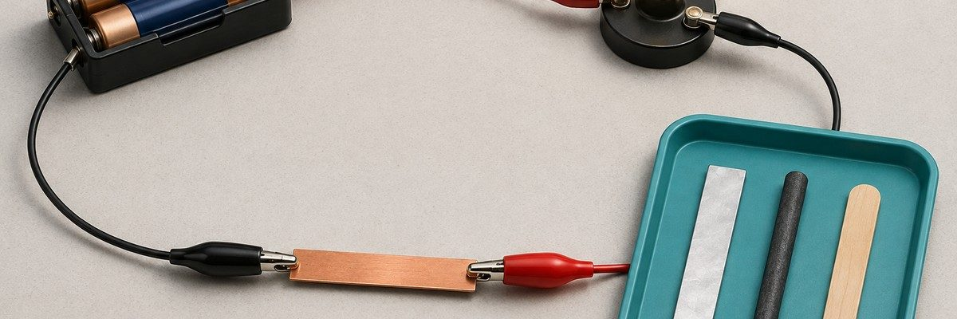
CASE 05
CER & ACE CASE FILES
PAGE 1 · CER
Conductor Clues
A dark lamp needs a second look
NAME
DATE
GROUP
THE MYSTERY
Which samples conduct electricity well enough to complete a low-voltage circuit? Test one sample at a time, then rule out loose clips or weak batteries before classifying an insulator.
CASE 05 · EVIDENCE TRAY
MATERIALS
Two-AA battery holder, LED lamp module, insulated leads, alligator clips, copper, aluminum, graphite, plastic
SAFETY
Use batteries only, never a wall outlet. Never clip the battery terminals directly together. Disconnect anything that becomes warm.
STEP 1 · OBSERVE BEFORE YOU EXPLAIN
SAMPLE / OBJECT | WHAT I OBSERVE | TOOL OR TEST USED
Copper
Aluminum
Graphite
Plastic
STEP 2 · COLLECT EVIDENCE
TEST PERFORMED | RESULT / DATA | WHAT IT TELLS ME
Lamp on / off
Brightness
Retest result
CASE 05 · PAGE 1 · CER
13

Slide 14
CASE 05
CER & ACE CASE FILES
PAGE 2 · CER
Conductor Clues
Build an argument from the evidence
HOW TO USE THIS SLIDE
Answer the mystery. Use specific data from Page 1, then explain the science idea that connects the evidence to your claim.
1 Claim
One clear sentence that answers the mystery.
2 Evidence
Name the measurements and observations that best support the claim.
3 Reasoning
Explain why the evidence supports the claim. Name the science concept that makes the evidence matter.
4 Alternative explanation
What else might explain the result, and what evidence makes it less likely?
5 Confidence check
What increases or limits your confidence?
STEMS Based on my investigation, I claim… | The strongest evidence is… | This supports my claim because…
CASE 05 · PAGE 2 · CER
14

Slide 15
STUDENT PACKET · ACE
CASES 01–05
RESPONSE FORMAT · ACE
GRADES 5–8 CORE · K–16 ADAPTABLE
Science Detective
Cases
OBSERVE. TEST. EXPLAIN. EXTEND.
Five reusable investigations in matter, energy, magnetism, and conductivity. Every case uses the same reasoning routine. Your response pages use Articulate · Connect · Extend.
01
Mystery Mixture
Which method separates each mixture
02
Density Deception
Which cube matches an unknown material
03
State Detectives
What changed and where energy moved
04
Magnet or Mimic?
Which objects respond to a magnet and why
05
Conductor Clues
Which materials complete a low-voltage circuit
NAME
CLASS / PERIOD
TCEA · CLASSROOM PACKET
GRADES 5–8 CORE · K–16 ADAPTABLE

Slide 16
ROUTINE
CER & ACE CASE FILES
ACE
The Case File Routine
Use the same four moves in every case
01
Observe
Record what you notice before naming the object or explaining the result.
02
Test
Choose a property, tool, or measurement that can produce useful evidence.
03
Explain
Connect the result to a science idea. Tell why the evidence matters.
04
Check
Retest, consider another explanation, and state what still feels uncertain.
TEAM ROLES
YOUR PAGE 2 RESPONSE
EVIDENCE MANAGER
Handles tools and samples safely
Articulate · Connect · Extend
Articulate what you learned and how you know. Connect it to something you already know. Extend it with a prediction, application, or new test.
RECORDER
Writes observations and measurements
SKEPTIC
Checks whether the evidence supports the claim
REPORTER
Shares the group's explanation and uncertainty
EVIDENCE RULE
A result is not automatically evidence. Explain what the result tells you and why it matters.
ROUTINE · ACE
2

Slide 17
CASE 00
CER & ACE CASE FILES
PAGE 1 · ACE
Worked Example: Density Deception
How evidence becomes an explanation
NAME
DATE
GROUP
THE MYSTERY
Four equal-volume cubes were tested. Which cube is aluminum, and how does the density evidence support the identification?
CASE 00 · EVIDENCE TRAY
MATERIALS
Four 2 cm cubes, balance, ruler, water tub, paper towels, calculator
SAFETY
Wipe spills. Lower cubes gently and keep the balance dry.
STEP 1 · OBSERVE BEFORE YOU EXPLAIN
SAMPLE / OBJECT | WHAT I OBSERVE | TOOL OR TEST USED
Cube A | Light tan; floats high | Hands; water
Cube B | White; floats low | Hands; water
Cube C | Silver-gray; sinks | Hands; water
Cube D | Dark gray; sinks fast | Hands; water
STEP 2 · COLLECT EVIDENCE
TEST PERFORMED | RESULT / DATA | WHAT IT TELLS ME
Mass | A=4.0 g; B=7.6 g; C=21.6 g; D=56.8 g | Mass differs at equal volume
Volume | All cubes = 8 cm³ | Volume is controlled
Density | A=0.50; B=0.95; C=2.70; D=7.10 | C matches aluminum
WORKED EXAMPLE · PAGE 1 · ACE
3

Slide 18
CASE 00
CER & ACE CASE FILES
PAGE 2 · ACE
Worked Example: Density Deception
Move from surface to connection and transfer
HOW TO USE THIS SLIDE
Use Page 1 evidence in every section. Your own words matter more than polished language.
A Articulate it
What did you figure out? Say it in your own words and name the evidence that changed or confirmed your thinking.
I found that Cube C is aluminum. Its mass was 21.6 g and its volume was 8 cm³, so its density was 2.70 g/cm³.
C Connect it
How does this result connect to something you already learned, observed, or experienced? Explain the relationship.
This connects to using characteristic properties to identify an unknown instead of relying only on color or whether it sinks.
E Extend it
Apply the idea somewhere new. Write a prediction, a real-world use, or a new test you could carry out.
Cube B has a density of 0.95 g/cm³. I predict it will sink in vegetable oil near 0.91 g/cm³ but float in water and denser saltwater.
☐ I named a result from Page 1. ☐ I explained why it matters. ☐ My extension could be tested or used.
STEMS I discovered… | This connects to… because… | If I changed…, I predict… because…
CASE 00 · PAGE 2 · ACE
4

Slide 19
CASE 01
CER & ACE CASE FILES
PAGE 1 · ACE
Mystery Mixture
Separate the evidence without changing it
NAME
DATE
GROUP
THE MYSTERY
Four mixtures are made from familiar solids. Choose a separation method for each sample, then use physical properties to explain why your method worked.
CASE 01 · EVIDENCE TRAY
MATERIALS
Samples A–D, trays, magnet wand, sieve, water cups, filter funnel, filter paper, scoop, magnifier
SAFETY
Wear goggles. Do not taste samples. Keep iron filings contained; do not rinse them into a sink.
STEP 1 · OBSERVE BEFORE YOU EXPLAIN
SAMPLE / OBJECT | WHAT I OBSERVE | TOOL OR TEST USED
Sample A
Sample B
Sample C
Sample D
STEP 2 · COLLECT EVIDENCE
TEST PERFORMED | RESULT / DATA | WHAT IT TELLS ME
Magnetism
Particle size / sieve
Solubility + filtration
CASE 01 · PAGE 1 · ACE
5

Slide 20
CASE 01
CER & ACE CASE FILES
PAGE 2 · ACE
Mystery Mixture
Move from surface to connection and transfer
HOW TO USE THIS SLIDE
Use Page 1 evidence in every section. Your own words matter more than polished language.
A Articulate it
What did you figure out? Say it in your own words and name the evidence that changed or confirmed your thinking.
C Connect it
How does this result connect to something you already learned, observed, or experienced? Explain the relationship.
E Extend it
Apply the idea somewhere new. Write a prediction, a real-world use, or a new test you could carry out.
☐ I named a result from Page 1. ☐ I explained why it matters. ☐ My extension could be tested or used.
STEMS I discovered… | This connects to… because… | If I changed…, I predict… because…
CASE 01 · PAGE 2 · ACE
6

Slide 21
CASE 02
CER & ACE CASE FILES
PAGE 1 · ACE
Density Deception
Use mass and volume to identify the unknown
NAME
DATE
GROUP
THE MYSTERY
Four equal-size cubes look similar. Which cube is aluminum? Measure mass and volume, calculate density, and compare your results with the reference table.
CASE 02 · EVIDENCE TRAY
MATERIALS
Cubes A–D, digital balance, metric ruler or graduated cylinder, water tub, paper towels, calculator
SAFETY
Wipe spills at once. Lower cubes into water gently. Keep the balance dry.
STEP 1 · OBSERVE BEFORE YOU EXPLAIN
SAMPLE / OBJECT | WHAT I OBSERVE | TOOL OR TEST USED
Cube A
Cube B
Cube C
Cube D
STEP 2 · COLLECT EVIDENCE
TEST PERFORMED | RESULT / DATA | WHAT IT TELLS ME
Mass (g)
Volume (cm³)
Density (g/cm³)
CASE 02 · PAGE 1 · ACE
7

Slide 22
CASE 02
CER & ACE CASE FILES
PAGE 2 · ACE
Density Deception
Move from surface to connection and transfer
HOW TO USE THIS SLIDE
Use Page 1 evidence in every section. Your own words matter more than polished language.
A Articulate it
What did you figure out? Say it in your own words and name the evidence that changed or confirmed your thinking.
C Connect it
How does this result connect to something you already learned, observed, or experienced? Explain the relationship.
E Extend it
Apply the idea somewhere new. Write a prediction, a real-world use, or a new test you could carry out.
☐ I named a result from Page 1. ☐ I explained why it matters. ☐ My extension could be tested or used.
STEMS I discovered… | This connects to… because… | If I changed…, I predict… because…
CASE 02 · PAGE 2 · ACE
8

Slide 23
CASE 03
CER & ACE CASE FILES
PAGE 1 · ACE
State Detectives
Follow the water and the energy
NAME
DATE
GROUP
THE MYSTERY
Water is changing at three stations. Identify melting, condensation, and evaporation, then explain whether the water undergoing each state change absorbs or releases energy.
CASE 03 · EVIDENCE TRAY
MATERIALS
Ice and beaker, cold metal cup, shallow warm-water dish, thermometers, timer, balance, trays, paper towels
SAFETY
Teacher provides warm water below 45 °C. No hot plates or open flames. Wipe condensation and spills.
STEP 1 · OBSERVE BEFORE YOU EXPLAIN
SAMPLE / OBJECT | WHAT I OBSERVE | TOOL OR TEST USED
Station A: ice
Station B: cold cup
Station C: warm water
Room air
STEP 2 · COLLECT EVIDENCE
TEST PERFORMED | RESULT / DATA | WHAT IT TELLS ME
Start / end temperature
Visible change / mass
Energy absorbed or released
CASE 03 · PAGE 1 · ACE
9

Slide 24
CASE 03
CER & ACE CASE FILES
PAGE 2 · ACE
State Detectives
Move from surface to connection and transfer
HOW TO USE THIS SLIDE
Use Page 1 evidence in every section. Your own words matter more than polished language.
A Articulate it
What did you figure out? Say it in your own words and name the evidence that changed or confirmed your thinking.
C Connect it
How does this result connect to something you already learned, observed, or experienced? Explain the relationship.
E Extend it
Apply the idea somewhere new. Write a prediction, a real-world use, or a new test you could carry out.
☐ I named a result from Page 1. ☐ I explained why it matters. ☐ My extension could be tested or used.
STEMS I discovered… | This connects to… because… | If I changed…, I predict… because…
CASE 03 · PAGE 2 · ACE
10

Slide 25
CASE 04
CER & ACE CASE FILES
PAGE 1 · ACE
Magnet or Mimic?
Metallic shine is not enough evidence
NAME
DATE
GROUP
THE MYSTERY
Several objects look metallic, but only some respond strongly to a magnet. Which objects are magnetic, and what second property could help you classify the mimics?
CASE 04 · EVIDENCE TRAY
MATERIALS
Magnet wand, steel washer, iron nail, paper clip, aluminum tab, copper disk, brass fastener, wood, plastic
SAFETY
Keep magnets away from electronics. Test objects on a tray and return every small item after use.
STEP 1 · OBSERVE BEFORE YOU EXPLAIN
SAMPLE / OBJECT | WHAT I OBSERVE | TOOL OR TEST USED
Object 1
Object 2
Object 3
Object 4
STEP 2 · COLLECT EVIDENCE
TEST PERFORMED | RESULT / DATA | WHAT IT TELLS ME
Magnetic attraction
Appearance / texture
Second property test
CASE 04 · PAGE 1 · ACE
11

Slide 26
CASE 04
CER & ACE CASE FILES
PAGE 2 · ACE
Magnet or Mimic?
Move from surface to connection and transfer
HOW TO USE THIS SLIDE
Use Page 1 evidence in every section. Your own words matter more than polished language.
A Articulate it
What did you figure out? Say it in your own words and name the evidence that changed or confirmed your thinking.
C Connect it
How does this result connect to something you already learned, observed, or experienced? Explain the relationship.
E Extend it
Apply the idea somewhere new. Write a prediction, a real-world use, or a new test you could carry out.
☐ I named a result from Page 1. ☐ I explained why it matters. ☐ My extension could be tested or used.
STEMS I discovered… | This connects to… because… | If I changed…, I predict… because…
CASE 04 · PAGE 2 · ACE
12

Slide 27
CASE 05
CER & ACE CASE FILES
PAGE 1 · ACE
Conductor Clues
A dark lamp needs a second look
NAME
DATE
GROUP
THE MYSTERY
Which samples conduct electricity well enough to complete a low-voltage circuit? Test one sample at a time, then rule out loose clips or weak batteries before classifying an insulator.
CASE 05 · EVIDENCE TRAY
MATERIALS
Two-AA battery holder, LED lamp module, insulated leads, alligator clips, copper, aluminum, graphite, plastic
SAFETY
Use batteries only, never a wall outlet. Never clip the battery terminals directly together. Disconnect anything that becomes warm.
STEP 1 · OBSERVE BEFORE YOU EXPLAIN
SAMPLE / OBJECT | WHAT I OBSERVE | TOOL OR TEST USED
Copper
Aluminum
Graphite
Plastic
STEP 2 · COLLECT EVIDENCE
TEST PERFORMED | RESULT / DATA | WHAT IT TELLS ME
Lamp on / off
Brightness
Retest result
CASE 05 · PAGE 1 · ACE
13

Slide 28
CASE 05
CER & ACE CASE FILES
PAGE 2 · ACE
Conductor Clues
Move from surface to connection and transfer
HOW TO USE THIS SLIDE
Use Page 1 evidence in every section. Your own words matter more than polished language.
A Articulate it
What did you figure out? Say it in your own words and name the evidence that changed or confirmed your thinking.
C Connect it
How does this result connect to something you already learned, observed, or experienced? Explain the relationship.
E Extend it
Apply the idea somewhere new. Write a prediction, a real-world use, or a new test you could carry out.
☐ I named a result from Page 1. ☐ I explained why it matters. ☐ My extension could be tested or used.
STEMS I discovered… | This connects to… because… | If I changed…, I predict… because…
CASE 05 · PAGE 2 · ACE
14

