Slide 1
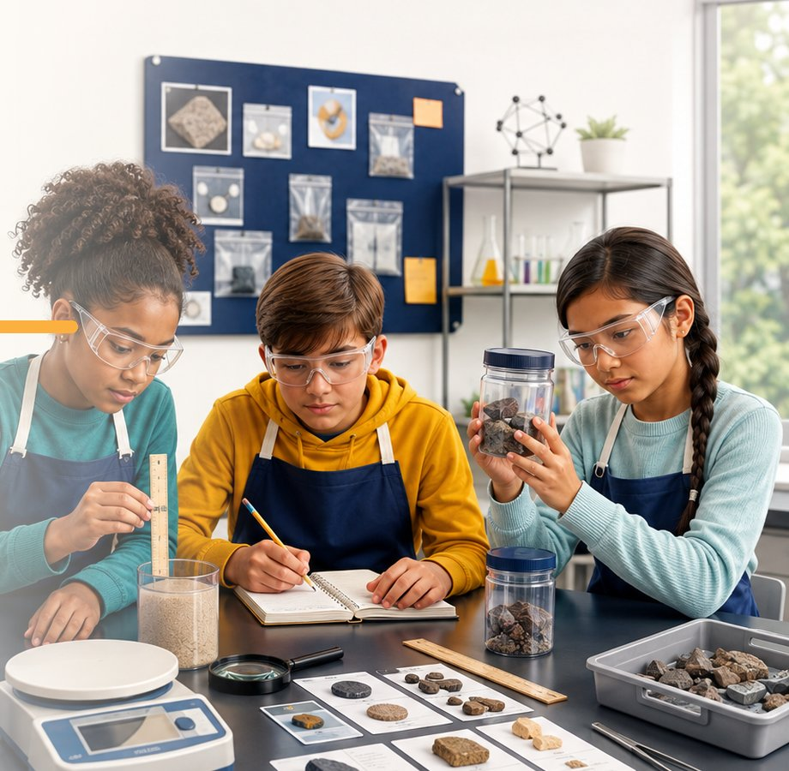
CLASSROOM DECK
CER & ACE Case Files
OBSERVE. TEST. EXPLAIN. EXTEND.
Grades 5–8 core · K–16 adaptable

Slide 2
The Case File Routine
Four moves. Every case.
01
02
03
04
Observe
Test
Explain
Check
Record what you notice before naming the object or explaining the result.
Choose a property, tool, or measurement that can produce useful evidence.
Connect the result to a science idea. Tell why the evidence matters.
Retest, consider another explanation, and state what still feels uncertain.
A result is not automatically evidence. Explain what the result tells you and why it matters.
THE ROUTINE
2 / 20

Slide 3
Choose the response
Both need Page 1 evidence. They ask for different thinking.
Claim · Evidence · Reasoning
Articulate · Connect · Extend
Use CER when students need a formal scientific argument. They state a claim, cite specific evidence, and connect that evidence to a science idea.
Use ACE when you want to hear more of the student's thinking. Students articulate what they learned, connect it to prior knowledge, and extend it with a prediction, application, or new test.
Team roles
EVIDENCE MANAGER
RECORDER
SKEPTIC
REPORTER
Handles tools and samples safely
Writes observations and measurements
Checks whether the evidence supports the claim
Shares the group's explanation and uncertainty
CER OR ACE
3 / 20

Slide 4
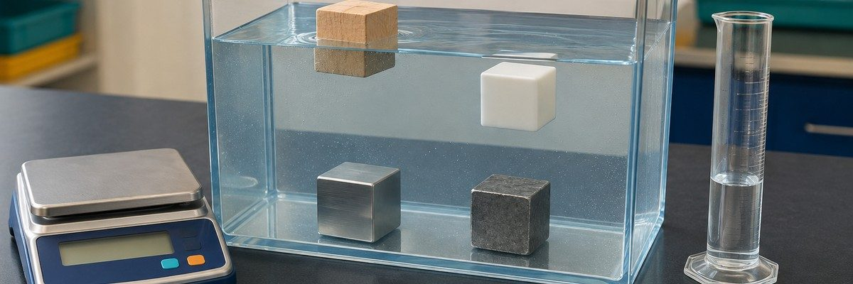
Worked Example: Density Deception
Four equal-volume cubes were tested. Which cube is aluminum, and how does the density evidence support the identification?
TEST | RESULT | WHAT IT TELLS ME
Mass | A=4.0 g; B=7.6 g; C=21.6 g; D=56.8 g | Mass differs at equal volume
Volume | All cubes = 8 cm³ | Volume is controlled
Density | A=0.50; B=0.95; C=2.70; D=7.10 | C matches aluminum
Ask: why can two equal-size cubes have different masses?
WORKED EXAMPLE · THE DATA
4 / 20

Slide 5
From measurement to argument
1 Claim
2 Evidence
3 Reasoning
Cube C is aluminum.
All four cubes had the same 8 cm³ volume. Cube C had a mass of 21.6 g, so its density was 2.70 g/cm³. That value matches the aluminum reference value, and Cube C sank in water as predicted.
Density is mass per unit volume and is a characteristic physical property under stated conditions. Dividing 21.6 g by 8 cm³ gives 2.70 g/cm³. Because this matches the reference value for aluminum, the measurements support the identification.
“I used the magnet” is a procedure. “The magnet removed the iron because iron is magnetic and sand is not” is reasoning.
WORKED EXAMPLE · THE ARGUMENT
5 / 20

Slide 6
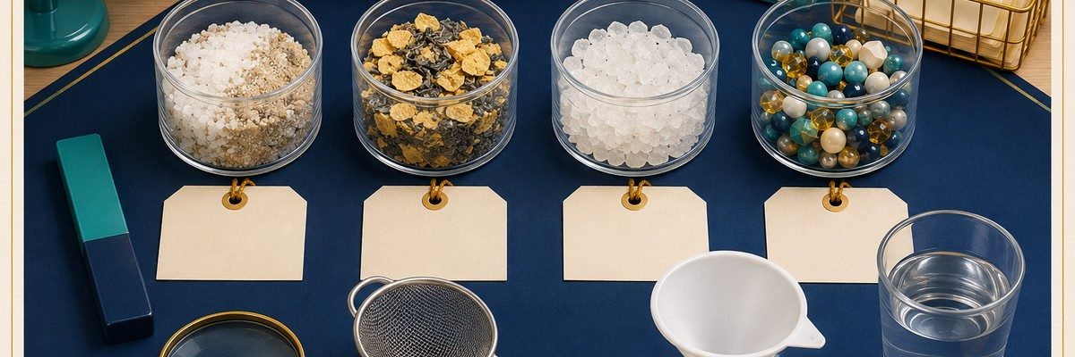
CASE 01
Mystery Mixture
Four mixtures are made from familiar solids. Choose a separation method for each sample, then use physical properties to explain why your method worked.
CASE 01 · THE MYSTERY
6 / 20

Slide 7
Mystery Mixture
What will you test, and what will it tell you?
EVIDENCE TO COLLECT
ASK WHILE THEY WORK
01 Magnetism
Which property are you using as evidence?
02 Particle size / sieve
Did the components change identity when you separated them?
03 Solubility + filtration
What would you try if your first method failed?
MATERIALS Samples A–D, trays, magnet wand, sieve, water cups, filter funnel, filter paper, scoop, magnifier
SAFETY Wear goggles. Do not taste samples. Keep iron filings contained; do not rinse them into a sink.
CASE 01 · RUN IT
7 / 20

Slide 8
Check the thinking
Case 01 · Mystery Mixture
COMMON MISCONCEPTION
Dissolving is not the same as disappearing. The dissolved substance remains in the solution.
ANSWER KEY
A separates with a magnet. B separates by dissolving salt, filtering sand, then evaporating the water. C separates by particle size with a sieve. D separates with a magnet or by hand sorting.
EXTEND
Have students design the fewest-step process that separates a three-part mixture.
CASE 01 · DEBRIEF
8 / 20

Slide 9
CASE 02
Density Deception
Four equal-size cubes look similar. Which cube is aluminum? Measure mass and volume, calculate density, and compare your results with the reference table.
CASE 02 · THE MYSTERY
9 / 20

Slide 10
Density Deception
What will you test, and what will it tell you?
EVIDENCE TO COLLECT
ASK WHILE THEY WORK
01 Mass (g)
Why can two equal-size cubes have different masses?
02 Volume (cm³)
What does a density greater than 1.0 predict in fresh water?
03 Density (g/cm³)
How close must a measured value be to count as a match?
MATERIALS Cubes A–D, digital balance, metric ruler or graduated cylinder, water tub, paper towels, calculator
SAFETY Wipe spills at once. Lower cubes into water gently. Keep the balance dry.
CASE 02 · RUN IT
10 / 20

Slide 11
Check the thinking
Case 02 · Density Deception
COMMON MISCONCEPTION
Weight alone does not determine floating. Compare an object's density with the fluid's density.
ANSWER KEY
A = wood (0.50), B = plastic (0.95), C = aluminum (2.70), D = zinc (7.10 g/cm³). Cube C is aluminum.
EXTEND
Predict and test each cube in vegetable oil, freshwater, and saltwater. Compare cube density with fluid density before testing.
CASE 02 · DEBRIEF
11 / 20

Slide 12
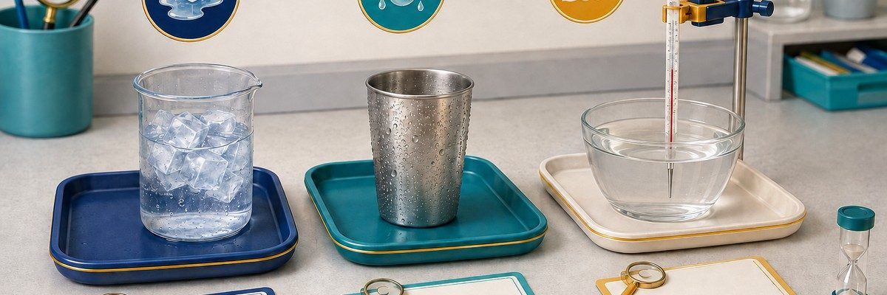
CASE 03
State Detectives
Water is changing at three stations. Identify melting, condensation, and evaporation, then explain whether the water undergoing each state change absorbs or releases energy.
CASE 03 · THE MYSTERY
12 / 20

Slide 13
State Detectives
What will you test, and what will it tell you?
EVIDENCE TO COLLECT
ASK WHILE THEY WORK
01 Start / end temperature
Where did the droplets on the outside of the cup come from?
02 Visible change / mass
What evidence shows a physical change rather than a new substance?
03 Energy absorbed or released
How would surface area affect evaporation?
MATERIALS Ice and beaker, cold metal cup, shallow warm-water dish, thermometers, timer, balance, trays, paper towels
SAFETY Teacher provides warm water below 45 °C. No hot plates or open flames. Wipe condensation and spills.
CASE 03 · RUN IT
13 / 20

Slide 14
Check the thinking
Case 03 · State Detectives
COMMON MISCONCEPTION
Condensation outside the cup does not leak through the cup; water vapor from the air forms the droplets.
ANSWER KEY
A is melting: solid water absorbs energy. B shows condensation: water vapor from the air releases energy as it becomes liquid. C shows evaporation: surface molecules absorb enough energy to enter the gas phase; the remaining liquid may cool.
EXTEND
Change one variable, such as exposed surface area, and predict the effect on evaporation rate.
CASE 03 · DEBRIEF
14 / 20

Slide 15
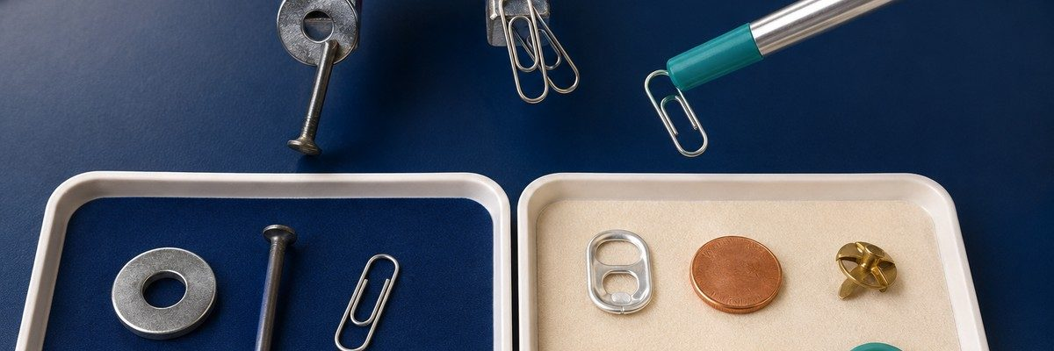
CASE 04
Magnet or Mimic?
Several objects look metallic, but only some respond strongly to a magnet. Which objects are magnetic, and what second property could help you classify the mimics?
CASE 04 · THE MYSTERY
15 / 20

Slide 16
Magnet or Mimic?
What will you test, and what will it tell you?
EVIDENCE TO COLLECT
ASK WHILE THEY WORK
01 Magnetic attraction
Which evidence changed your first prediction?
02 Appearance / texture
Does 'metal' always mean 'magnetic'?
03 Second property test
What additional property would separate two nonmagnetic samples?
MATERIALS Magnet wand, steel washer, iron nail, paper clip, aluminum tab, copper disk, brass fastener, wood, plastic
SAFETY Keep magnets away from electronics. Test objects on a tray and return every small item after use.
CASE 04 · RUN IT
16 / 20

Slide 17
Check the thinking
Case 04 · Magnet or Mimic?
COMMON MISCONCEPTION
Not all metals are magnetic. Magnetic response depends on the material, not on shine or color.
ANSWER KEY
The iron nail, plain-carbon-steel washer, and steel paper clip should attract. Aluminum, copper, brass, wood, and plastic should not. Some stainless steels respond weakly or not at all; test the actual samples before class.
EXTEND
Compare magnetic force at increasing distances using paper spacers as a simple distance scale.
CASE 04 · DEBRIEF
17 / 20

Slide 18
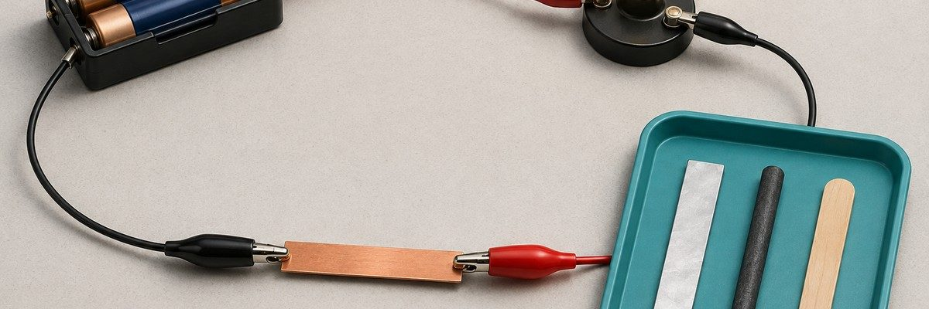
CASE 05
Conductor Clues
Which samples conduct electricity well enough to complete a low-voltage circuit? Test one sample at a time, then rule out loose clips or weak batteries before classifying an insulator.
CASE 05 · THE MYSTERY
18 / 20

Slide 19
Conductor Clues
What will you test, and what will it tell you?
EVIDENCE TO COLLECT
ASK WHILE THEY WORK
01 Lamp on / off
What must you check before calling a sample an insulator?
02 Brightness
Why might graphite produce a dimmer lamp than copper?
03 Retest result
Which material would you choose for a wire and for its covering?
MATERIALS Two-AA battery holder, LED lamp module, insulated leads, alligator clips, copper, aluminum, graphite, plastic
SAFETY Use batteries only, never a wall outlet. Never clip the battery terminals directly together. Disconnect anything that becomes warm.
CASE 05 · RUN IT
19 / 20

Slide 20
Check the thinking
Case 05 · Conductor Clues
COMMON MISCONCEPTION
A dark lamp does not prove insulation until the circuit and components have been checked.
ANSWER KEY
Copper and aluminum should light the lamp. Graphite conducts, but its resistance and dimensions may keep this lamp dark. Plastic is an insulator. Check the circuit before treating a dark lamp as evidence.
EXTEND
Rank conductors by lamp brightness, then discuss why brightness is only a rough comparison.
CASE 05 · DEBRIEF
20 / 20

