Slide 1

Escape:
An Adventure
in the Middle-Earth
The Ultimate Python Learning Game
Ironhack Data Full-Time Bootcamp
Project 1 – April 2022
Miguel Martinez & Maria Garcia Luengo

Slide 2

‘The Ring has awoken…
It’s heard its Master’s call.’

Slide 3
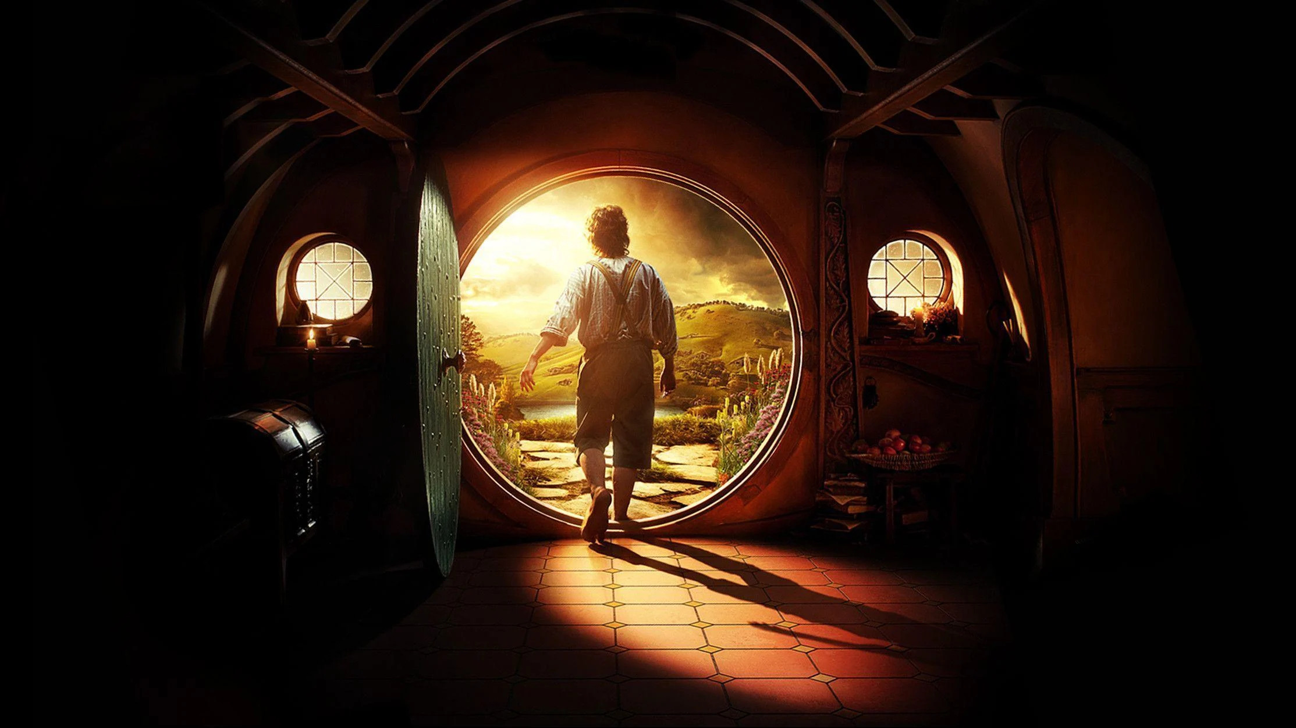
Destroy the Ring. Save the world. Learn to code.
‘Even the smallest person
can change the course
of the future’

Slide 4
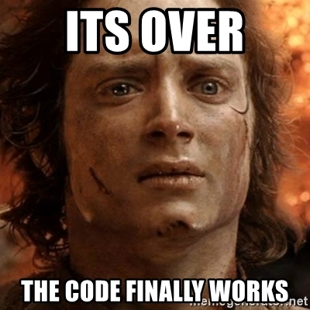
Why this game?
USP
03
Market size
Title
-94% new coders online*.
- Increasing demand across roles and industries.
- B2B & B2C.
You can describe the topic of the section here
- Gamification for adults
- Theme (popular culture).
- Flexible, short challenges.
*2021 survey – 18,000 new coding students

Slide 5
MVP deliverable in detail
New
features
Product
enhancements
- Themed script.
- Interactive minigames.
- Multiple levels of difficulty.
- Timer.
Improved user experience:
Seamless flows.
Clearer outputs.
Readability, text
display.

Slide 6
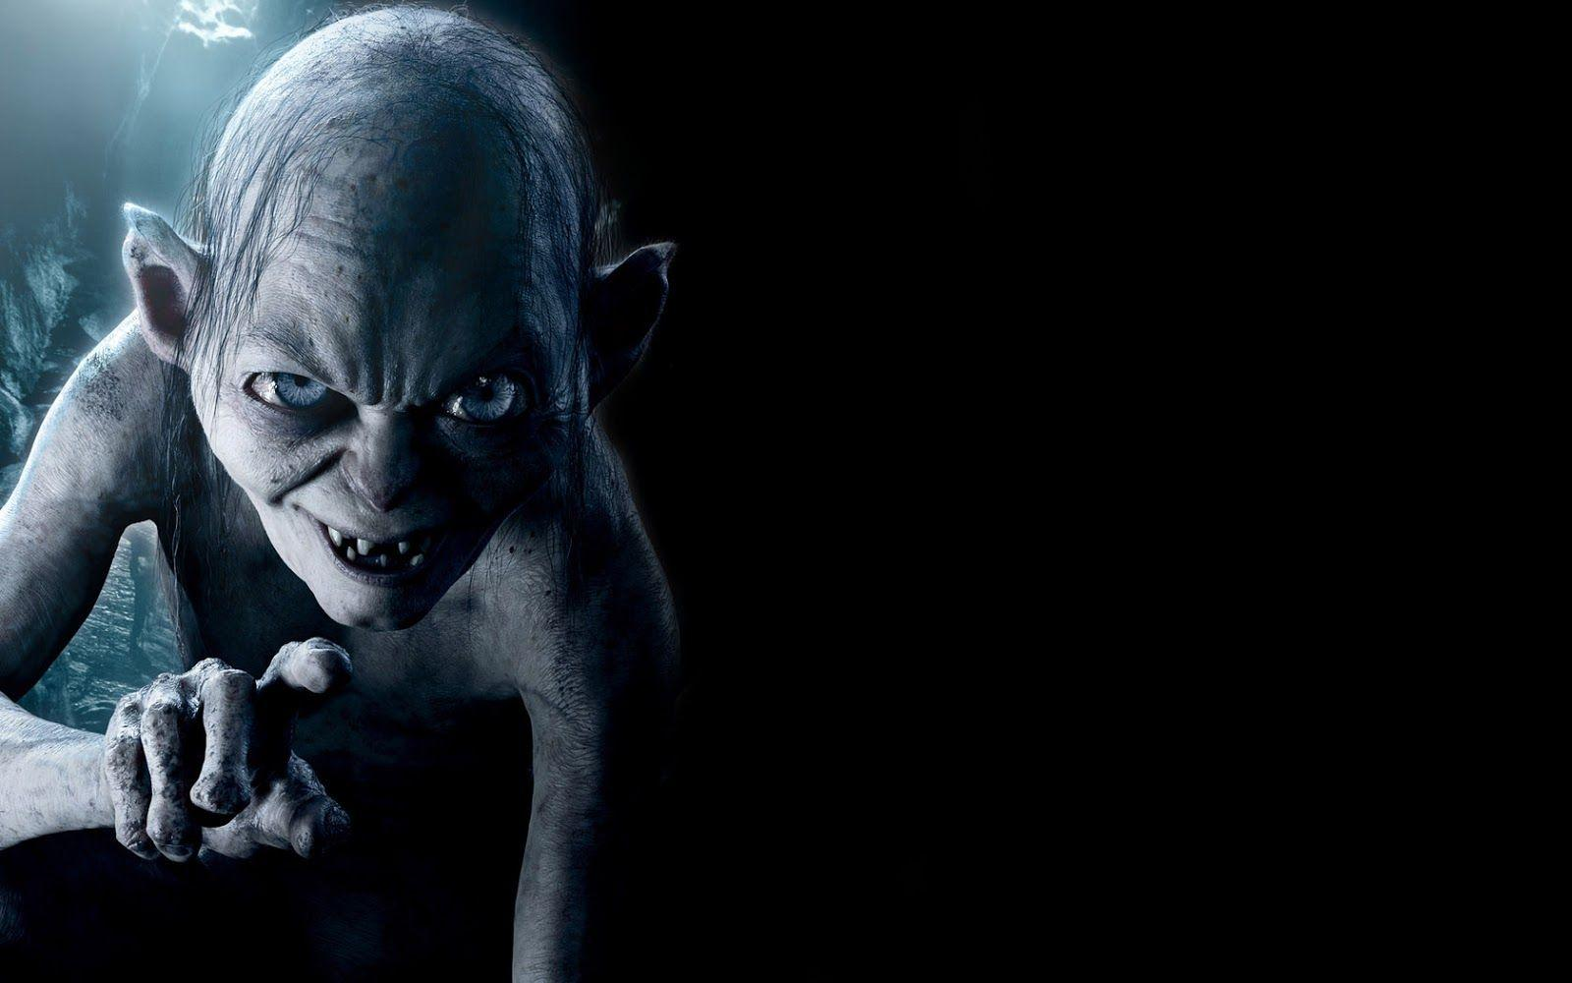

It’s demo time!
We need a volunteer:
Are you strong enough
to resist the power
of the Ring?

Slide 7
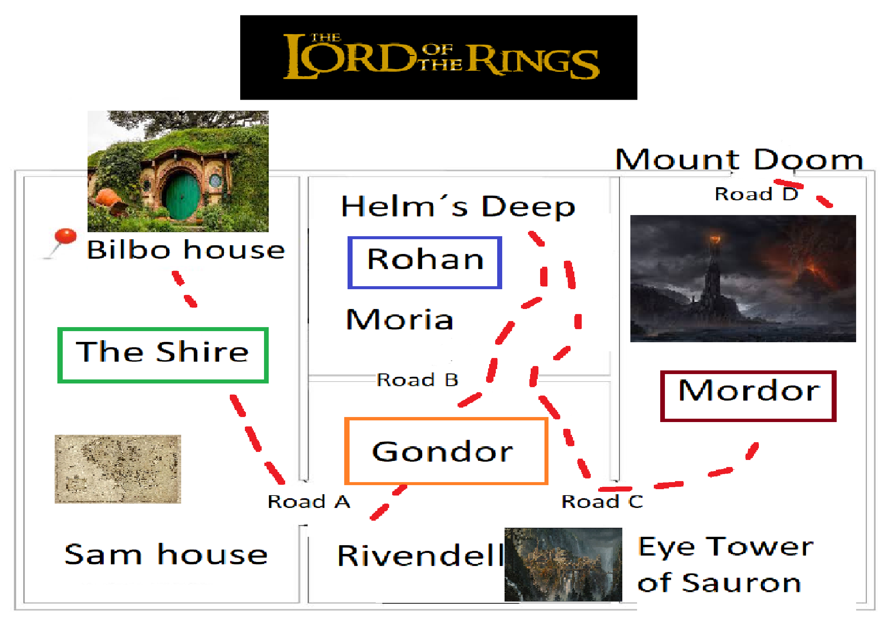

Slide 8
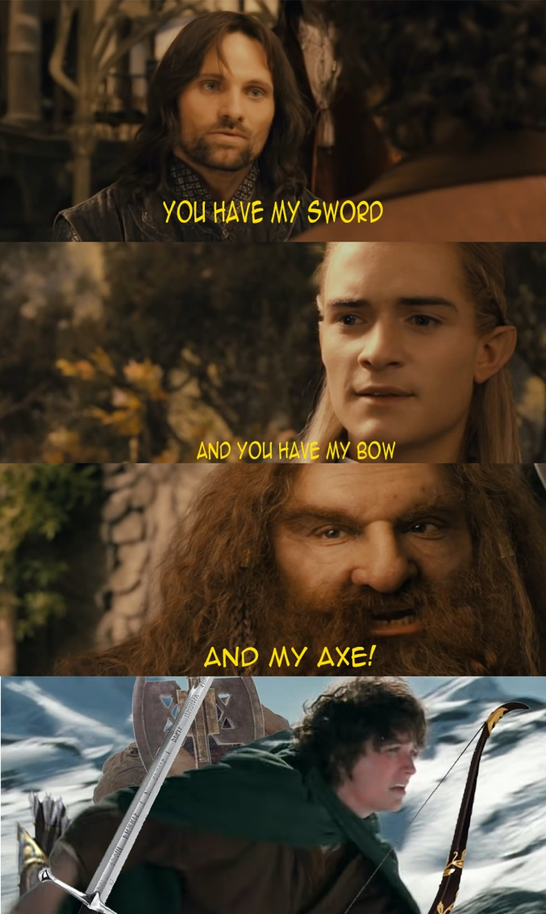



Tech Stack
No hero can succeed
without the right tools
Python
One language
to rule them all
Termcolor library
Add colors to terminal
Time library
Add timer

Slide 9
What’s next?
Levels, scenarios
Coding challenges
GUI
- Multi-level.
- Maps, places, characters.
- Random elements.
- Python coding games to unlock maps.
- Basic graphic interface (see map, check progress…)

Slide 10
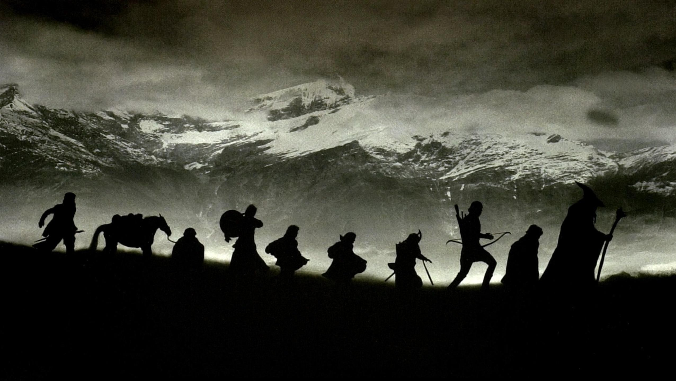

mbeovides
Thank you!
mgluengo

