Slide 1
Overview of the PBPM protocol
Gabriela Martínez
September 2019

Slide 2
The PBPM protocol
A command line interface program built in Python 3 to generate Patient by Disrupted Pathways Matrices (PBPMs). It generates three types of matrices:
Binary PBPM: unique patient identifiers as rows and pathways as columns. Values are binary (1 or 0) indicators for each column when a mutation was found for any gene in that pathway for a patient.
Numerical PBPM: unique patient identifiers as rows and pathways as columns. Values are the number of mutations found for each pathway and patient.
Normalized numerical PBPM: unique patient identifiers as rows and pathways as columns. Values are the number of mutations found for each pathway and patient, normalized considering the number of genes of each pathway.

Slide 3
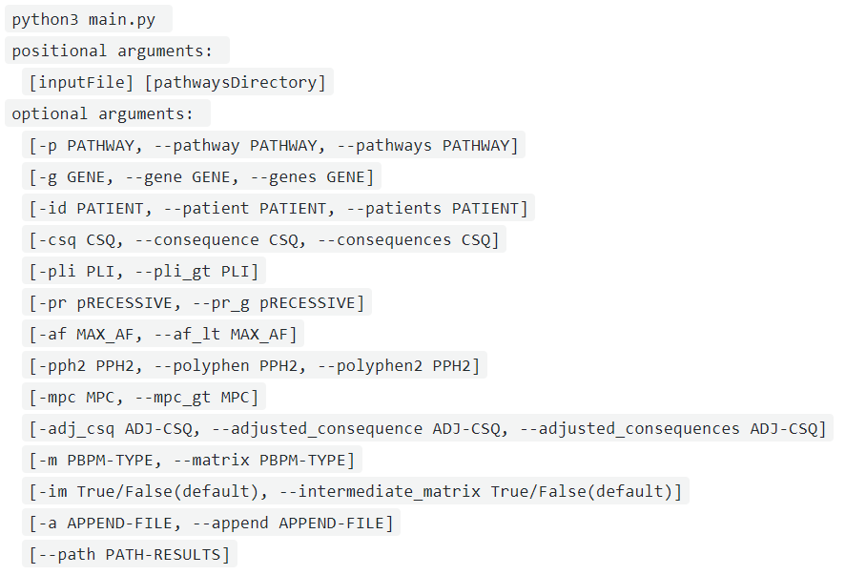
How to execute this protocol?
This module is written in Python 3 and uses up-to-date libraries for this version as well.
To run the main module in a Linux environment, simply open a new terminal and call the script together with the arguments it accepts:

Slide 4
PBPM protocol arguments
Mandatory parameters
Input file containing patients and mutations.
Optional parameters: act as filters
Pathways.
Folder containing pathways and their genes.
Genes.
Patients.
Consequences.
pLI.
PolyPhen2 prediction label.
MPC.
Adjusted consequence.
Max control AF.
pRecessive.
The protocol accepts a explicit subset of them and also external files
Note: help() is available for all the parameters via the command line.

Slide 5
PBPM mandatory parameters: input file
The input file containing patients and mutations has the following columns*. Moreover, only observations with a valid HGNC_symbol will be considered.
Chr | Position | … | child_id | consequence | HGNC_symbol | constraint_score | … | pLI | MPC
11 | 881802 |  | Patient_10 | missense_variant | V595I | 0.018 |  | 0.14 | 1.7
12 | 686702 |  | Patient_19 | Near_3splice | NA | 0.651 |  | 0.21 | NA
3 | 981711 |  | Patient_21 | Intron | NA | 0.006 |  | 0.35 | NA
15 | 1121834 |  | Patient_31 | Silent | R589R | 0.124 |  | 0.05 | NA
20 | 541255 |  | Patient_98 | missense_variant | L239P | 0.032 |  | 0.12 | 3.5
*and many more. This is not exhaustive.

Slide 6
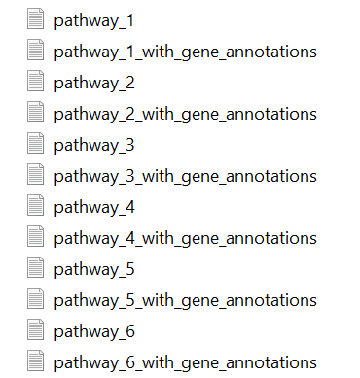
PBPM mandatory parameters: pathways folder
The sample folder to build the PBPM protocol contained 80 pathways, for which the files ended with “_gene_annotations” were considered
Folder structure
Pathway_1 | HGNC_symbol | …
SCN4A | SCN4A
ANK1 | ANK1
SPTB | SPTB
KCNQ2 | KCNQ2
ACTB | ACTB

Slide 7
How to specify mandatory parameters?
Run the protocol by specifying both positional arguments:
  $ python3 main.py ~/PBPM/data/raw/mutations-file.txt ~/PBPM/data/raw/pathways/
Input file
Pathways directory
Important notes:
Be aware of respecting the order of the positional arguments.
Also, keep the names of the patients and mutations file as follows:
Chr, Position, Ref, Alt, Type, Gene, consequence, child_id, HGNC_symbol, HGNC_mapping, constraint_score, pLI, pRecessive, max_control_AF, pph2_prediction, MPC, adjusted_consequence.
The directory containing the pathways can contain multiple files. However, only those ending with '_with_gene_annotations' will be considered for processing.

Slide 8
PBPM optional parameters
Final PBPMs will be filtered according to the optional arguments included in the analysis. Most of the parameters have both short and long names to be called.
Pathways
Optional argument to filter specific pathways. If no setting is provided, all available pathways will be considered.
Example 1: protocol will filter data for pathway R-HSA-69620
  python3 main.py ~/PBPM/data/raw/mutations-file.txt
  ~/PBPM/data/raw/pathways/
  -p R-HSA-69620
Example 2: protocol will not filter data by any pathway.
  python3 main.py ~/PBPM/data/raw/mutations-file.txt
  ~/PBPM/data/raw/pathways/

Slide 9
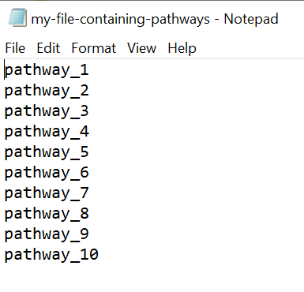
Pathways
To filter by more than one pathway, you can specify one of the following:
A subset of pathways separated by comma (without spaces):
-p R-HSA-69620,0051705
A txt tab delimited file with no headers and the desired pathways to filter written in the first column:
-p ~/PBPM/data/raw/filters/my-file-containing-pathways.txt

Slide 10
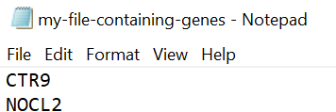
Genes
Optional argument to filter specific genes. If no setting is provided, all available genes will be considered.
Example: protocol will filter data for gene CTR9
$ python3 main.py ~/PBPM/data/raw/mutations-file.txt
~/PBPM/data/raw/pathways/
-g CTR9
To filter by more than one gene, you can specify one of the following:
Subset of genes separated by comma (without spaces):
-g CTR9,NOCL2
A txt tab delimited file with no headers and the desired genes to filter:
-g ~/PBPM/data/raw/filters/my-file-containing-genes.txt

Slide 11
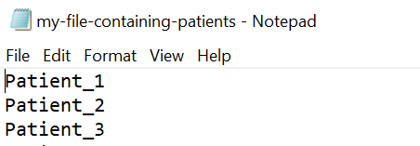
Patients
Optional argument to filter specific patient IDs. If no setting is provided, all available patients will be considered.
Example: protocol will filter data for patient with ID 1
$ python3 main.py ~/PBPM/data/raw/mutations-file.txt
~/PBPM/data/raw/pathways/
-id Patient_1
To filter by more than one patient, you can specify one of the following:
A subset of patients IDs separated by comma (without spaces):
-id Patient_X,Patient_Y
A txt tab delimited file with no headers and the desired patients to filter:
-id ~/PBPM/data/raw/filters/my-file-containing-patients.txt

Slide 12
Consequences
Optional argument to filter specific consequences. If no setting is provided, all available consequences will be considered.
Example: protocol will filter data for consequences of type 'missense_variant’
$ python3 main.py ~/PBPM/data/raw/mutations-file.txt
~/PBPM/data/raw/pathways/
-csq missense_variant
To filter by more than one consequence, you can specify one of the following:
A subset of mutations separated by comma (without spaces):
-csq missense_variant,Intron
A txt tab delimited file with no headers and the desired consequences to filter.
-csq ~/PBPM/data/raw/filters/my-file-containing-mutations.txt

Slide 13
pLI
Optional argument to filter records with values greater than or equal to a specified pLI threshold. Example:
$ python3 main.py ~/PBPM/data/raw/mutations-file.txt
~/PBPM/data/raw/pathways/
-pli 0.6
pRecessive
Optional argument to filter records with values greater than a specified pRecessive threshold. Example:
$ python3 main.py ~/PBPM/data/raw/mutations-file.txt
~/PBPM/data/raw/pathways/
-pr 0.6

Slide 14
Max control AF
Optional argument to filter records with values less than a max_control_AF threshold. Example:
$ python3 main.py ~/PBPM/data/raw/mutations-file.txt
~/PBPM/data/raw/pathways/
-af 0.3
PolyPhen predictions
Optional argument to filter records with specific PolyPhen predictions. Available options for this parameter are: benign, possibly damaging, and probably damaging. Example:
$ python3 main.py ~/PBPM/data/raw/mutations-file.txt
~/PBPM/data/raw/pathways/
-pph2 "possibly damaging"
Note that qualifiers must be enclosed with quotes as they hold blank spaces.

Slide 15
PolyPhen predictions
To filter by more than one qualifier, you must separate their labels with comma and without spaces while keeping the quotes:
-pph2 "probably damaging,possibly damaging"
MPC
Optional argument to filter records with values greater than or equal to a specified MPC threshold. Example:
$ python3 main.py ~/PBPM/data/raw/mutations-file.txt
~/PBPM/data/raw/pathways/
-mpc 0.7

Slide 16
Adjusted consequence
Optional argument to filter records by specific adjusted consequence labels. Available options for this parameter include: PTV, Missense3, Missense, etc. Example:
$ python3 main.py ~/PBPM/data/raw/mutations-file.txt
~/PBPM/data/raw/pathways/
-adj_csq PTV
To filter by more than one adjusted consequence, you must separate their labels with comma:
-adj_csq Missense3,Missense

Slide 17
PBPM: other useful parameters
Download intermediate matrix
Besides filtering, this protocol allows to extract an intermediate matrix used to compute the final PBPMs. This matrix serves as raw data for individual exploratory analysis, and can be also appended to an existing dataset of the same nature.
By default, this boolean parameter is set to False, case in which only a final PBPM will be downloaded and a copy of the intermediate matrix will not be saved. To download this dataset, as well as the final PBPM, a True must be explicit by typing the parameter –im or –intermediate_matrix.
$ python3 main.py ~/PBPM/data/raw/mutations-file.txt
~/PBPM/data/raw/pathways/
-im
$ python3 main.py ~/PBPM/data/raw/mutations-file.txt
~/PBPM/data/raw/pathways/
- -intermediate_matrix

Slide 18
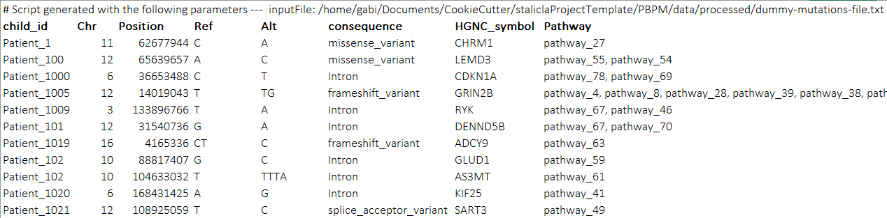
PBPM: other useful parameters
Download intermediate matrix
The base matrix looks like:
Patient-level data for more in-depth information

Slide 19
PBPM: other useful parameters
Append intermediate matrix
Optional argument to append the intermediate matrix of the current session to the file provided, which is expected to be another intermediate matrix. Appended information will be used to compute the final PBPM. Example:
$ python3 main.py ~/PBPM/data/raw/mutations-file.txt
~/PBPM/data/raw/pathways//
-a path-to-my-historic-file.txt
$ python3 main.py ~/PBPM/data/raw/mutations-file.txt
~/PBPM/data/raw/pathways//
-append path-to-my-historic-file.txt
The appended file will be overwritten and it will contain the commands used to generate all the information of the intermediate matrix.

Slide 20
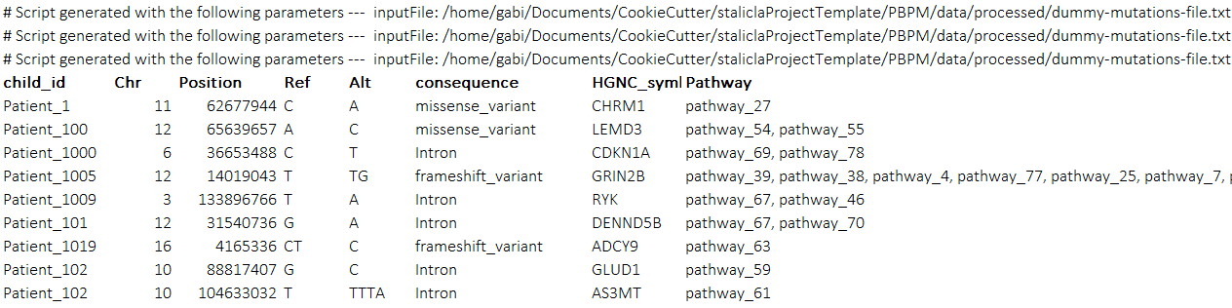
PBPM: other useful parameters
Append intermediate matrix
An appended intermediate matrix looks like:
This is an appended-like intermediate matrix coming from three different runs

Slide 21
PBPM: other useful parameters
Path to store final PBPM
Optional argument to specify the path where the user wants to store the final PBPM generated. Example:
$ python3 main.py ~/PBPM/data/raw/mutations-file.txt
~/PBPM/data/raw/pathways//
- -path location-where-I-want-to-save-PBPM
When not specified, the final PBPMs will be stored in the analysis folder of the project.

Slide 22
PBPM: choosing the final PBPM
The argument –m (also - -matrix) will allow choosing the type of matrix that is desired. When not specified, by default, this parameter will extract a binary PBPM.
Example to explicitly generate a binary matrix :
$ python3 main.py ~/PBPM/data/raw/mutations-file.txt
~/PBPM/data/raw/pathways/
-m b
Example to generate a numerical matrix (not normalized):
$ python3 main.py ~/PBPM/data/raw/mutations-file.txt
~/PBPM/data/raw/pathways/
-m n
Example to generate a normalized numerical matrix:
$ python3 main.py ~/PBPM/data/raw/mutations-file.txt
~/PBPM/data/raw/pathways/
-m nn

Slide 23
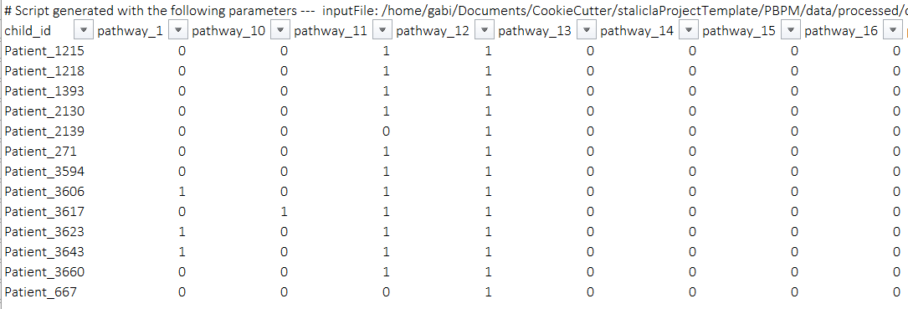
How do PBPMs look like?
Overview of a binary PBPM

Slide 24
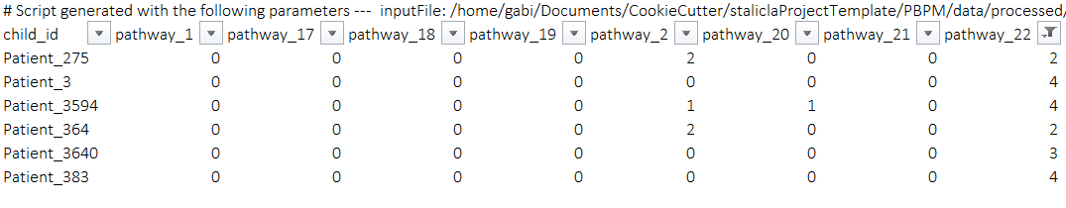
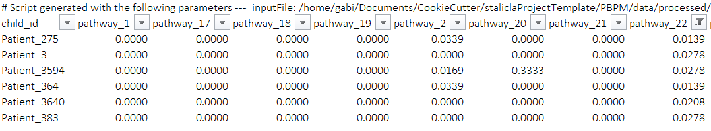
How do PBPMs look like?
Overview of a numerical PBPM
Overview of a normalized PBPM

Slide 25
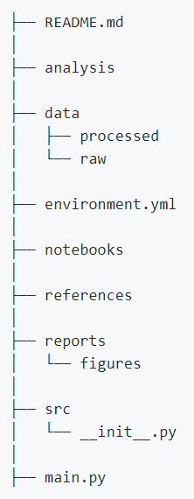
What is the project organization?
It has the Stalicla Cookiecutter template for GitHub projects:
Available for the entire project settings
Execution logs are stored at this level and also PBPMs when an alternative path is not specified
Intermediate matrices are stored at this level
Specific libraries for the project can be found here
Where this presentation is
Source code for the project can be found here: PBPM.py and main.py

Slide 26
Where is this protocol stored?
Up to now, the PBPM repository is at my private GitHub:
https://github.com/mgmartinezl/Stalicla-PBPM
PENDING task: upload to the cluster and schedule some tests with final users.

