Slide 1
Clustering PTV patients with ASD
Gabriela Martínez
August 2019

Slide 2
Our objectives…
PTV patients
We want to find clusters of similar PTV patients
We are also interested in finding correlated pathways
In the end: we need external validation for these clusters

Slide 3
Roadmap for patients clustering
Statistical results for clustering always need to be validated by experts:
Compute similarity between patients
Compute distance matrix for patients
Apply hierarchical clustering
Validate clusters
This distance matrix serves as input for any clustering algorithm and it is the most important step in the pipeline
It facilitates the visualization of grouped patients
If this stage fails, clustering needs to be reviewed and recomputed

Slide 4

How are two patients considered “similar”?
The first step for clustering is to define how similarity will be defined.
Jaccard’s distance
Two patients will be “closer to each other”, or “similar” when they share mutations in the same pathways. For every pathway and pair of patients, the following matrix of similarity is computed:
 | 0 | 1
0 | M00 | M10
1 | M01 | M11
The more mutations in the same pathways are shared by two patients, the more similar they are!
This measure is a probability: the closer to 1, the more similarity.
Unmatching mutations
Common mutations
Unmatching mutations
$$d= \frac{M_{11}}{M_{01}+M_{10}+M_{11}}$$

Slide 5
How does our patient similarity matrix look like?
After all computations, we will have a large matrix (257 x 257) of patients and their measure of distance (the closer this number to 1, the more similar these patients are):
 | Patient_1 | Patient_2 | Patient_3 | Patient_4
Patient_1 | 1
Patient_2 | 0.95 | 1
Patient_3 | 0.50 | 0.90 | 1
Patient_4 | 0.30 | 0.76 | 0.66 | 1

Slide 6
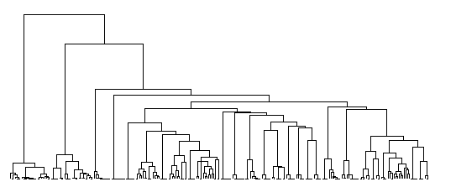
Hierarchical clustering for patients
3 clusters of PTV patients were visually identified. Results are generated for 2,3,4 and 5 clusters in a separate xlsx file.
25 patients
26 patients
Height
206 patients
Patient IDs

Slide 7
Clustering pathways is also a good idea
It may be useful to find which pathways are “similar”, as they may lead to related patients’ behavior or symptoms.
Compute correlation between pathways
Compute similarity between pathways
Apply hierarchical clustering
Validate results
The approach for analyzing similarity between variables (pathways) differs from the one for observations (patients)
It facilitates the visualization of potentially akin pathways
Pathways could be grouped to recompute patients’ clusters

Slide 8
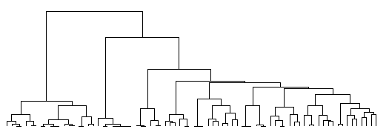
Hierarchical clustering for pathways
Dimensionality reduction could be possible by grouping similar pathways into new variables that can improve the natural clustering of the PTV patients.
Height
Pathways

Slide 9
Conclusions
Visual examination of hierarchical clustering allowed to explore an initial clue about the natural association of PTV patients.
The clustering exercise is a cyclic process that needs to be externally validated by knowledge experts before changing the statistical approach.
Clustering not only patients but also pathways may result in a more powerful feature engineering scope, useful for future clustering processes.
Other methods, such as k-means and LCA were tested, with almost the same results as the ones obtained with hierarchical techniques,

