Slide 1
Overview of the PBPM protocol
Gabriela Martínez
September 2019

Slide 2
The PBPM protocol
A command line interface program built in Python 3 to generate Patient by Disrupted Pathways Matrices (PBPMs). It generates three types of matrices:
Binary PBPM: unique patient identifiers as rows and pathways as columns. Values are binary (1 or 0) indicators for each column when a mutation was found for any gene in that pathway for a patient.
Numerical PBPM: unique patient identifiers as rows and pathways as columns. Values are the number of mutations found for each pathway and patient.
Normalized numerical PBPM: unique patient identifiers as rows and pathways as columns. Values are the number of mutations found for each pathway and patient, normalized considering the number of genes of each pathway.

Slide 3
PBPM protocol arguments
Mandatory parameters
Input file containing patients and mutations.
Optional parameters: act as filters
Pathways.
Folder containing pathways and their genes.
Genes.
Patients.
Mutations.
pLI.
PolyPhen2 prediction label.
MPC.
Adjusted consequence.
Max control AF.
The protocol accepts a explicit subset of them and also external files
Note: help() is available for all the parameters via the command line.

Slide 4
PBPM mandatory parameters: input file
The input file containing patients and mutations has the following columns*.
Only observations with a valid HGNC_symbol will be considered.
Chr | Position | … | child_id | consequence | HGNC_symbol | constraint_score | … | pLI | MPC
11 | 881802 |  | Patient_10 | missense_variant | V595I | 0.018 |  | 0.14 | 1.7
12 | 686702 |  | Patient_19 | Near_3splice | NA | 0.651 |  | 0.21 | NA
3 | 981711 |  | Patient_21 | Intron | NA | 0.006 |  | 0.35 | NA
15 | 1121834 |  | Patient_31 | Silent | R589R | 0.124 |  | 0.05 | NA
20 | 541255 |  | Patient_98 | missense_variant | L239P | 0.032 |  | 0.12 | 3.5
*and many more. This is not exhaustive.

Slide 5
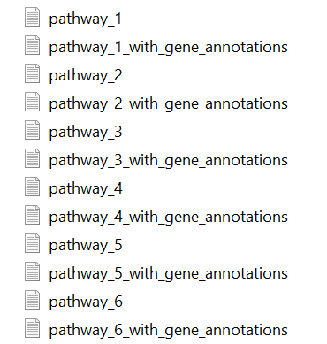
PBPM mandatory parameters: pathways folder
The sample folder to build the PBPM protocol contained 80 pathways, for which the files ended with “_gene_annotations” were considered
Folder structure
Pathway_1 | HGNC_symbol | …
SCN4A | SCN4A
ANK1 | ANK1
SPTB | SPTB
KCNQ2 | KCNQ2
ACTB | ACTB

Slide 6
PBPM optional parameters
Final PBPMs will be filtered according to the optional arguments included in the analysis. Examples will illustrate this as follows:
Pathways
Optional argument to extract only specific pathways. If no setting is provided, all available pathways will be extracted by default.
Example 1: it will run only for pathway R-HSA-69620
Example 2: it will run for all possible pathways

Slide 7
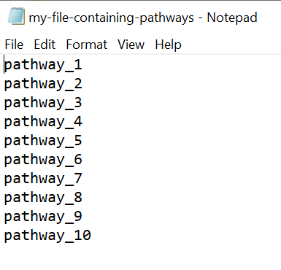
Pathways
For more than one pathway, you can specify one of the following:
Subset of pathways separated by comma (without spaces):
A txt tab delimited file with no headers and the desired pathways to filter written in the first column:

Slide 8

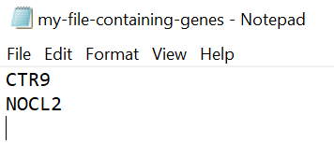
Genes
Optional argument to extract only specific genes. If no setting is provided, all available genes will be extracted by default.
Example: it will run only for gene CTR9
For more than one gene, you can specify one of the following:
Subset of genes separated by comma (without spaces):
A txt tab delimited file with no headers and the desired genes to filter:

Slide 9

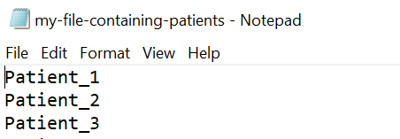
Patients
Optional argument to extract only specific child IDs. If no setting is provided, all available patients will be extracted by default.
Example: it will run only for patient with ID 1
For more than one patient, you can specify one of the following:
Subset of patients IDs separated by comma (without spaces):
A txt tab delimited file with no headers and the desired patients to filter:

Slide 10
Mutations
Optional argument to extract only specific mutations. If no setting is provided, all available consequences will be extracted by default.
Example: it will run only for mutations of type 'missense_variant'
For more than one mutation, you can specify one of the following:
Subset of mutations separated by comma (without spaces):
A txt tab delimited file with no headers and the desired mutations to filter.

Slide 11
pLI
Optional argument to filter records with values greater than or equal to a specified pLI threshold. Example:
Max control AF
Optional argument to filter records with values less than a max_control_AF threshold. Example:

Slide 12

PolyPhen predictions
Optional argument to filter records for qualifiers of pph2 predictions. Available options for this parameter are: benign, possibly damaging, and probably damaging. Note that qualifiers must be enclosed with quotes as they hold blank spaces. Example:
To filter more than one qualifier, you must separate their labels with comma and without spaces while keeping the quotes:

Slide 13

MPC
Optional argument to filter records with values greater than or equal to a specified MPC threshold. Example:
Adjusted consequence
Optional argument to filter records by specific value(s) of adjusted consequence. Available options for this parameter include: PTV, Missense3, Missense, etc. Example:
To filter more than one pph2 qualifier, you must separate their labels with comma:

Slide 14
PBPM: other useful parameters
Download base matrix
Besides filtering, this protocol allows to extract a base matrix used to compute the final PBPMs. This base matrix serves as raw data for individual exploratory analysis, and can be also appended to an existing dataset of the same nature.
By default, this Boolean parameter is set to NO (‘no’), case in which only a final PBPM will be generated. To download this data as well as the final PBPM, a yes (‘y’) must be explicitly passed to the argument –r, as follows:

Slide 15
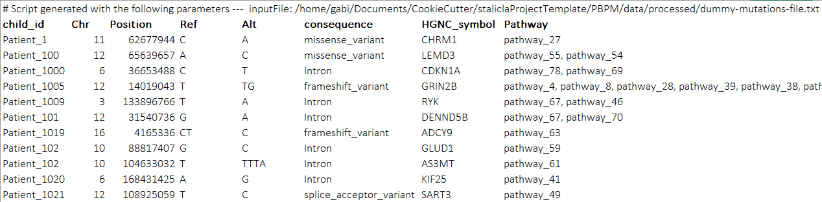
PBPM: other useful parameters
Download base matrix
The base matrix looks like:
Patient-level data for more in-depth information

Slide 16


PBPM: other useful parameters
Append base matrix
The base matrix will not only be downloaded, but also appended to an existing file, when the parameter –append is set. Thus, it will not be necessary to explicitly set the download (-r) parameter to yes (‘y’), unless a separate copy of the base matrix is desired. Example:
The appended file will be overwritten and it will contain the commands used to generate all the information of the base matrix.

Slide 17
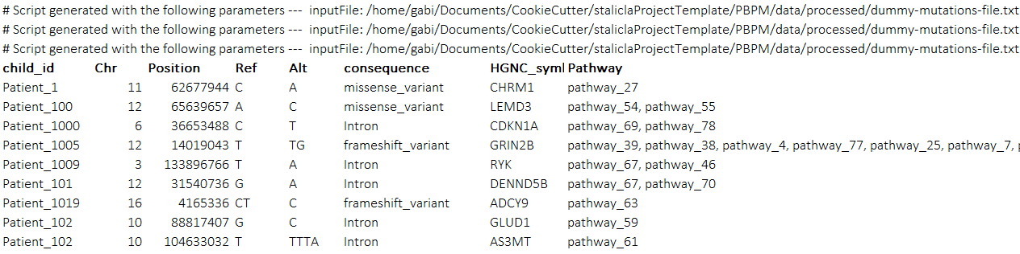
PBPM: other useful parameters
Append base matrix
An appended base matrix looks like:
This is an appended-like base matrix coming from three different runs

Slide 18
PBPM: choosing the final PBPM
The argument –matrix will allow choosing the type of matrix that is desired: binary (b), numerical (n) or normalized (nn). By default, this parameter will extract a binary PBPM.
Example to explicitly generate a binary matrix :
Example to generate a numerical matrix (not normalized):
Example to generate a normalized numerical matrix:

Slide 19
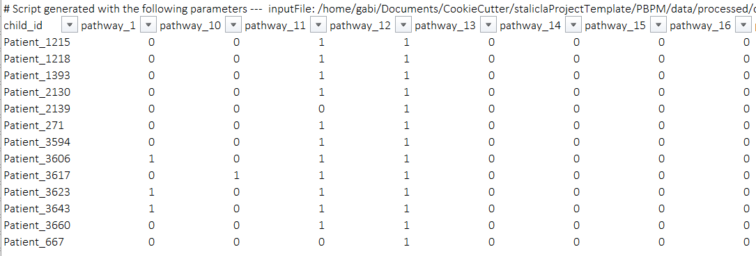
How do PBPMs look like?
Overview of a binary PBPM

Slide 20
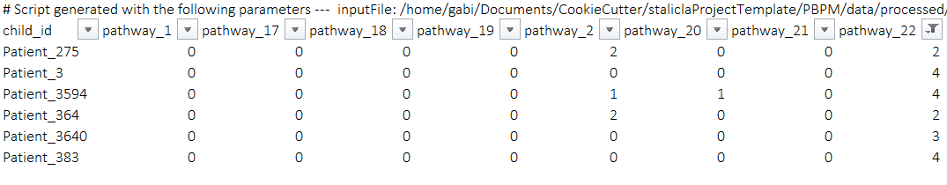
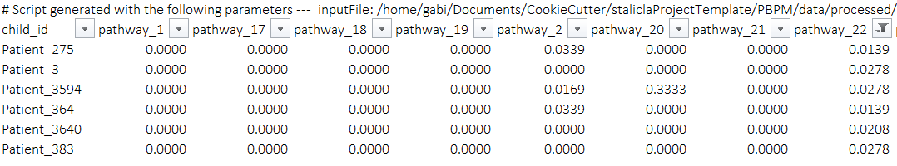
How do PBPMs look like?
Overview of a numerical PBPM
Overview of a normalized PBPM

Slide 21
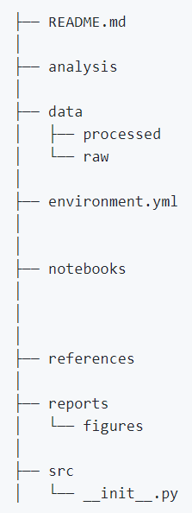
What is the project organization?
It has the Stalicla Cookiecutter template for GitHub projects:
Available for the entire project settings
Execution logs are stored at this level
Specific libraries for the project can be found here
Where this presentation is
PBPMs and base matrices are stored at this level
Source code for the project can be found here: PBPM.py and main.py

Slide 22
How to execute this protocol?
The scripts PBPM.py, and main.py are written in Python 3, which uses up-to-date libraries for this version as well. To run the main module in a Linux environment, simply open a new terminal and call the script together with the arguments it needs:

Slide 23
Where is this protocol stored?
Up to now, the PBPM repository is at my private GitHub:
https://github.com/mgmartinezl/Stalicla-PBPM
PENDING task: upload to the cluster and schedule some tests with final users.

