Slide 1

Distributed Tracing using Zipkin and Open Telemetry
Michael McCarthy
Architect
Patient Communications

Slide 2
Why Distributed Tracing?
TODO, make LogAll and QueueExplorer, support emails, etc. screengrab then animate to next slide…

Slide 3
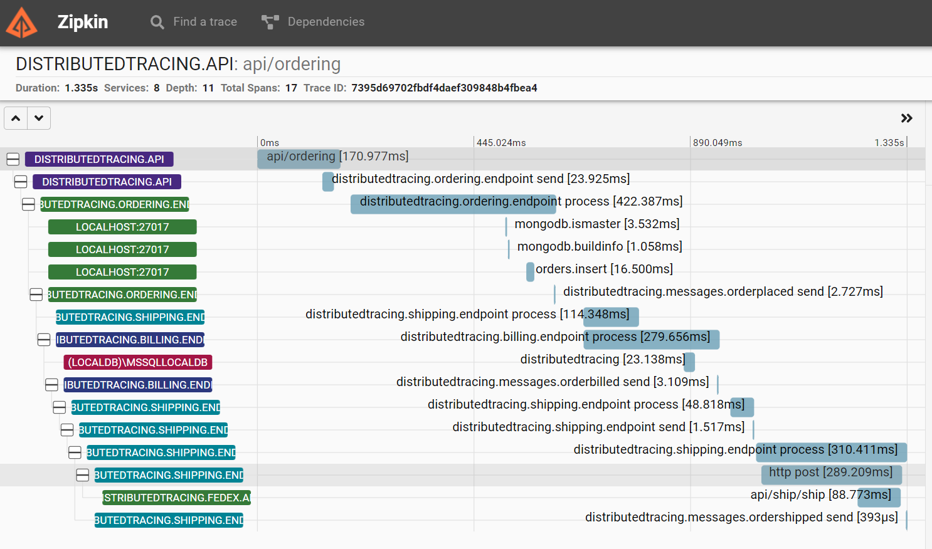
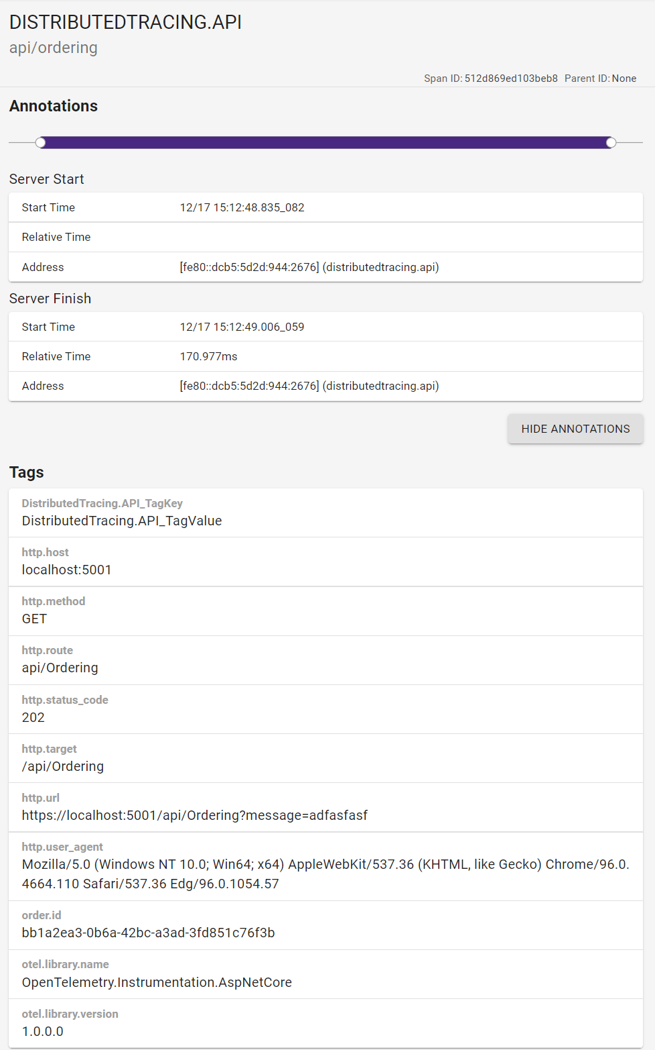

Slide 4
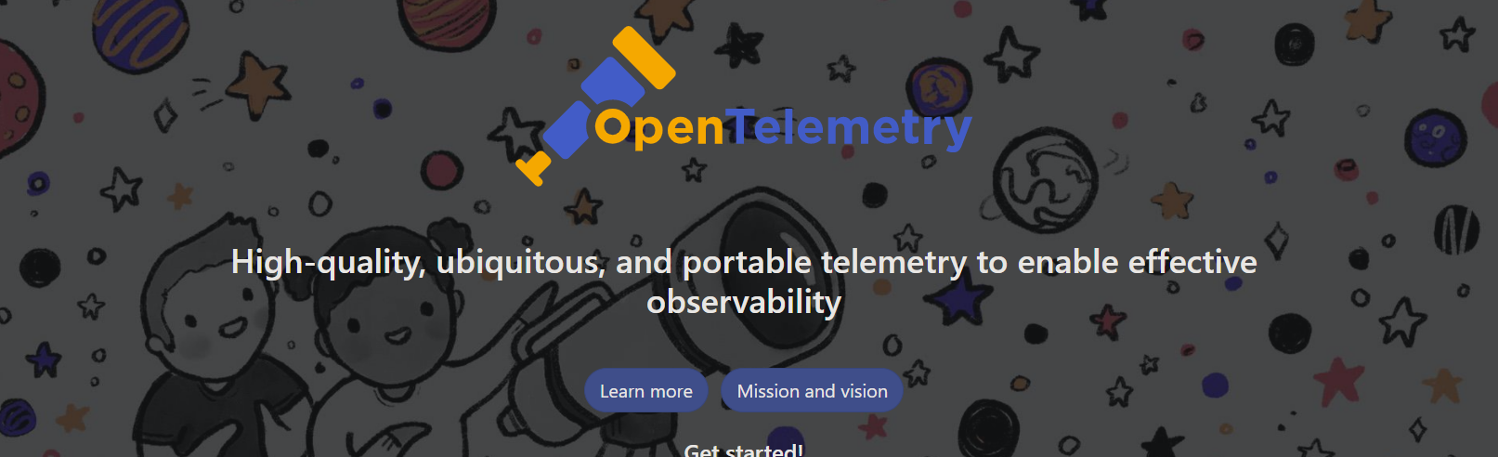
A collection of tools, APIs, and SDKs used to instrument, generate, collect, and export telemetry data (metrics, logs, and traces) to help you analyze your software’s performance and behavior.
Notes:
https://opentelemetry.io/

Slide 5

.NET System.Diagnostics
Provides classes that allow you to interact with system processes, event logs, and performance counters
Activity
ActivityListener
ActivitySource

Slide 6

Activity Class
Represents an operation with context to be used for logging.
The first step in collecting telemetry from your application
Around since .NET Framework 4.0 (System.Activities namespace)
As of .NET Core 2.0, moved to System.Diagnostics
One of many classes for adding distributed tracing instrumentation
.Start/.Stop
Access with Activity.Current?.[propertyName]
Notes:
first, there was Activity…
System.Diagnostics.Activity
Introduced in .NET Core 2.0: https://docs.microsoft.com/en-us/dotnet/api/system.diagnostics.activity?view=netcore-2.0
System.Activities.Activity
Introduced way back in .net framework 4.0: https://docs.microsoft.com/en-us/dotnet/api/system.activities.activity?view=netframework-4.0
BREAK FOR DEMO

Slide 7
ActivityId
00-7921ba6ed272c44c99d17ab66cb2bb4b-d98875cf42dc6345-00
traceId is propagated from Activity to Activity and is the correlationId for the entire distributed call chain
A Span is analogous to an Activity as of .NET 5 and OpenTelemetry 1.0
 | traceId | spanId
00 | 7921ba6ed272c44c99d17ab66cb2bb4b | d98875cf42dc6345 | 00
Notes:
00-7921ba6ed272c44c99d17ab66cb2bb4b-d98875cf42dc6345-00
| traceId | spanId |
00 | 7921ba6ed272c44c99d17ab66cb2bb4b | d98875cf42dc6345 | 00
But starting and stopping an Activity per module/library is kind of a pain… and there is no way to link them together w/out using Activity.SetParent()
enter ActivitySource and Activity Listener

Slide 8
ActivitySource and ActivityListener
Create as static and use it as long as needed
Each library should have its own ActivitySource
Allows listening to the start and stop activity events and gives the opportunity to decide creating an activity for sampling scenarios.
New as of v5 of the System.Diagnostics.DiagnosticSource package
Provides APIs to create and start Activity objects and to register ActivityListener objects to listen to the Activity events.
Notes:
ActivitySource: https://docs.microsoft.com/en-us/dotnet/api/system.diagnostics.activitysource?view=net-5.0
ActivityListener: https://docs.microsoft.com/en-us/dotnet/api/system.diagnostics.activitylistener?view=net-5.0
BREAK FOR DEMO

Slide 9

ActivitySource and ActivityListener
We now have the listening code separate from the business code doing the raising of activities
The API’s signatures of these new classes were shaped by the new Otel standard (v1.0)
Notes:
So, finally, we’ve achieved…

Slide 10
Alignment
.NET 5 System.Diagnostics
OpenTelemetry v1.0
Notes:
Alignment between class names, semantics and standards with .NET 5 and Otel 1.0
Now that we’re starting and stopping Activities, and listening to those starts and stops, we need to send this data somewhere. Thankfully, there are options!
https://medium.com/opentelemetry/opentelemetry-specification-v1-0-0-tracing-edition-72dd08936978

Slide 11

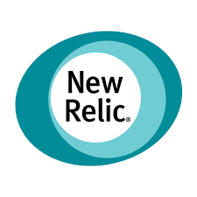




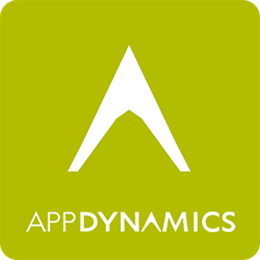
Notes:
Before the Otel standard emerged, you’d need to build a bridge/translation layer to instrument your application to send data to each of these tools, all which have their own proprietary API.
As of Otel 1.0, not only has alignment been brought to specific languages/frameworks like .NET 5, but these vendors have started to support the Otel API standard to have data sent to them.
But how do we instrument our application to send data to any of these, we need to add OpenTelemetry nuget packages…

Slide 12
OpenTelemetry Nuget Packages
<PackageReference Include="OpenTelemetry.Extensions.Hosting" Version="1.0.0-rc8" />
sends out reported activities to some type of exporters
<PackageReference Include="OpenTelemetry.Exporter.Jaeger" Version="1.1.0" />
<PackageReference Include="OpenTelemetry.Exporter.Zipkin" Version="1.1.0" />
Jaeger and Zipkin are supported exporters

Slide 13
OpenTelemetry Nuget Packages
<PackageReference Include="OpenTelemetry.Instrumentation.AspNetCore" Version="1.0.0-rc8" />
<PackageReference Include="OpenTelemetry.Instrumentation.Http" Version="1.0.0-rc8" />
<PackageReference Include="OpenTelemetry.Instrumentation.SqlClient" Version="1.0.0-rc8" />
<PackageReference Include="MongoDB.Driver.Core.Extensions.DiagnosticSources" Version="1.1.0" />
<PackageReference Include="NServiceBus.Extensions.Diagnostics" Version="1.1.0" />
These provide a way to listen to the activities that are to be reported out through the configured exporters
AspNetCore: for incoming requests
Http: for any HttpClient traffic
SqlClient: for anything that talks to sql server
MongoDB: for anything that talks to mongo
NServiceBus: for any message operation over the configured transport
Notes:
Great, how do you configure all this?

Slide 14
Application Configuration
services.AddOpenTelemetryTracing(builder => builder
.AddAspNetCoreInstrumentation()
.AddSqlClientInstrumentation(opt => opt.SetDbStatementForText = true)
.AddNServiceBusInstrumentation()
.AddSource(“AnyActivitySourceInYourApp”)
.AddZipkinExporter(o =>
{
o.Endpoint = new Uri("http://localhost:9411/api/v2/spans");
})
.AddJaegerExporter(c =>
{
c.AgentHost = "localhost";
c.AgentPort = 6831;
}));
Notes:
Instead of coupling to each exporter’s individual API/implementation, we’re using the OpenTelemetry standard
Very similar to ILogger abstraction for abstracting away Serilog, log4net, etc.

Slide 15



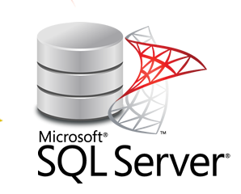
Ordering.Endpoint
Shipping.Endpoint
PlaceOrder
PlaceOrderHandler
ShippingSaga
ShipOrderHandler
API
OrderPlaced
ShipOrder
OrderShipped
OrderPlaced
Billing.Endpoint
OrderPlacedHandler
FedEx.API
OrderBilled
Notes:
DEMO DistributedTracing

Slide 16
Tags and Baggage
Tags and Baggage are ways to enrich the current Activity with additional key/value pairs.
Think of it as a Property or Context “bag”. Essentially, it’s the logical concept of a “header” (http, NServiceBus, etc.)
Tags are localized to the current Activity
Baggage is distributed and will propagate
But, for Baggage to show up in a reporting tool you need to map all values from Baggage to Tags at the ActivityListener level
Notes:
Back to DEMO, enable breakpoints on OrderingController and PlaceOrderHandler and each of those Program files

Slide 17
References
Building End-to-End Diagnostics and Tracing Blog Series: https://jimmybogard.com/building-end-to-end-diagnostics-and-tracing-a-primer/
Distributed Tracing Made Easy with .NET 5, with Jimmy Bogard: https://youtu.be/N0r5NSY3ZIQ
Increasing Trace Cardinality with Activity Tags and Baggage: https://jimmybogard.com/increasing-trace-cardinality-with-tags-and-baggage/
Diagnostics and Instrumentation Packages for MongoDB and NServiceBus Published: https://jimmybogard.com/diagnostics-and-instrumentation-for-mongodb-and-nservicebus/
OpenTelemetry 1.0 Extensions Released: https://jimmybogard.com/opentelemetry-1-0-extensions-released/
OpenTelemetry: https://opentelemetry.io/https://github.com/open-telemetry
Mongo packages:
https://github.com/jbogard/MongoDB.Driver.Core.Extensions.DiagnosticSources
https://github.com/jbogard/MongoDB.Driver.Core.Extensions.OpenTelemetry
NServiceBus Packages:
https://github.com/jbogard/NServiceBus.Extensions.Diagnostics
https://github.com/jbogard/NServiceBus.Extensions.Diagnostics.OpenTelemetry

Slide 18
Ordering.Endpoint
Shipping.Endpoint
PlaceOrder
PlaceOrderHandler
ShippingSaga
ShipOrderHandler
API
OrderPlaced
ShipOrder
OrderShipped
OrderPlaced
Billing.Endpoint
OrderPlacedHandler
FedEx.API
OrderBilled
Notes:
DEMO DistributedTracing

Slide 19
Notes:
Before the Otel standard emerged, you’d need to build a bridge/translation layer to instrument your application to send data to each of these tools, all which have their own proprietary API.
As of Otel 1.0, not only has alignment been brought to specific languages/frameworks like .NET 5, but these vendors have started to support the Otel API standard to have data sent to them.
But how do we instrument our application to send data to any of these, we need to add OpenTelemetry nuget packages…

