Slide 1
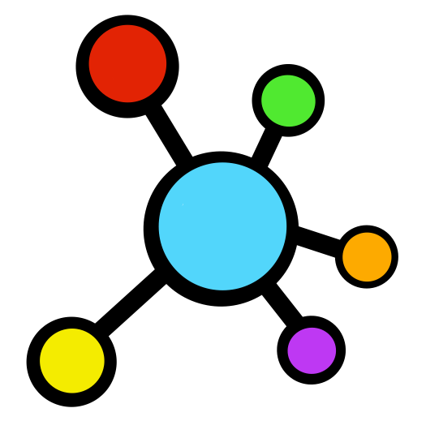
Improving
C LLAB
Learn More
RATION
one team at a time

Slide 2
About
Testimonies
C LAB
LOGIN
This You?
How to Use
Mission
is a collaborative tool used in group settings to help ease communication!

Slide 3

Login Page
How to Use
LOGIN
Email
______________________________
Mission
LOGIN
Password
______________________________
About
LOGIN
This You?
Forgot Password
Testimonies
CREATE A NEW ACCOUNT
Continue with Google

Slide 4
About
CoLab consists of:
weekly web-based self and peer assessment check-in on the entire group designed for students and teachers to stay connected and informed during group projects!
LOGIN
C LAB

Slide 5
Hear from your peers!
Voted The BEST way to give and get feedback in the nation by Google
LOGIN

Slide 6
Our Mission
We, at CoLab, aim to help you collaborate with others!
LOGIN
We understand how daunting working in teams can be, but with CoLab, working in teams can be more efficient and fun!

Slide 7
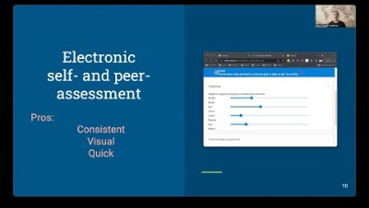
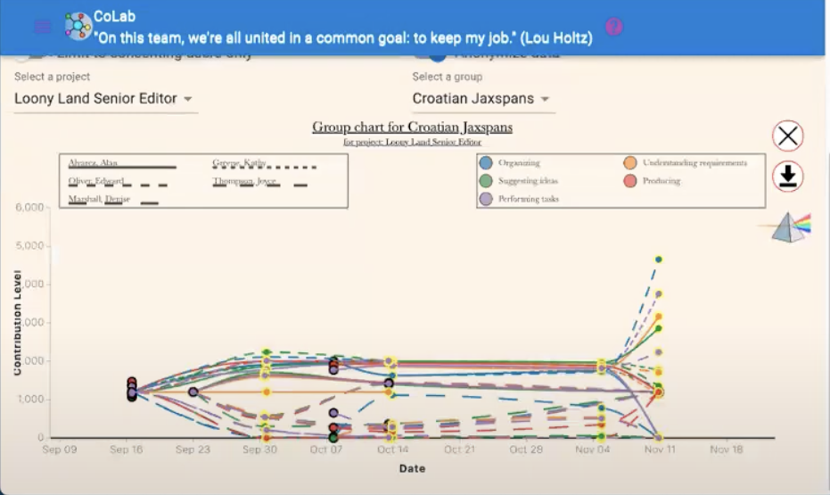
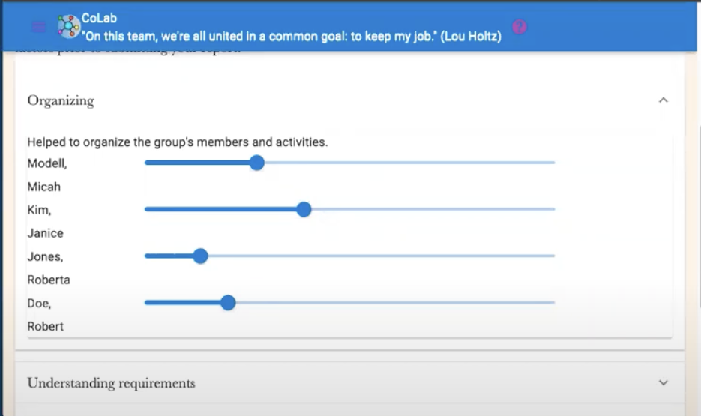
How To Use
Students take less than 5 minutes to input feedback and submit to professors
Students receive a weekly reminder to input information about their week working with their group
LOGIN
- Teachers collect data from graph and make evaluations as needed to assist students
Students: slide the bar to match the amount of effort you think each person contributed and write a comment if necessary
Professors: Use the data from this graph to track student’s activity and see who needs help

Slide 8
How To Use
Weekly Check-ins
Simulated Team Experiences
Bingo! Learning
Iterative Assignments
See a video
LOGIN

Slide 9
How To Use
Weekly Check-ins
Simulated Team Experiences
Bingo! Learning
Iterative Assignments
See a video
LOGIN
Coming Soon!

Slide 10
How To Use
Weekly Check-ins
Simulated Team Experiences
Bingo! Learning
Iterative Assignments
See a video
LOGIN

Slide 11
How To Use
Students receive a weekly reminder to input information about their week working with their group
Weekly Check-ins
Simulated Team Experiences
Bingo! Learning
Iterative Assignments
See a video
LOGIN
Students: slide the bar to match the amount of effort you think each person contributed and write a comment if necessary

Slide 12
Target Audience
LOGIN
Teachers who want to help their students become strong team citizens.
Students who want to have a smoother team experience.

