Slide 1
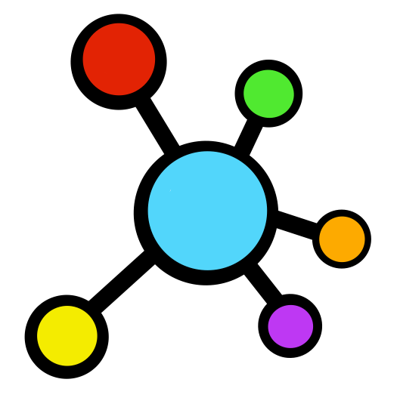
Improving
C LLAB
LOGIN
RATION
LEARN MORE
one conversation at a time

Slide 2
C LAB
LOGIN
is a collaborative tool used in group settings to help ease communication.

Slide 3

Login Page
LOGIN
Email
______________________________
LOGIN
Password
______________________________
LOGIN
Forgot Password
CREATE A NEW ACCOUNT
Continue with Google

Slide 4
About
LOGIN
C LAB

Slide 5
Hear from your peers!
Voted The BEST way to give and get feedback in the nation by Google
LOGIN

Slide 6
Our Mission
We, at CoLab, aim to help you collaborate with other
LOGIN
C LAB

Slide 7
How To Use
Use content in video… student coming in and using it!! The things that they will be using that will help them
Watch YT videos
Think about hwo you will plan for the future…
Bingo- read while chapter come up with 10 terms plus their definitions and go in evaluate then the ones that are good and build a bingo sheet…
C LAB

Slide 8
Target Audience
YOU

