Slide 1
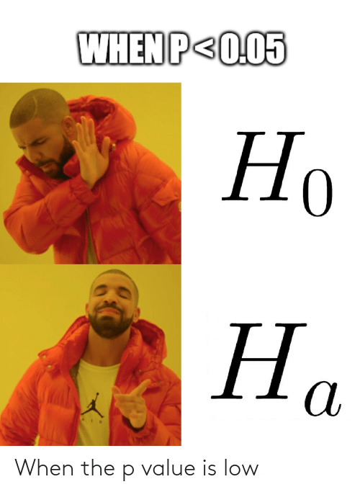
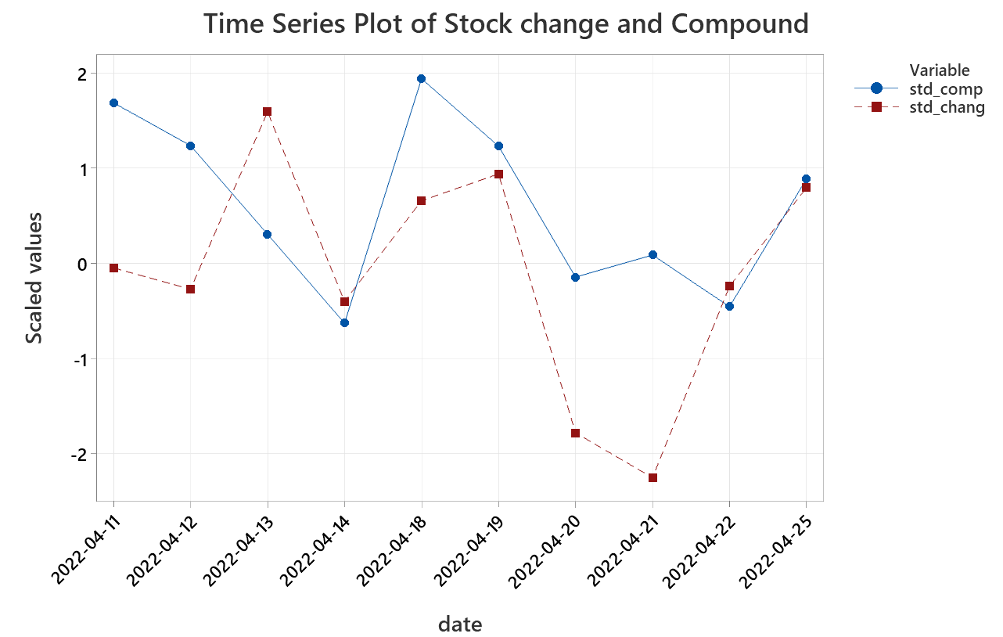
Methodology
Granger Causality Analysis
Correlate Tesla stock change to Twitter Tesla mood
Lag | Compound
1 day | 0.5212
2 days | 0.806
3 days | 0.9414
4 days | 0.0312
5 days | 0.0413
STATISTICAL SIGNIFICANCE (P-VALUES) OF BIVARIATE GRANGER-CAUSALITY CORRELATION BETWEEN MOODS AND TESLA STOCK IN PERIOD FAPRIL 2022 TO NOVEMBER 2022.

Slide 2
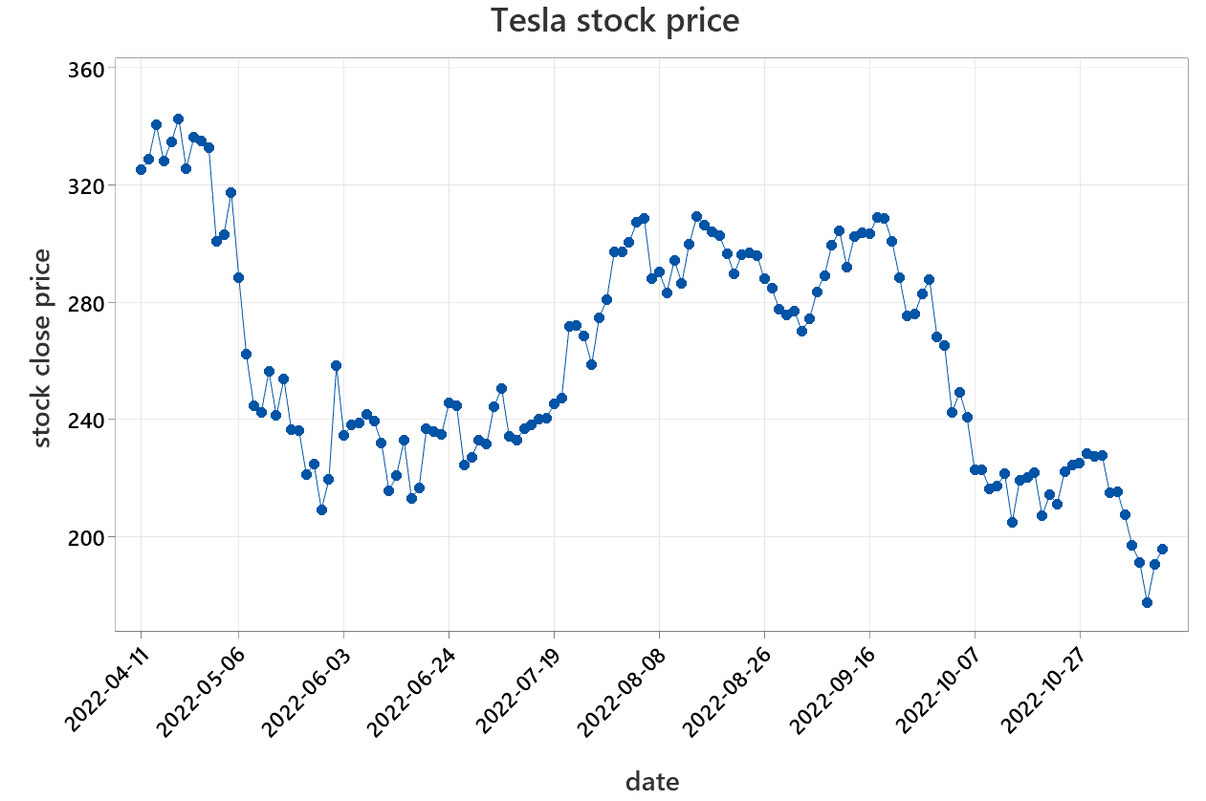
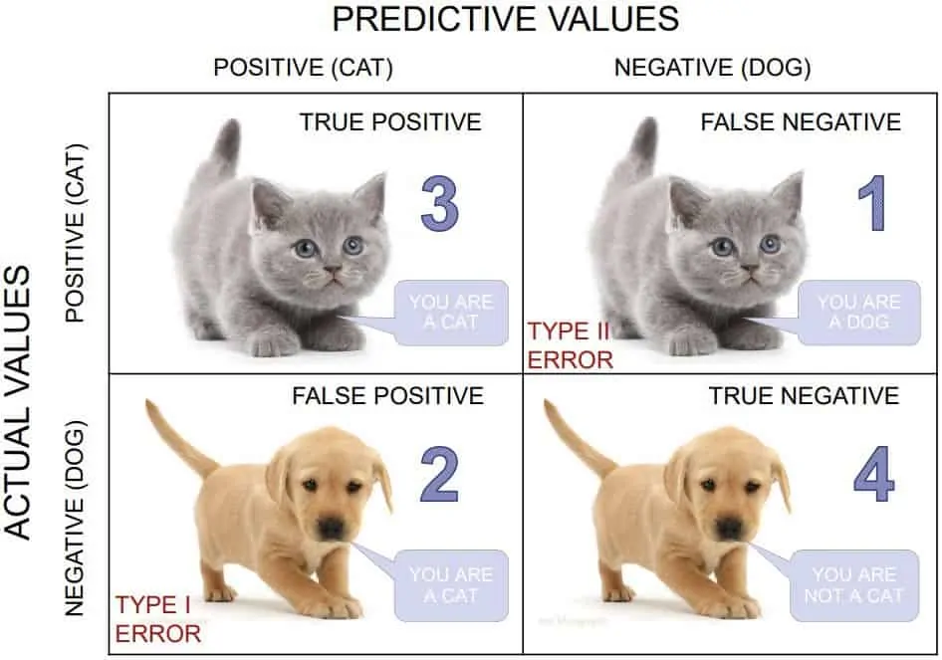
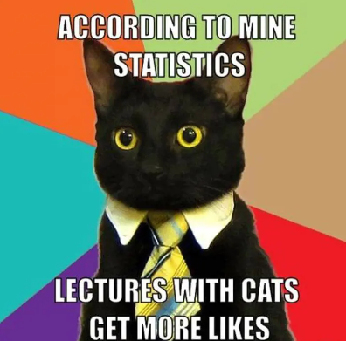
Classification model
Tesla stock change
Tesla twitter mood
Random Forest model
Mean accuracy test set: .675
Random Forest Classifier
Down
Up

Slide 3
date | Compound | open | close | change | direction | pred
12/7/2022 | 0.128022 | 175.03 | 174.04 | -0.99 | down
12/8/2022 | 0.155608 | 172.2 | 173.44 | 1.24 | up
12/9/2022 | 0.029505 | 173.84 | 179.05 | 5.21 | up
12/10/2022 | 0.069755 | 173.84 | 179.05 | 5.21 | up
12/11/2022 | 0.010891 | 173.84 | 179.05 | 5.21 | up | up
12/12/2022 | 0.0055 | 176.1 | 167.82 | -8.28 | down | up
12/13/2022 | 0.069047 | 174.87 | 160.95 | -13.92 | down | down
12/14/2022 | 0.143605 | 159.25 | 156.8 | -2.45 | down | down
12/15/2022 |  |  |  |  |  | down
12/16/2022 |  |  |  |  |  | down
12/17/2022 |  |  |  |  |  | down
12/18/2022 |  |  |  |  |  | up

