Slide 1
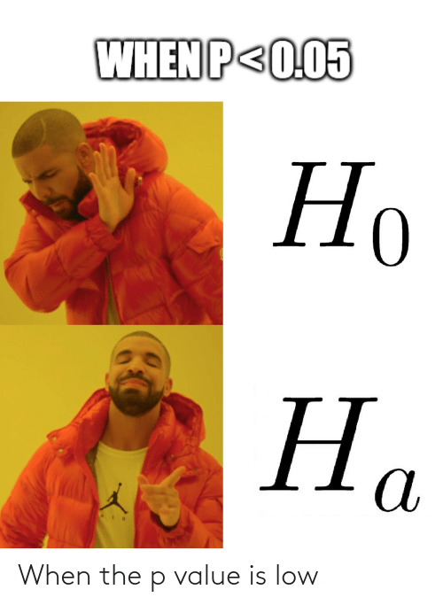
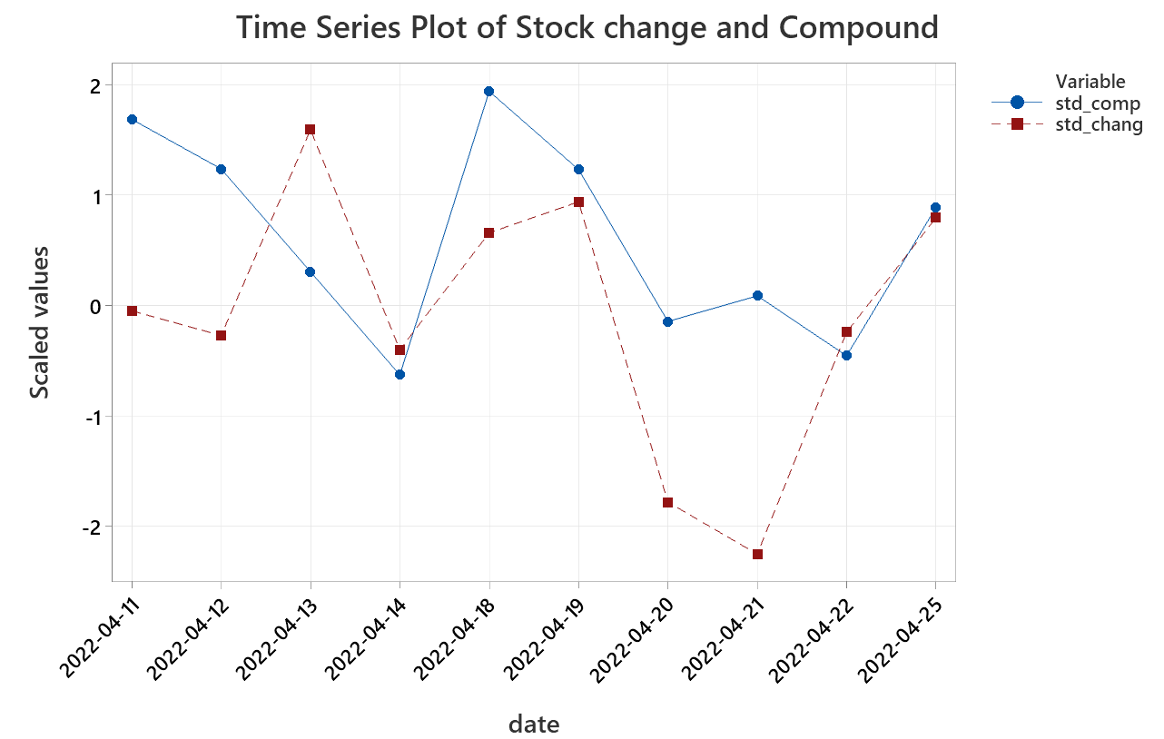
Methodology
Granger Causality Analysis
Correlate Tesla stock change to Twitter Tesla mood
Lag | Compound
1 day | 0.5212
2 days | 0.806
3 days | 0.9414
4 days | 0.0312
5 days | 0.0413
STATISTICAL SIGNIFICANCE (P-VALUES) OF BIVARIATE GRANGER-CAUSALITY CORRELATION BETWEEN MOODS AND TESLA STOCK IN PERIOD FAPRIL 2022 TO NOVEMBER 2022.

Slide 2
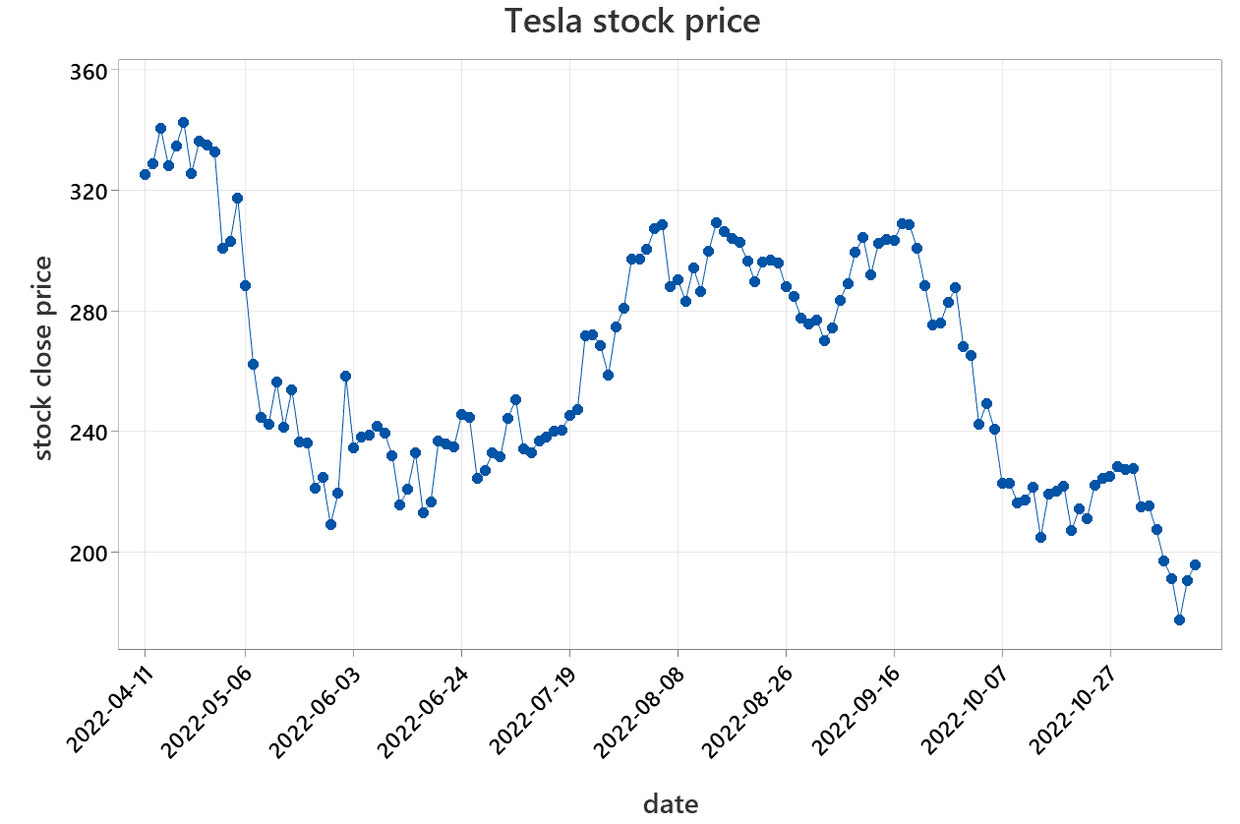
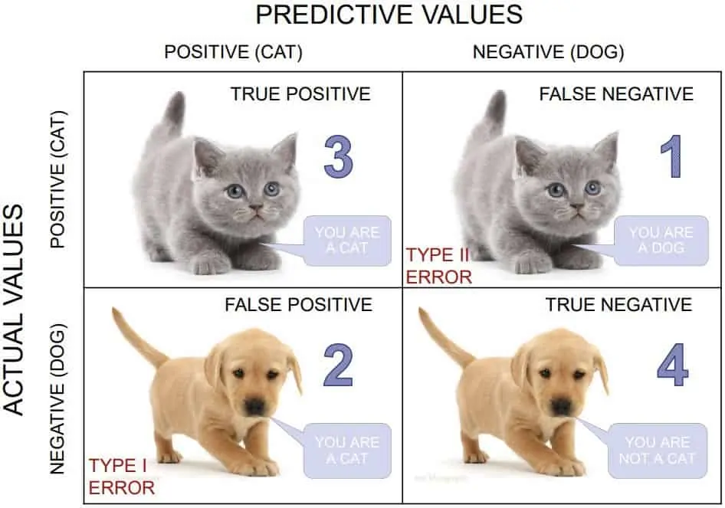
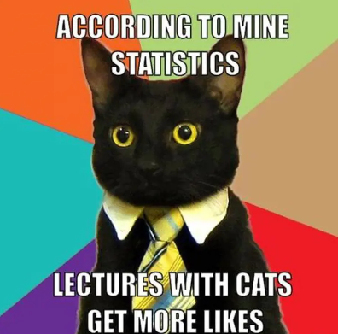
Classification model
Tesla stock change
Tesla twitter mood
Random Forest model
Mean accuracy test set: .675
Random Forest Classifier
Down
Up

